Slide 1
Finding Meaning in Data across Languages
Sprogteknologisk Konference
30 November 2022
Daniel Hershcovich
Department of Computer Science (DIKU)

Slide 2
What is a language model?
What is the next word in this sentence
Language modeling: given text, estimate the probability distribution of the next word
(usually based on huge text corpora)

Slide 3
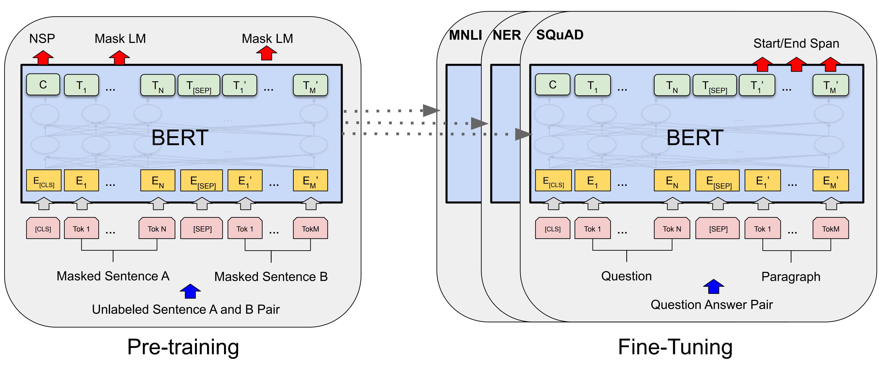
Pre-trained language models
NLP since ~2018: pre-train LMs and fine-tune representations on tasks
BERT: Pre-training of Deep Bidirectional Transformers for Language Understanding (Devlin et al., NAACL 2019)

Slide 4
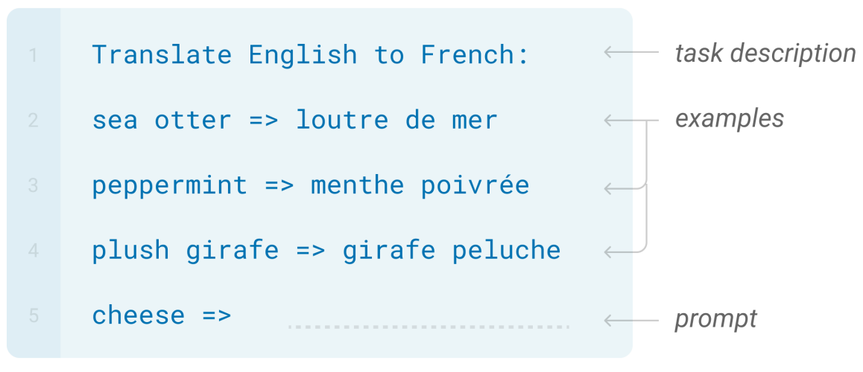
Language models
Zero-shot
Paradigm shift in NLP since ~2021:
"Any" task can be cast as language modeling
One-shot
Few-shot
Language Models are Few-Shot Learners (Brown et al., NeurIPS 2020)

Slide 5
Language models
Exploring the limits of transfer learning with a unified text-to-text transformer (Raffel et al., JMLR 2020)

Slide 6
Language models
Flan-PaLM
Scaling Instruction-Finetuned Language Models (Chung et al., 2022)

Slide 7
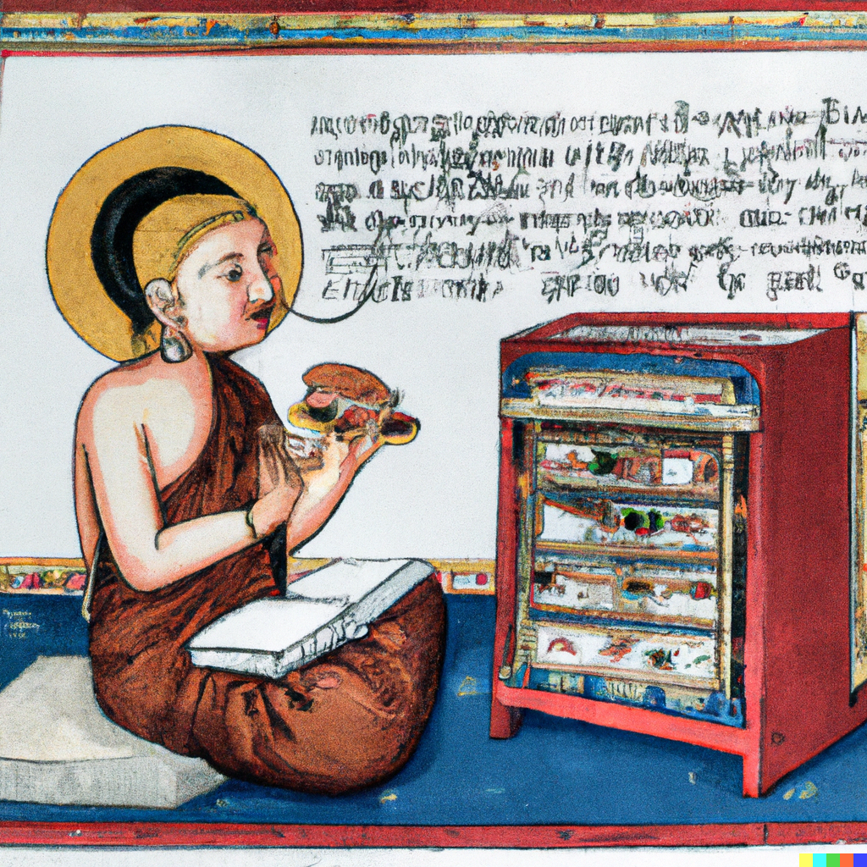
Text-to-image
Medieval painting of a monk eating a sandwich at a poster session on language technology

Slide 8
Text-to-code with language models
Knowledge base
answer
Compositional semantic parsing with large language models (Drozdov et al., 2022)

Slide 9
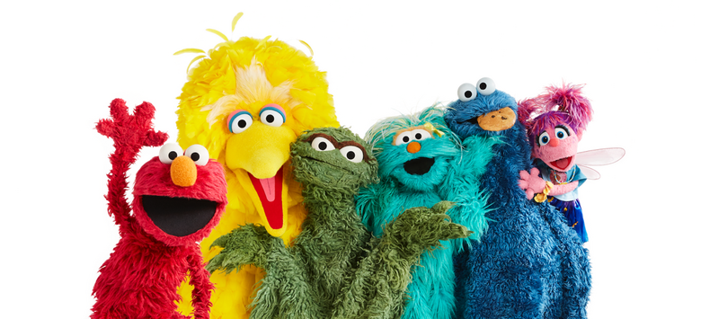
Language models
Masked/bidirectional LMs:
ELMo (Peters et al., 2018)
BERT (Devlin et al., 2019)
RoBERTa (Liu et al., 2019)
...
Causal/generative/autoregressive LMs:
GPT-2 (Radford et al., 2018)
GPT-3 (Brown et al., 2020)
T5 (Raffel et al., 2019)
T0 (Sanh et al., 2021)
BART (Lewis et al., 2020)
FLAN (Wei et al., 2021)
...
All trained (almost) only on English text

Slide 10
Resource disparity for languages
English
Icelandic
Swedish
Danish
Swedish sign language
Faroese
The State and Fate of Linguistic Diversity and Inclusion in the NLP World
(Joshi et al., ACL 2020)

Slide 11
Multilingual language models
mBERT (Devlin et al., 2019)
XLM, XLM-R (Conneau et al., 2020)
mBART (Liu et al., 2020)
mT5 (Xue et al., 2021)
XGLM (Lin et al., 2021)
BLOOM (Le Scao et al., 2022)
...

Slide 12
Language distribution in multilingual language models
mT5: A Massively Multilingual Pre-trained Text-to-Text Transformer (Xue et al., NAACL 2021)
BLOOM: A 176B-Parameter Open-Access Multilingual Language Model (Le Scao et al., 2022)

Slide 13
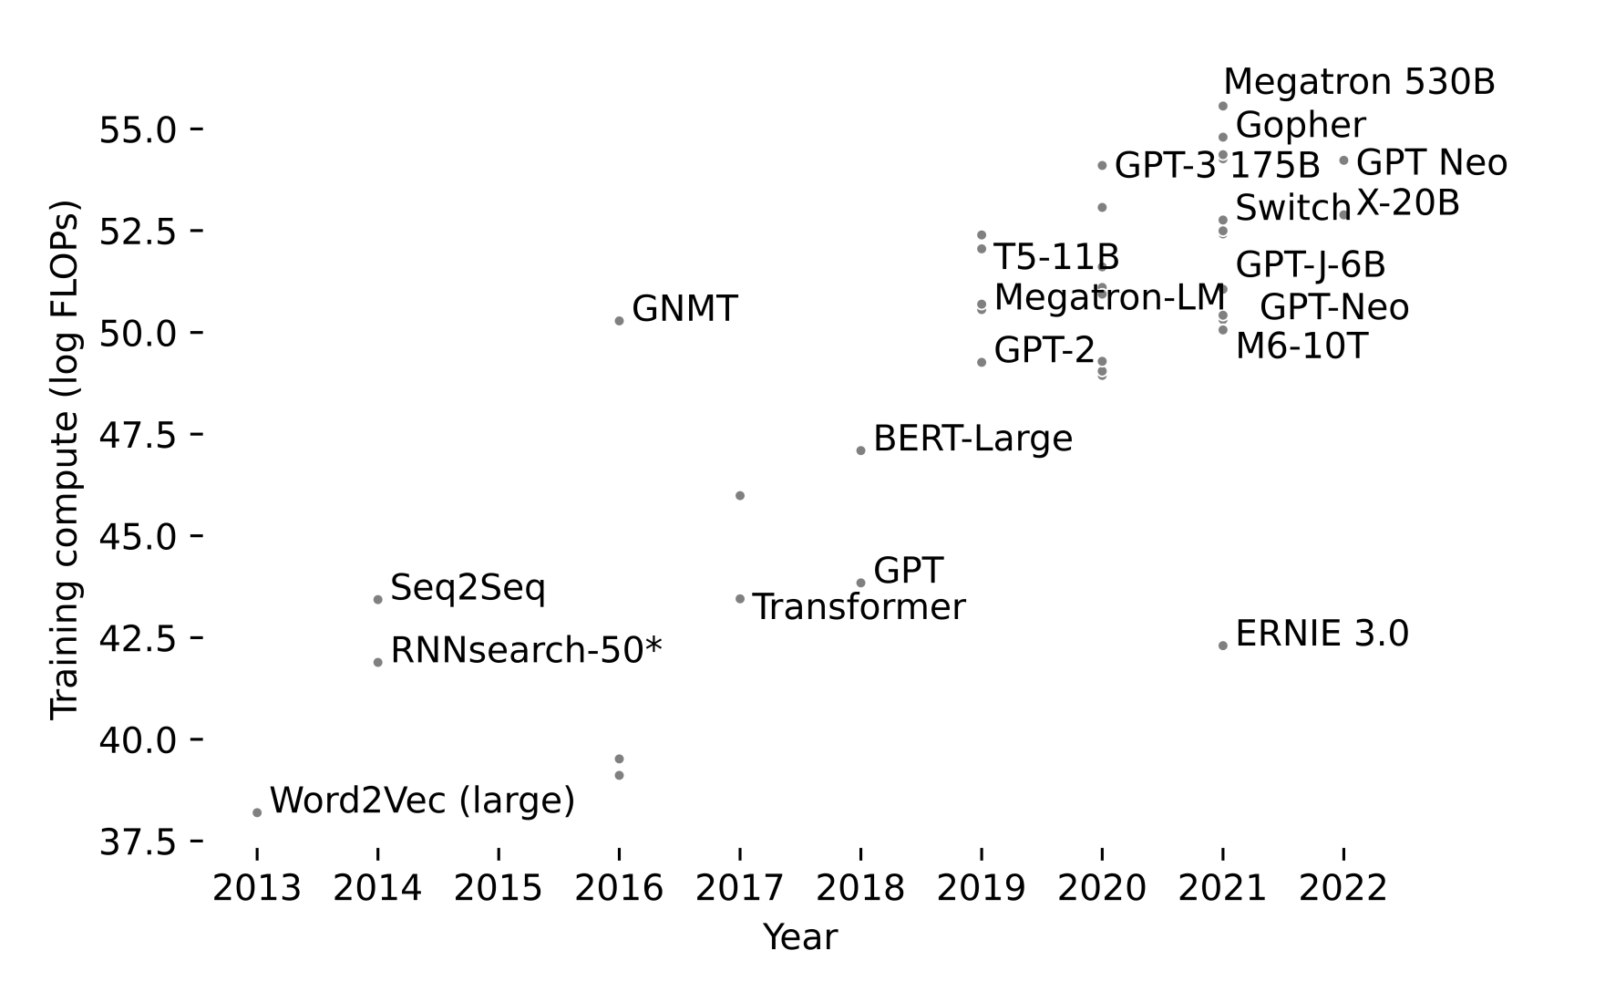
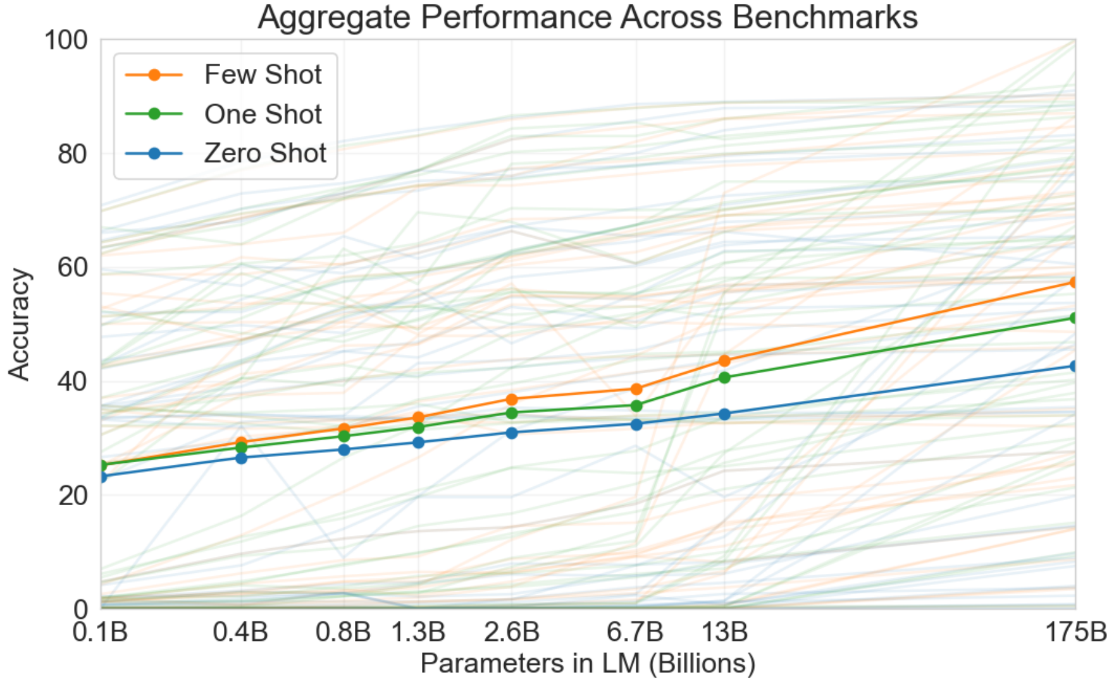
Diminishing returns?
Newer and larger models perform better but require more and more resources and energy
Language Models are Few-Shot Learners (Brown et al., NeurIPS 2020)
Towards Climate Awareness in NLP Research (Hershcovich et al., EMNLP 2022)

Slide 14
Can we do more with less data?
Performance
Inductive bias
Understanding
Theoretical analysis
Access to structured data
Fine-grained control
Interpretability
Generalization
Domains
Languages
Tasks
Reasoning ability
Explicit meaning representation can be worth gigabytes of text data...

Slide 15
Finding meaning by decomposition
[Meaning], [Representation] and [Parsing] 1. What we mean, 2. How to represent (something), 3. How to parse (something)
[Meaning Representation] and [Parsing] 1. How to represent what we mean, 2. How to parse (something)
[Meaning [Representation and Parsing]] 1. How to represent what we mean, 2. How to parse what we mean
[Meaning Representation] and [Parsing (to Meaning Representation)] 1. How to represent what we mean, 2. How to parse (1)

Slide 16
Meaning in text-to-image
A bat is flying over a baseball stadium
a seal is opening a letter
DALLE-2 is Seeing Double: Flaws in Word-to-Concept Mapping in Text2Image Models (Rassin et al., BlackboxNLP 2022)

Slide 17
Meaning in text-to-code
Compositional semantic parsing with large language models (Drozdov et al., 2022)

Slide 18
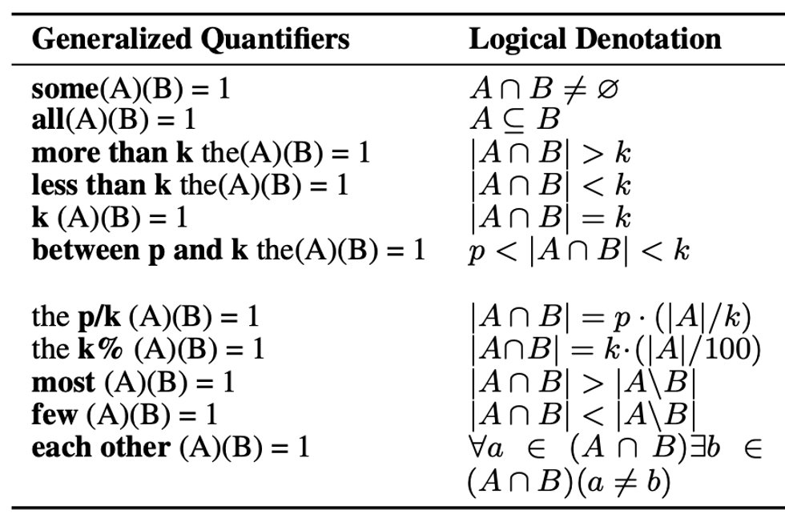
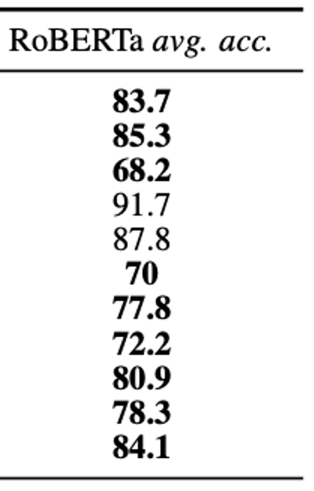
Meaning representation for analysis of language models
Context: A piece of paper was later found on which he had written his last statements in two languages, Latin and German. Only one statement was in Latin and the rest in German.
Question: In what language were most statements written?
Answer: German
Predicted answer (RoBERTa): Latin and German
Generalized Quantifiers as a Source of Error in Multilingual NLU Benchmarks (Cui et al., NAACL 2022)

Slide 19
Meaning representation frameworks
Multitask Parsing Across Semantic Representations (Hershcovich et al., ACL 2018)

Slide 20
Universal Conceptual Cognitive Annotation (UCCA)
Design principles
Cross-linguistic portability and stability
Accessibility to non-expert annotators
Modularity of semantic components
Corpora
English, German, French, Russian, Hebrew & Turkish
Applications
Text simplification
Machine translation
Relation extraction
Textual process description
Universal Conceptual Cognitive Annotation (UCCA) (Abend & Rappoport, ACL 2013)

Slide 21
UCCA example

Slide 22
Implicit relations in UCCA
Refining Implicit Argument Annotation for UCCA (Cui & Hershcovich, DMR 2020)
Great Service! Fine-grained Parsing of Implicit Arguments (Cui & Hershcovich, IWPT 2021)

Slide 23
Cross-linguistic stability in UCCA

Slide 24
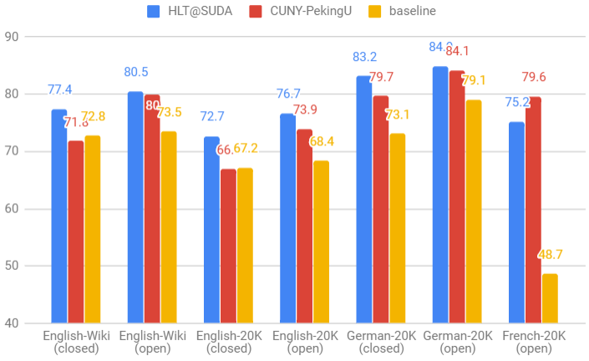
UCCA parsing
Successful cross-lingual transfer
SemEval-2019 Task 1: Cross-lingual Semantic Parsing with UCCA (Hershcovich et al., SemEval 2019)

Slide 25
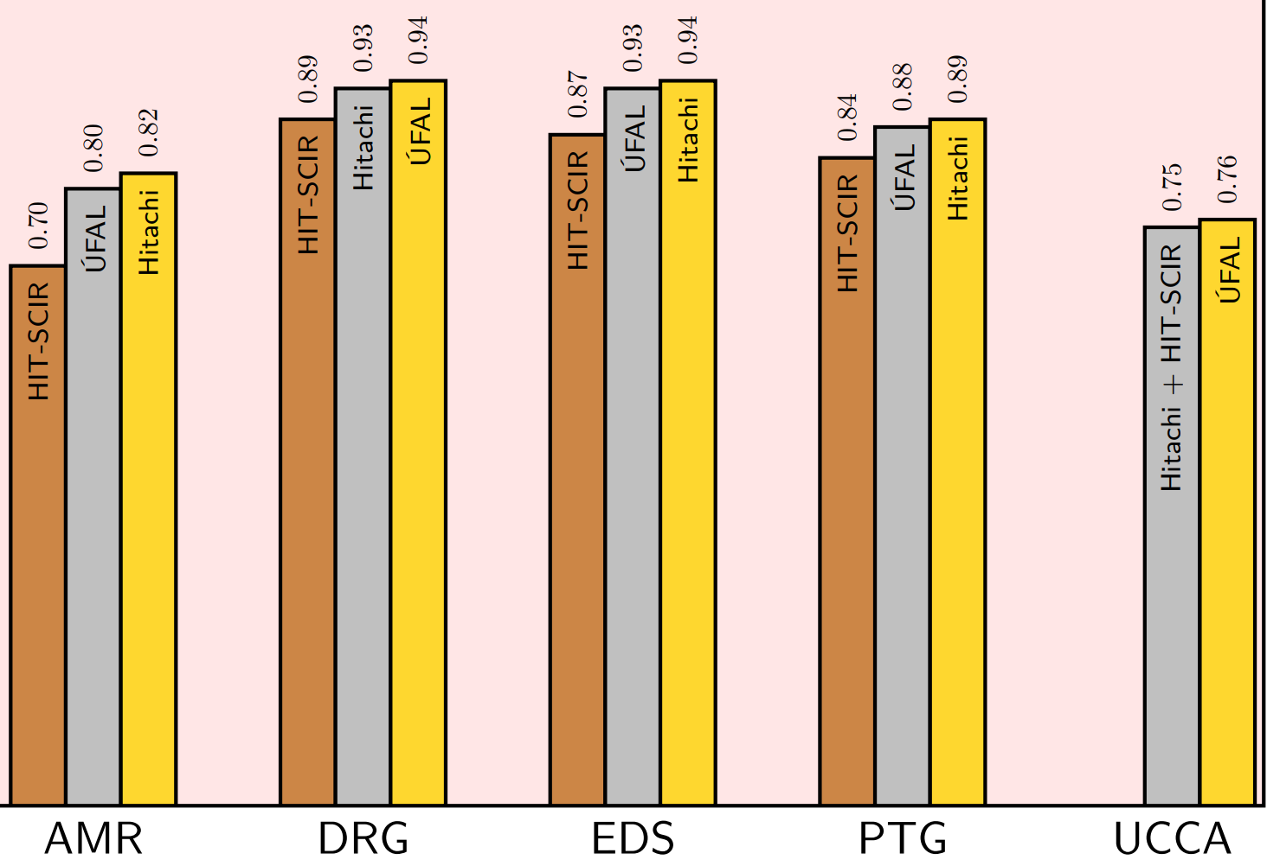
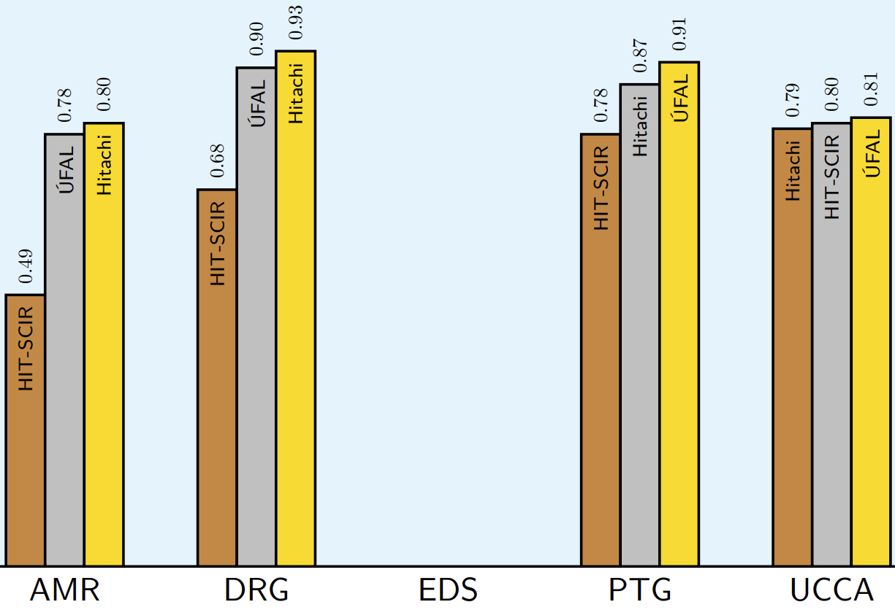
Meaning representation parsing
Successful monolingual parsing in different languages
English
Chinese German Czech​ German
MRP 2020: The Second Shared Task on Cross-Framework and Cross-Lingual Meaning Representation Parsing (Oepen et al., CoNLL 2020)

Slide 26
Uniform Meaning Representation
Designing a Uniform Meaning Representation for Natural Language Processing (Van Gysel et al., KI - Künstliche Intelligenz 2021)

Slide 27
Compositional generalization
"the ability to systematically generalize to composed test examples of a certain distribution after being exposed to the necessary components during training on a different distribution"
Train set
Who directed inception?
Did Greta Gerwig produce Goldfinger?
Test set
Did Greta Gerwig direct Goldfinger?
Who produced inception?
Measuring compositional generalization: A comprehensive method on realistic data (Keysers et al., ICLR 2020)

Slide 28
Multilingual Compositional Wikidata Questions (MCWQ)
answer
Compositional Generalization in Multilingual Semantic Parsing over Wikidata (Cui et al., TACL 2022)

Slide 29
MCWQ
Multilingual compositional generalization benchmark
mT5 achieves similar within-language generalization across languages
Zero-shot cross-lingual generalization fails

Slide 30
Limitations of compositional generalization benchmarks
Synthetic & unnatural data
Mostly automatic translation
No cultural adaptation

Slide 31
Social factors
NLP is for people (not just languages)
The Importance of Modeling Social Factors of Language: Theory and Practice
(Hovy & Yang, NAACL 2021)

Slide 32
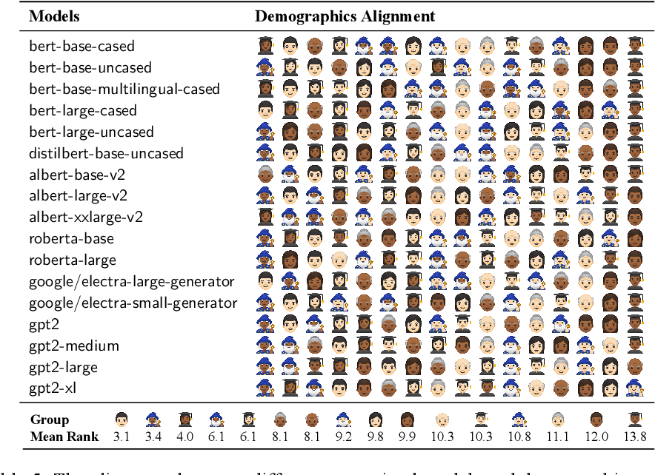
Social bias in language models
Sociolectal Analysis of Pretrained Language Models
(Zhang et al., EMNLP 2021)

Slide 33
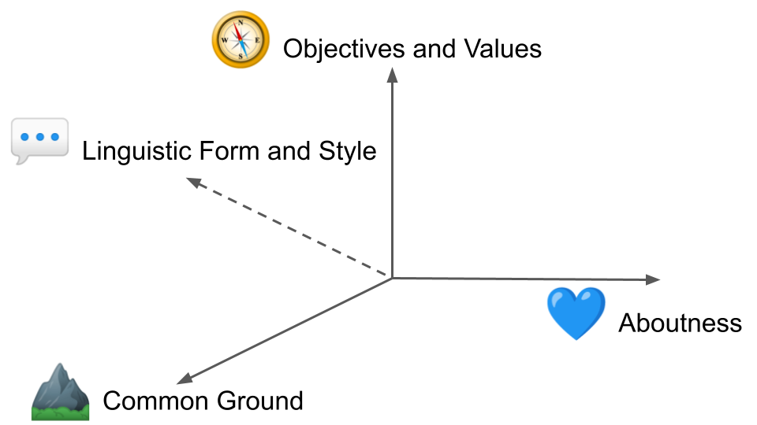
Cultural awareness in NLP
Challenges and Strategies in Cross-Cultural NLP
(Hershcovich et al., ACL 2022)

Slide 34
Form 💬
How we express ourselves in language
Morphosyntax
Style
Word choice

Slide 35
Levels of granularity
Linguistic and cultural variation within groups
Idiolect
Individual, personality
Sociolect,
dialect
Social group or region, sub-culture
Standardised language
Country, national culture
Language,
language family
International cultures

Slide 36
Common ground ⛰️
Conceptualisation
Commonsense
Shared knowledge based on which people reason and communicate

Slide 37
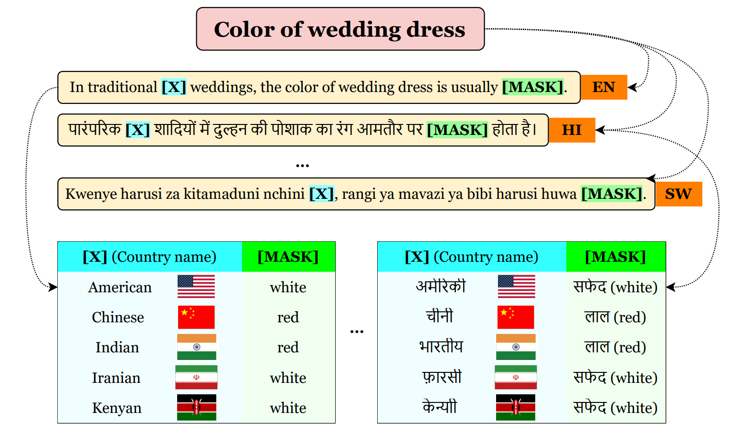
Commonsense
Some knowledge is "universal", other culture-specific
GeoMLAMA: Geo-Diverse Commonsense Probing on Multilingual Pre-Trained Language Models
(Yin et al., EMNLP 2022)

Slide 38
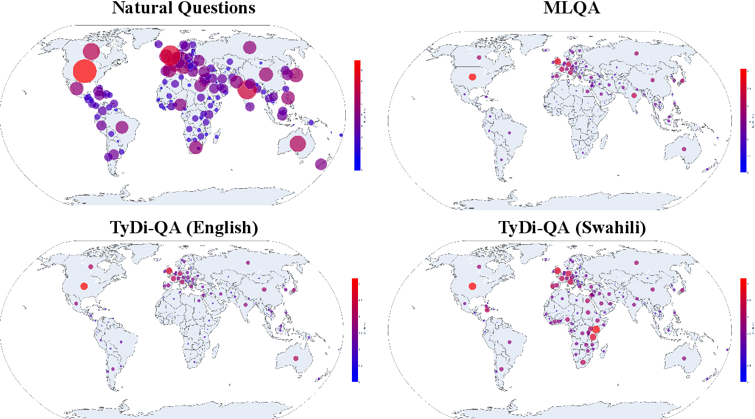
Aboutness 💙
What content do people care about​?
Entities
Experiences
Aspects
Dataset Geography: Mapping Language Data to Language Users (Faisal et al., ACL 2022)

Slide 39
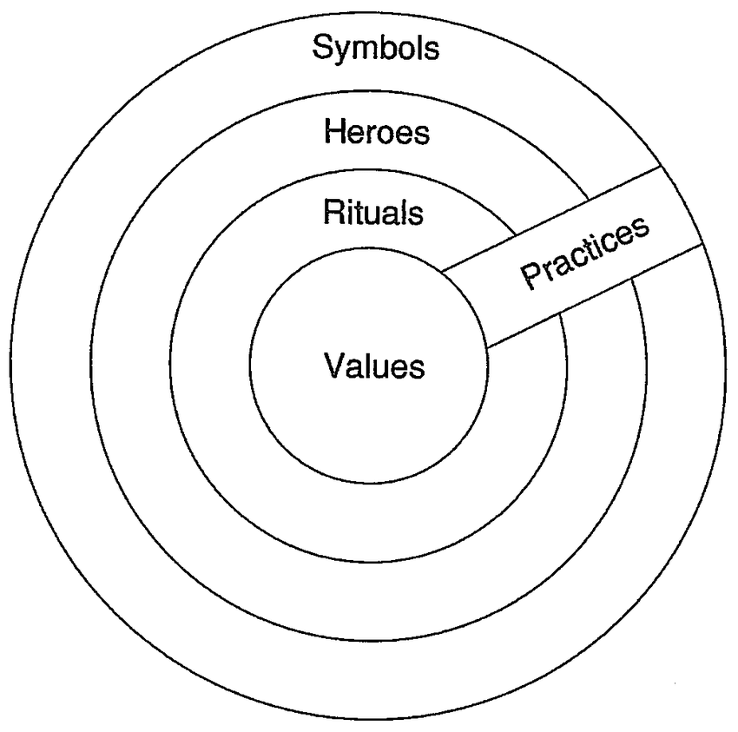
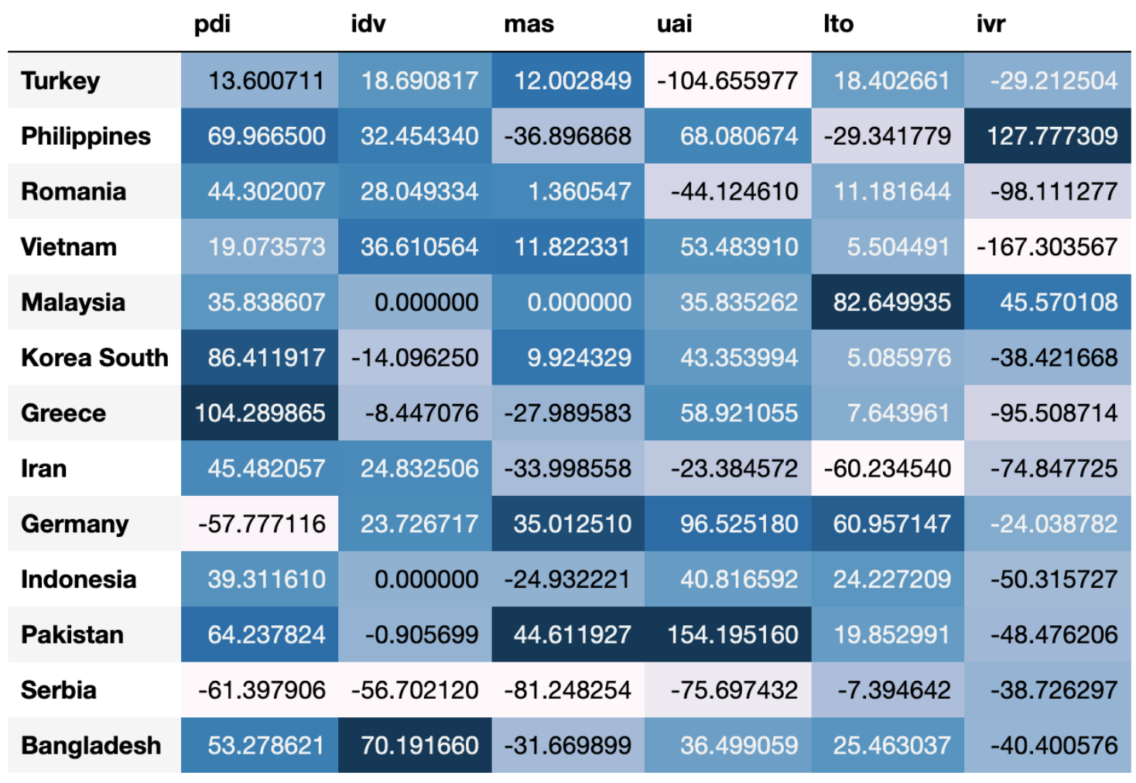
Values 🧭
Uncertainity Avoidance
Masculinity
Long-term Orientation
Power Distance
Individualism
Indulgence
Cultures and Organizations: Software of the Mind
(Hofstede, 1991)
Probing Pre-Trained Language Models for Cross-Cultural Differences in Values (Arora et al., 2022)

Slide 40
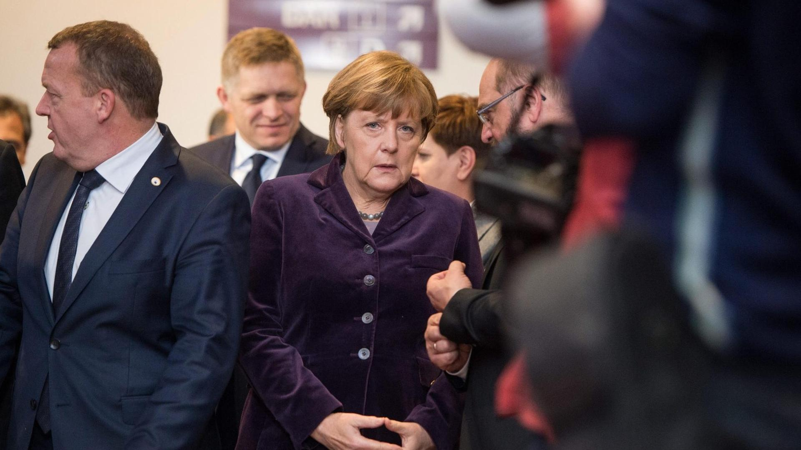
Value bias in language models
Values are altered to reflect US culture
(translation)
Die allermeisten von uns kennen den Zustand völliger Erschöpfung auf der Flucht, verbunden mit Angst um das eigene Leben oder das Leben der Kinder oder der Partner, zum Glück nicht. Menschen, die sich zum Beispiel aus Eritrea, aus Syrien oder dem Nordirak auf den Weg machen, müssen oft Situationen überwinden oder Ängste aushalten, die uns wahrscheinlich schlichtweg zusammenbrechen ließen. Deshalb müssen wir beim Umgang mit Menschen, die jetzt zu uns kommen, einige klare Grundsätze gelten lassen. Diese Grundsätze entstammen nicht mehr und nicht weniger als unserem Grundgesetz, unserer Verfassung.
“1. I am in favor of limiting immigration.
2. I am in favor of limiting immigration for humanitarian reasons.
3. I am in favor of limiting immigration for economic reasons.”
GPT-3
summarize
The Ghost in the Machine has an American accent: value conflict in GPT-3 (Johnson et al., 2022)

Slide 41
Strategies
Data
Models
Tasks
Style transfer
Culture-sensitive curation
Entity adaptation
Culturally diverse collection
Explanation by analogy
Native data or culturally sensitive translation

Slide 42
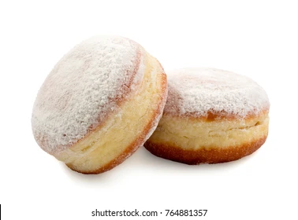
Tasks
Entity adaptation
Recipe adaptation
凉拌秋葵
用料
秋葵 20根左右
生抽 2-3勺
醋 1勺
蚝油 1勺
做法
将秋葵洗净放开水中焯2分钟左右。
开水中放盐一勺，油一勺，这样秋葵颜色翠绿鲜艳）...
香油 1勺
糖 1勺
蒜 3-5瓣
盐 酌量
绿芥末膏不用也行 酌量
“I saw Merkel eating a Berliner from Dietsch on the ICE”
Chinese Okra Salad
Ingredients
8 oz (225 g) okra
2 teaspoons light soy sauce (or soy sauce)
1/2 teaspoons green Sichuan pepper oil (or more to taste)
Instructions
Bring a medium pot of water to a boil. Add 1 teaspoon vegetable oil and a pinch of salt...
I saw Biden eating a Boston Cream from Dunkin’ Donuts on the Acela
Adapting Entities across Languages and Cultures
(Peskov et al., Findings 2021)

Slide 43
Summary
We must consider culture in cross-lingual/multilingual NLP
(Multilingual) language models are getting better and better
Meaning representations help with efficiency, interpretability, control

Slide 44
Thanks! danielhers.github.io dh@di.ku.dk
@daniel_hers
sigmoid.social/@dh

