Slide 1
Reversing the Alignment Paradigm: LLMs Shaping Human Cultural Norms, Behaviors, and Attitudes
ACL 2024 Workshop on Human-Centered Large Language Modeling
Daniel Hershcovich
August 15th, 2024

Slide 2
Intro: Some Factors in Human Culture and Language
Challenges and Strategies in Cross-Cultural NLP (Hershcovich et al., ACL 2022)
Notes:
Countless areas. Challenging to define! Requires expertise. Subjective. But still worth it because it allows breaking barriers

Slide 3
Application: Intercultural Communication
凉拌秋葵
用料
秋葵 20根左右
生抽 2-3勺
醋 1勺
蚝油 1勺
做法
将秋葵洗净放开水中焯2分钟左右。
开水中放盐一勺，油一勺，这样秋葵颜色翠绿鲜艳）...
Cultural Adaptation of Recipes (Cao et al., TACL 2024)
Cross-cultural translation
… entity substitution (Peskov et al., 2021),
… or explicitation (Han et al., 2023)
Bridging knowledge gaps by code-switching (Tarunesh et al., 2021),
香油 1勺
糖 1勺
蒜 3-5瓣
盐 酌量
绿芥末膏不用也行 酌量
Chinese Okra Salad
Ingredients
8 oz (225 g) okra
2 teaspoons light soy sauce (or soy sauce)
1/2 teaspoons green Sichuan pepper oil (or more to taste)
Instructions
Bring a medium pot of water to a boil. Add 1 teaspoon vegetable oil and a pinch of salt...
Envisioning NLP for intercultural climate communication (Bird et al., ClimateNLP 2024)

Slide 4
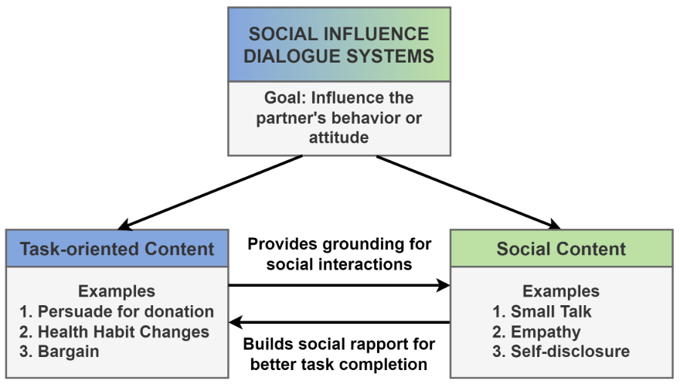
Opportunities: Influencing Humans
Democratic discourse
Opening up minds (Farag et al., 2022)
Human learning & training
Language learning (Paddags et al., 2024)
Persuasion
Social good (Wang et al., 2019, Pauli et al., 2024)
Policy issues (Durmus et al., 2024)
Improving political conversations (Argyle et al., 2024)
Teacher coaching (Wang & Demszky, 2023)
Social Influence Dialogue Systems: A Survey of Datasets and Models For Social Influence Tasks (Chawla et al., EACL 2023)
Towards Bidirectional Human-AI Alignment: A Systematic Review for Clarifications, Framework, and Future Directions (Shen et al., 2024)
Notes:
Democratic discourse, i.e. management of differences and enablement of productive cooperation (Kasirzadeh & Gabriel, 2023)

Slide 5
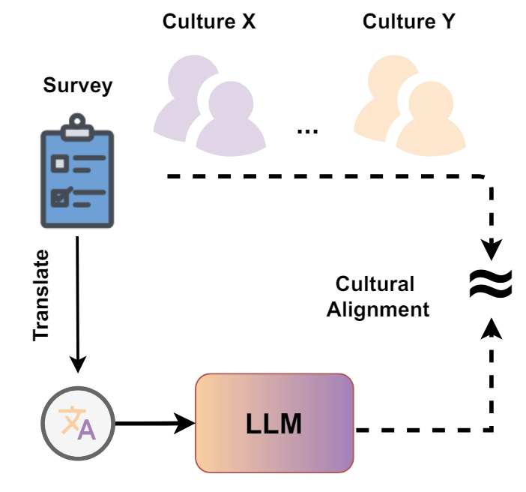
Problem: Cultural Bias
Abundant evidence
…
Values
Knowledge
Hofstede survey (Cao et al., 2023, Wang et al., 2024), World Values Survey (Arora et al., 2023, Zhao et al., 2024, AlKhamissi et al., 2024, Durmus et al., 2024)...
Names, drinks (Naous et al., 2024), food (Zhou et al., 2024, Li et al., 2024), images (Cao et al., 2024)
Style
Emotion (Ahmad et al., 2024)
Investigating Cultural Alignment of Large Language Models (AlKhamissi et al., ACL 2024)
Why is this a problem?
User experience
Usability and productivity
Allocational harms (Blodgett et al., 2020)
Instigates/reinforces social change
Having Beer after Prayer? Measuring Cultural Bias in Large Language Models (Naous et al., ACL 2024)

Slide 6
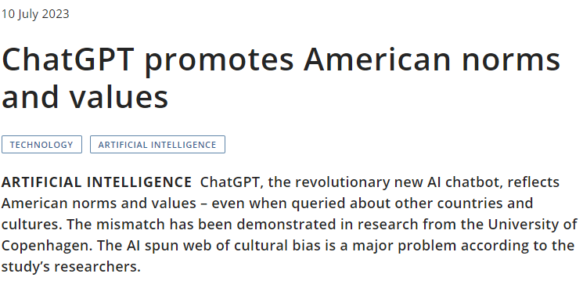
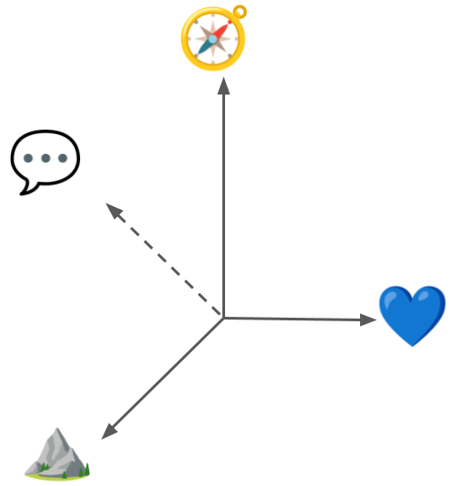
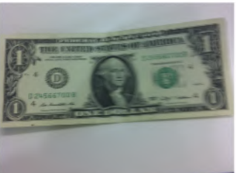
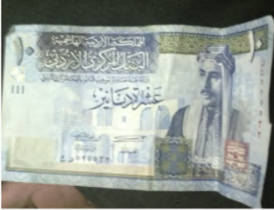
Risks: Influencing Humans
Restricting communicative style
Influencing decision making
Perpetuating bias and stereotypes
Creating partial/false impressions
Vision-Language Models under Cultural and Inclusive Considerations (Karamolegkou et al., HuCLLM 2024)
Notes:
Jordan 10 dinars, King Talal Ibn Abdullah

Slide 7
Solution: Alignment?
Towards Bidirectional Human-AI Alignment: A Systematic Review for Clarifications, Framework, and Future Directions (Shen et al., 2024), adapted from Gabriel (2020)
Direct Preference Optimization: Your Language Model is Secretly a Reward Model (Rafailov et al., NeurIPS 2023)

Slide 8
Human Preferences & Values
The PRISM Alignment Project: What Participatory, Representative and Individualised Human Feedback Reveals About the Subjective and Multicultural Alignment of Large Language Models (Kirk et al., 2024)
Position: A Roadmap to Pluralistic Alignment (Sorensen et al., ICML 2024)

Slide 9
Aligning to Pluralistic Human Values and Preferences
The PRISM Alignment Project: What Participatory, Representative and Individualised Human Feedback Reveals About the Subjective and Multicultural Alignment of Large Language Models (Kirk et al., 2024)

Slide 10
Adding the Human to the Alignment Objective
Towards Bidirectional Human-AI Alignment: A Systematic Review for Clarifications, Framework, and Future Directions (Shen et al., 2024)

Slide 11
But AI Alignment Discourse is Machine-Centered
“our AI systems must do what we want them to do” (Russel et al., 2015)
“prevent [autonomous systems] from causing unintended harm” (Amodei et al., 2016)
“imbuing artificial agents with moral values becomes increasingly important as computer systems operate with greater autonomy” (Gabriel, 2020)
“we need systems that can understand and cater to a broader set of needs” (Sorensen et al., 2024)
“aligning AI to humans ensures AI produces the intended outcomes determined by humans, […] aligning humans to AI aims to help individuals and society adjust to AI advancements” (Shen et al., 2024)
Notes:
“increase helpfulness and truthfulness while mitigating the harms and biases” (OpenAI, 2022)
“to steer and control AI systems much smarter than us” (OpenAI, 2023)

Slide 12
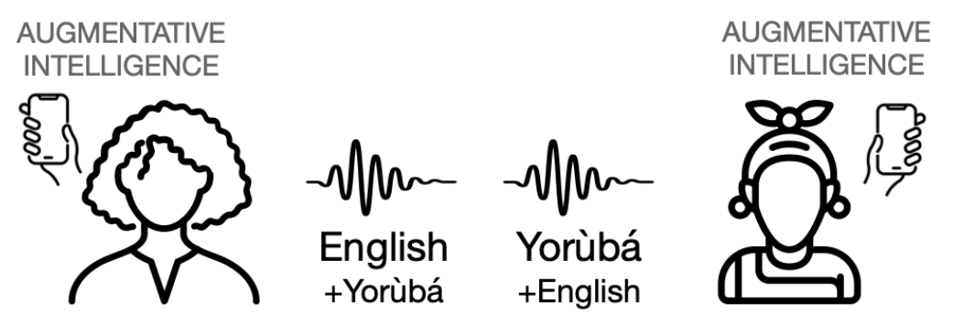
From Human-in-the-Loop to Machine-in-the-Loop
Centering the Speech Community (Bird & Yibarbuk, EACL 2024)
Must NLP be Extractive? (Bird, ACL 2024)

Slide 13
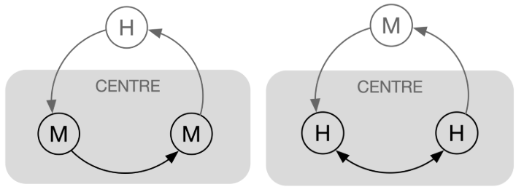
Reframing the Alignment Objective to be Human-Centered
Align Humans ↦ AI or Align Humans + AI ↦ a (social) goal?
preferences
augmentation
automation
feedback
optimization
relationship & communication
Adapted from Centering the Speech Community (Bird & Yibarbuk, EACL 2024)

Slide 14
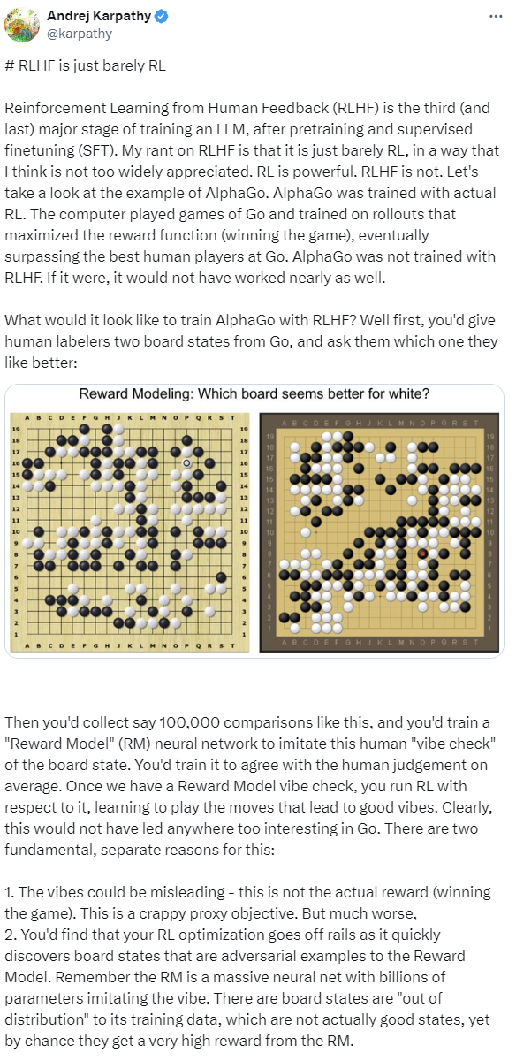
Society-Centered Alignment
Modeling social change
Determining the objective
Reinforcement learning with very delayed rewards
https://x.com/karpathy/status/1821277264996352246

Slide 15
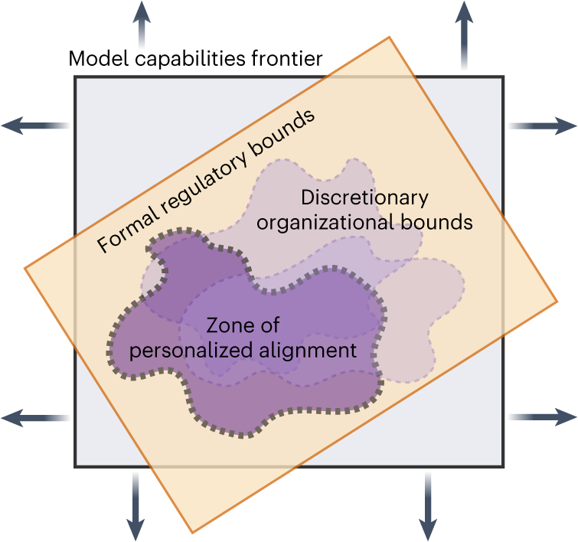
Who Decides?
Researchers
Practitioners
End-users
Affected communities
Regulators
The benefits, risks and bounds of personalizing the alignment of large language models to individuals (Kirk et al., Nature Machine Intelligence 2024)
Notes:
recently published draft guidelines

Slide 16
Join Us at C3NLP 2024!
Workshop on Cross-Cultural Considerations in NLP
Co-located with ACL
Tomorrow, August 16
28 papers
Lightning talks
Poster session
3 panels with 8 speakers
https://sites.google.com/view/c3nlp
Alice Oh
Luis Chiruzzo
Shalom H. Schwartz
Kalika Bali
Diyi Yang
Xun Wu
Industry:
LG, Google

Slide 17
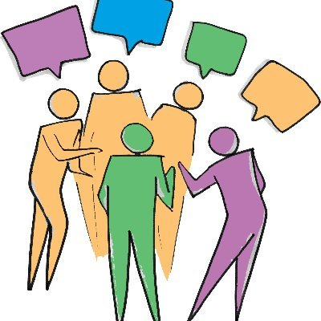
Join Us at SICon 2024!
Workshop on Social Influence in Conversations
Co-located with EMNLP 2024
Workshop date: November 16
Submission deadline: August 30
Shared Task: GenSICon 2024
Classify persuasion/negotiation strategies
Testing Phase: August 16 – August 20
https://sites.google.com/view/sicon2024

Slide 18
Summary
In the long term, LLMs influence society
We should model this to align (only) with desired social change
LLMs influence humans through interaction
Workshops:
C3NLP: tomorrow, Aug 16
SICon: deadline Aug 30
Contact:
danielhers.github.io dh@di.ku.dk

Slide 19
Impact on Society
Towards Bidirectional Human-AI Alignment: A Systematic Review for Clarifications, Framework, and Future Directions (Shen et al., 2024)

