Slide 1
Recipe Adaptation with Language Models
Daniel Hershcovich, DIKU
June 14th 2023

Slide 2
Food, language and identity
Food is a communicative medium
Food is a carrier of meaning
Food is tightly linked to identity
Notes:
When we talk about food we talk about our embodied existence in the world.
Food addresses historical, cultural, social, bodily, spiritual, and environmental issues.
Sense of community and feelings of national, regional, ethnic, religious etc. belonging.

Slide 3
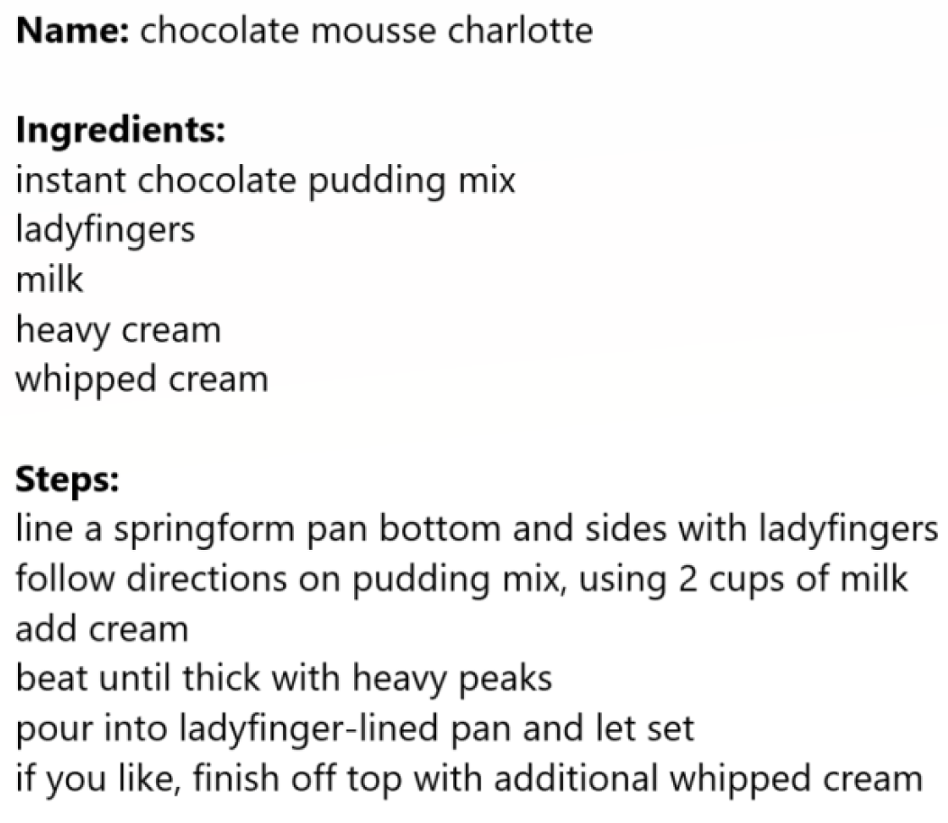
Recipes
A useful way to express food in language
Part of the creative process of food creation
Used by both professional and home cooks

Slide 4
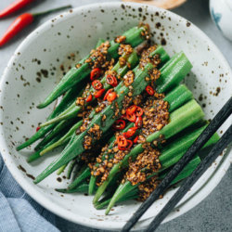
Recipe adaptation
Dietary restrictions, e.g., vegan
Cross-cultural differences
凉拌秋葵
用料
秋葵 20根左右
生抽 2-3勺
醋 1勺
蚝油 1勺
做法
将秋葵洗净放开水中焯2分钟左右。
开水中放盐一勺，油一勺，这样秋葵颜色翠绿鲜艳）...
香油 1勺
糖 1勺
蒜 3-5瓣
盐 酌量
绿芥末膏不用也行 酌量
Chinese Okra Salad
Ingredients
8 oz (225 g) okra
2 teaspoons light soy sauce (or soy sauce)
1/2 teaspoons green Sichuan pepper oil (or more to taste)
Instructions
Bring a medium pot of water to a boil. Add 1 teaspoon vegetable oil and a pinch of salt...
Can we automate this process?

Slide 5
Language models
Vered Shwartz, Everything you wanted to know about ChatGPT

Slide 6
Language models
Vered Shwartz, Everything you wanted to know about ChatGPT

Slide 7
Language models
Vered Shwartz, Everything you wanted to know about ChatGPT

Slide 8
Large Language Models (LLMs)

Slide 9
Strengths and weaknesses
LLMs are good at
Writing fluent and well-formed language
They are not so good at
Accessing up-to-date knowledge (but can search)
Explaining their answers
Summarizing long documents
Math (but can use plugins)
Knowing what they don't know
Writing programming code
...
...
Real-world common sense

Slide 10
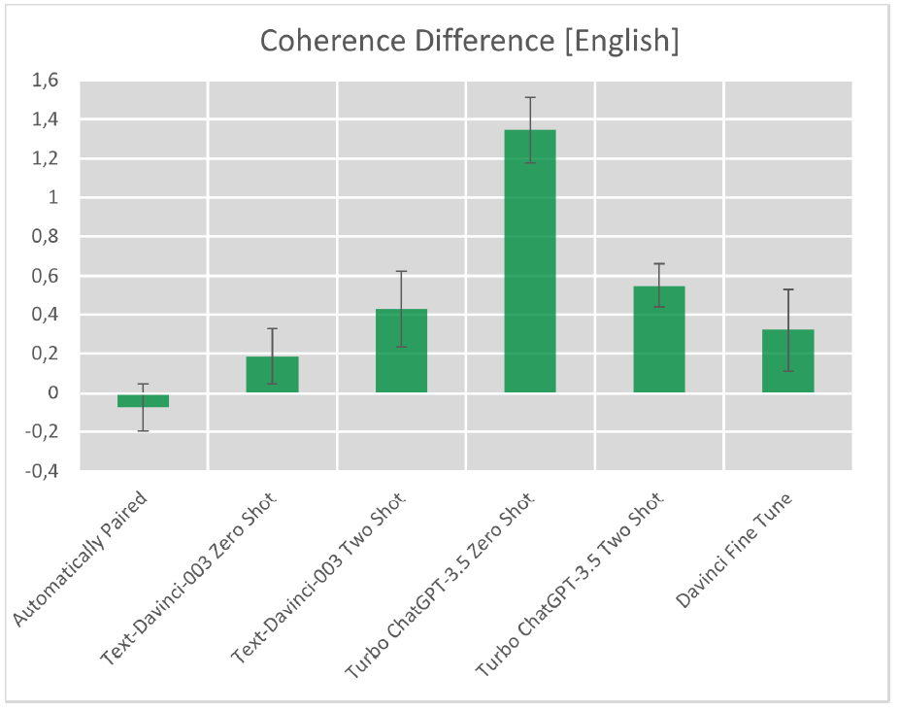
Veganizing recipes using language models
Bachelor project by Jonathan Sigh Musso at DIKU
(co-supervised by Morten Arendt Rasmussen and myself)
Notes:
Promising results with GPT-3.5 in English and Danish, including creative adaptations and additional tips

Slide 11
Cultural adaptation of recipes
Ongoing project, targeting translation that accounts for cultural differences
Current focus:
English→Chinese
Chinese→English
凉拌秋葵
用料
秋葵 20根左右
生抽 2-3勺
醋 1勺
蚝油 1勺
做法
将秋葵洗净放开水中焯2分钟左右。
开水中放盐一勺，油一勺，这样秋葵颜色翠绿鲜艳）...
香油 1勺
糖 1勺
蒜 3-5瓣
盐 酌量
绿芥末膏不用也行 酌量
Culture Adaptation
Direct Translation
Chinese Okra Salad
Ingredients
8 oz (225 g) okra
2 teaspoons light soy sauce (or soy sauce)
1/2 teaspoons green Sichuan pepper oil (or more to taste)
Instructions
Bring a medium pot of water to a boil. Add 1 teaspoon vegetable oil and a pinch of salt...

Slide 12
What is culture?
shared beliefs, values, practices, behaviors, and artifacts
a system of symbols
characterizes a social group
learned, not innate
integrated with daily experience
taken-for-granted notions, rules, moralities, and behaviors
dynamic process through which social meanings are constructed
Cultural anthropology: Asking questions about humanity (Welsch and Vivanco, 2015)

Slide 13
Granularities of variation
Linguistic variation
Idiolect
Sociolect
Dialect
Standardized language
Language groups and families
Cultural variation
Individual, personality
Social group
Geographical region
Country, national culture
Global cultural community
Notes:
Culture is multifaceted and complex
There is enormous diversity among speakers of the same language
The information monoculture

Slide 14
Cultural dimensions in language technolgoy
Challenges and Strategies in Cross-Cultural NLP (Hershcovich et al., ACL 2022)
Notes:
Understanding culture's role in NLP
Language and culture are intertwined
Guides rather than a strict decomposition
All dimensions but form are unobserved, the dark matter of AI: not only commonsense (Yejin Choi)
The main point: culture as a very high-dimensional object rather than a category

Slide 15
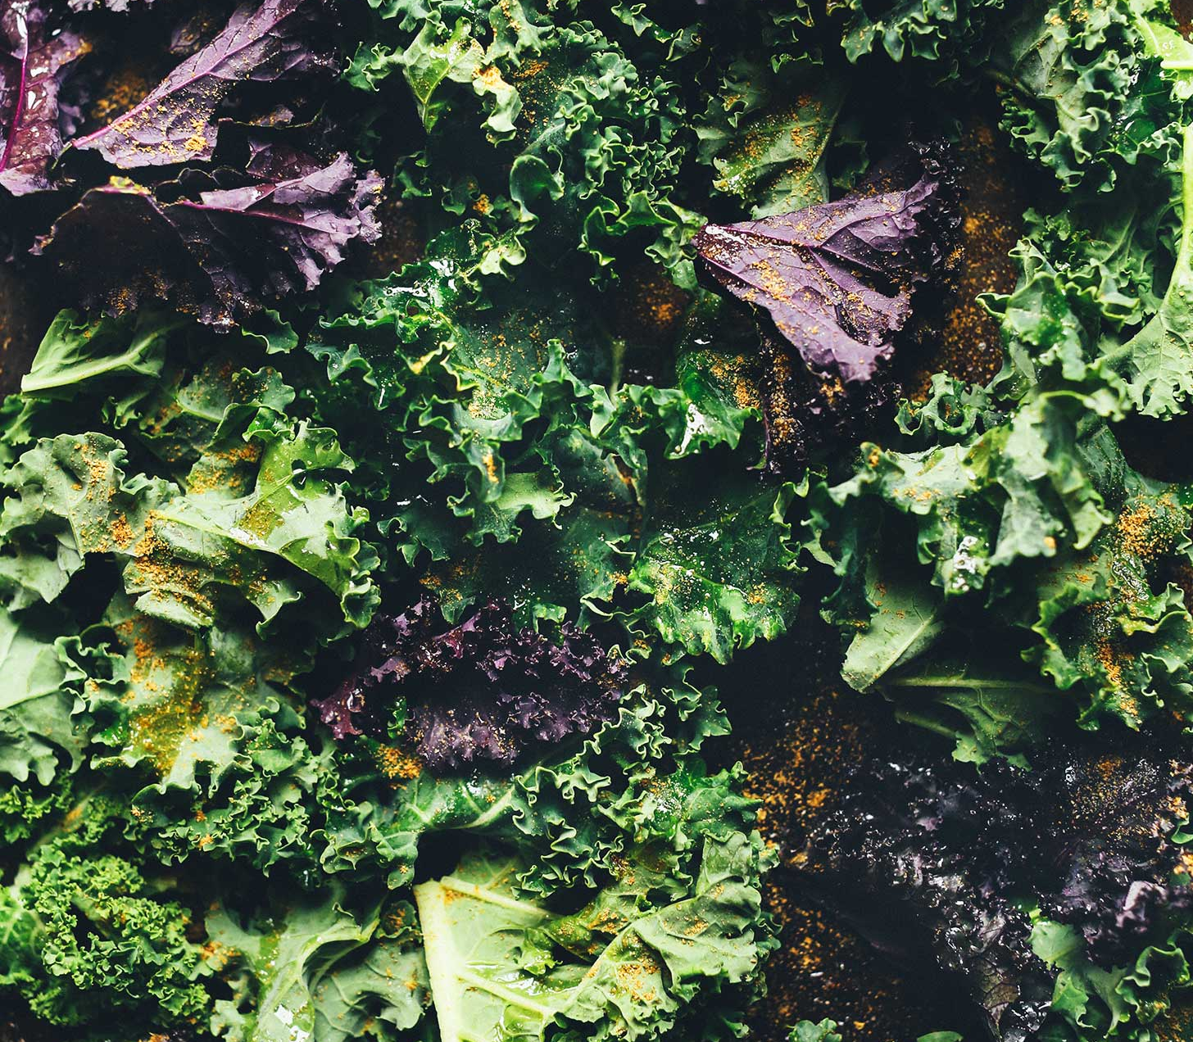
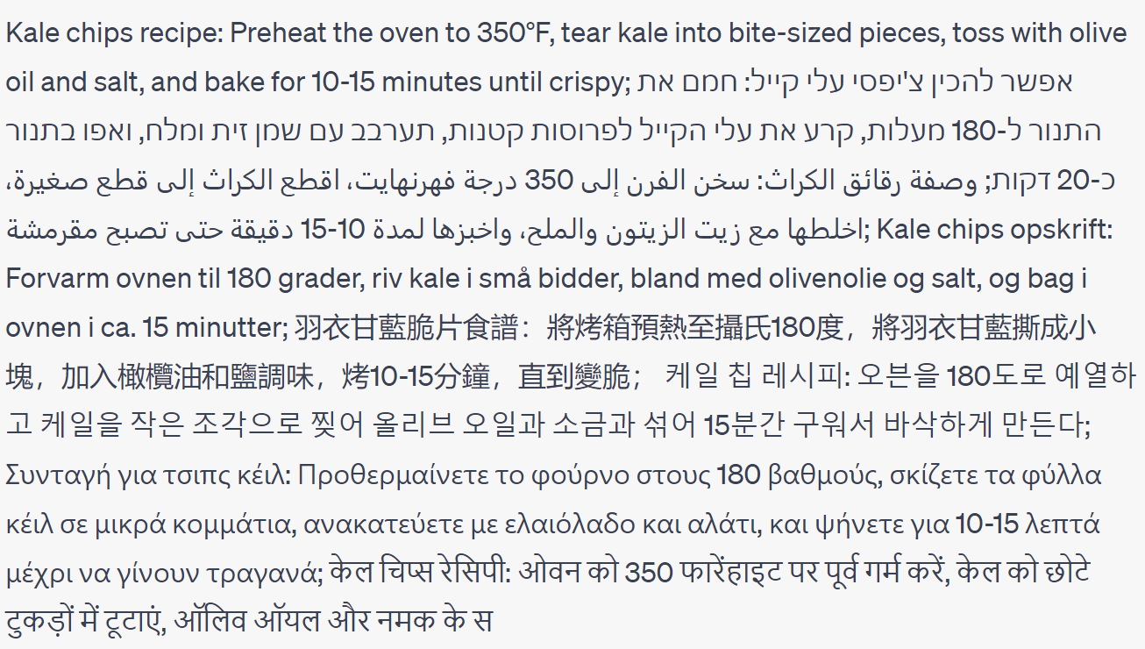
Linguistic form
Give me a one-sentence kale chips recipe in English, Hebrew, Arabic, Danish, Mandarin Chinese, Korean, Greek, Hindi, Bulgarian and Turkish. Do not say which languages they are.
Notes:
A popular web app to assist me in generating examples, not to showcase its AGI
Orthography, morphology, syntax, word choice, style

Slide 16
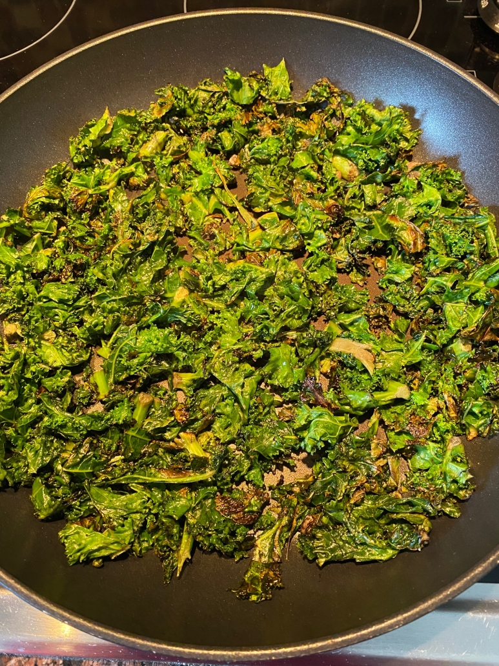
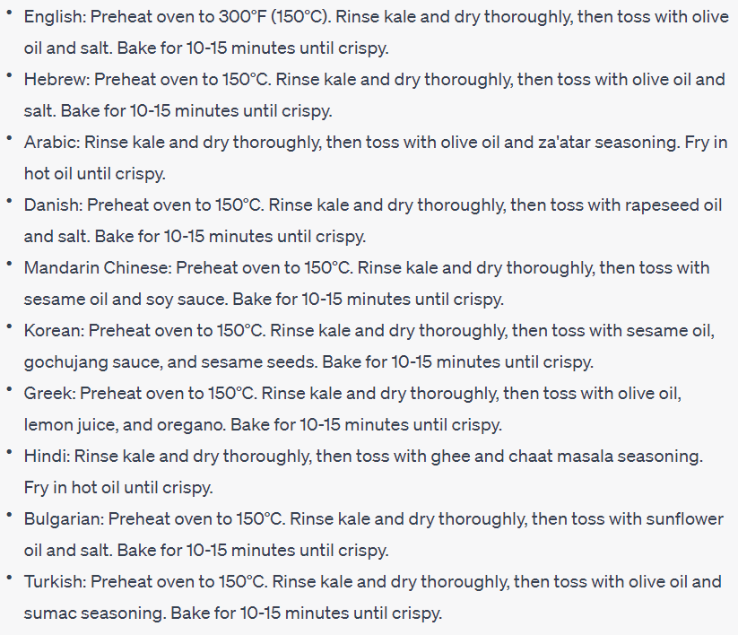
Common ground
Adapt the recipe to the common ingredients, cooking methods and tools in each culture's cuisine.
Notes:
Shared knowledge based on which people reason and communicate
Can also be about explaining methods in more detail if they are not commonly known

Slide 17
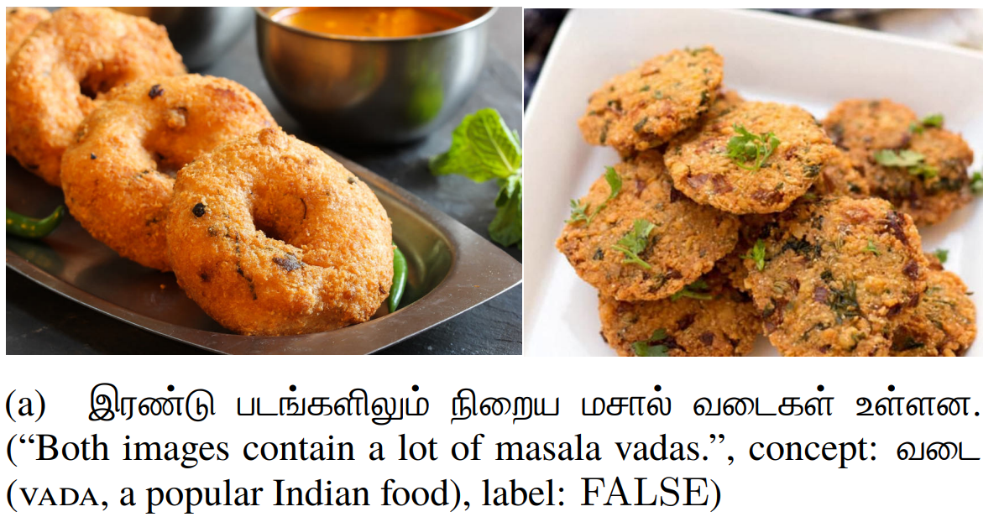
Conceptualization
Visually Grounded Reasoning across Languages and Cultures (Liu et al., EMNLP 2021)
Notes:
Visual concepts include culture-specific activities that cannot be mapped across cultures.
Objects
Colours
Kinship
Space
Time
Events

Slide 18
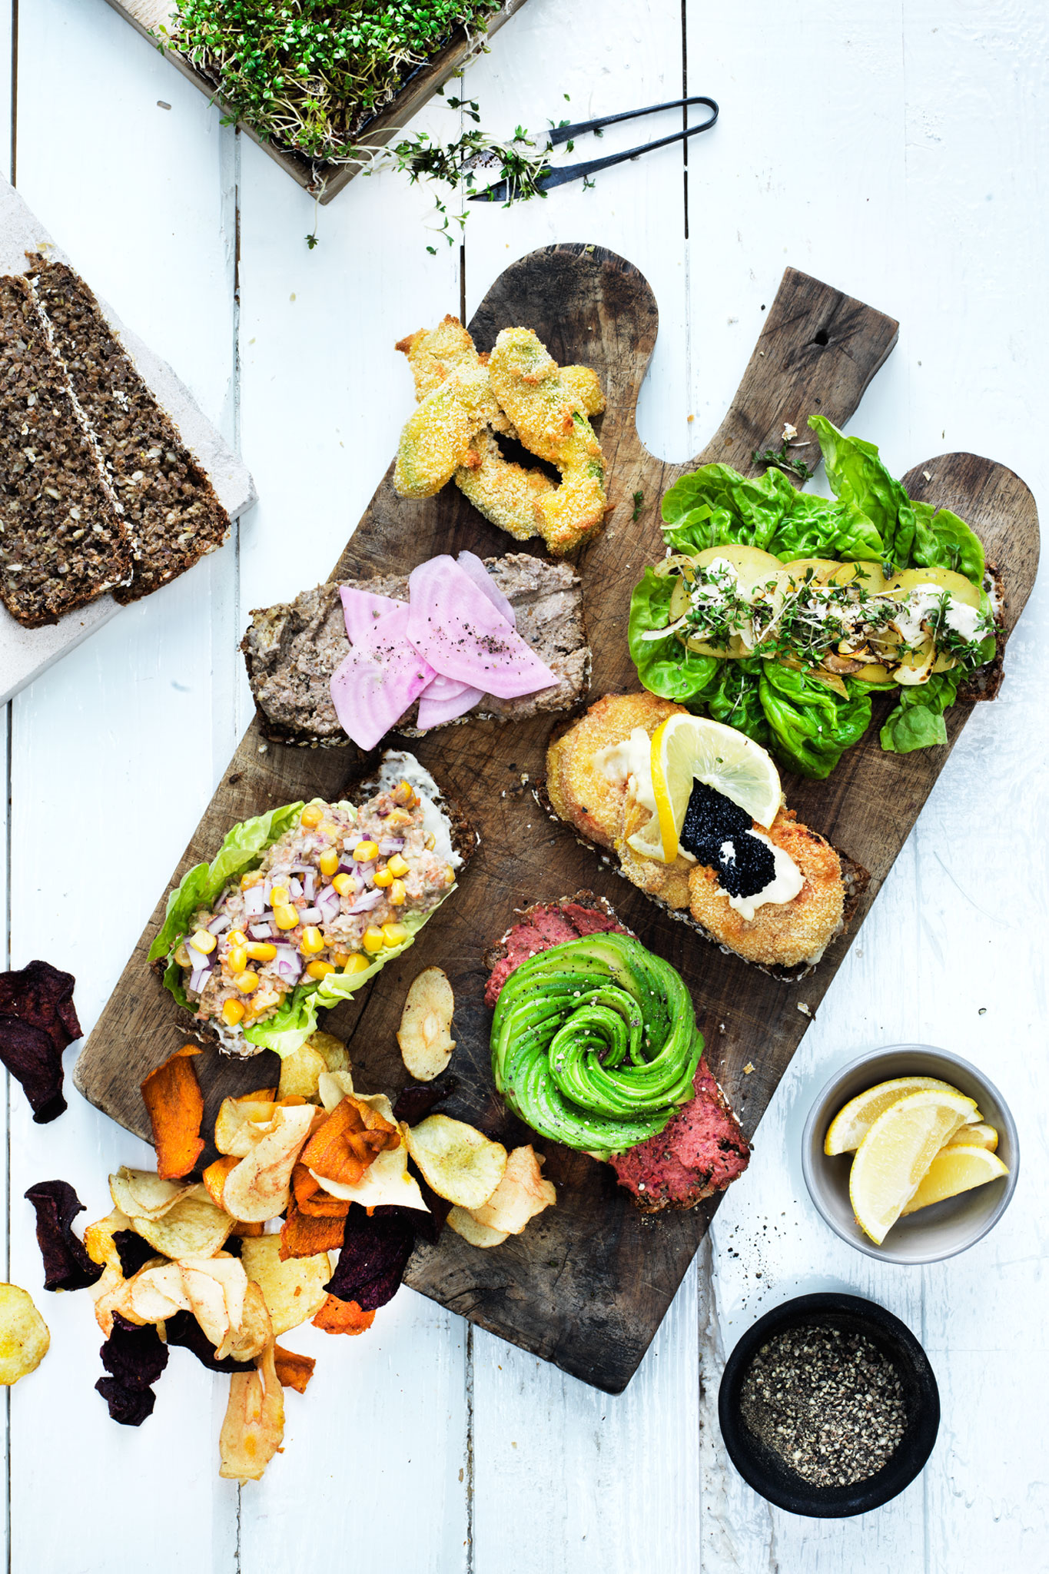
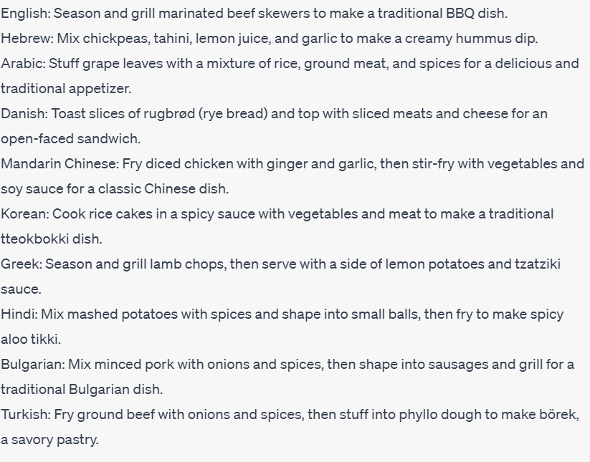
Aboutness
Give me one-sentence recipes for different culture-specific dishes in the following languages (without specifying the dish names): English, Hebrew, Arabic, Danish, Mandarin Chinese, Korean, Greek, Hindi, Bulgarian and Turkish
Notes:
What people care to talk about: topics, aspects, entities

Slide 19
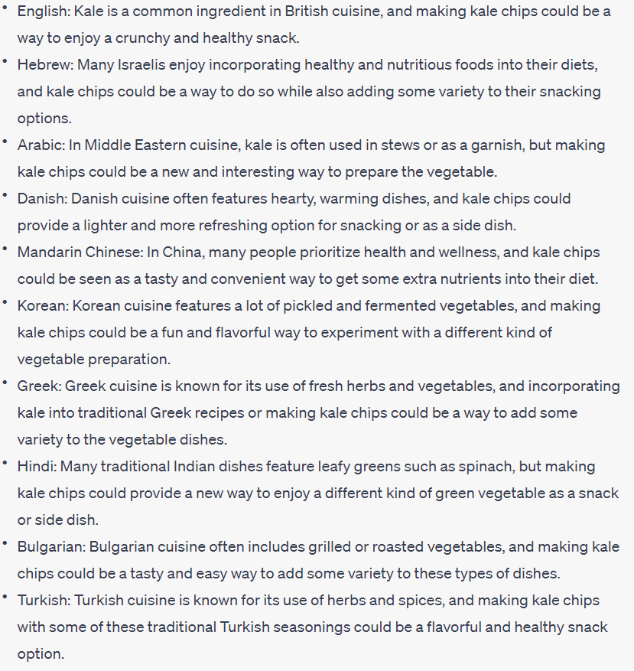
Objectives and values
For each of these cultures, give a specific reason for why they would even want to make kale chips
Reasons
Variety
Sustainability
Enjoyment
Health

Slide 20
My overall research agenda
Building culture-adaptive language models
Using language models to bridge between cultures
Understanding culture's role in language technology
Identifying cultural bias in language models
Notes:
Mostly questions

Slide 21
Domains for cultural adaptation
Notes:
Countless areas. Challenging to define! Requires expertise. Subjective. But still worth it because it allows breaking barriers

Slide 22
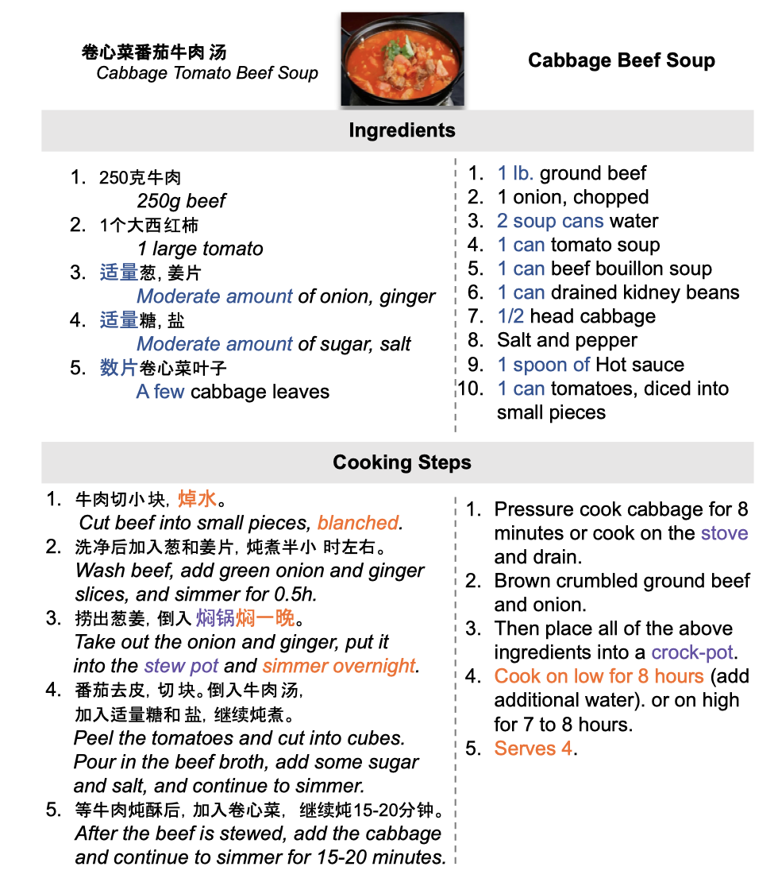
Recipe differences across cultures
Ingredient availability and preference
Measurement units, writing style
Available equipment and tools
Known techniques, typical ordering
Desired flavours
Desired texture

Slide 23
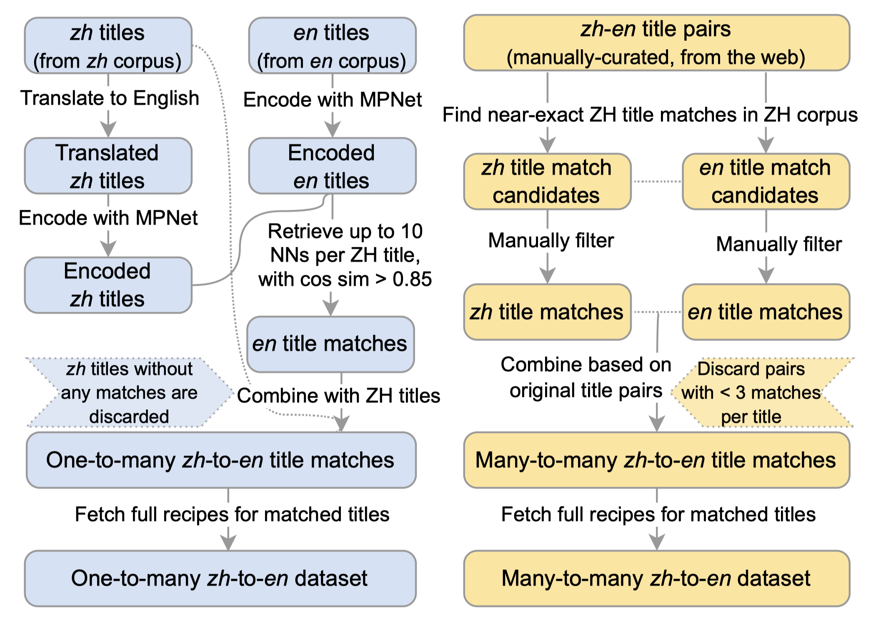
Preliminary data collection
2M English recipes from various websites (e.g., food.com)
1.5M Chinese recipes from xiachufang.com
Automatic pairing based on assumptions:
If two recipes have the same title, they describe the same dish.
If two recipes have a semantically equivalent title (possibly in another language), they describe the same dish.

Slide 24
Models and preliminary results
Language models and machine translation systems trained on automatically paired reference recipes
Evaluating against automatically paired reference recipes

Slide 25
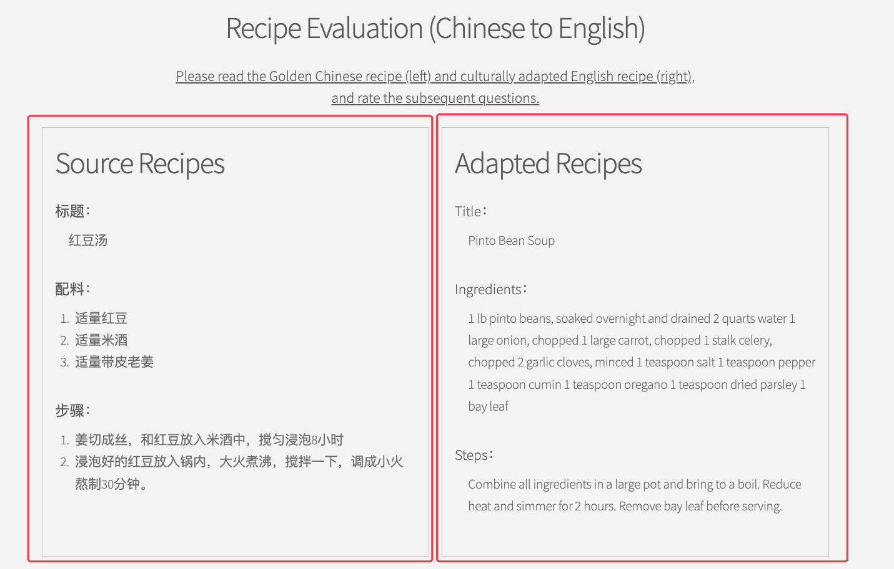
Human evaluation
Grammar
Consistency
Preservation
Cultural appropriateness
Starting crowdsourcing on Prolific.
Online platform for evaluation: https://recipecoastalproject.studio/

Slide 26
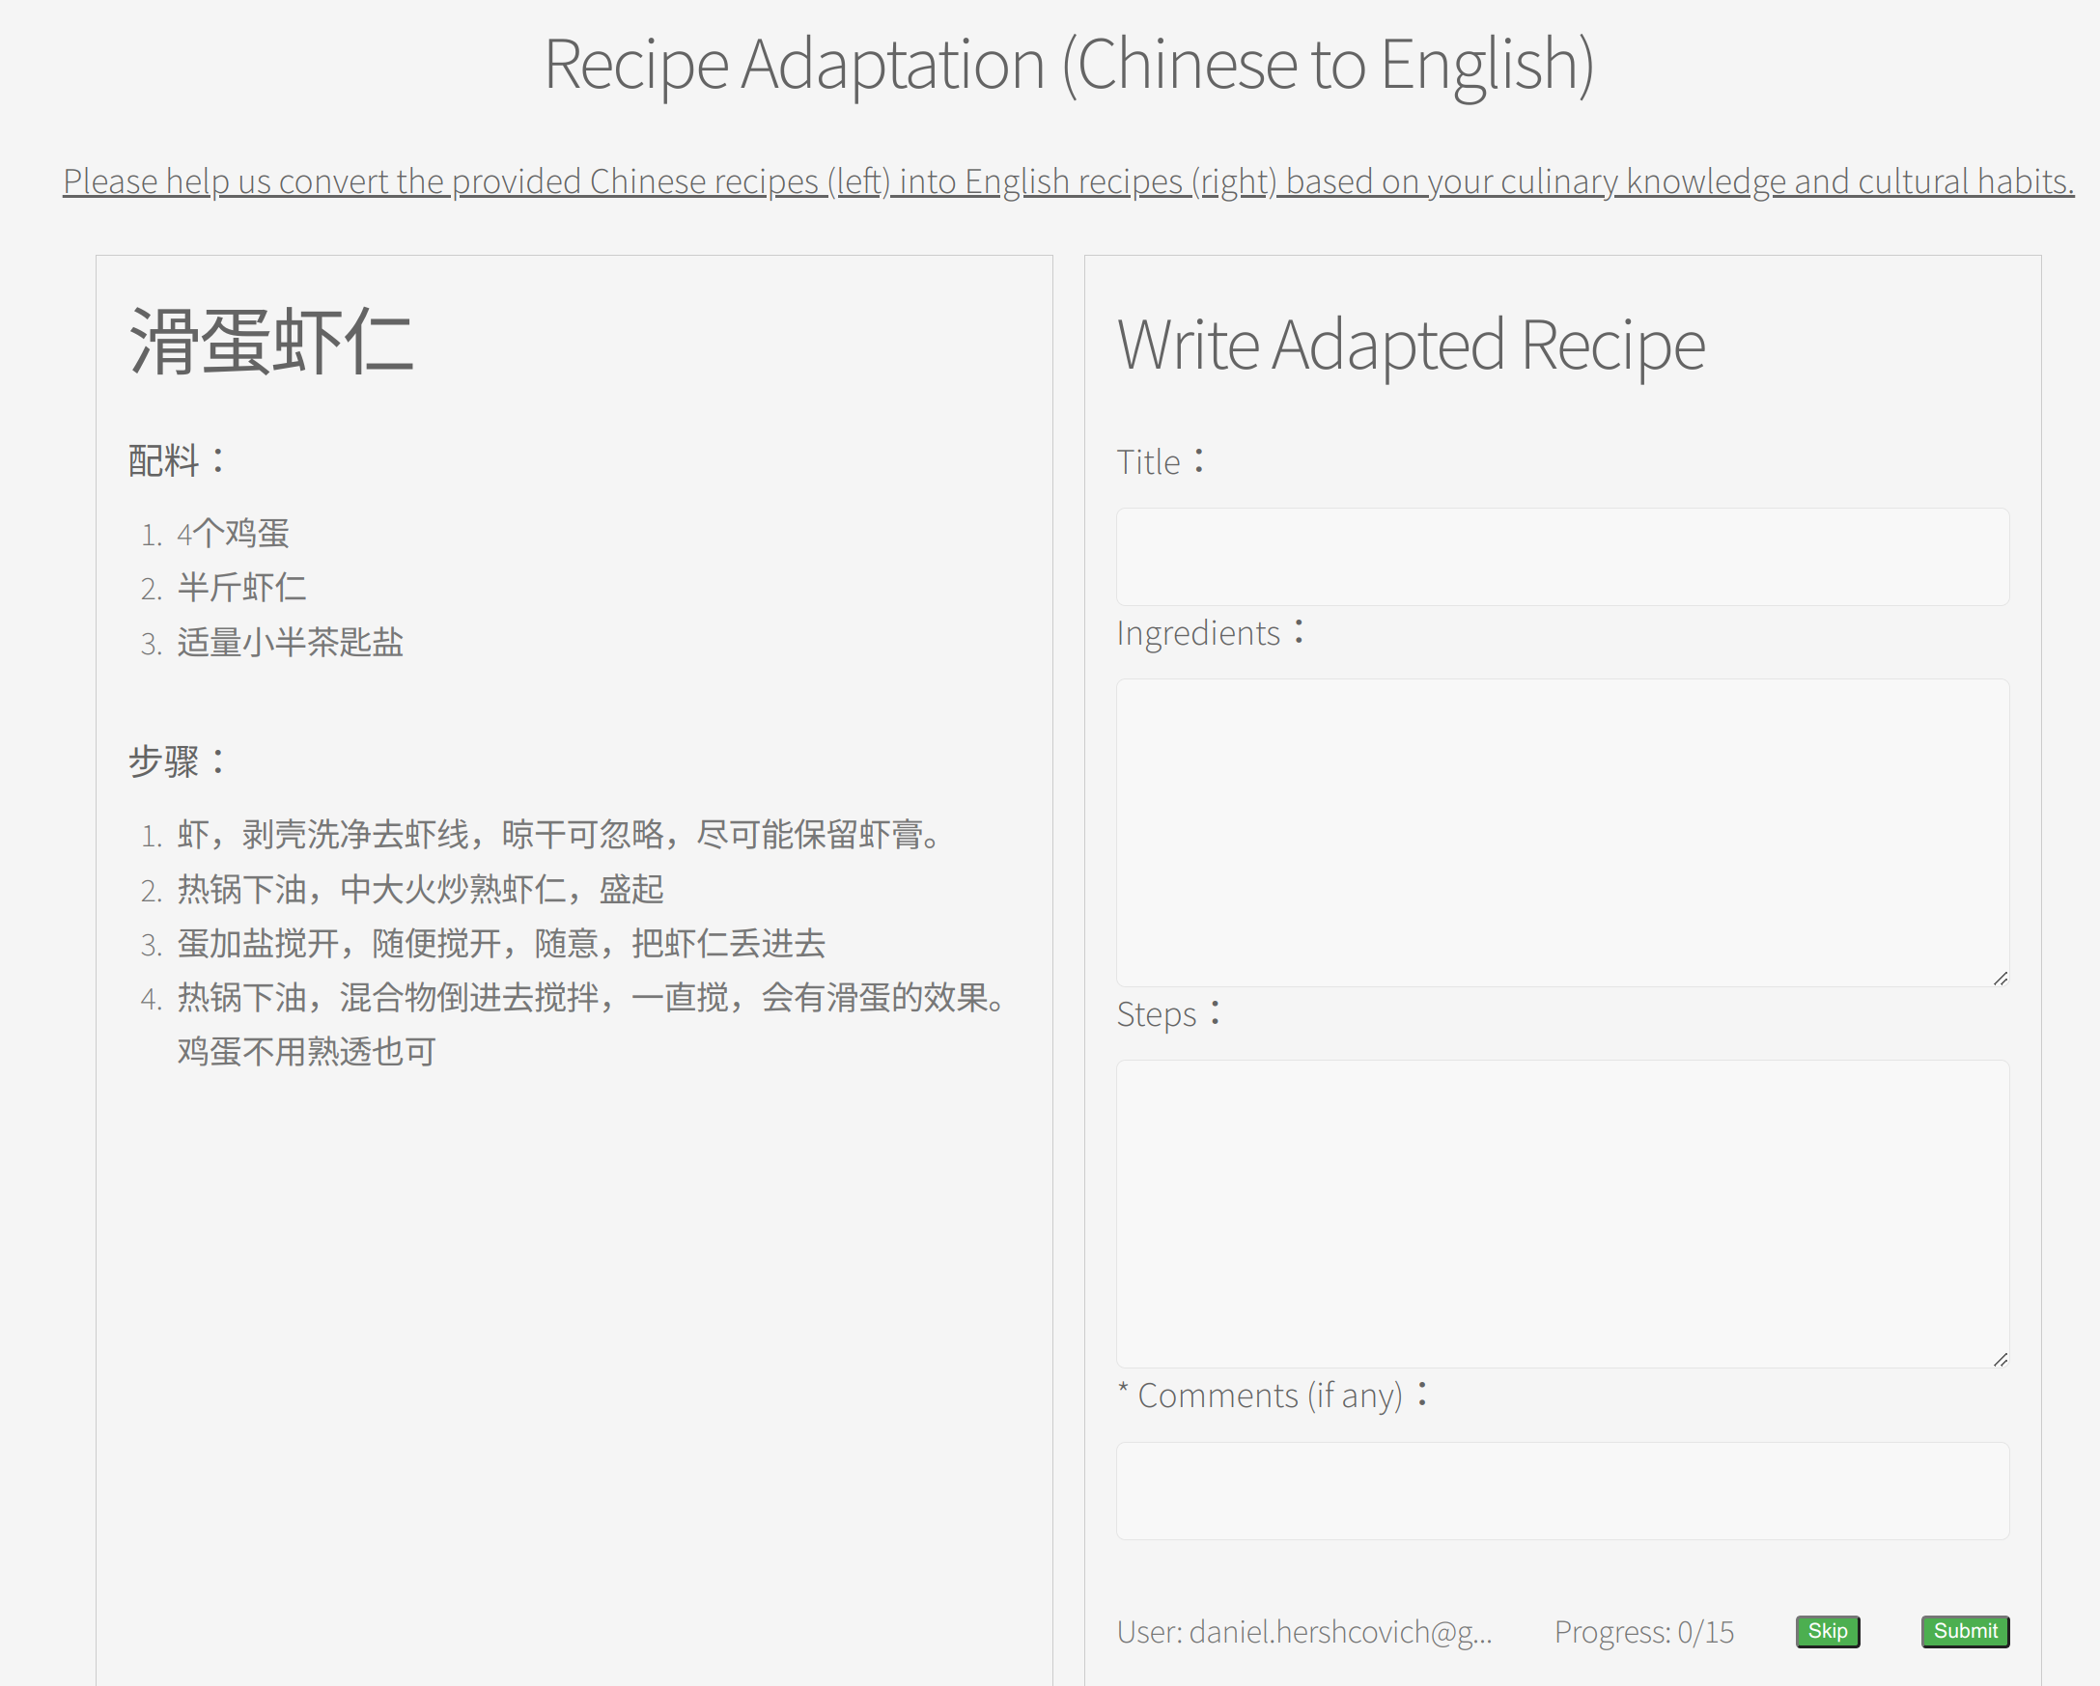
Ongoing work
Goal: evaluate against human-written references recipes
Requires English+Chinese speakers
Please stay for the next hour to help us!
https://recipecoastalproject.studio/

Slide 27
Thanks! danielhers.github.io dh@di.ku.dk
@daniel_hers
sigmoid.social/@dh

Slide 28
Language Models are Linguistically Biased
BERT (Devlin et al., 2019)
GPT-2 (Radford et al., 2018)
GPT-3 (Brown et al., 2020)
GPT-4 (OpenAI, 2023)
T5 (Raffel et al., 2019)
BART (Lewis et al., 2020)
mBERT (Devlin et al., 2019)
XLM, XLM-R (Conneau et al., 2020)
mBART (Liu et al., 2020)
mT5 (Xue et al., 2021)
XGLM (Lin et al., 2021)
BLOOM (Le Scao et al., 2022)
Trained on (mostly) English
Trained on multilingual text

Slide 29
Language Models are Linguistically Biased
English
Icelandic
Swedish
Danish
Swedish sign language
Faroese
The State and Fate of Linguistic Diversity and Inclusion in the NLP World
(Joshi et al., ACL 2020)

Slide 30
Language Models are Culturally Biased
Having Beer after Prayer? Measuring Cultural Bias in Large Language Models (Naous et al., 2023)

Slide 31
Language Models are Culturally Biased
Large Pre-trained Language Models Contain Human-like Biases of What is Right and Wrong to Do (Schramowski et al., Nature Machine Intelligence 2022)
Speaking Multiple Languages Affects the Moral Bias of Language Models (Hämmerl et al., arXiv 2022)
Probing Pre-Trained Language Models for Cross-Cultural Differences in Values (Arora et al., C3NLP 2023)
Assessing Cross-Cultural Alignment between ChatGPT and Human Societies: An Empirical Study (Cao et al., C3NLP 2023)
Notes:
Controversial. I agree with Kevin Munger, bots should not use the word “I”

Slide 32
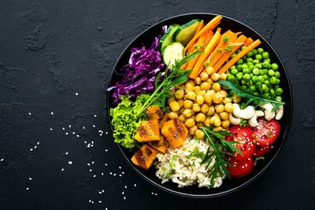
A Dataset of Sustainable Diet Arguments on Twitter
Corpus of 32840 English tweets
1
600 arguments annotated for 5 topics
2
Trained NLP models with strong performance
3
We should reduce the consumption of meat
Plant based food should be encouraged
Meat alternatives should be encouraged
Vegan and vegetarian diets should be encouraged
We should pursue policies that promote sustainable foods
Argument mining for green nutrition. M. Hansen (MSc thesis, 2022)

Slide 33
Potential applications
Surveying public attitudes and exposing misinformation
Generation of convincing arguments for communication campaigns
Understanding public knowledge of sustainable diets

Slide 34
Argumentation
Can AI convince consumers of diverse backgrounds to change their habitual behavior?
What characterizes successful arguments for behavior change in public discourse?
An autonomous debating system
Slonim et al. (Nature 2021)

Slide 35
Denmark's Official Dietary Guidelines
Eat plant-rich, varied and not too much
Eat more vegetables and fruit
Eat less meat – choose legumes and fish
Eat wholegrain foods
Choose vegetable oils and low-fat dairy products
Eat less sweet, salty and fatty food
Thirsty? Drink water
https://altomkost.dk/english

Slide 36
Enriching Arguments with Diverse Perspectives
Denmark's Official Dietary Guidelines argues "for health and climate"
What about cultural, economic, ethical perspectives?

