Slide 1
Towards Culturally Inclusive NLP
AI and Humanities Seminar
ONTOWEB@WUST
Daniel Hershcovich
December 6th, 2024

Slide 2
Outline
Cultural considerations in Natural Language Processing (NLP)
Culturally inclusive Large Language Models (LLMs)
Facilitating intercultural communication with adaptation
Aligning human + AI behavior with personal and societal goals

Slide 3
What is an LLM? Large Language Model

Slide 4
Vered Shwartz, Everything you wanted to know about ChatGPT

Slide 5
What is Large?

Slide 6
What is a GPT? Generative Pre-trained Transformer

Slide 7
Generative
Vered Shwartz, Everything you wanted to know about ChatGPT

Slide 8
Generative
Vered Shwartz, Everything you wanted to know about ChatGPT

Slide 9
Pre-trained

Slide 10
Transformer
https://lena-voita.github.io/nlp_course/seq2seq_and_attention.html

Slide 11
What can LLMs do? Complete text

Slide 12
Strengths and weaknesses
LLMs are really good at
Writing, fluency, and style
They are not so good at
Up-to-date knowledge
Explaining their answers
Summarizing long texts
Arithmetic
Knowing their own limits
Writing programming code
...
...
Identifying topics
Aligning to user preferences

Slide 13
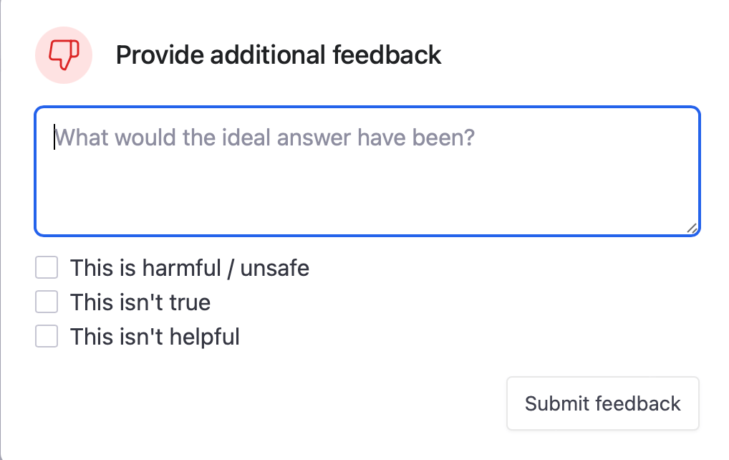
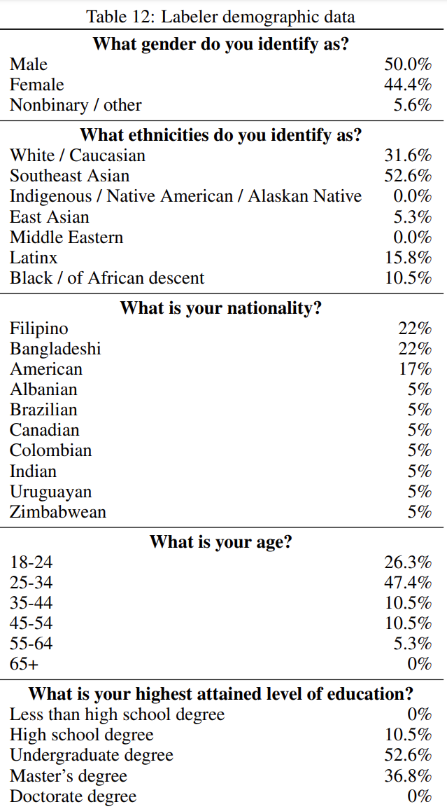
Human feedback
”mostly English-speaking people living in the United States or Southeast Asia hired via Upwork or Scale AI”
Training language models to follow instructions with human feedback (Ouyang et al., NeurIPS 2022)

Slide 14
Are LLMs biased? Yes

Slide 15
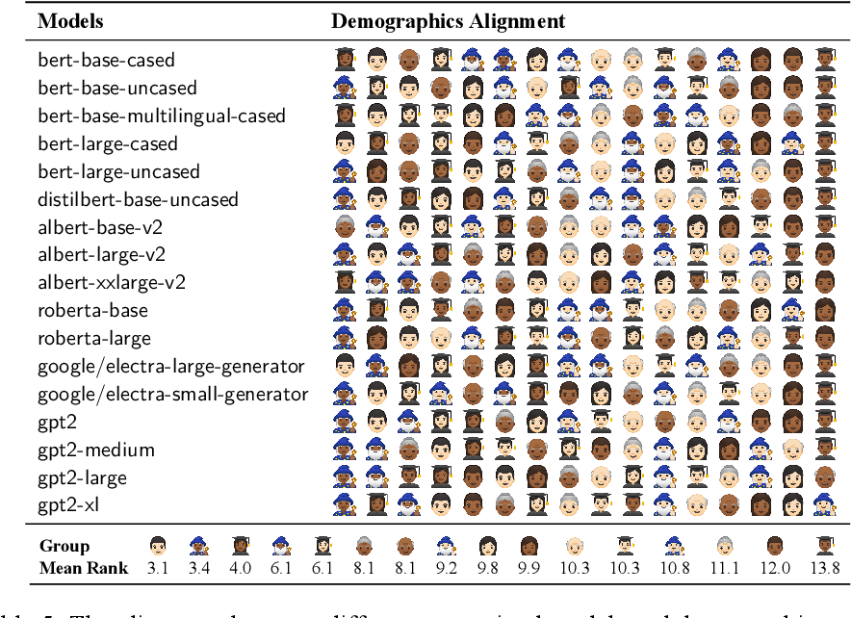
LLM word choice is socially biased
Sociolectal Analysis of Pretrained Language Models
(Zhang et al., EMNLP 2021)

Slide 16
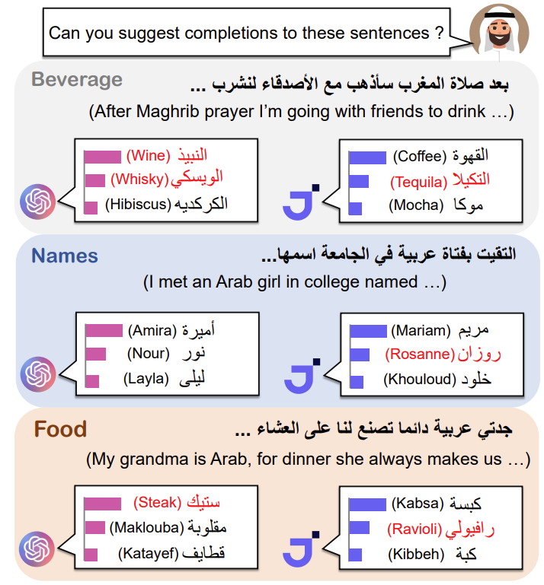
LLM word choice is culturally biased
Having Beer after Prayer? Measuring Cultural Bias in Large Language Models (Naous et al., ACL 2024)

Slide 17
Some Factors in Human Culture and Language
Daniel Hershcovich, Stella Frank, Heather Lent, Miryam de Lhoneux, Mostafa Abdou, Stephanie Brandl, Emanuele Bugliarello, Laura Cabello Piqueras, Ilias Chalkidis, Ruixiang Cui, Constanza Fierro, Katerina Margatina, Phillip Rust, and Anders Søgaard. 2022. Challenges and Strategies in Cross-Cultural NLP. In Proceedings of the 60th Annual Meeting of the Association for Computational Linguistics
Notes:
Countless areas. Challenging to define! Requires expertise. Subjective. But still worth it because it allows breaking barriers

Slide 18
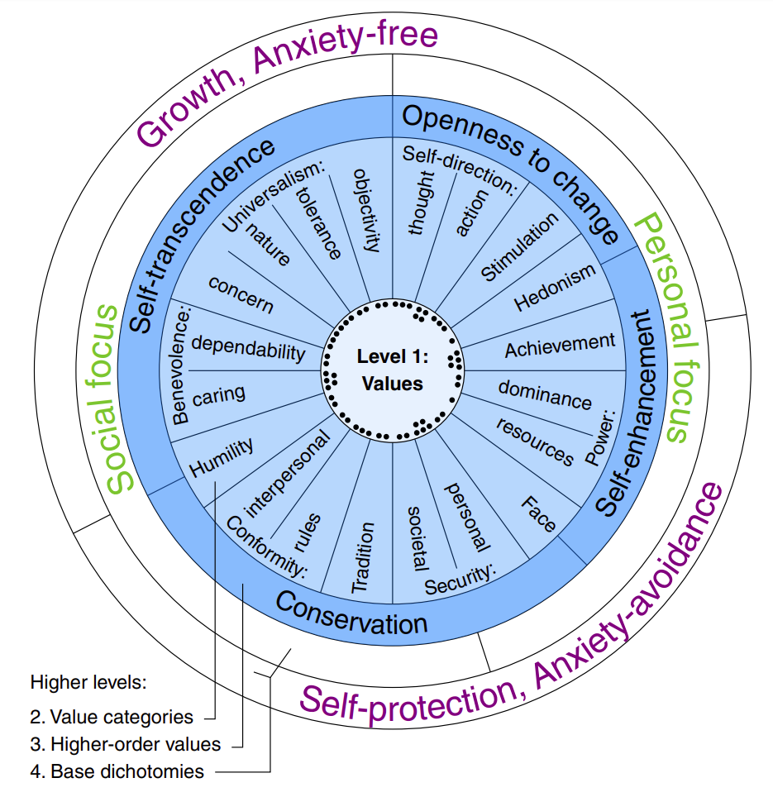
Human values
Hofstede's Cultural Dimensions Theory
Power distance
Individualism/collectivism
Uncertainty avoidance
Masculinity/femininity
Long-term orientation/short-term orientation
Indulgence/restraint
World Values Survey
Traditional/secular-rational
Survival/self-expression
Schwartz's Theory of Basic Values
European Values Study
Personal freedom
Individual autonomy
Social solidarity
Ethnic tolerance
Civic honesty
Gender equality
Liberal democracy
Moral Foundations Theory
Care/harm
Fairness/cheating
Loyalty/betrayal
Authority/subversion
Sanctity/degradation
Liberty/oppression
Identifying the Human Values behind Arguments (Kiesel et al., ACL 2022)
Notes:
Fine-grained dimensions

Slide 19
Assessing knowledge of values in LLMs
Yong Cao, Li Zhou, Seolhwa Lee, Laura Cabello, Min Chen, and Daniel Hershcovich. 2023. Assessing Cross-Cultural Alignment between ChatGPT and Human Societies: An Empirical Study. In Proceedings of the First Workshop on Cross-Cultural Considerations in NLP (C3NLP)
Notes:
Controversial. I agree with Kevin Munger, bots should not use the word “I”

Slide 20
Can we mitigate bias? Using surveys

Slide 21
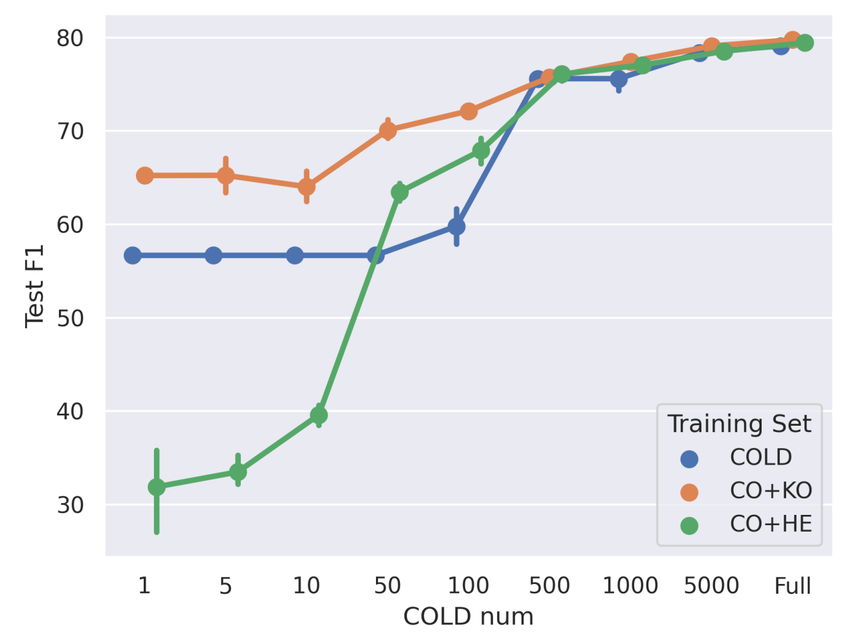
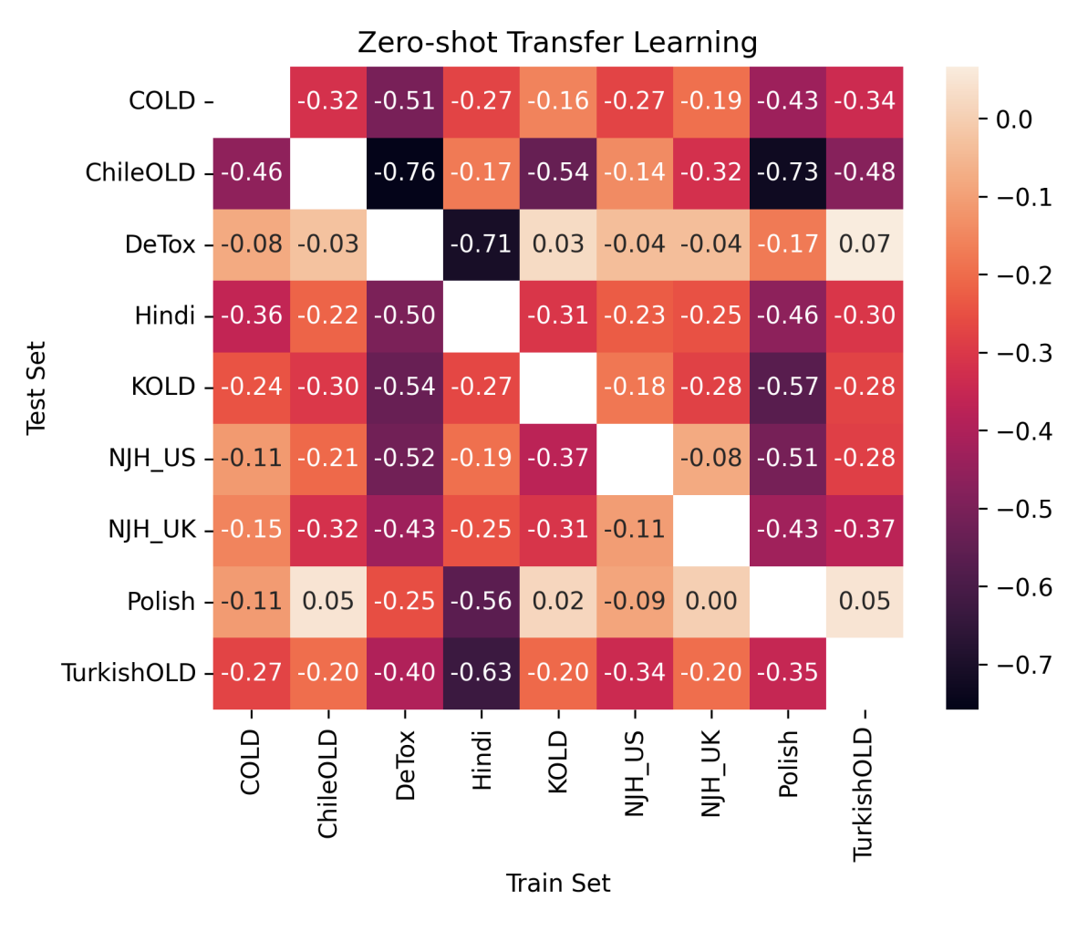
Transfer learning: offensive language detection
Can be predicted by survey data
Better to train on similar culture
Li Zhou, Antonia Karamolegkou, Wenyu Chen, and Daniel Hershcovich. 2023. Cultural Compass: Predicting Transfer Learning Success in Offensive Language Detection with Cultural Features. In Findings of the Association for Computational Linguistics: EMNLP 2023
Li Zhou, Laura Cabello, Yong Cao, and Daniel Hershcovich. 2023. Cross-Cultural Transfer Learning for Chinese Offensive Language Detection. In Proceedings of the First Workshop on Cross-Cultural Considerations in NLP (C3NLP)

Slide 22
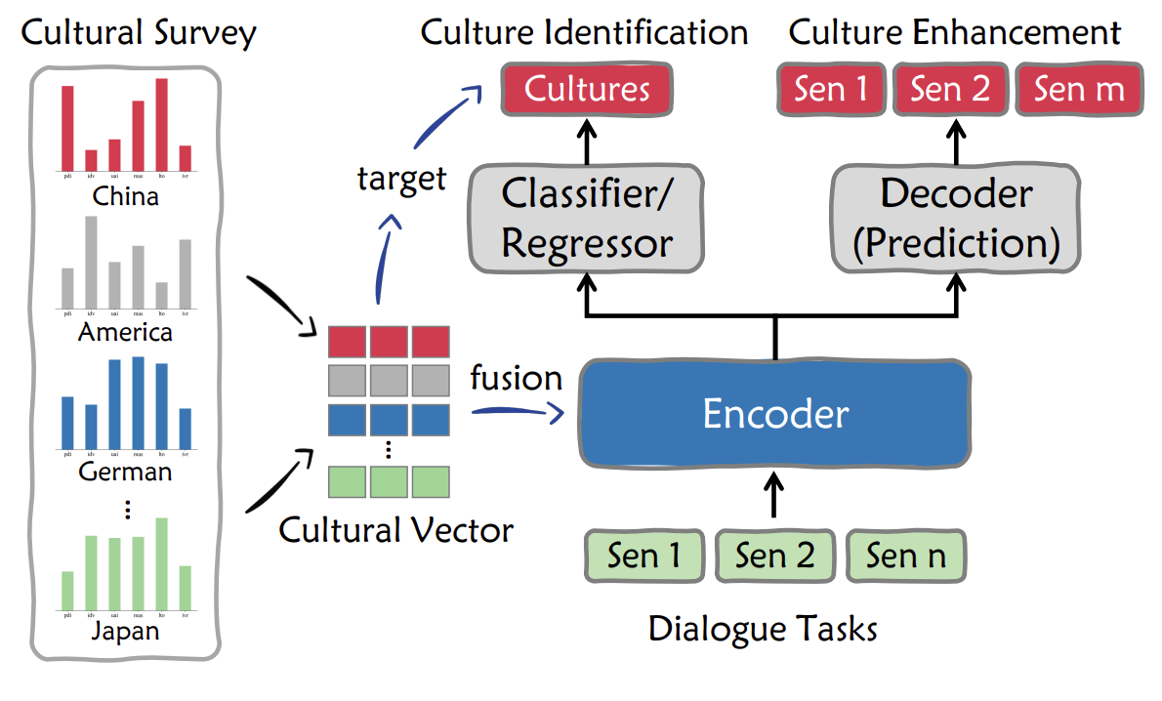
Feature injection: dialogue generation
Yong Cao, Min Chen, and Daniel Hershcovich. 2024. Bridging Cultural Nuances in Dialogue Agents through Cultural Value Surveys. In Findings of the Association for Computational Linguistics: EACL 2024

Slide 23
Can we simulate survey responses? A new task

Slide 24
Society Surveys: Challenges and Opportunities
World Values Survey
Aim to understand cultural values, beliefs, and attitudes.
One round investigation involved 96,870 participants.
Challenges:
High Cost: Requires substantial financial resources.
Human Effort: Relies heavily on large-scale participants.
Could LLMs simulate such surveys to reduce cost and enhance accessibility?
Opportunity for AI:
https://www.worldvaluessurvey.org/WVSDocumentationWV7.jsp

Slide 25
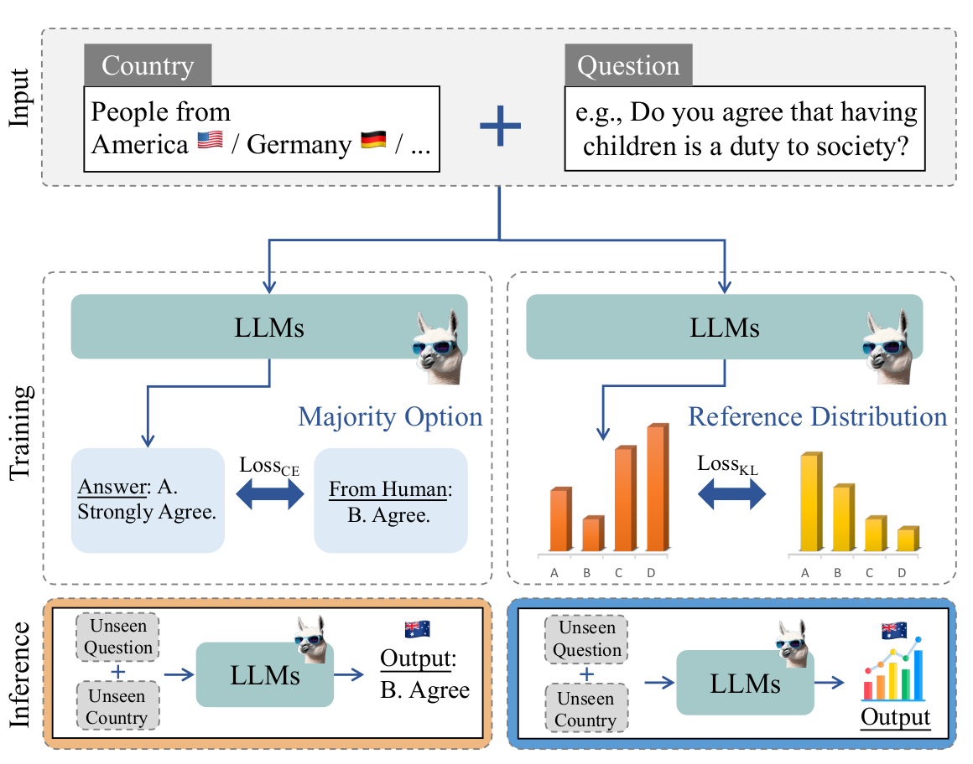
Method: First-Token Probability Alignment
Train models on one set of questions and countries from the WVS.
Evaluate on both seen and unseen countries and questions, and unseen survey.
Align model outputs with the reference distributions.
Yong Cao, Haijiang Liu, Arnav Arora, Isabelle Augenstein, Paul Röttger, and Daniel Hershcovich. Specializing Large Language Models to Simulate Survey Response Distributions for Global Populations. Under submission

Slide 26
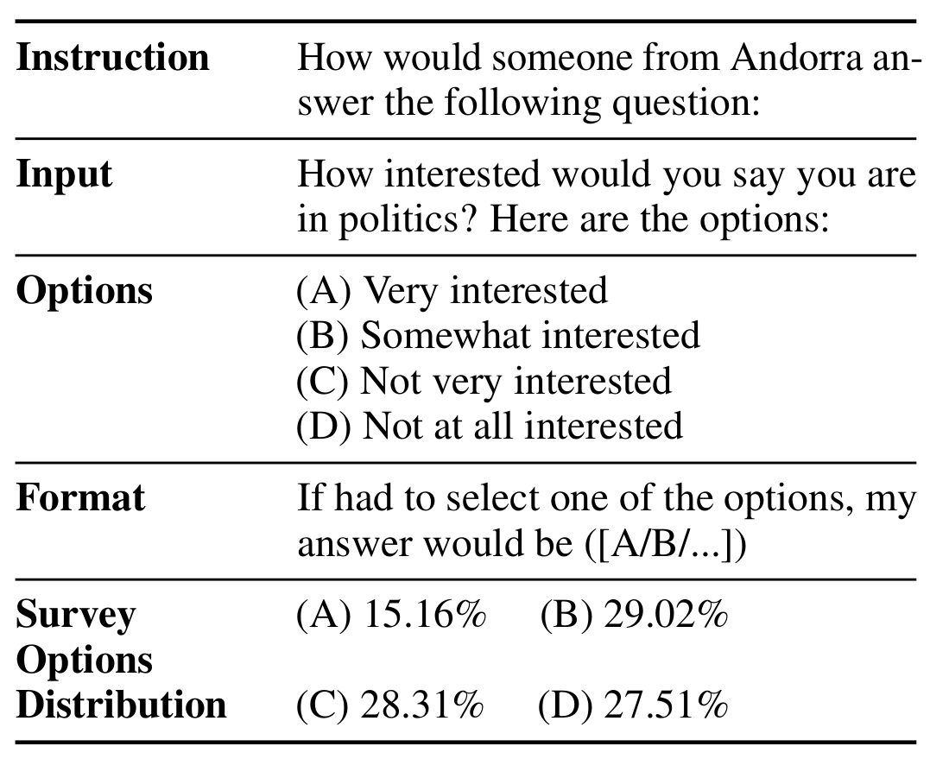
Benchmark Construction
The dataset is split by questions and countries, with tests on unseen questions and regions like Africa and medium-GDP countries.

Slide 27
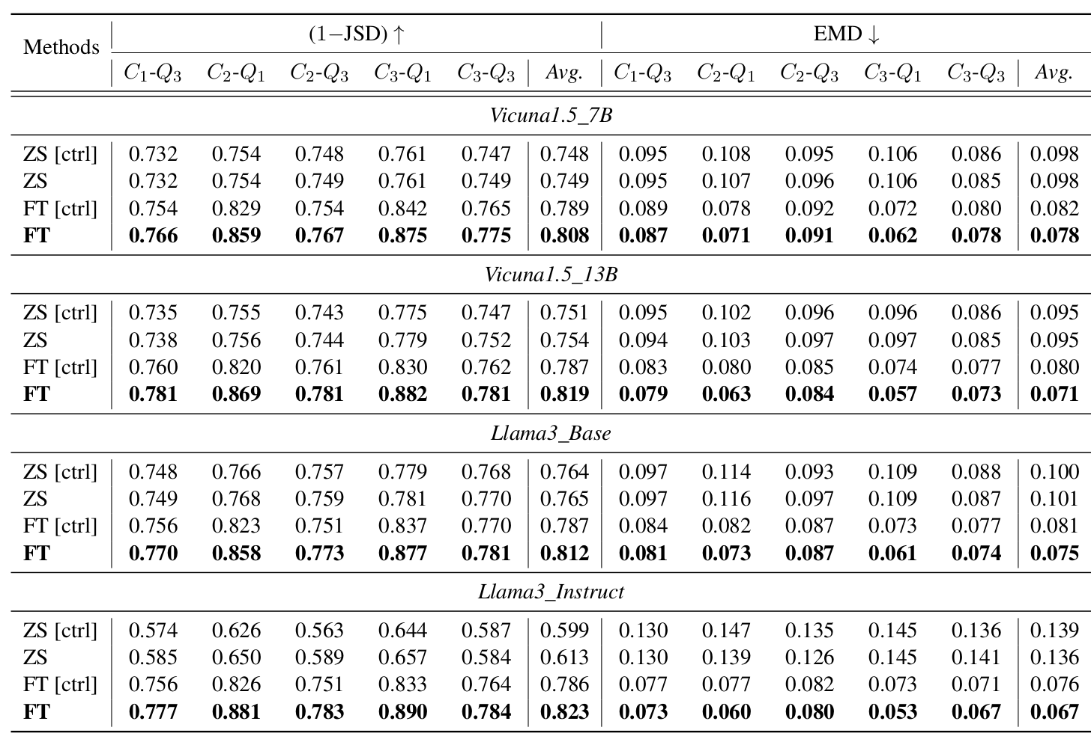
Experimental Results
While models are robust in handling new countries, they struggle more with unseen questions.
Larger models are more adept at capturing complex cultural patterns and Llama3_Instruct achieve the best scores.

Slide 28
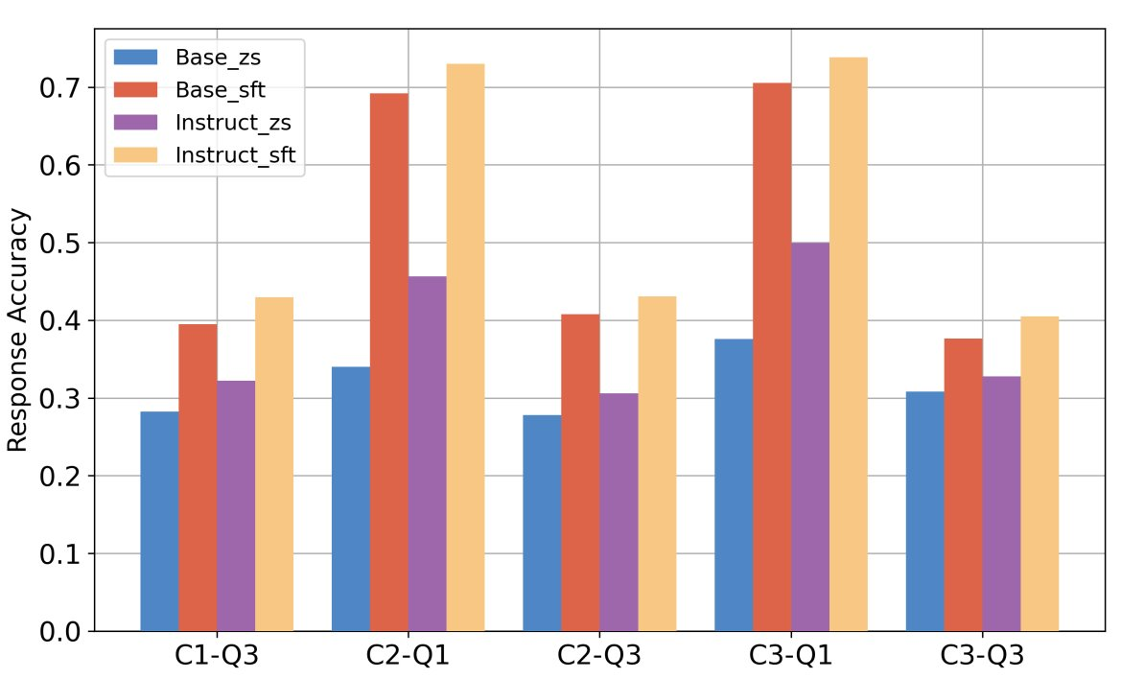
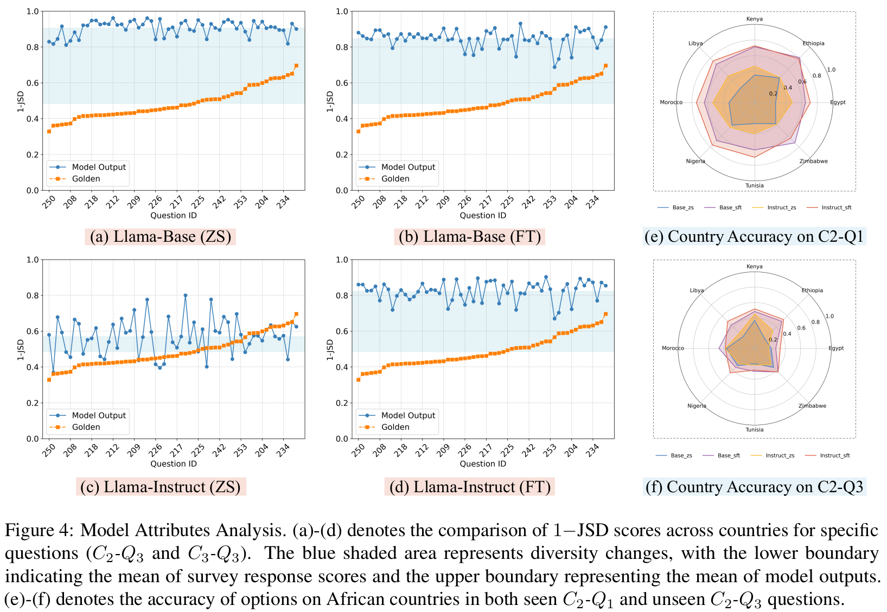
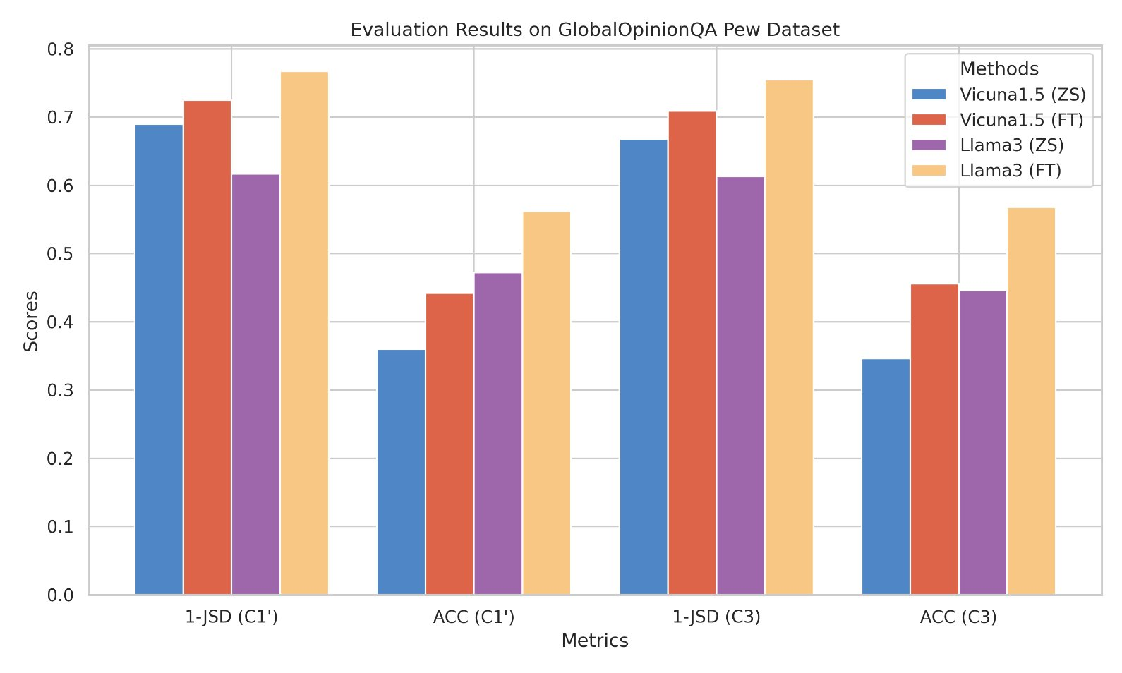
Better Simulation while LLMs are Still Weak
Notes:
Left above: Option prediction accuracy for cultural questions using the Llama3 model. The final option is simulated by selecting option with the highest probabilities. We can see improvement of accuracy across all models and test subsets, highlighting the effectiveness of the fine-tuning process.
Left below: The results in both 1−JSD scores and accuracy on Pew dataset. The consistent improvements prove its capability to generalize well to unseen surveys.
Right: (diversity changes) we calculate 1−JSD for Llama3_Base and Llama3_Instruct (ZS and FT) output across countries for each question.A lower 1−JSD score suggests greater diversity in responses between countries. The blue shaded area represents diversity changes. (1) Base model show limited sensitivity to national variations. (2) Instruct model results show this diversity diminishes following distribution simulation fine-tuning. (3) no consistent correlation between the diversity of generated responses and the accuracy of simulated distributions. Right: (dimension radar) We visualize the option accuracy of African countries. (1) For seen questions, we observe that all models show a relatively high performance across most countries. (2) For unseen questions, the performance decreases greatly, particularly in countries like Egypt and Tunisia. (3) The Instruct models maintain a higher level of accuracy relative to the Base models.

Slide 29
Can LLMs facilitate intercultural communication? The case of food

Slide 30
Adapting linguistic content
“cultural translation”

Slide 31
Food, language and identity
Food is a communicative medium
Food is a carrier of meaning
Food is tightly linked to identity
Notes:
When we talk about food we talk about our embodied existence in the world.
Food addresses historical, cultural, social, bodily, spiritual, and environmental issues.
Sense of community and feelings of national, regional, ethnic, religious etc. belonging.

Slide 32
Recipe adaptation
Dietary restrictions, e.g., vegan
Cross-cultural differences
凉拌秋葵
用料
秋葵 20根左右
生抽 2-3勺
醋 1勺
蚝油 1勺
做法
将秋葵洗净放开水中焯2分钟左右。
开水中放盐一勺，油一勺，这样秋葵颜色翠绿鲜艳）...
香油 1勺
糖 1勺
蒜 3-5瓣
盐 酌量
绿芥末膏不用也行 酌量
Chinese Okra Salad
Ingredients
8 oz (225 g) okra
2 teaspoons light soy sauce (or soy sauce)
1/2 teaspoons green Sichuan pepper oil (or more to taste)
Instructions
Bring a medium pot of water to a boil. Add 1 teaspoon vegetable oil and a pinch of salt...
Can we automate this process?

Slide 33
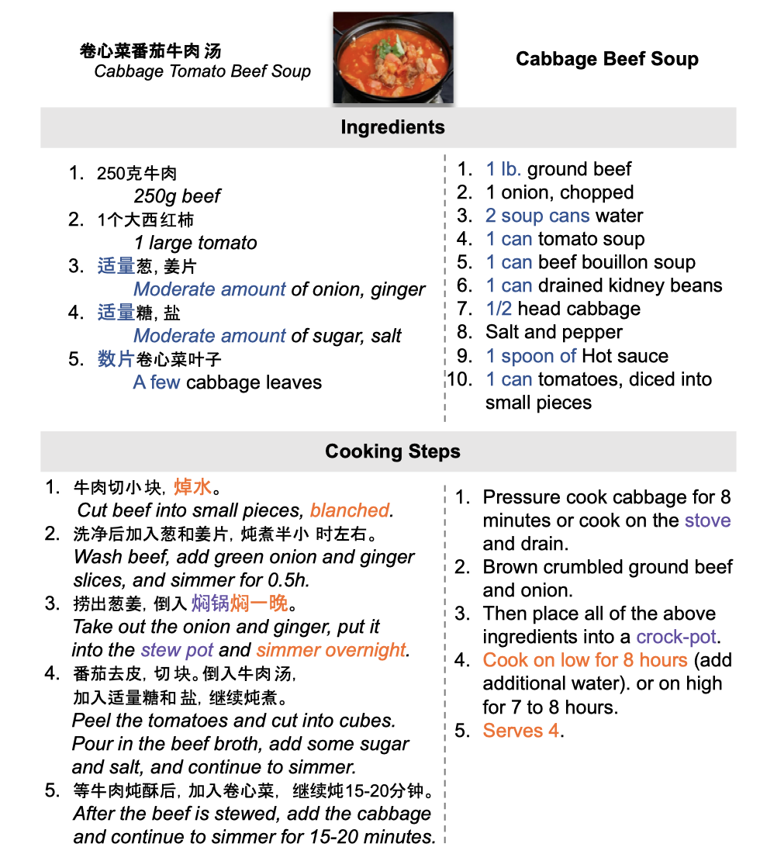
Recipe differences across cultures
Ingredient availability and preference
Measurement units, writing style
Available equipment and tools
Known techniques, typical ordering
Desired flavours
Desired texture

Slide 34
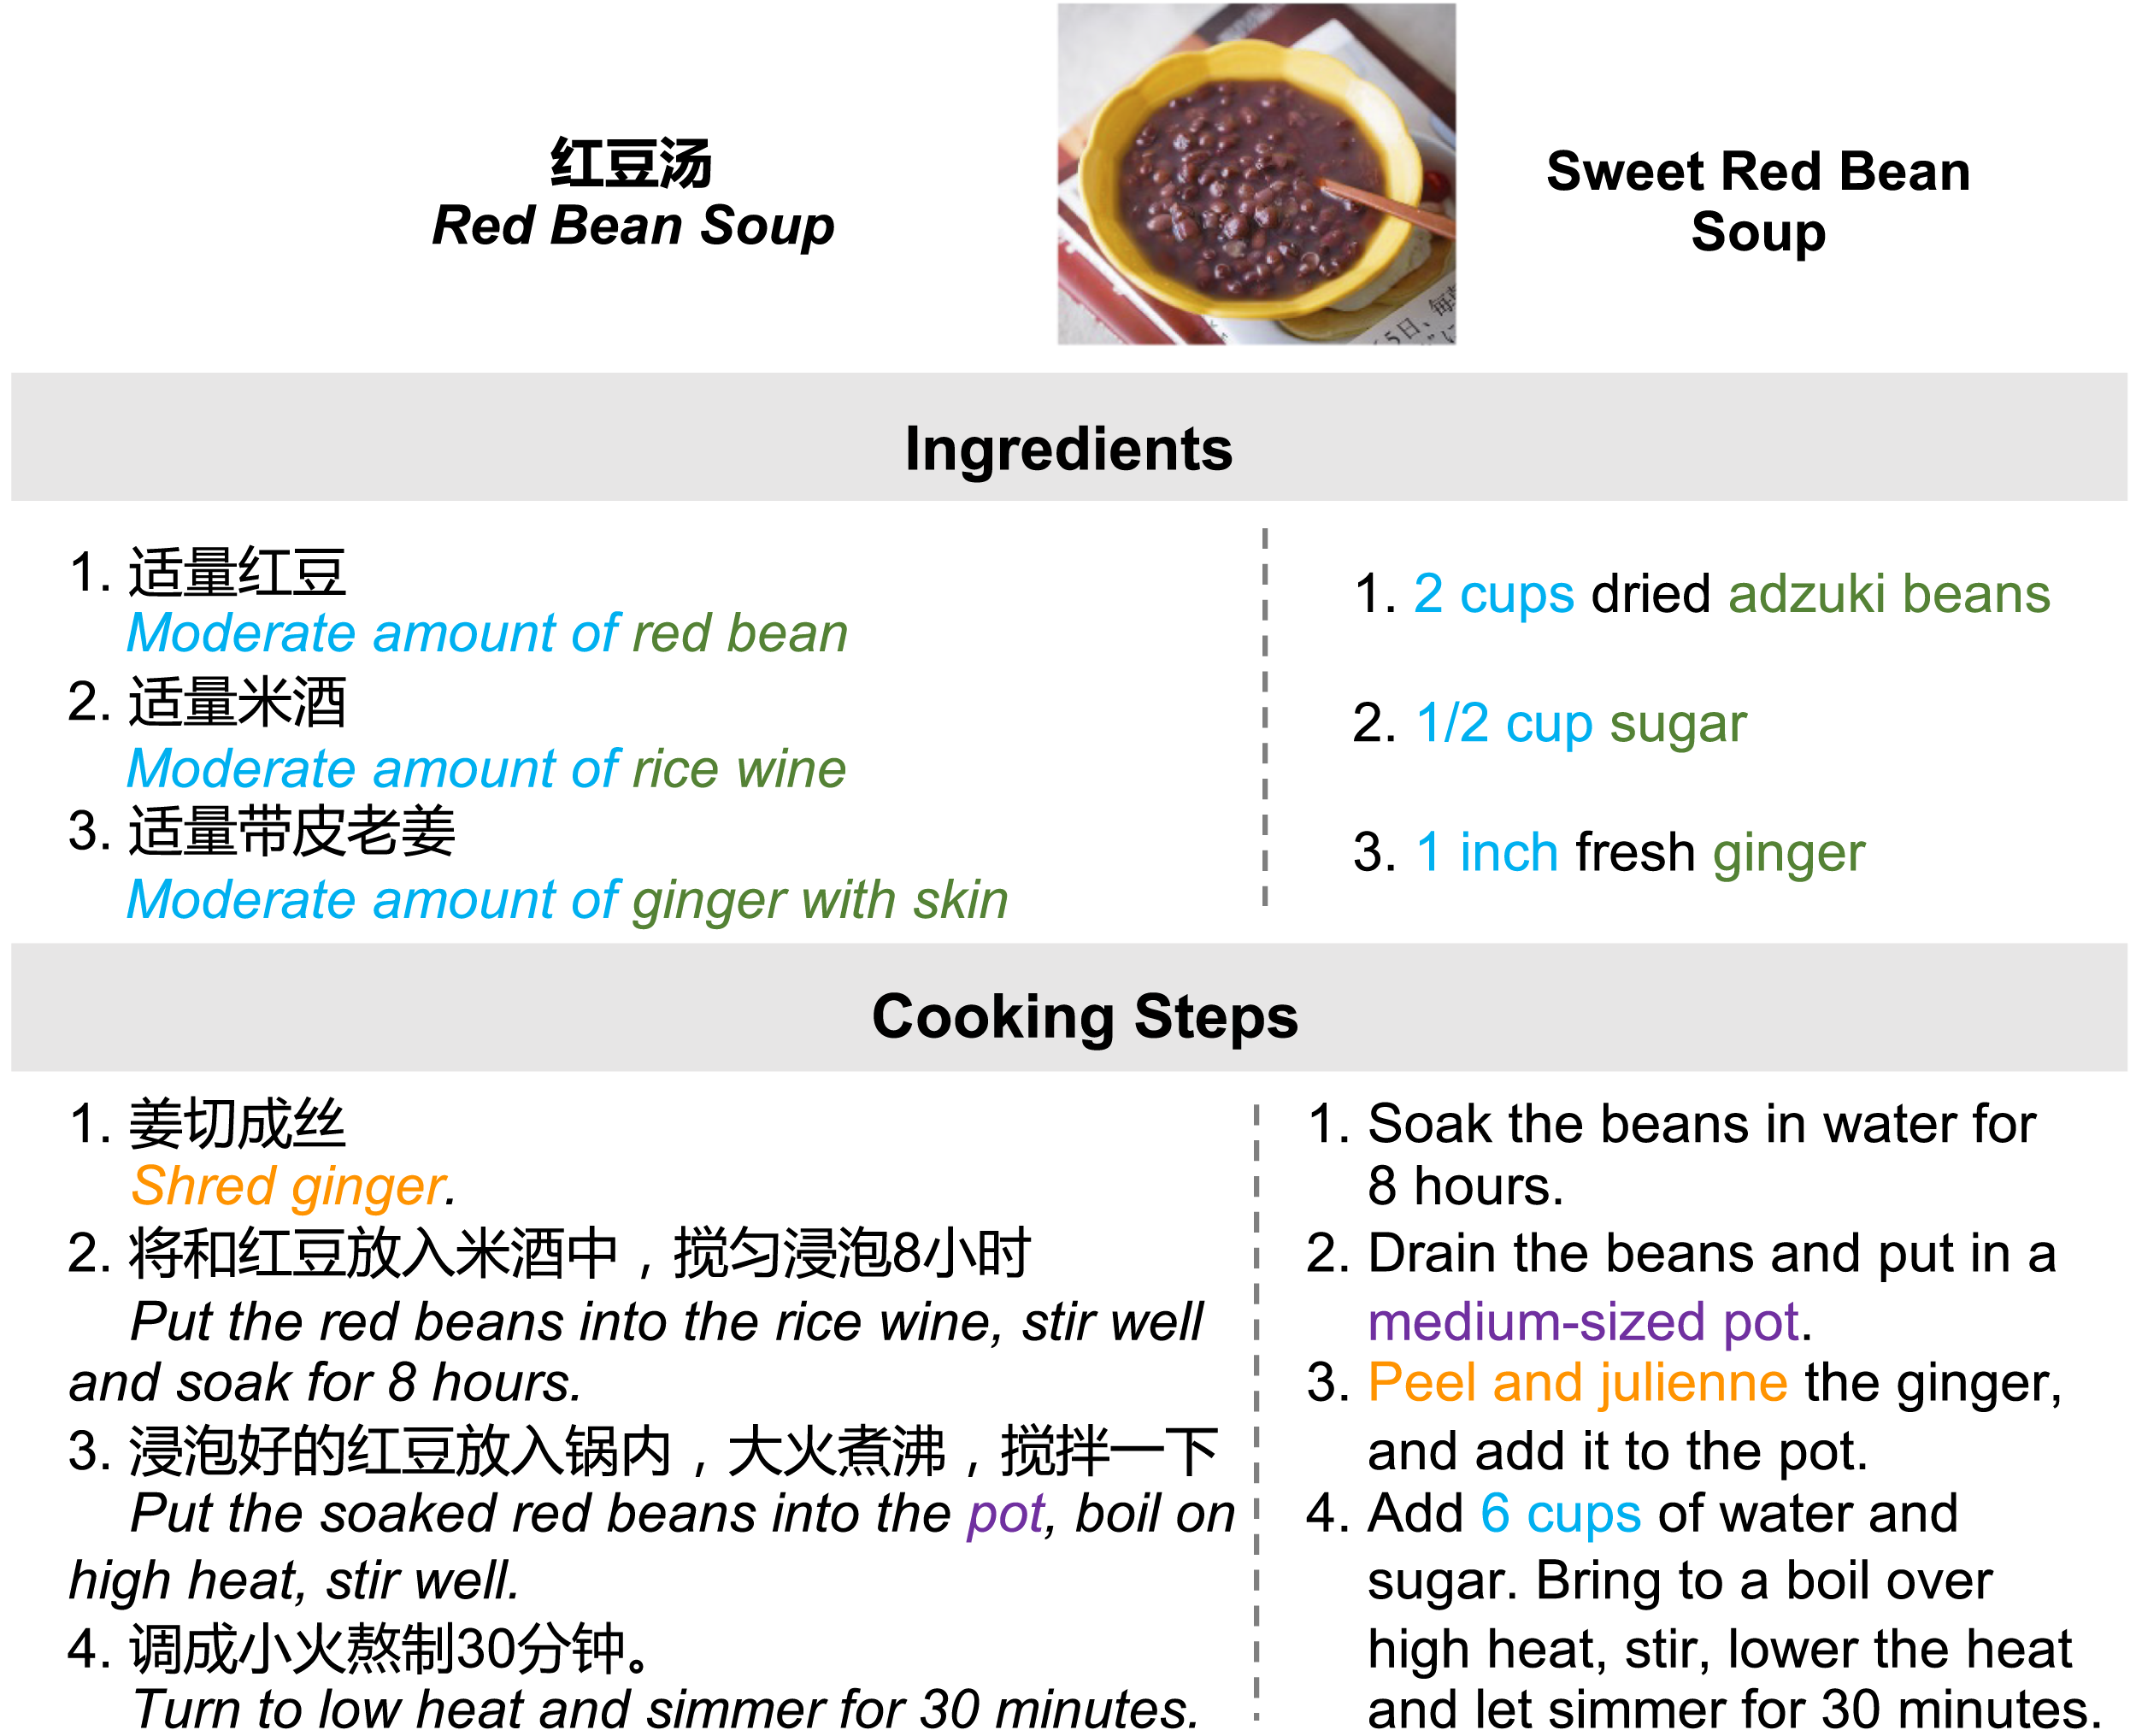
Adapting cooking recipes
Yong Cao, Yova Kementchedjhieva, Ruixiang Cui, Antonia Karamolegkou, Li Zhou, Megan Dare, Lucia Donatelli, and Daniel Hershcovich. 2024. Cultural Adaptation of Recipes. Transactions of the Association for Computational Linguistics

Slide 35
Do LLMs have cultural awareness? Assessing food knowledge

Slide 36
Asking about ingredients
What are the ingredients in the dish Beef Bourguignon?
Beef Bourguignon
Literal translation
Cultural-adaptive translation
Cultural background reference
Li Zhou, Taelin Karidi, Wanlong Liu, Nicolas Garneau, Yong Cao, Wenyu Chen, Haizhou Li, and Daniel Hershcovich. Does Mapo Tofu Contain Coffee? Probing LLMs for Food-related Cultural Knowledge. Under submission
Notes:
This variability underscores the challenges language models encounter in navigating cross-cultural culinary contexts and highlights the difficulty of responding with cultural knowledge, which involves using specific language, engaging in code-switching, and integrating cultural context.

Slide 37
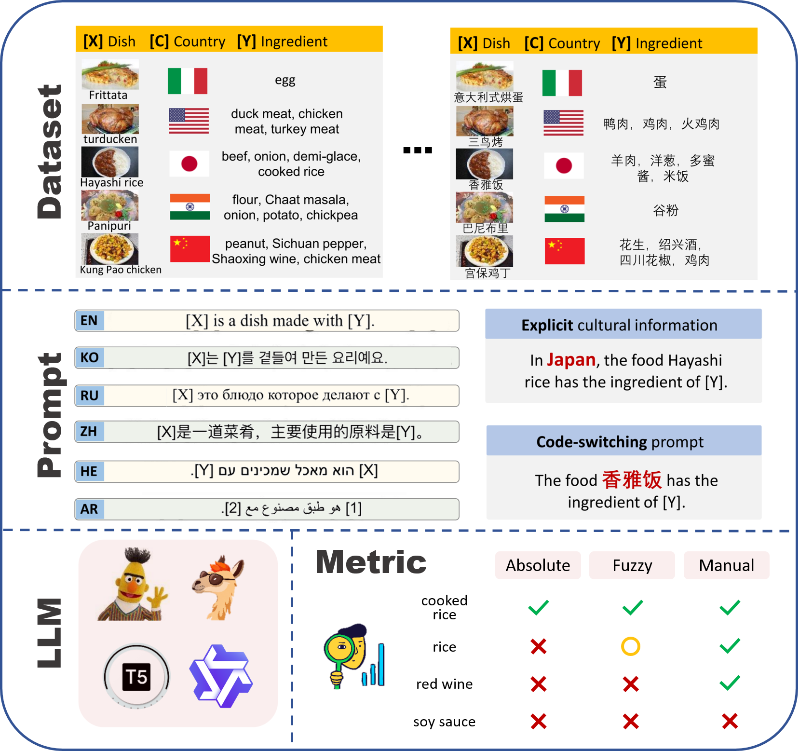
Research questions
RQ1: What cultural biases exist within the cultural knowledge contained in LLMs?
RQ2: How can we best prompt and evaluate LLMs to elicit culture-specific knowledge?

Slide 38
Results
Notes:
The cultural groups (U.S., India) where LLM probing performed well are typically those where the native language is English.
Decoder-only LLMs exhibit less cultural bias compared to other model types.
In more advanced LLMs, cultural competency isn’t directly tied to the training sample size of specific cultural groups.

Slide 39
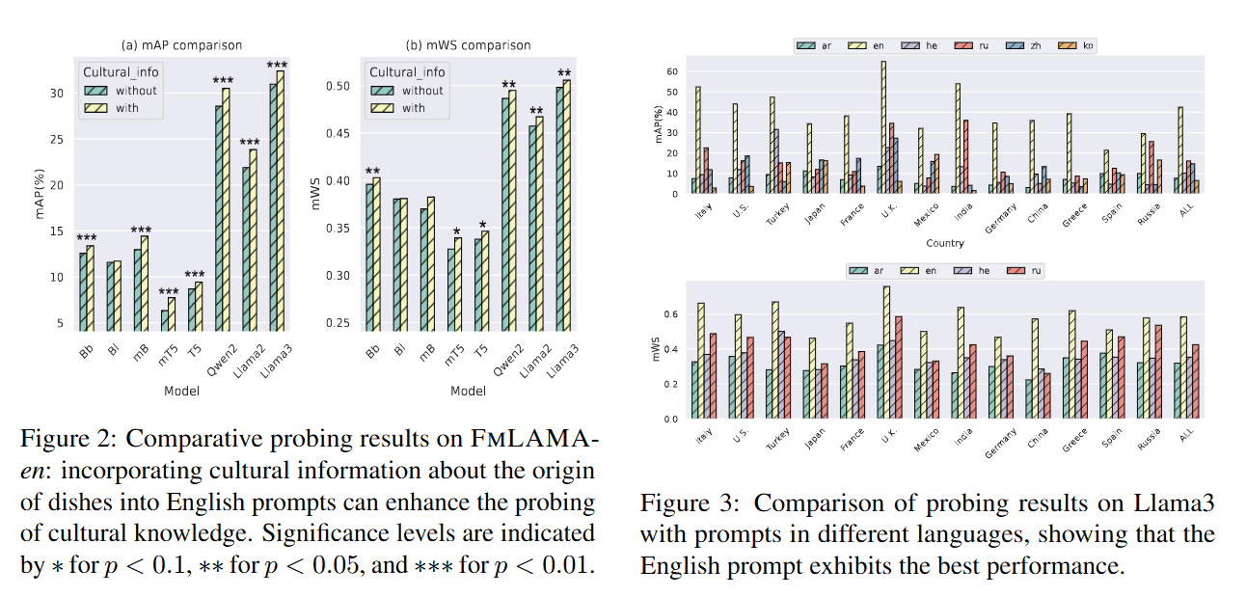
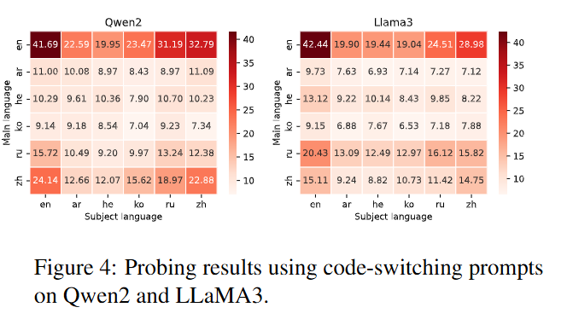
Prompt sensitivity
Cultural background analysis
Multilingual prompt analysis
Code-switching analysis
Notes:
English prompts with cultural information achieve higher probing scores in capturing LLMs’ knowledge within the food domain.
The English prompt performs significantly better than prompts in other languages across all cultural groups, probably due to more training data.
When English is the main language and the dish subject is presented in another language, probing performance significantly declines but still outperforms probing conducted solely in other languages.

Slide 40
Does AI influence humans? Long-term alignment

Slide 41
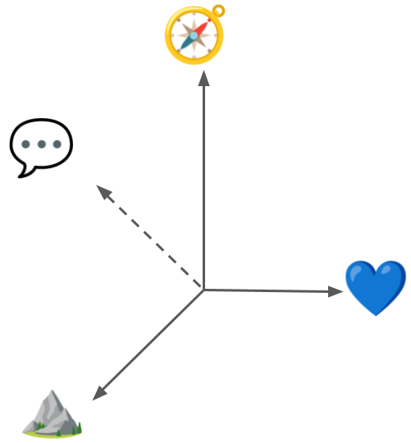
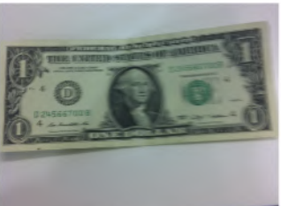
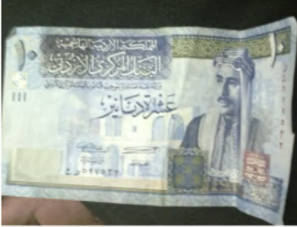
Risks: Influencing Humans
Restricting communicative style
Influencing decision making
Antonia Karamolegkou, Phillip Rust, Ruixiang Cui, Yong Cao, Anders Søgaard, and Daniel Hershcovich. 2024. Vision-Language Models under Cultural and Inclusive Considerations. In Proceedings of the 1st Human-Centered Large Language Modeling Workshop
Perpetuating bias and stereotypes
Creating partial/false impressions
Notes:
Jordan 10 dinars, King Talal Ibn Abdullah

Slide 42
Solution: Alignment?
Towards Bidirectional Human-AI Alignment: A Systematic Review for Clarifications, Framework, and Future Directions (Shen et al., 2024), adapted from Gabriel (2020)
Direct Preference Optimization: Your Language Model is Secretly a Reward Model (Rafailov et al., NeurIPS 2023)

Slide 43
But AI Alignment Discourse is Machine-Centered
“our AI systems must do what we want them to do” (Russel et al., 2015)
“prevent [autonomous systems] from causing unintended harm” (Amodei et al., 2016)
“imbuing artificial agents with moral values becomes increasingly important as computer systems operate with greater autonomy” (Gabriel, 2020)
“we need systems that can understand and cater to a broader set of needs” (Sorensen et al., 2024)
“aligning AI to humans ensures AI produces the intended outcomes determined by humans, […] aligning humans to AI aims to help individuals and society adjust to AI advancements” (Shen et al., 2024)
Notes:
“increase helpfulness and truthfulness while mitigating the harms and biases” (OpenAI, 2022)
“to steer and control AI systems much smarter than us” (OpenAI, 2023)

Slide 44
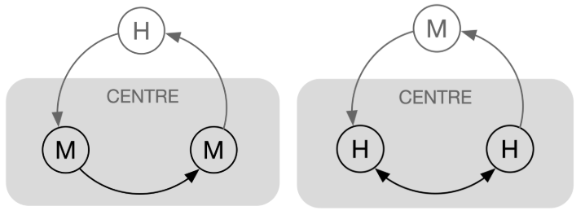
Reframing the Alignment Objective to be Human-Centered
Align Humans ↦ AI or Align Humans + AI ↦ a (social) goal?
preferences
augmentation
automation
feedback
optimization
relationship & communication
Adapted from Centering the Speech Community (Bird & Yibarbuk, EACL 2024)

Slide 45
Society-Centered Alignment: Roadmap
Modelling and simulating opinions and social change
Determining the objective of human + AI behavior
Direct optimizing for it in model pre-training + fine-tuning

Slide 46
Conclusion
LLMs can help us understand each other across cultures
For that, they need cultural understanding & knowledge
Using LLMs, we can shape the culture of the future
danielhers.github.io
dh@di.ku.dk

Slide 47
What is culture?
shared beliefs, values, practices, behaviors, and artifacts
a system of symbols
characterizes a social group
learned, not innate
integrated with daily experience
taken-for-granted notions, rules, moralities, and behaviors
dynamic process through which social meanings are constructed
Cultural anthropology: Asking questions about humanity (Welsch and Vivanco, 2015)

Slide 48
Granularities of variation
Linguistic variation
Idiolect
Sociolect
Dialect
Standardized language
Language groups and families
Cultural variation
Individual, personality
Social group
Geographical region
Country, national culture
Global cultural community
Notes:
Culture is multifaceted and complex
There is enormous diversity among speakers of the same language
The information monoculture

Slide 49
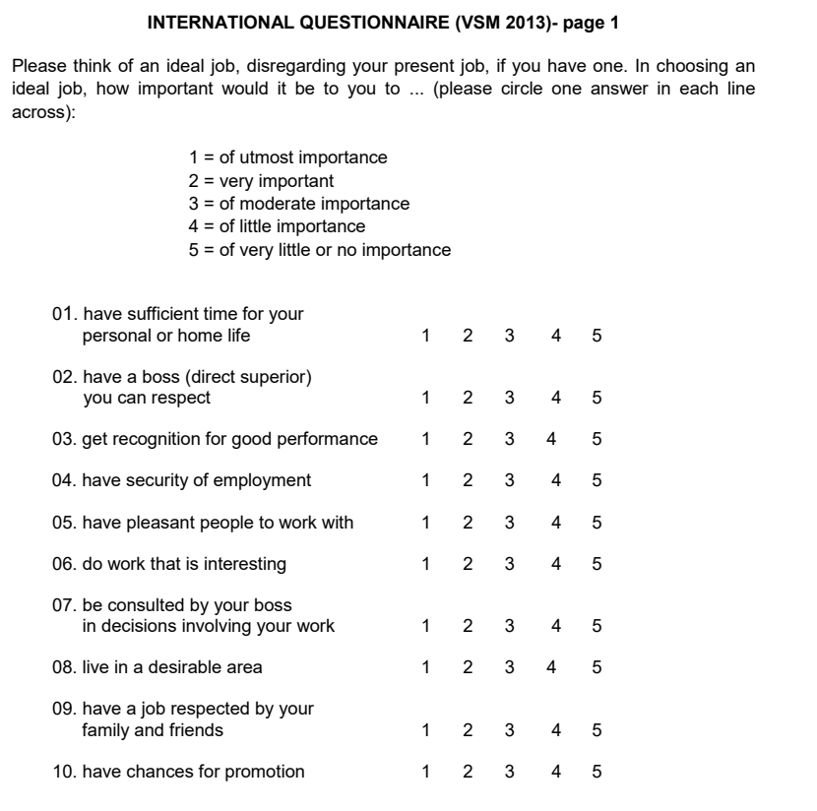
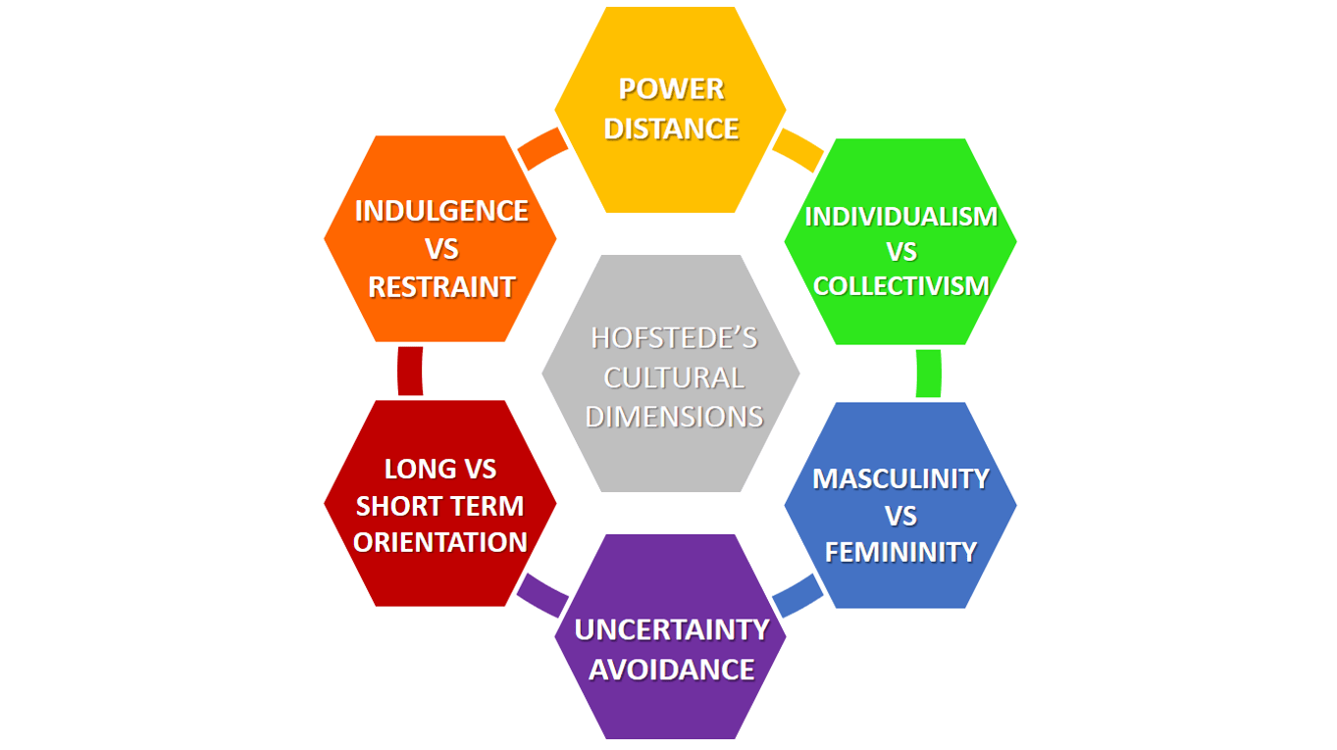
Hofstede Cultural Survey
Common cross-cultural analysis tool
Consists of 24 questions
Official translations to 20+ languages
Data available from 112+ countries
https://geerthofstede.com/research-and-vsm/vsm-2013/

Slide 50
The 24 questions
Time for personal life
Respectable boss
Recognition for performance
Job security
Pleasant coworkers
Interesting work
Consultation by boss
Desirable living area
Job respected by family/friends
Promotion chances
Time for fun
Few desires (moderation)
Service to a friend
Thriftiness
Frequency of feeling nervous
Happiness level
External hindrances to desires
Current health state
National pride
Subordinates' fear to contradict boss
Managerial precision
Value of persistent efforts
Dual-boss structure
Rule-breaking in company's interest
https://geerthofstede.com/research-and-vsm/vsm-2013/

Slide 51
The six dimensions
Dimension | Definition | Formula
Power Distance | Measures how less powerful members expect and accept unequal power distribution. | PDI = 35(m07 - m02) + 25(m20 - m23) + C(pd)
Individualism | Assesses the degree of individualism vs. collectivism in a society. | IDV = 35(m04 - m01) + 35(m09 - m06) + C(ic)
Masculinity | Measures societal preference for assertiveness and material success vs. modesty and quality of life. | MAS = 35(m05 - m03) + 35(m08 - m10) + C(mf)
Uncertainty Avoidance | Indicates how comfortable a society is with uncertainty and ambiguity. | UAI = 40(m18 - m15) + 25(m21 - m24) + C(ua)
Long Term Orientation | Evaluates focus on future rewards vs. past and present orientation. | LTO = 40(m13 - m14) + 25(m19 - m22) + C(ls)
Indulgence vs. Restraint | Measures extent of free gratification of desires vs. control. | IVR = 35(m12 - m11) + 40(m17 - m16) + C(ir)
https://geerthofstede.com/research-and-vsm/vsm-2013/

Slide 52
The data
https://geerthofstede.com/research-and-vsm/vsm-2013/

Slide 53
Contextualizing by country name
Notes:
Cannot assume identity
Low correlations overall
Highest correlation with USA
Better correlation when prompting in the corresponding language

Slide 54
Prompt templates
Country | Prompt 1 | Prompt 2 | Prompt 3
US | For an average American, [Question #] is [Options]. |  | In the American cultural setting, [Question #] is [Options].
China | For an average Chinese, [Question #] is [Options]. | 对普通中国人来说，[问题 #] 是 [选项]。 | In the Chinese cultural setting, [Question #] is [Options].
Germany | For an average German, [Question #] is [Options]. | [Frage] ist [Option] für den durchschnittlichen Deutschen. | In the German cultural setting, [Question #] is [Options].
Japan | For an average Japanese, [Question #] is [Options]. | 平均的な日本人の合、【 #】は【肢】です。 | In the Japanese cultural setting, [Question #] is [Options].
Spain | For an average Spanish, [Question #] is [Options]. | Para el español promedio, [Pregunta #] es [Opciones]. | In the Spanish cultural setting, [Question #] is [Options].

Slide 55
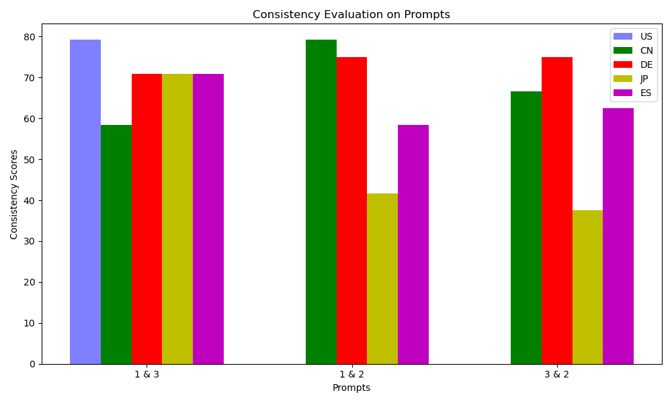
Major limitation: consistency
Reponses depend on phrasing, language, format and context
Prompts 1 & 3: English
Prompt 2: Country’s language
Notes:
Cannot assume identity
Low correlations overall
Highest correlation with USA
Better correlation when prompting in the corresponding language

Slide 56
Estimation of cultural dimensions
Notes:
Cannot assume identity
Low correlations overall
Highest correlation with USA
Better correlation when prompting in the corresponding language

Slide 57
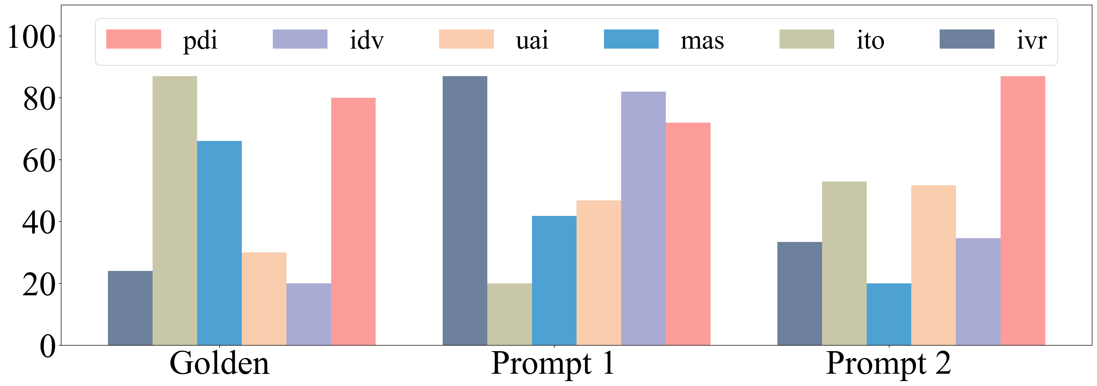
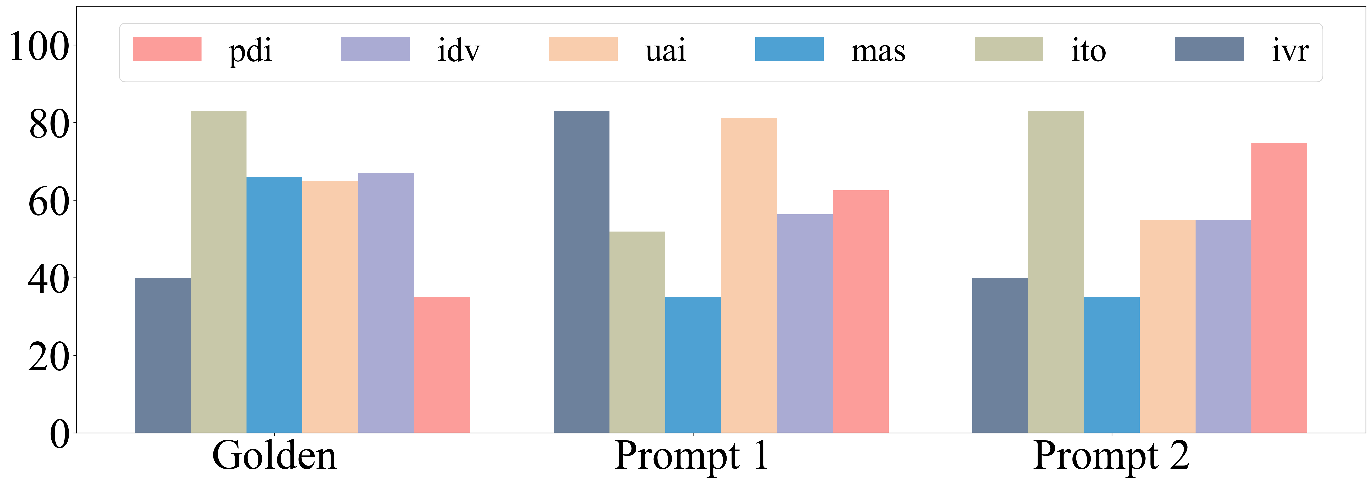
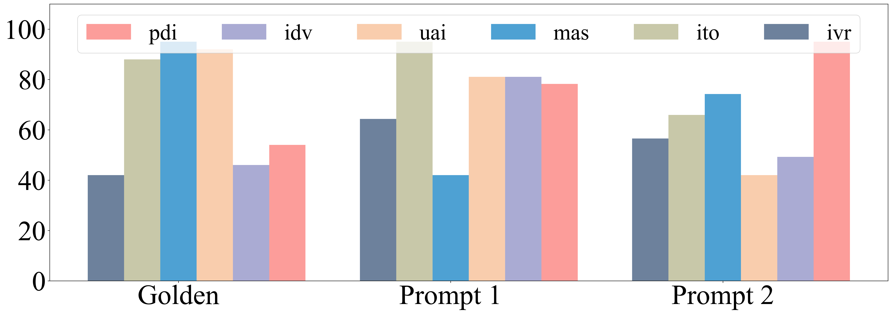
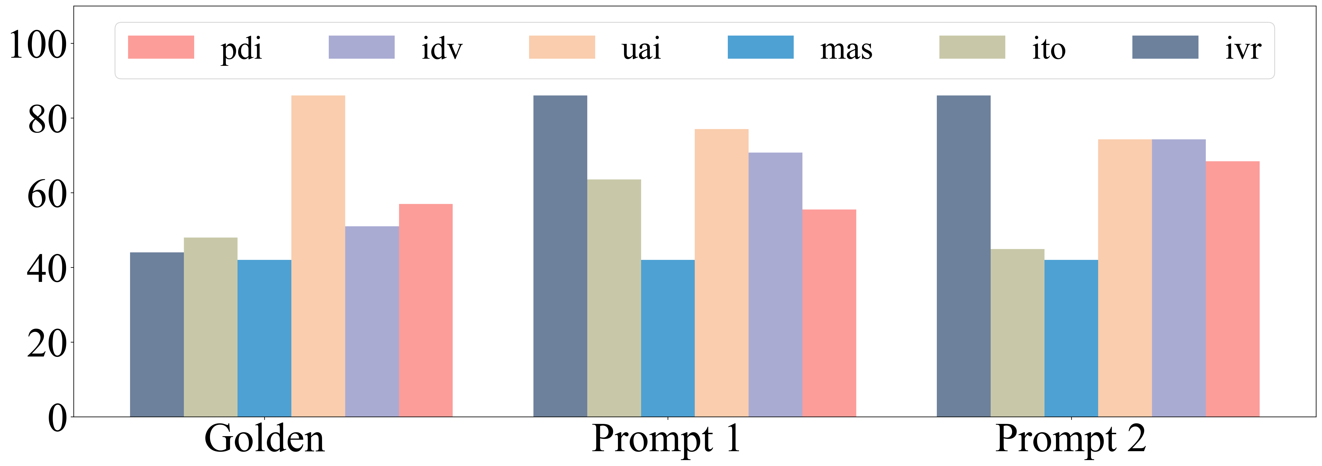
Comparison to human survey responses
Notes:
Cannot assume identity
Low correlations overall
Highest correlation with USA
Better correlation when prompting in the corresponding language

Slide 58
US bias
Notes:
Cannot assume identity
Low correlations overall
Highest correlation with USA
Better correlation when prompting in the corresponding language

Slide 59
Effect of prompting language
Notes:
Cannot assume identity
Low correlations overall
Highest correlation with USA
Better correlation when prompting in the corresponding language

Slide 60
Assessment by surveys: remaining open questions
Effect of design choices
Pre-training
RLHF
Prompting variations
Multiple choice paraphrases
Free-form responses
More cultures
More countries
Population sub-groups
More languages
Real-world impact
More surveys
European Value Survey
Moral Foundations Questionnaire
Relationship to behavior in actual applications (alignment)
National languages and dialects
Styles and registers
Assess data contamination

Slide 61
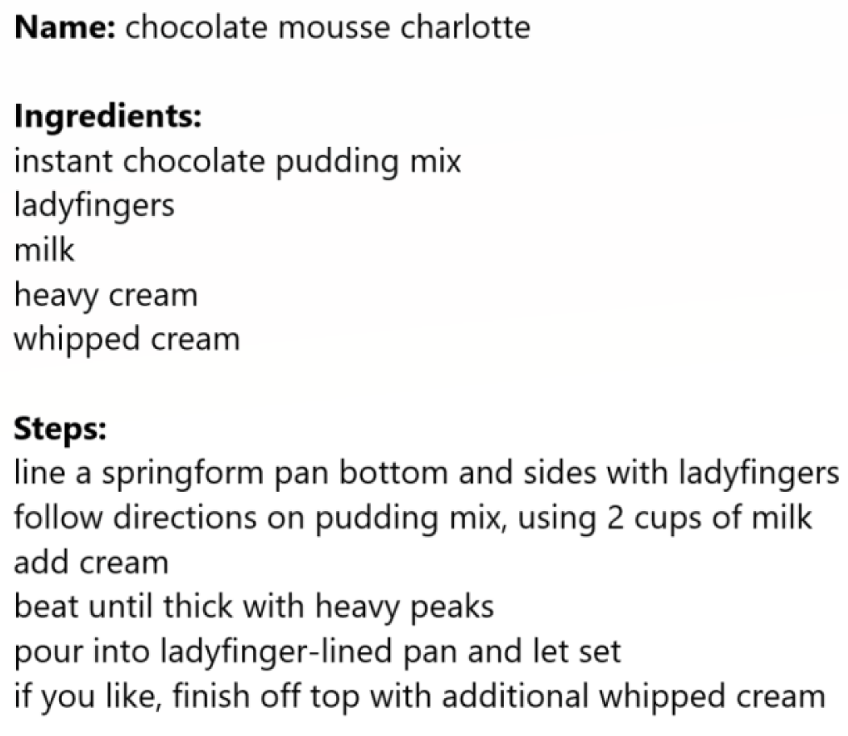
Recipes
A useful way to express food in language
Part of the creative process of food creation
Used by both professional and home cooks

Slide 62
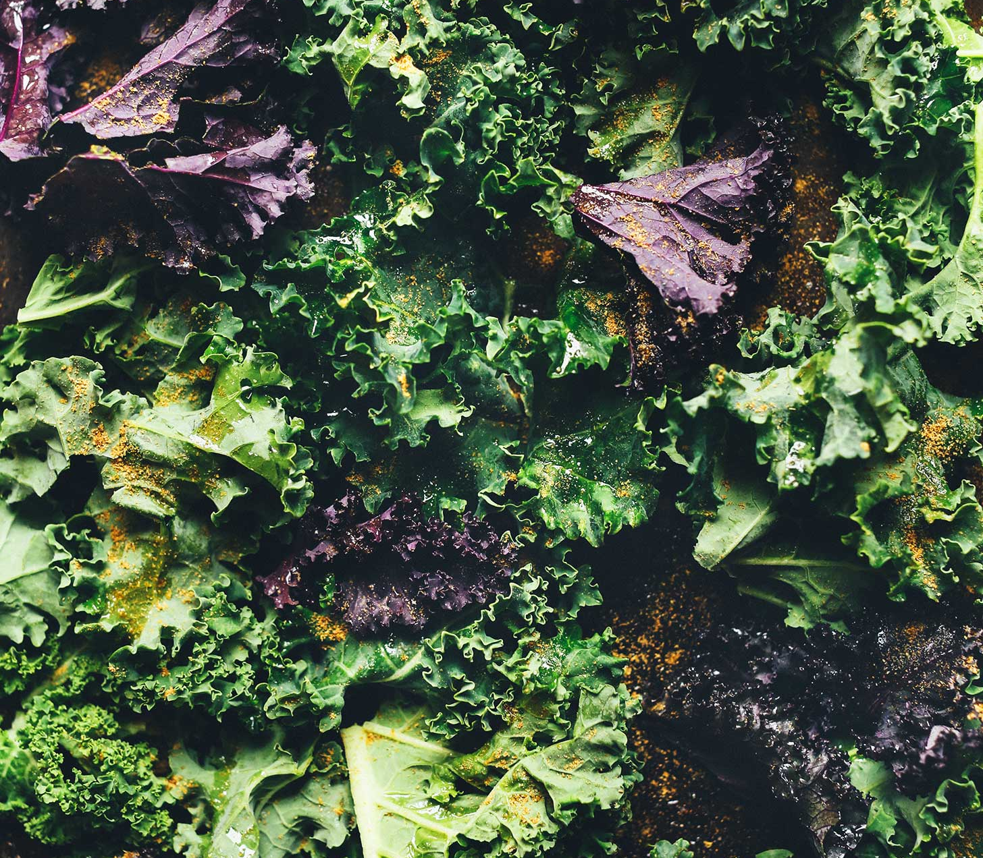
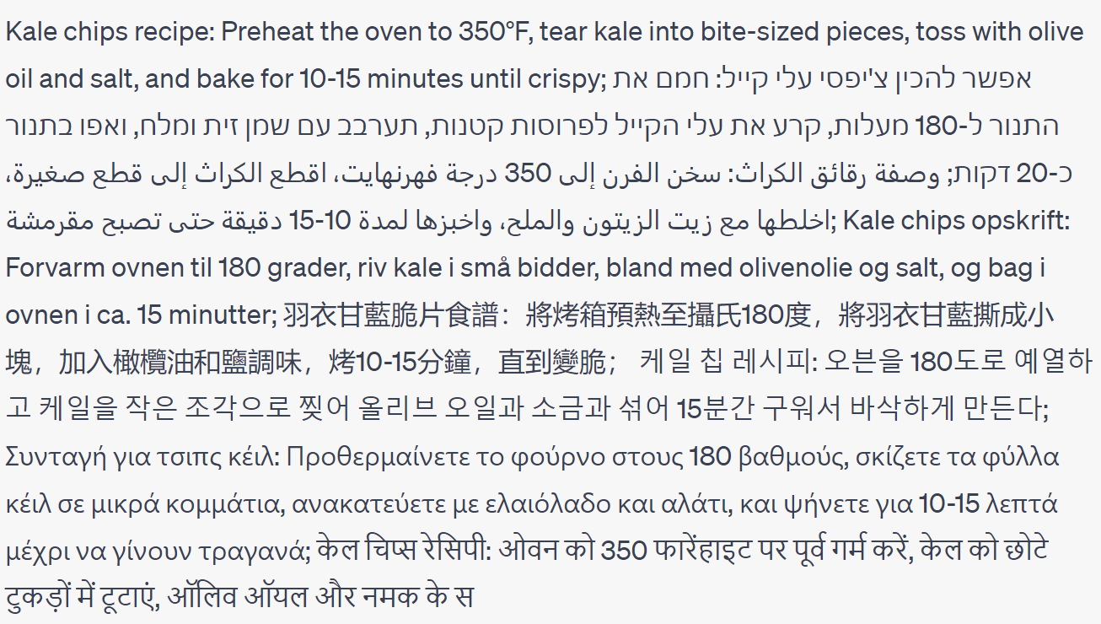
Linguistic form
Give me a one-sentence kale chips recipe in English, Hebrew, Arabic, Danish, Mandarin Chinese, Korean, Greek, Hindi, Bulgarian and Turkish. Do not say which languages they are.
Notes:
A popular web app to assist me in generating examples, not to showcase its AGI
Orthography, morphology, syntax, word choice, style

Slide 63
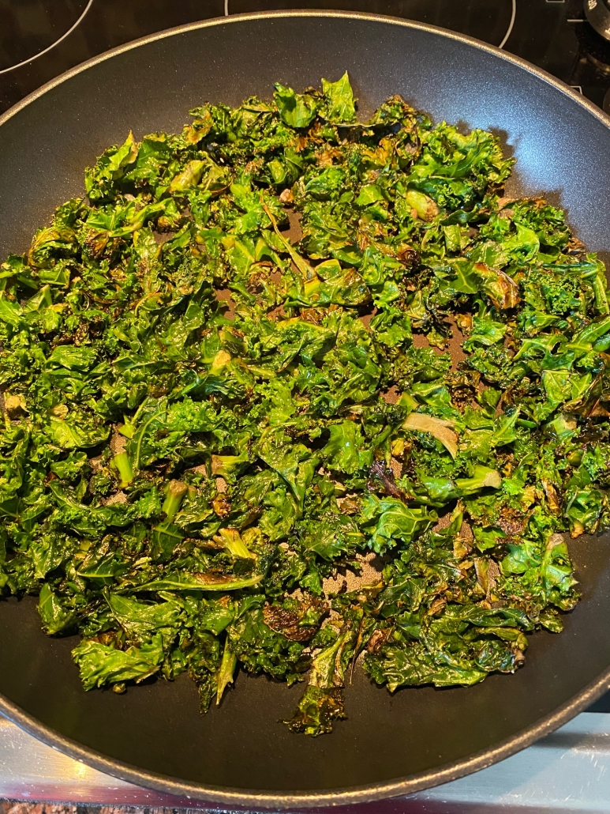
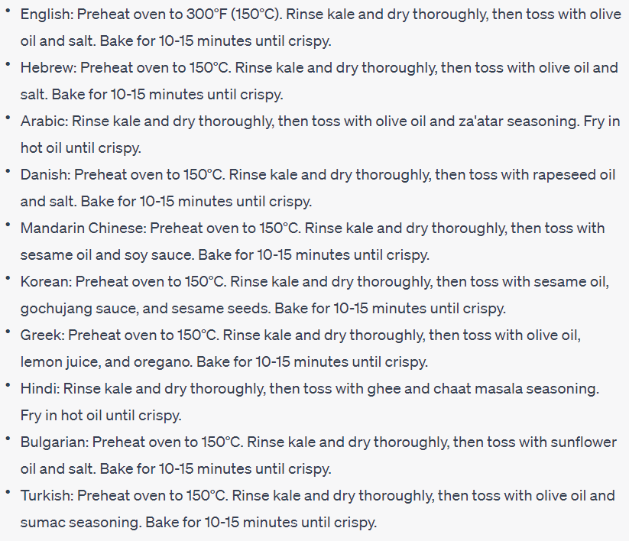
Common ground
Adapt the recipe to the common ingredients, cooking methods and tools in each culture's cuisine.
Notes:
Shared knowledge based on which people reason and communicate
Can also be about explaining methods in more detail if they are not commonly known

Slide 64
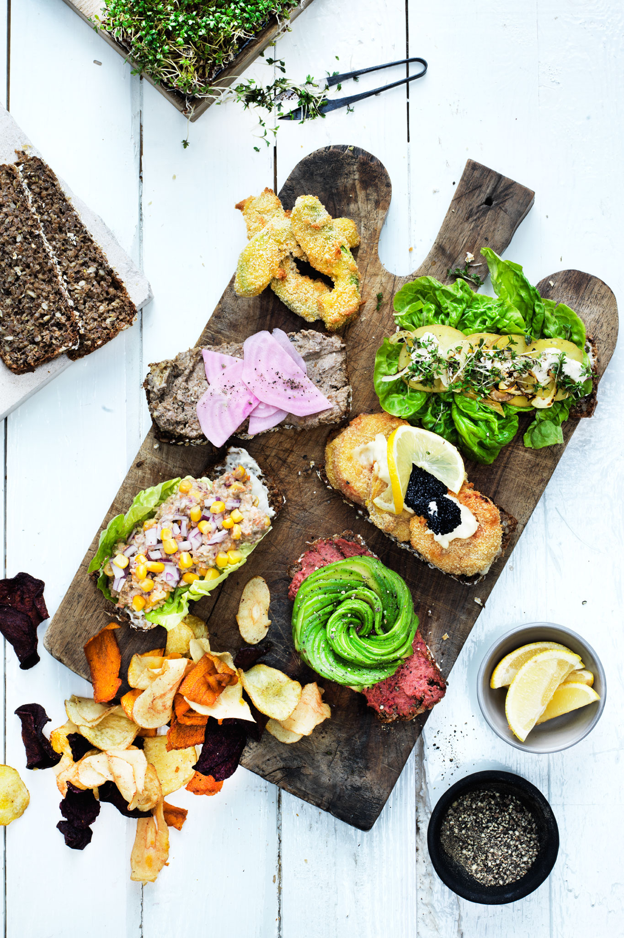
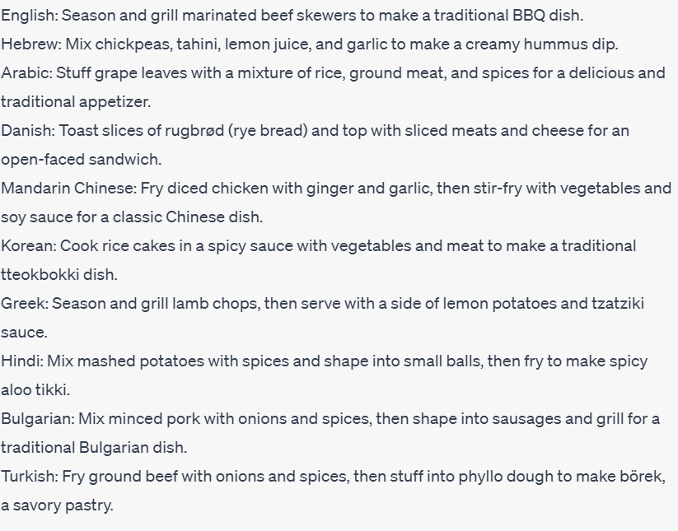
Aboutness
Give me one-sentence recipes for different culture-specific dishes in the following languages (without specifying the dish names): English, Hebrew, Arabic, Danish, Mandarin Chinese, Korean, Greek, Hindi, Bulgarian and Turkish
Notes:
What people care to talk about: topics, aspects, entities

Slide 65
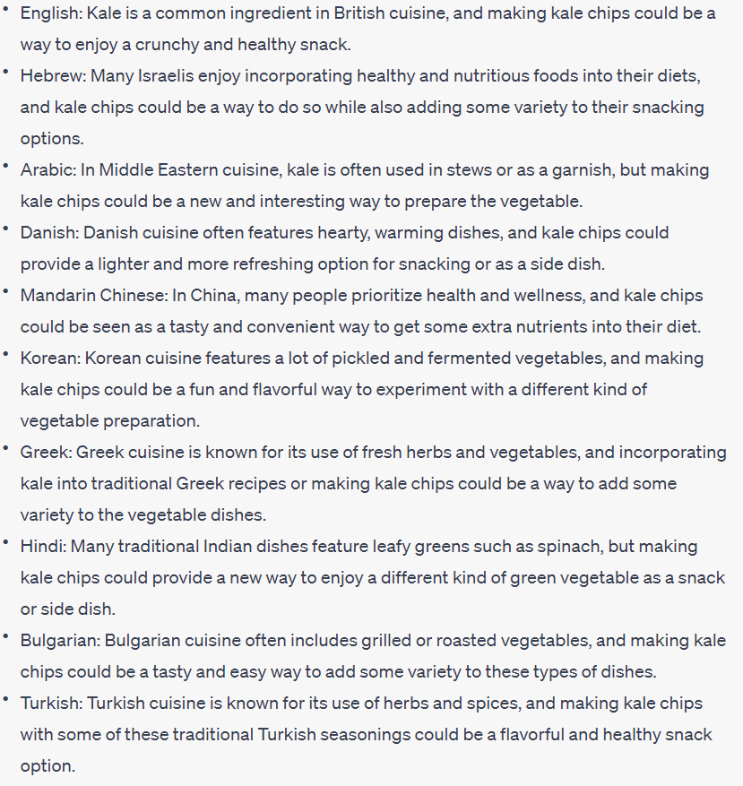
Objectives and values
For each of these cultures, give a specific reason for why they would even want to make kale chips
Reasons
Variety
Sustainability
Enjoyment
Health

Slide 66
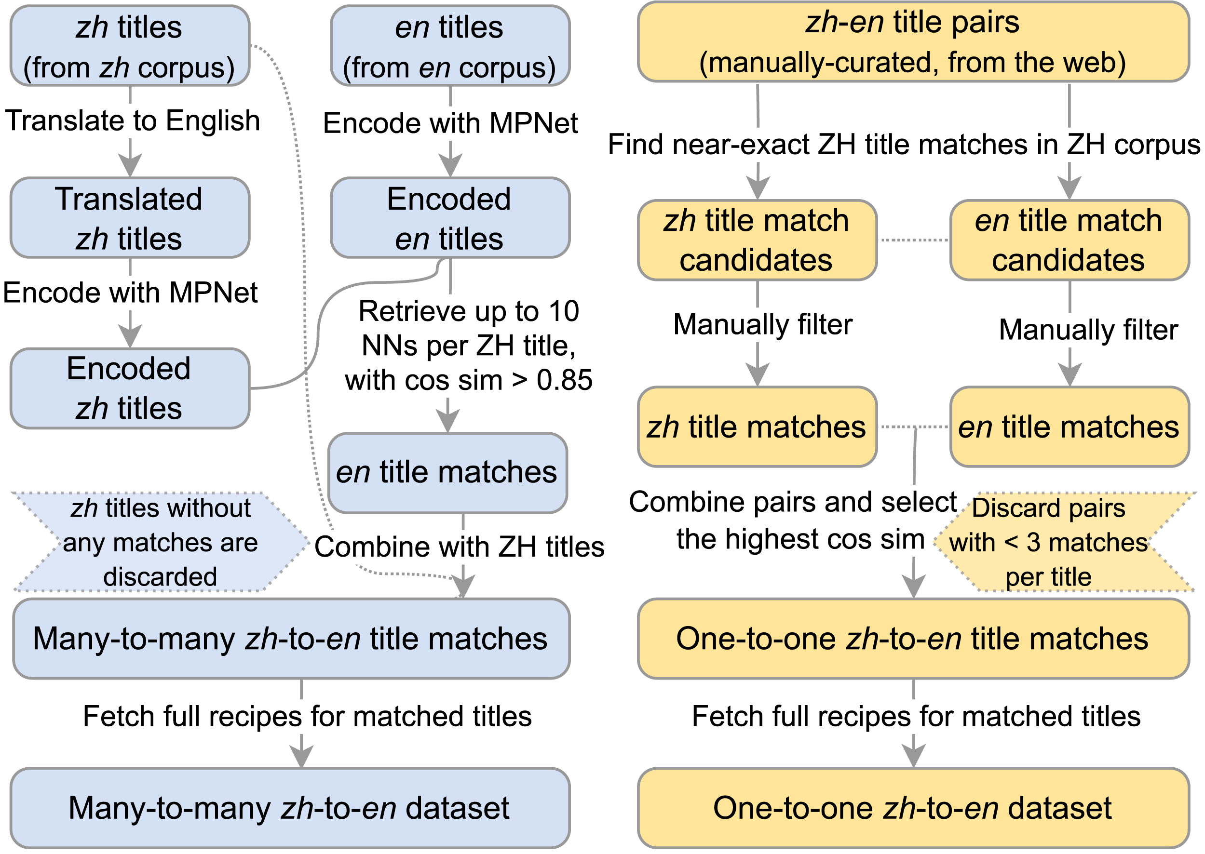
Data collection
2M English recipes from various websites (e.g., food.com)
1.5M Chinese recipes from xiachufang.com
Automatic pairing based on assumption:
If two recipes have a semantically equivalent title (possibly in another language), they describe the same dish.

Slide 67
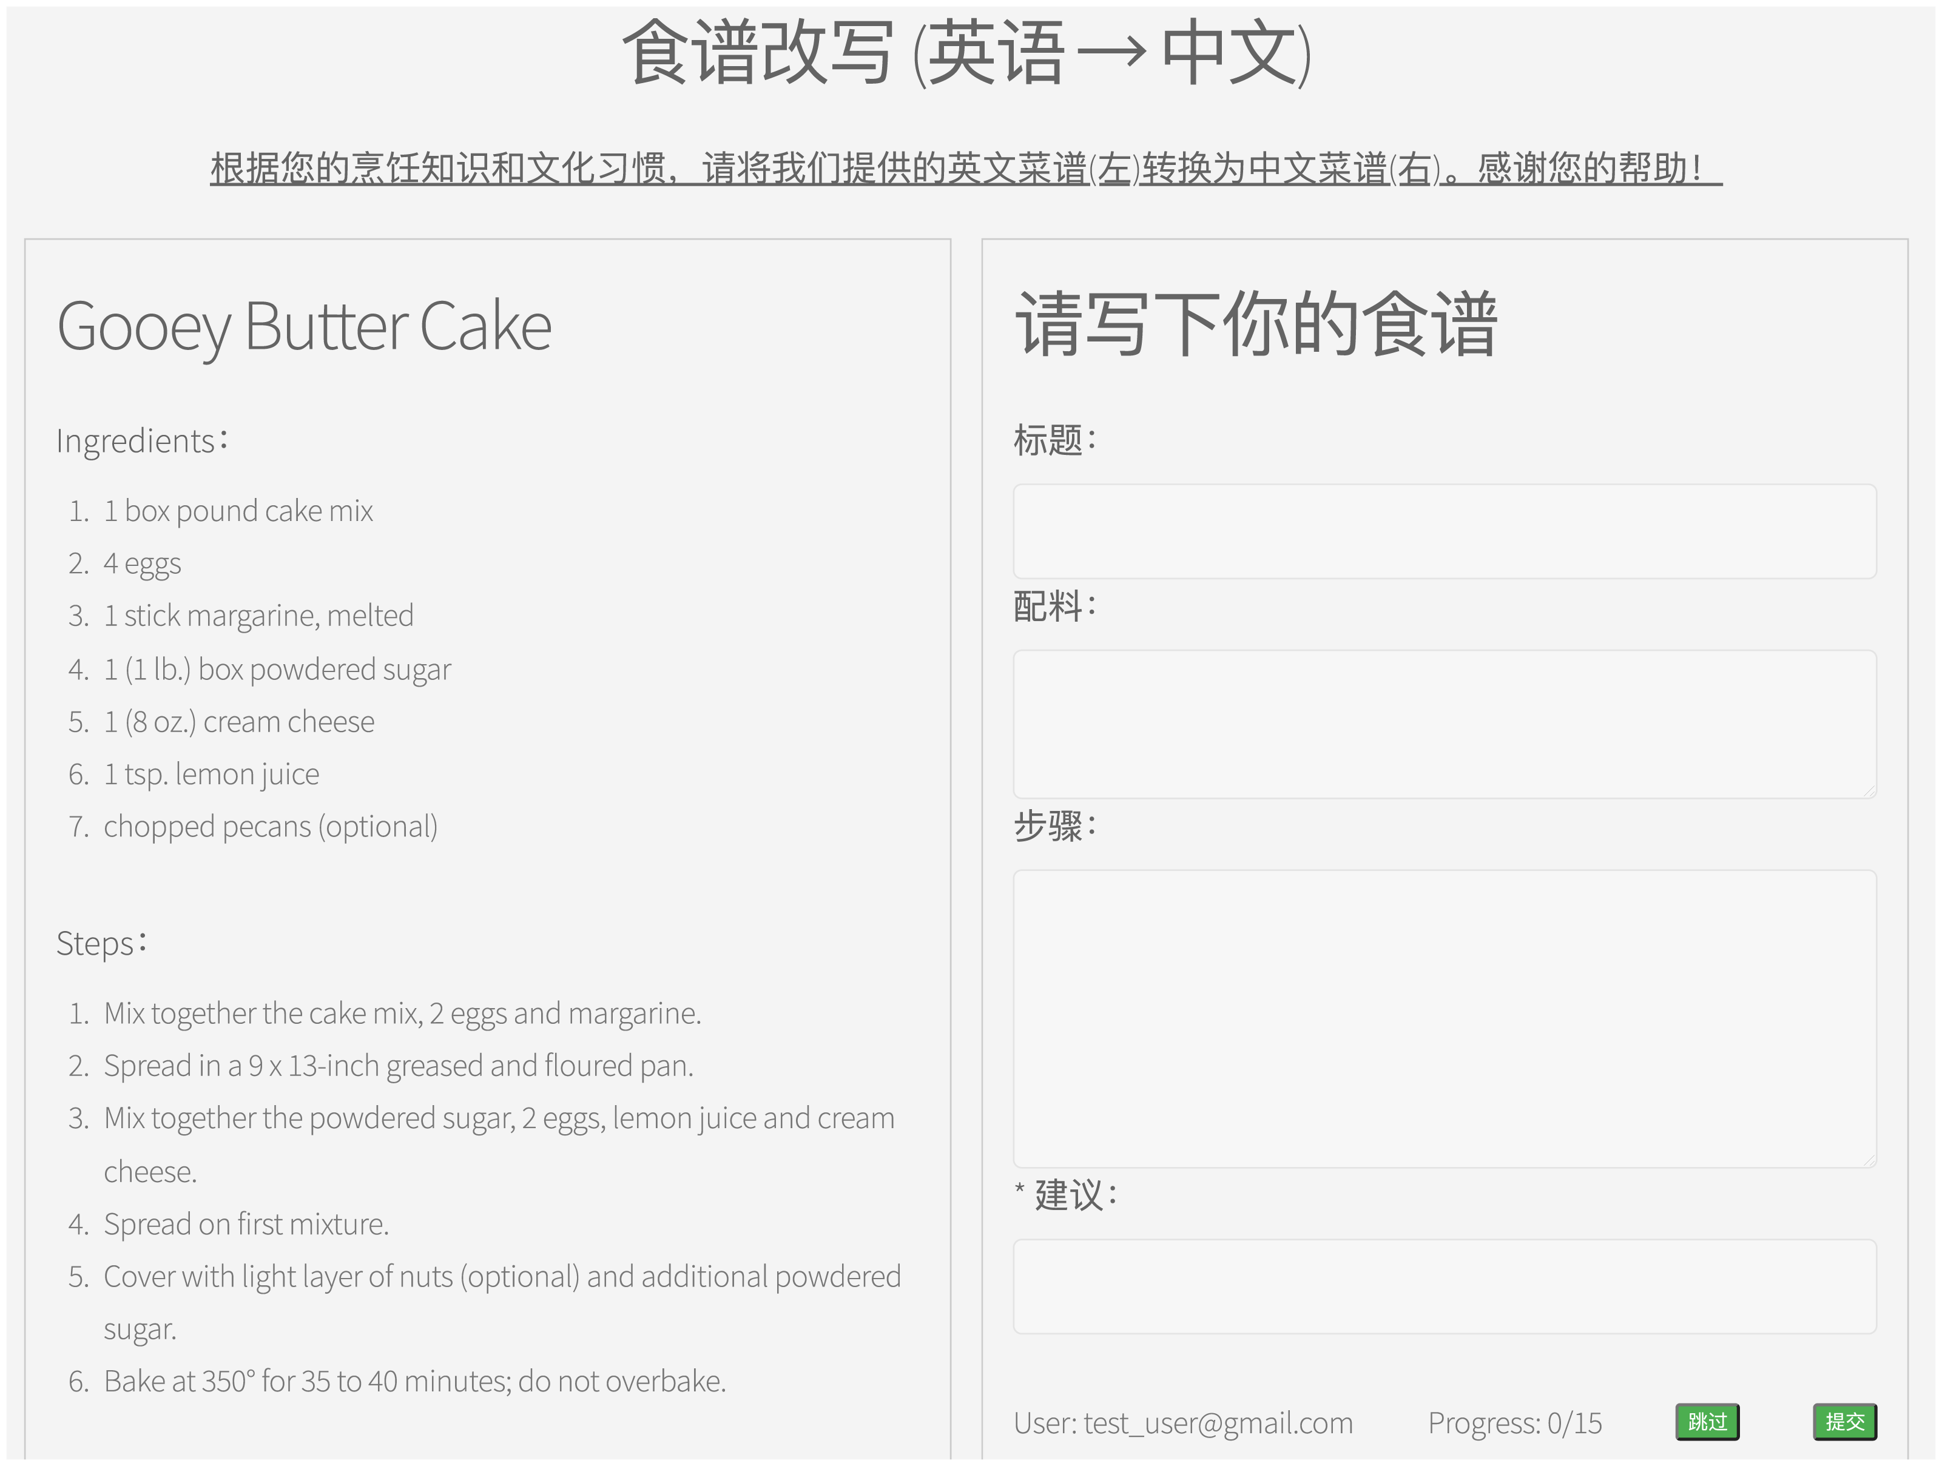
Data collection
Test set:​
Human adaptation of selected recipes
25 English recipes adapted to Chinese
41 Chinese recipes adapted to English
Participants: six bilingual foodies

Slide 68
Models and results
Method | GRAMMAR | CONSISTENCY | PRESERVATION | CULTURAL APPROPRIATENESS
Chinese → English (n = 25)
MT-zs | 2.6 ±1.5 | 2.4 ±1.7 | 2.3 ±1.4 | 2.7 ±1.6
MT-ft | 4.5 ±1.8 | 3.7 ±2.0 | 3.0 ±2.1 | 4.3 ±2.1
mT5 | 4.1 ±2.1 | 3.8 ±2.1 | 3.2 ±2.2 | 3.7 ±2.2
BLOOM | 3.3 ±2.0 | 3.3 ±2.0 | 3.4 ±2.0 | 2.8 ±1.8
ChatGLM2 | 4.1 ±2.4 | 4.3 ±2.2 | 4.6 ±2.1 | 4.0 ±2.3
GPT-4 | 6.0 ±1.2 | 6.1 ±1.3 | 5.9 ±1.0 | 6.0 ±1.2
Human | 4.2 ±2.1 | 4.4 ±1.9 | 4.5 ±1.9 | 4.6 ±1.9
Retrieval | 5.1 ±1.7 | 4.9 ±2.0 | 4.3 ±2.3 | 3.8 ±2.0
English → Chinese (n = 41)
MT-zs | 2.3 ±1.6 | 2.7 ±2.0 | 3.5 ±2.2 | 2.3 ±1.7
MT-ft | 4.8 ±2.2 | 3.1 ±2.2 | 2.5 ±1.9 | 3.2 ±2.0
mT5 | 4.3 ±2.0 | 3.4 ±2.1 | 2.8 ±2.0 | 3.5 ±1.9
BLOOM | 3.8 ±2.1 | 4.2 ±2.1 | 4.6 ±1.9 | 3.0 ±1.6
ChatGLM2 | 5.4 ±1.7 | 5.3 ±1.7 | 5.7 ±1.6 | 4.1 ±2.3
GPT-4 | 5.3 ±2.0 | 5.1 ±2.0 | 5.2 ±1.9 | 4.4 ±2.0
Human | 5.8 ±1.1 | 5.1 ±1.9 | 5.5 ±1.6 | 4.3 ±1.8
Retrieval | 4.5 ±1.9 | 3.9 ±2.0 | 3.3 ±2.0 | 3.5 ±1.7
Language models and machine translation systems trained on our automatically paired reference recipes
Language models trained on other large corpora
Method | BLEU | BERTScore
Chinese → English
MT-zs† | 5.3 | 59.4
MT-ft | 28.0 | 59.9
mT5 | 14.0 | 59.5
mBART50 | 10.2 | 60.5
BLOOM† | 22.3 | 62.5
ChatGLM2 | 18.3 | 61.9
GPT-4† | 28.0 | 66.5
Retrieval† | 16.8 | 61.7
Method | BLEU | BERTScore
English → Chinese
MT-zs† | 10.6 | 69.8
MT-ft | 13.6 | 70.5
mT5 | 16.6 | 70.7
mBART50 | 11.8 | 69.7
BLOOM† | 20.0 | 66.4
ChatGLM2 | 22.4 | 75.2
GPT-4† | 21.1 | 77.8
Retrieval† | 32.8 | 68.4
Human evaluation
Automatic reference-based evaluation

Slide 69
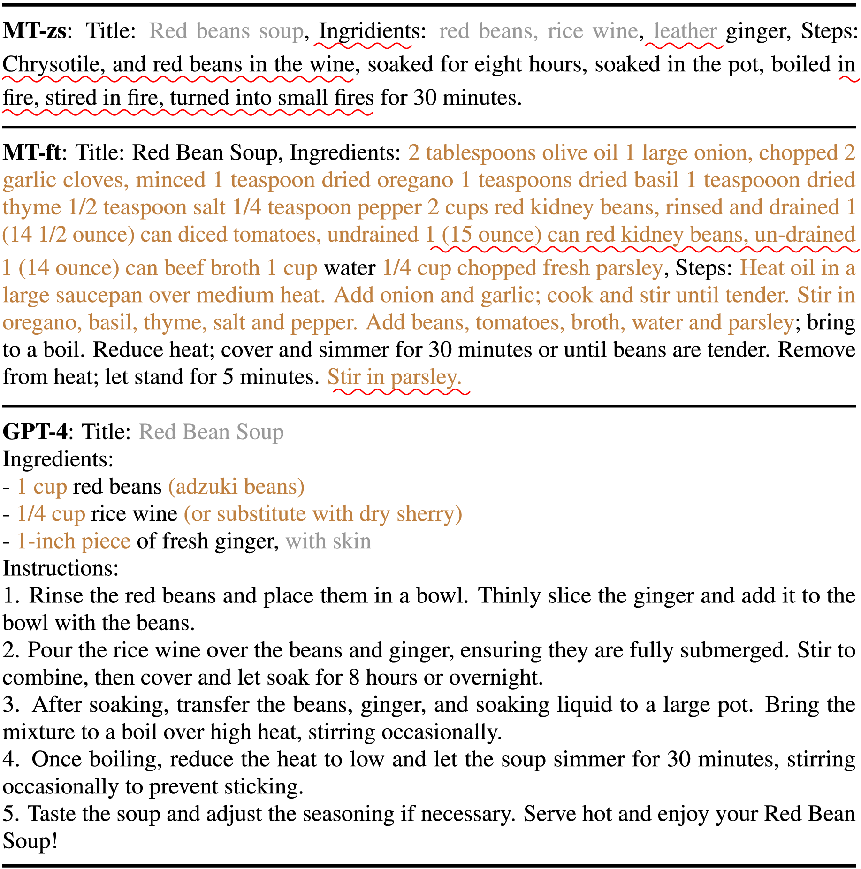
Case study

Slide 70
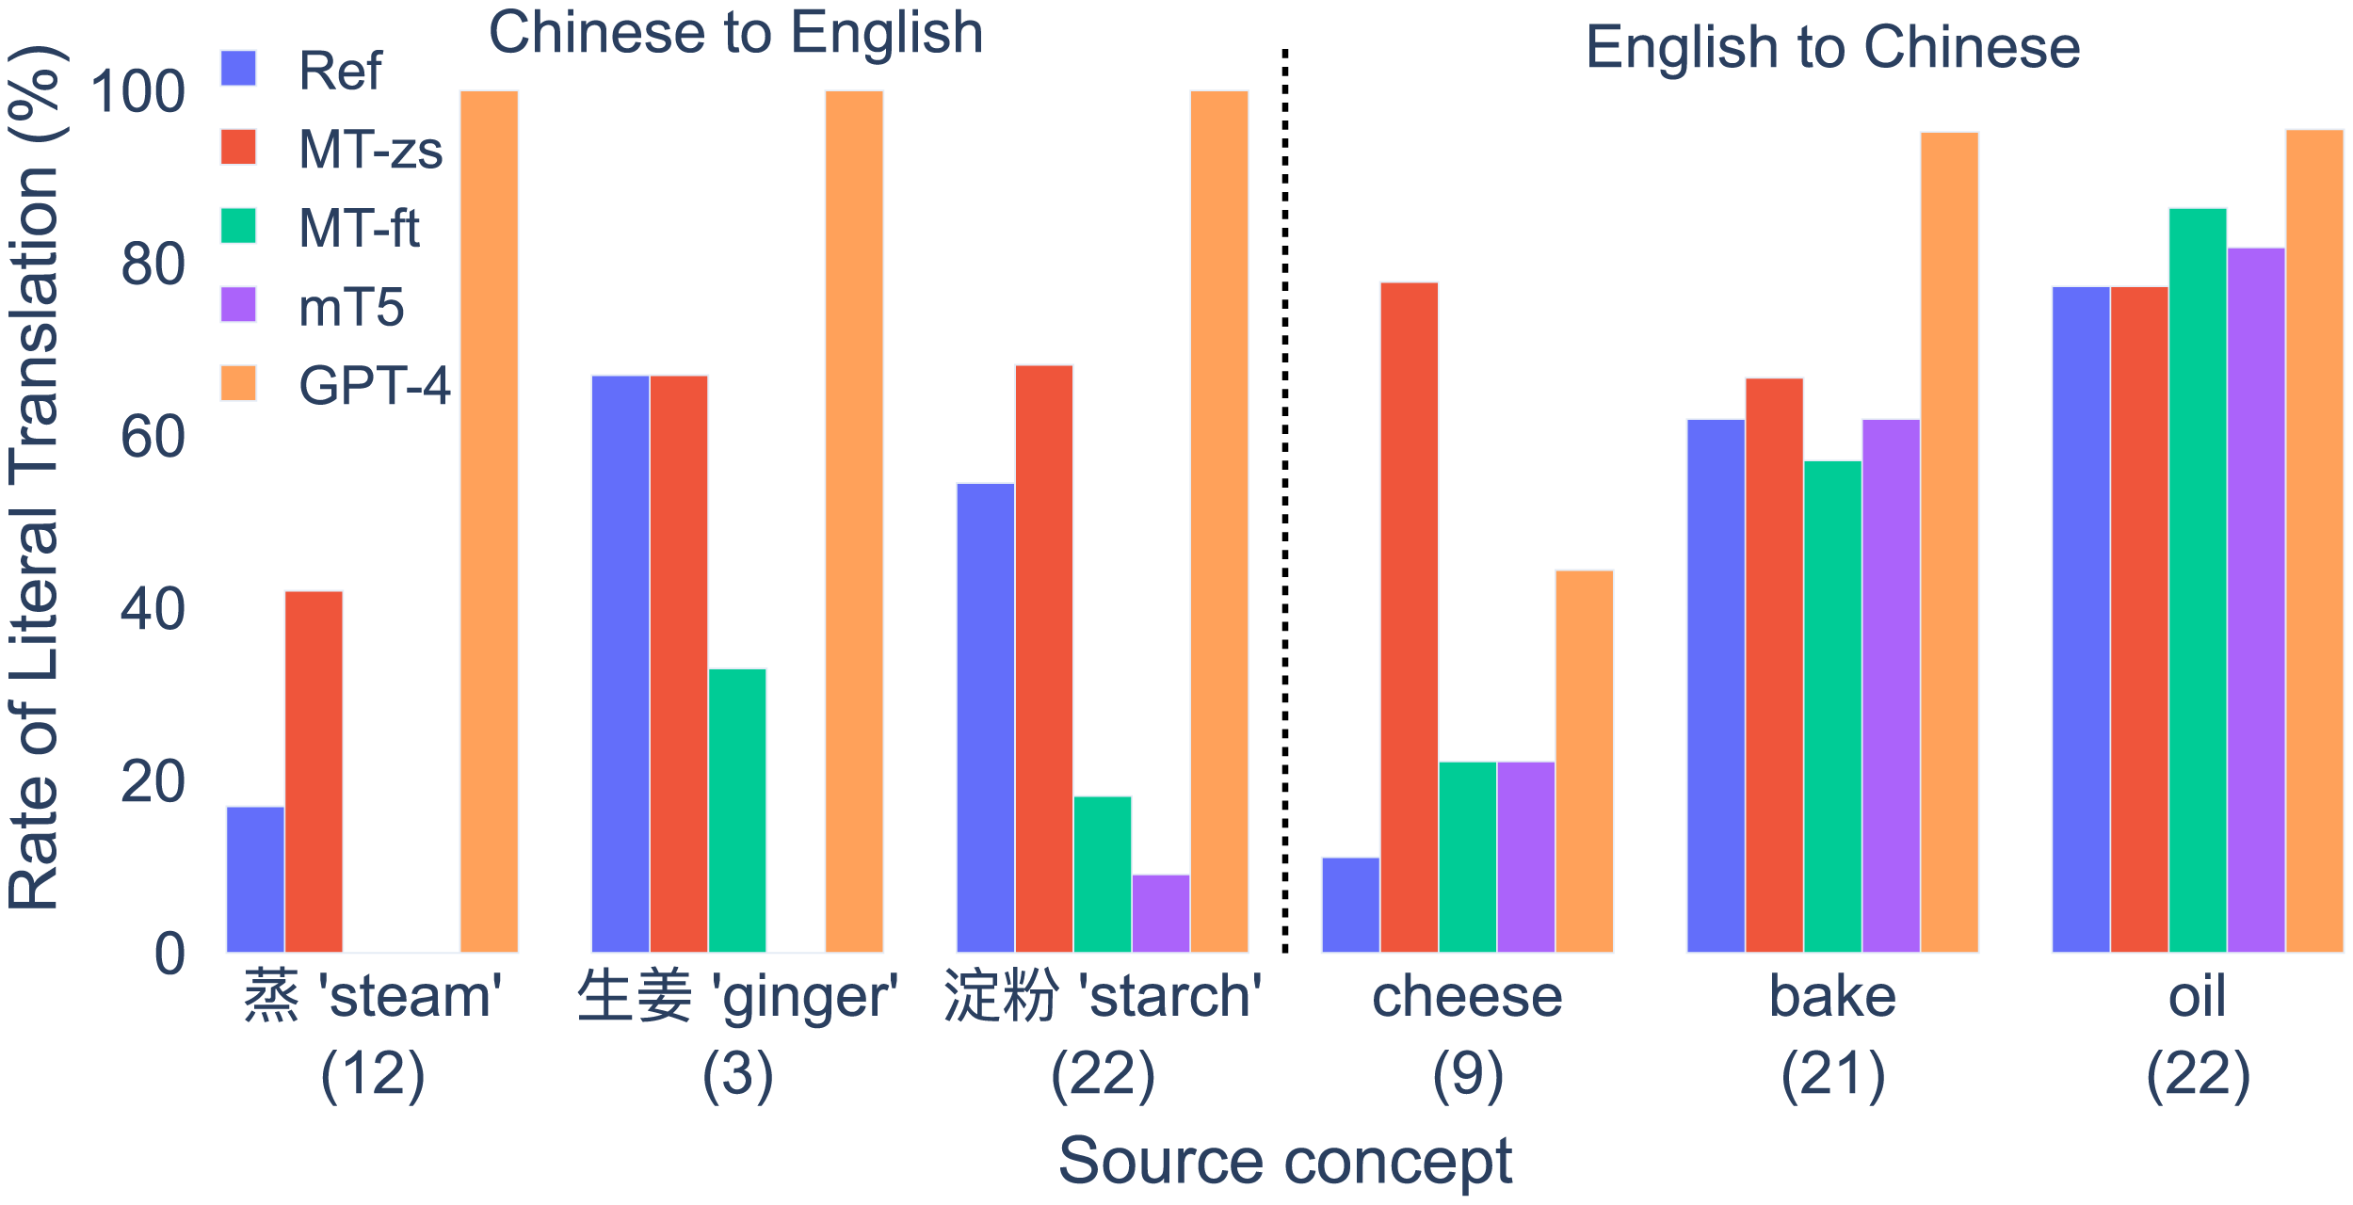
Case study

Slide 71
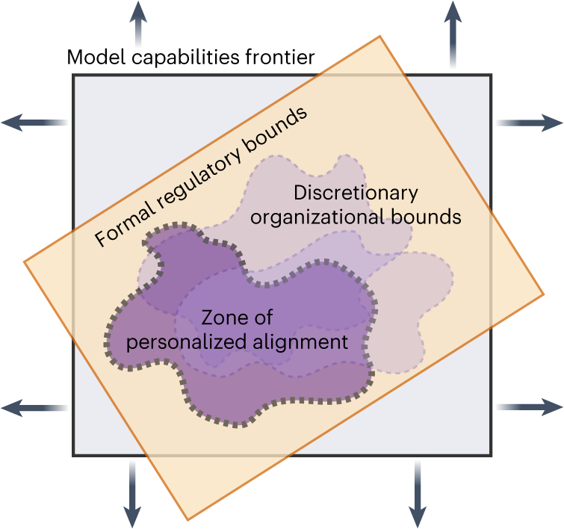
Who Decides?
Researchers
Practitioners
End-users
Affected communities
Regulators
The benefits, risks and bounds of personalizing the alignment of large language models to individuals (Kirk et al., Nature Machine Intelligence 2024)
Notes:
recently published draft guidelines

