Slide 1
How can we use AI Language Models for Personalized Guidance and Nutrition?
Morten Arendt Rasmussen, Professor, FOOD
Daniel Hershcovich, Tenure-Track Assistant Professor, DIKU
Jonathan Sigh Musso, BSc Machine Learning & Data Science
Lukas Mikelionis, MSc Computer Science
Digital Tech Summit, October 30, 2024

Slide 2
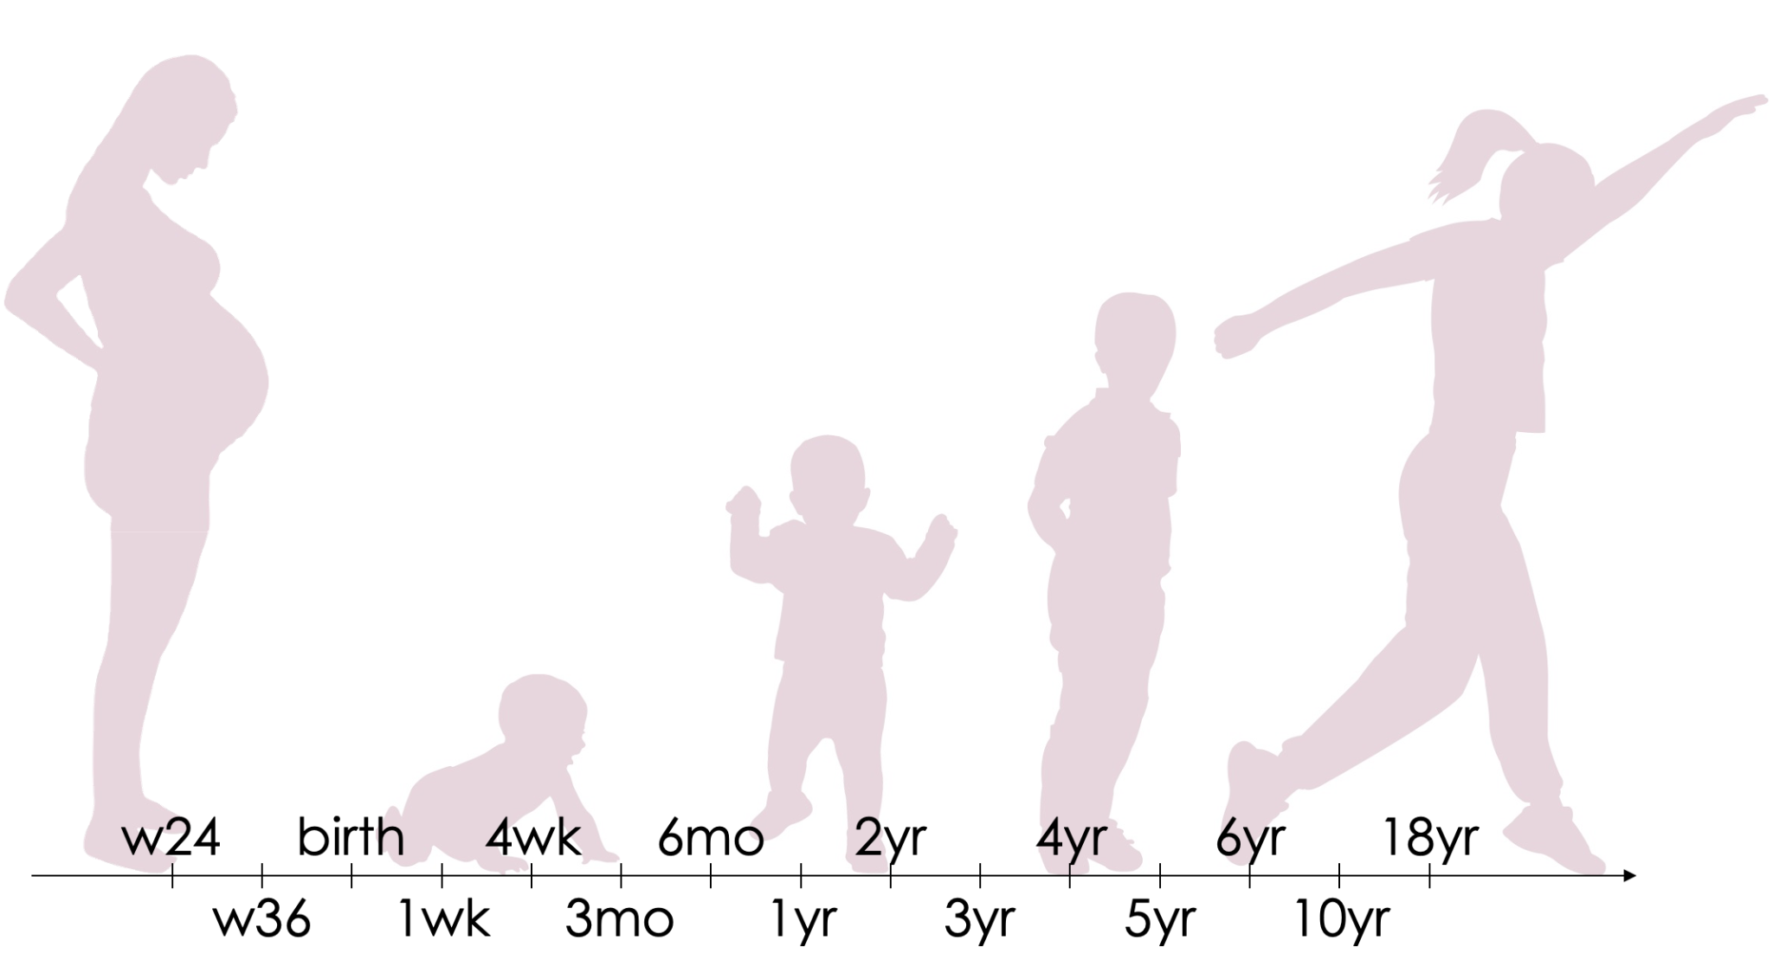
Why is diet important?
Asthma
Exposome
Allergy
Eczema
Diet
Obesity
Notes:
skriv RCT ud som test

Slide 3
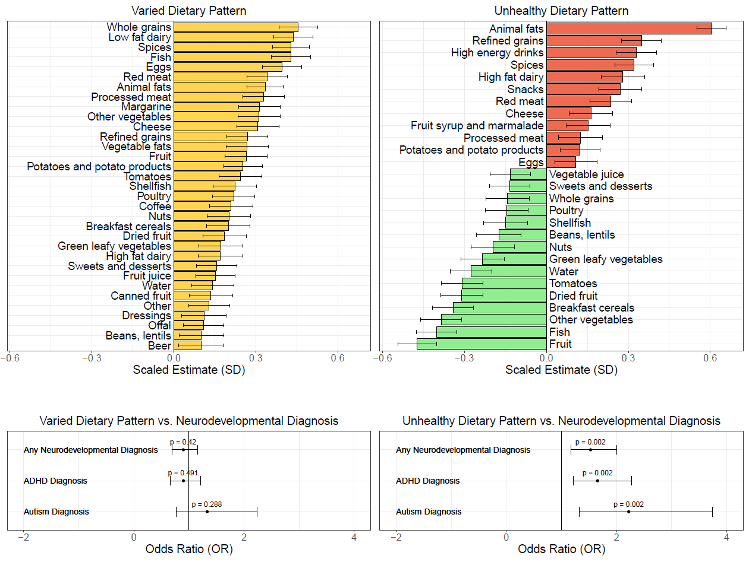
Diet in Pregnancy and offspring health
David Horner et al (2024) An Unhealthy Dietary Pattern during Pregnancy is Associated with Neurodevelopmental Disorders in Childhood and Adolescence. In review

Slide 4
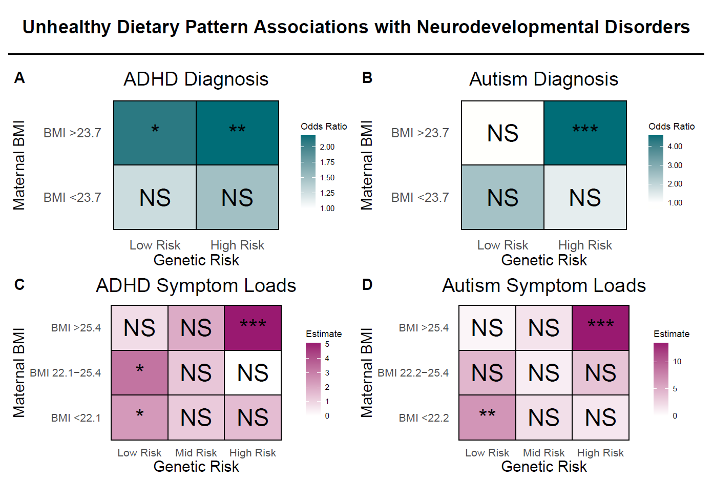
David Horner et al (2024) An Unhealthy Dietary Pattern during Pregnancy is Associated with Neurodevelopmental Disorders in Childhood and Adolescence. In review

Slide 5
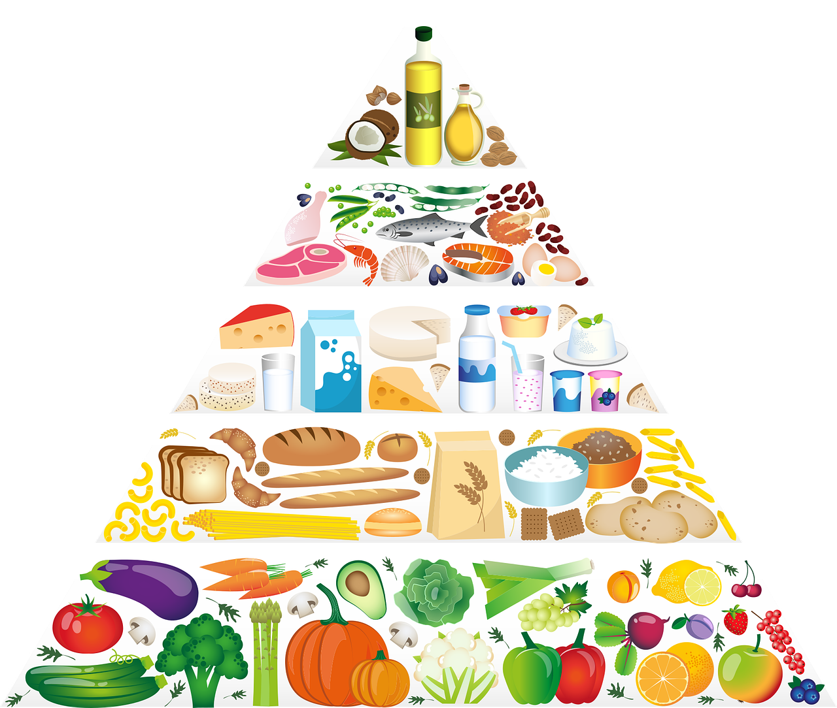
Personalized Nutrition
But knowing what is good is one thing
Actually doing it …. is another challenge
Going beyond general recommendations
A tailored Madpyramide
X
But just as well: Identify those where diet can play a role, and let the rest unaffected
X

Slide 6
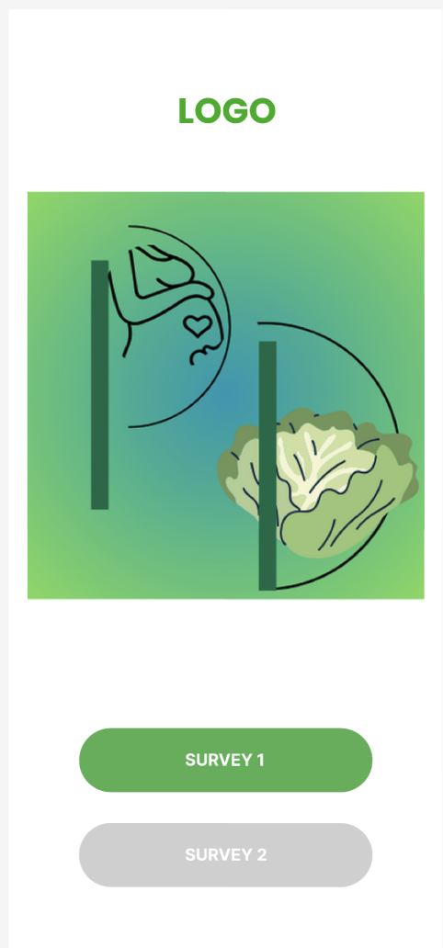
App for improving of health
Personalize on
Contemporary diet
Diet preferences
Recommendations
Recipes
Ingredients
Dailies
Try a new food/ingredient
Skip sugar
…
Gamification and Rewards
Leaderboard
Achievements / Badges
Sangita Sharma Poudel
Dietician and Msc Student

Slide 7
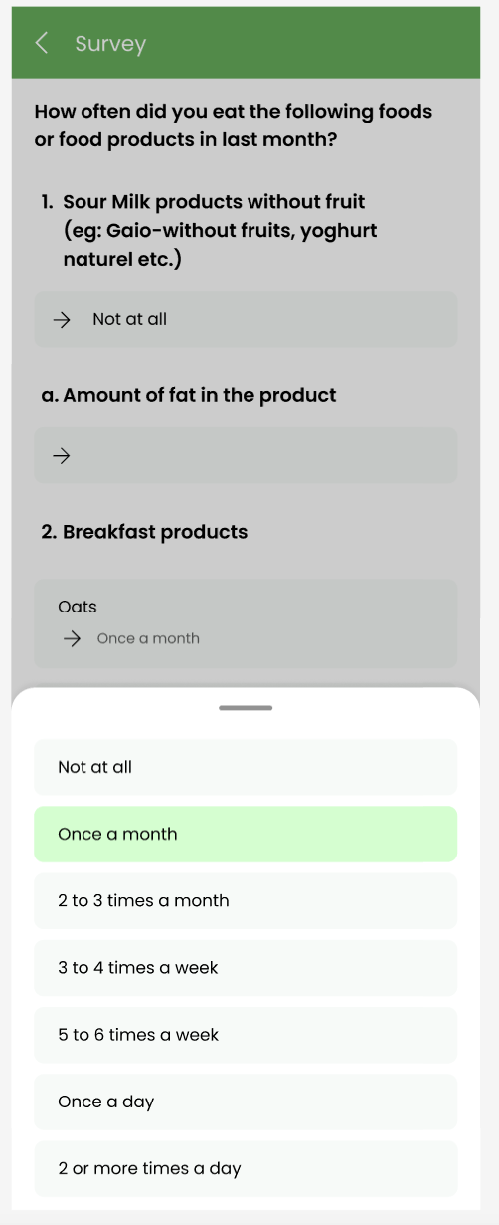
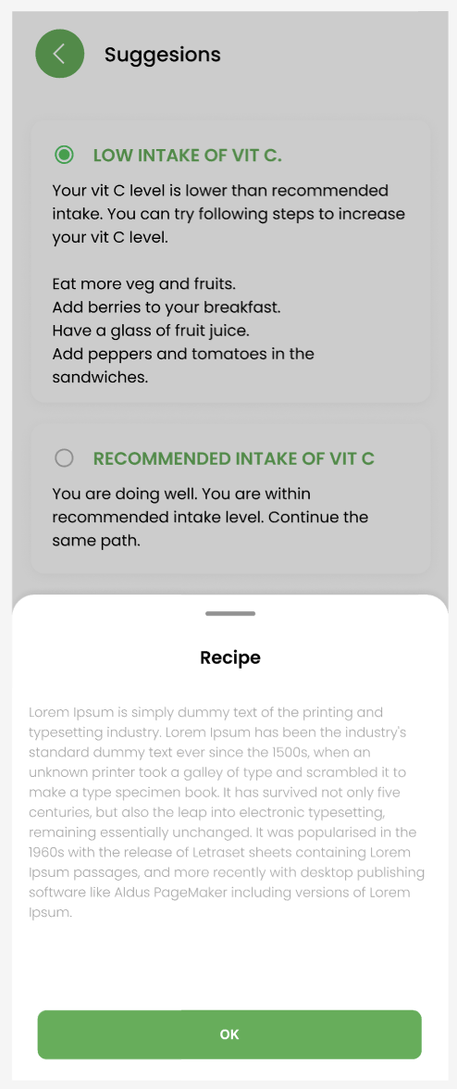
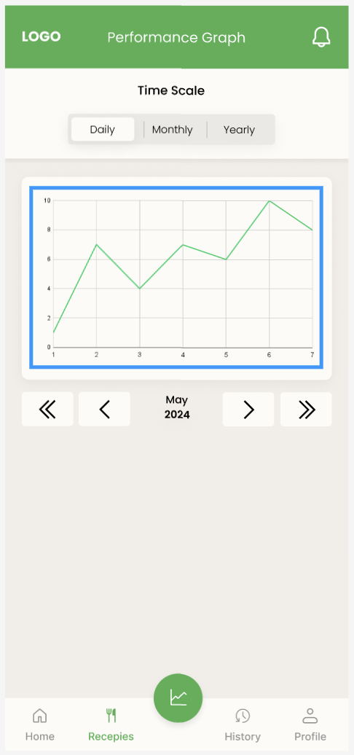
Data on habitual diet
Changes
Performance
Notes:
In the box under “changes” is Recipes , which is the clue to Daniel to talk about how to AI-fill this field.

Slide 10
AI Influences Human Behavior
Whether through explicit persuasion or implicit priming, user behavior changes as a result of interaction with AI
How to ask for donations? learning user-specific persuasive dialogue policies through online interactions (Tran et al., UMAP 2022)
Can we harness this for positive behavior change?

Slide 11
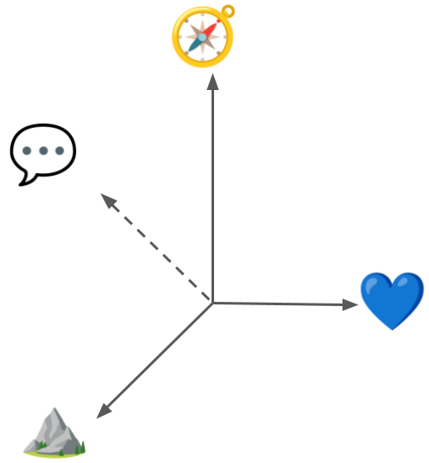
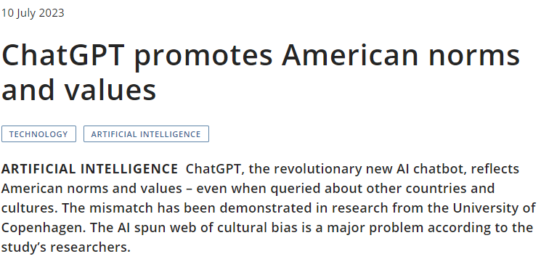
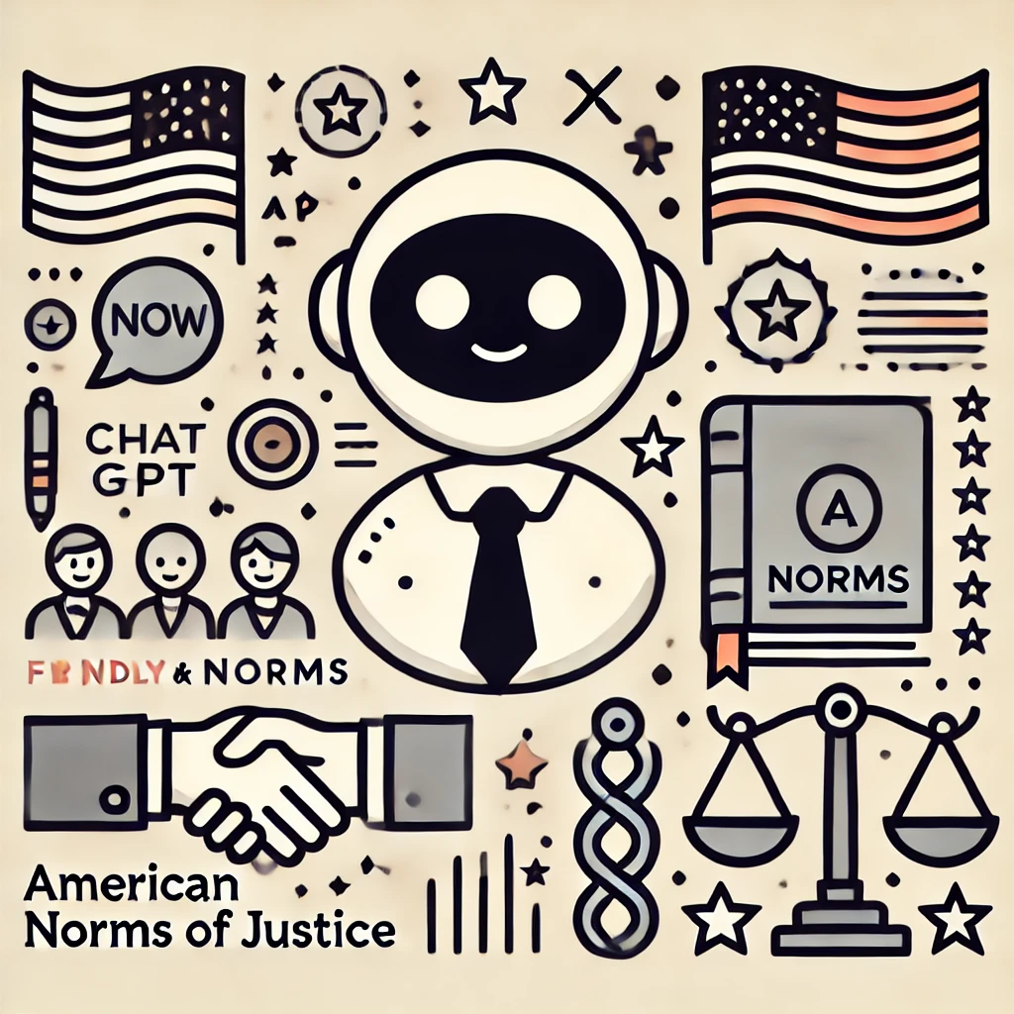
Risks of AI Influence
Restricting communicative style
Influencing decision making
Assessing Cross-Cultural Alignment between ChatGPT and Human Societies: An Empirical Study (Cao et al., C3NLP 2023)
Perpetuating bias and stereotypes
Creating partial/false impressions
Challenges and Strategies in Cross-Cultural NLP (Hershcovich et al., ACL 2022)

Slide 12
AI Alignment
“our AI systems must do what we want them to do” (Russel et al., 2015)
“prevent [autonomous systems] from causing unintended harm” (Amodei et al., 2016)
Towards Bidirectional Human-AI Alignment: A Systematic Review for Clarifications, Framework, and Future Directions (Shen et al., 2024), adapted from Gabriel (2020)

Slide 13
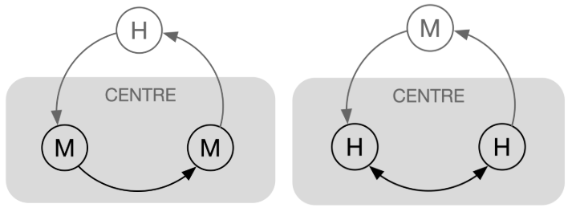
Our Goal: Reframing Alignment
from Aligning AI ↦ Humans to Aligning Humans + AI ↦ a goal
preferences
augmentation
automation
feedback
optimization
relationship & communication
Adapted from Centering the Speech Community (Bird & Yibarbuk, EACL 2024)

Slide 14
Food, language and identity
FOOD IS A COMMUNICATIVE MEDIUM
FOOD IS A CARRIER OF MEANING
FOOD IS TIGHTLY LINKED TO IDENTITY
Notes:
When we talk about food we talk about our embodied existence in the world.
Food addresses historical, cultural, social, bodily, spiritual, and environmental issues.
Sense of community and feelings of national, regional, ethnic, religious etc. belonging.

Slide 15
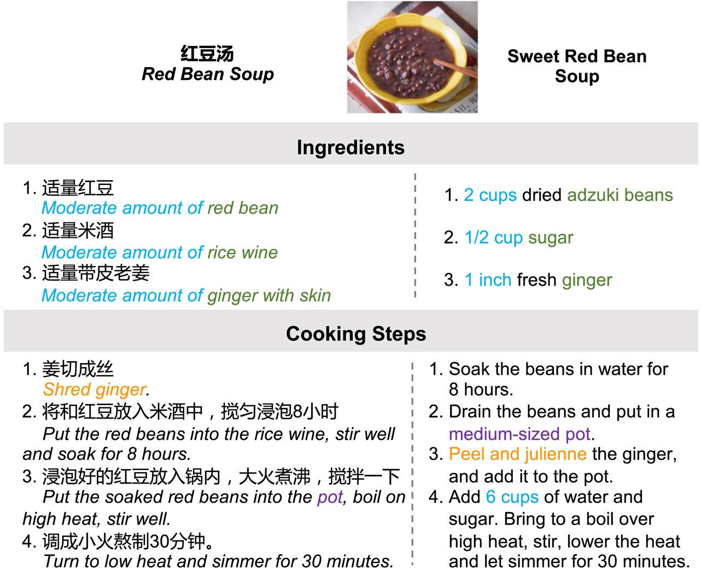
Recipe adaptation
Dietary restrictions, e.g., vegan
Cross-cultural differences
Can we automate this process?
Cultural Adaptation of Recipes (Cao et al., TACL 2024)

Slide 16
Aligning Humans + AI for Positive Behavior Change
Vision:
Combining adapted recipes with tailored diverse argumentation in a personal AI assistant

Slide 17
Structured Argument Mining in Persuasive Online Articles on Sustainable Diets
MSc thesis project by Lukas Mikelionis
Supervised by Daniel Hershcovich
2023

Slide 18
Structured Argument Mining in Persuasive Online Articles on Sustainable Diets
Structured Argument Mining: extraction of arguments and their relations
Persuasive Online Articles: opinionated and influential content for the public
Sustainable Diets: relevant topic in the modern society
Notes:
## 1. Argument Mining
- Speaking about argumentation, it's yet another area where AI could help us via Argument Mining
- This exactly what I focusd on when working on my MSc thesis. The title is a bit long but basically it can be separated into 3 key concepts:
- Structured Argument Mining - that is a task in which AI automatically extracts arguments and their relations from text documents
- Persuasive Online Articles - a content type that is by design meant to be influencial, where often authors urge governments, industries of the society in generate to take action
- Sustainable Diets - a topic that is nowadays highly relevant

Slide 19
Curating a Dataset and Choosing a ML Model
Articles:
(10) Altinget
(5) The Guardian
(5) Plant Based News (PBN)
Prevalent sub-topics:
Innovation in food industry
Meat alternatives
Cooking education
Social and cultural challenges regarding dietary preferences
Annotation:
Amazon’s Mechanical Turk crowdsourcing platform
Funded by Green Solutions Centre
ML model:
Architecture: End-to-End Structured AM (Morio et. al., 2022)
Base embedding layer: Longformer (Beltagy et al., 2020)
Notes:
## 2. Curating a Dataset of Opinon Pieces (Persuasive Articles)
- Now a little bit about the dataset and experimental setup used in the project
- So the ML model was fine-tuned and evaluated on 20 opinion articles that were chosen from 3 websites: Altinget, The Guardian and Plant Based News
- The most prevelent topics in the articles were:
- Innovation in food industry
- Meat alternatives
- Cooking education
- And of course social and cultural challenges regarding dietary preferences
- For gathering annotations I developed a web application that integrated with a crowdsourcing platform. Basically the participants were presented with text and their task was to mark arguments
- Participants were paid using the funding provided by the Green Solutions Centre at the Univeristy of Copenhagen
- As for model details themselves, I've used, at the time state of art, end-to-end structured AM model introduced by Morio et. al.

Slide 20
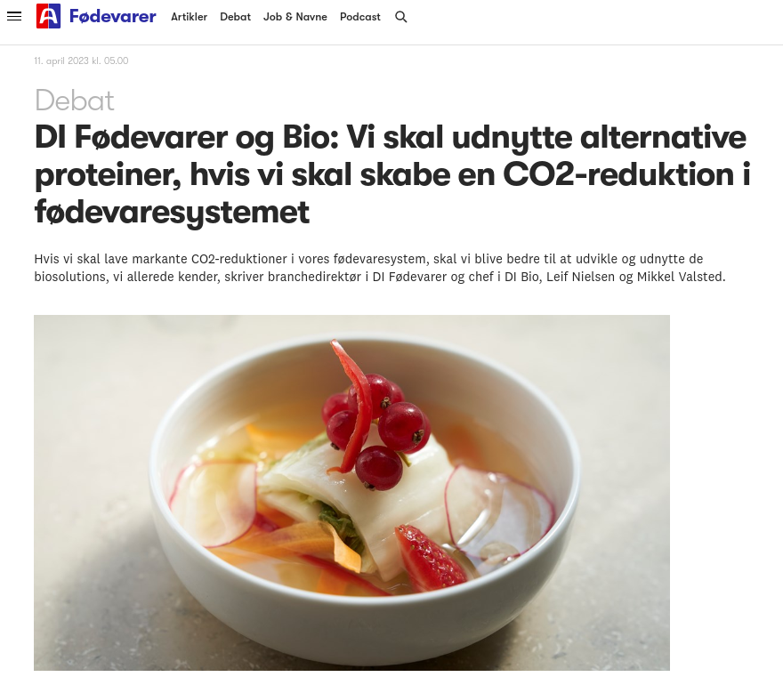
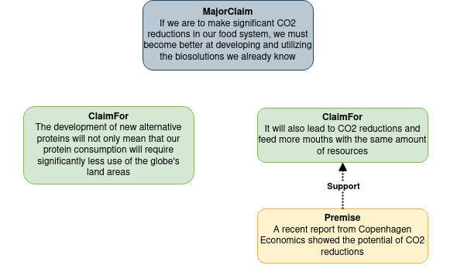
Structuring Arguments and an Example AI Output
Notes:
## 3. Structuring Arguments and an Example AI Output
- I've mentioned a few times this automated argument extraction. But how exactly are arguments and their relations represented? Let's have a look at a concrete argument structure that AI was able to extract when given an article from Altinget.
- The headline of the article is: We must utilize alternative proteins if we are to create CO2 reduction in the food system
- At the very top there is what's called the major claim. It summarizes authors position and is the key point that they are trying to make. In this case they claim that, in order to reduce CO2 reductions in food systm we must better utilize biosolutions.
- Then there are sub-claims in green. For example, the claim on the left says that biosolutions would also help to reduce the land areas used for food production.
- Lastly, we have premises that can express support or, in some cases attack towards claims. They generaly do not contain opionated statements but provide more detail or elaborate on claims that they related to. In this example, the premise in yellow acts as evidence supporting the claim.

Slide 21
Observations and Possible Applications of Argument Mining
Observations:
AM is a challenging task
Impressive result by ML model
Future potential of AM
Applications:
Summarizing content
Debate support
Writing support
Analysis of actors
Decision making
Notes:
## 4. Observation and Possible Application of Argument Mining
- And finally to wrap up my part, during the course of the project I've made a few observations:
- First of all, AM is a challenging task, especially on more intricate pieces of text such as opinion articles. And it's actually a difficult task not just AI but for us humans too, as I've noticed this by working with crowdsource participants and examing the articles myself.
- Then, even though the predictions that AI made were in many cases not perfect they were still quite impressive, showing that AI clearly understood the task and in some cases it even outperformed human annotators.
- Overall the results are quite promising and exciting for future research in AM areas as well as potential applications.
And here you can see several possible applications: for example in debates, AI could act as an assitant to suggest arguments for a topic as well as counter arguments against opponents ideas. Aditionally, governments with the help of AI could potentially gather various arguments and points of view on such topic as sustainable diets. Then they could perhaps form a more influencial narrative that could help convince more people to transition more sustainable food options.

Slide 22
Veganizing Recipes using Language Models
BSc project by Jonathan Sigh Musso
Supervised by Daniel Hershcovich & Morten Arendt Rasmussen
2023

Slide 23
Project Goal and Motivation
Many benefits of a vegan diet
Widespread adaptation hindered due to a lack of familiarity with vegan ingredients/methods
Solution: Apply language models to adapt recipes into vegan alternatives, while preserving dish essence

Slide 24
Approach & Methodology
GPT Models from OpenAI API
Recipes adapted across both English and Danish
Crowdsourcing used for evaluations due to lack of automatic metric
Crowdsourcing Humanly Written Adaptations
Models and Setups:
Text-Davinci-003 Zero Shot Prompting
Text-Davinci-003 Two Shot Prompting
Turbo GPT-3.5 Zero Shot Prompting
Turbo GPT-3.5 Two Shot Prompting
GPT-3 Davinci Fine-Tuning

Slide 25
Adaptations and Crowdsourcing
English recipes sourced from Food.com dataset (~133k nonvegan and ~7k vegan recipes).
Danish recipes scraped from popular Danish cooking sites, followed by data cleaning and annotation. (~6500 nonvegan and ~2000 vegan recipes)
Crowdsourcing
Prolific online crowdsourcing
In-Person Food and Meal Consumer Research Course
1096 english responses
704 danish responses

Slide 26
Example 1 - Turbo GPT-3.5 Two Shot
Name: chicken stir fry with cashews
Ingredients:
oyster sauce fish sauce brown sugar cornstarch water boneless skinless chicken breast halves cooking oil onion red chili peppers garlic unsalted cashews cooked rice
Name: cashew and vegetable stir fry
Ingredients:
vegetable broth soy sauce maple syrup cornstarch water extra-firm tofu vegetable oil onion red bell pepper garlic ginger unsalted cashews cooked rice

Slide 27
Example 2 - Turbo GPT-3.5 Two Shot
Name: simple pancakes
Ingredients:
egg sugar vanilla milk flour baking powder
Name: Fluffy Vegan Pancakes
Ingredients:
flaxseed meal water agave syrup vanilla extract unsweetened almond milk all-purpose flour baking powder salt coconut oil for frying

Slide 28
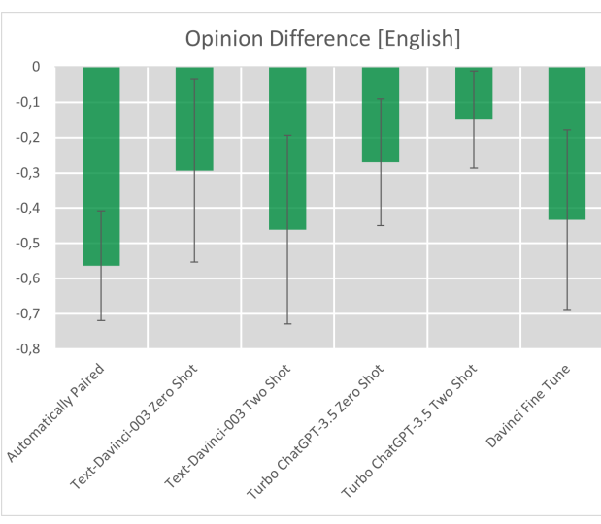
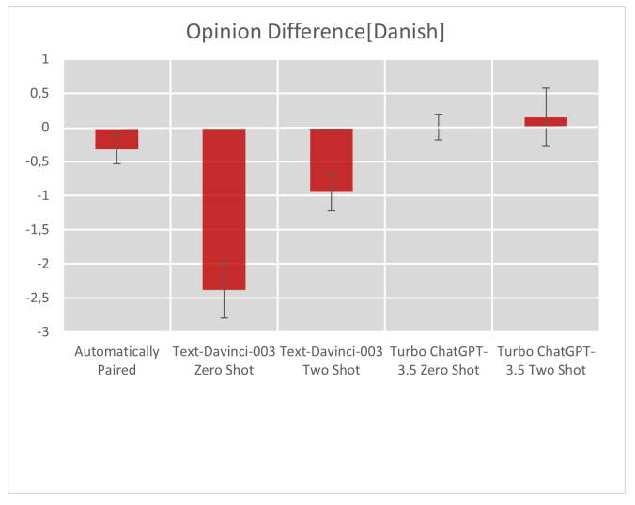
Results
0.46 absolute Increase
0.43 absolute Increase

Slide 29
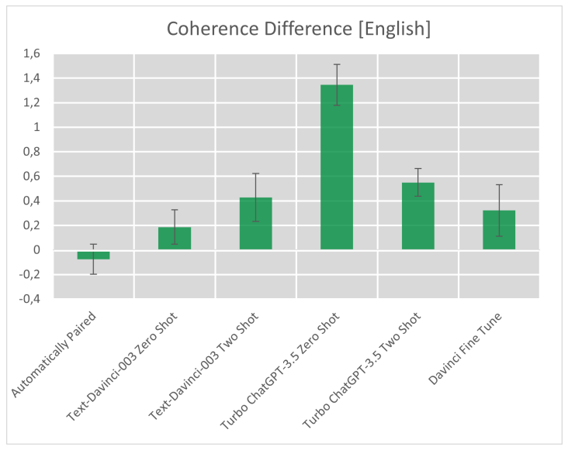
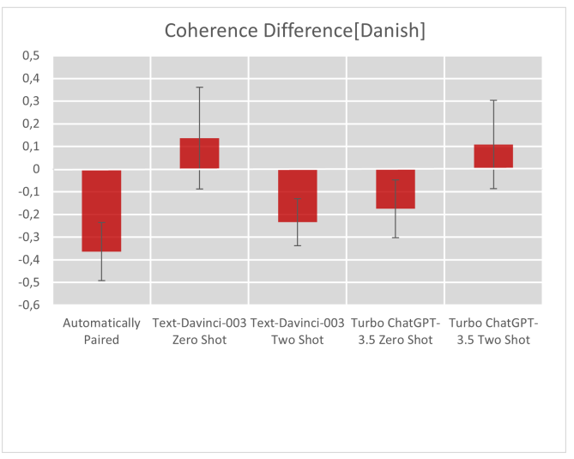
Results
1.79 absolute Increase
0.46 absolute Increase

Slide 30
Recap and what’s next?
Results look better than automatically assigned – Is this good enough?
Lack of benchmark
GPT-4
How much can be read from recipes ? - Cooking the dish

Slide 31
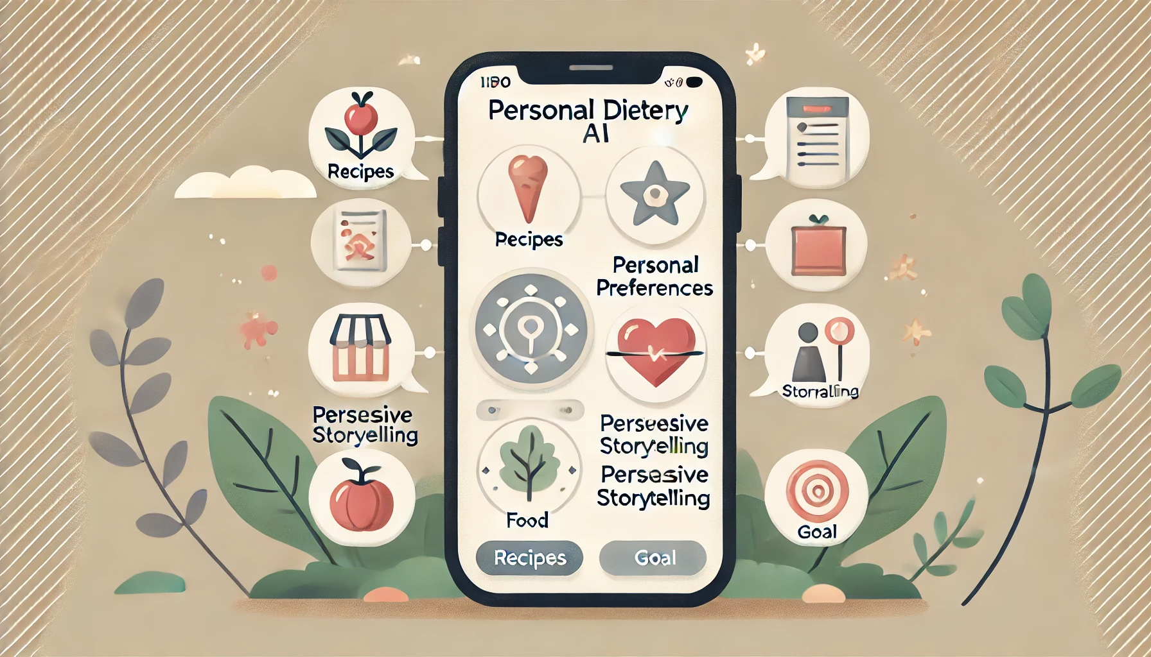
Summary
Adapting recipes and advice to personal preferences and values
Combining with persuasive tailored stories and argumentation
Contact: dh@di.ku.dk
mortenr@food.ku.dk
Personal dietary AI to assist behavior change to personal/societal goals

Slide 32
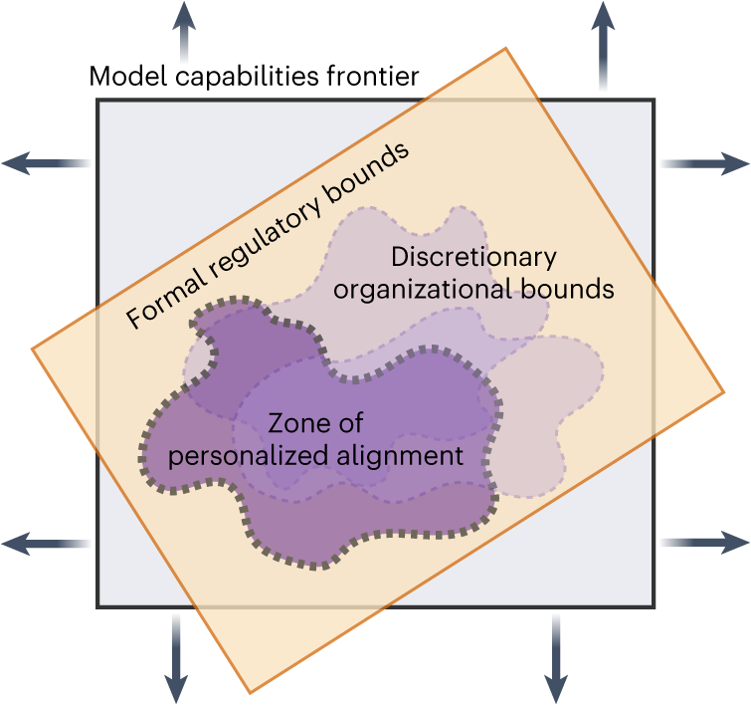
Who Decides?
Researchers
Practitioners
End-users
Affected communities
Regulators
The benefits, risks and bounds of personalizing the alignment of large language models to individuals (Kirk et al., Nature Machine Intelligence 2024)
Notes:
recently published draft guidelines

