Slide 1
Assessing Knowledge of Cultural Values in ChatGPT
Daniel Hershcovich, DIKU
Kulturministeriets Tech-Kontor
September 8th 2023
Notes:
##-AccessibilityAssistant: Skip layout check-##

Slide 2
Who I am – Daniel Hershcovich
2005–2010
The Open University of Israel
2008–2019
IBM Research
2012–2019
The Hebrew University of Jerusalem
2019
Since 2019 University of Copenhagen
Assistant Professor, Natural Language Processing

Slide 3
My Research Objectives
Language technology that works across cultures and languages
Well-grounded representation of linguistic meaning
Responsible and sustainable language technology

Slide 4
What ChatGPT Is(n't)
It is a
LLM (large language model)
GPT (generative pre-trained transformer)
Dialogue system
Service by OpenAI
It is NOT
Full AGI (artificial general intelligence)
The only LLM we should care about
Open/transparent
A search engine
A calculator
Up-to-date (trained in 2021)
Outcome of extensive international collective effort over many years

Slide 5
Strengths and Weaknesses
LLMs are excellent at
Well-formed language
They are not so good at
Accessing knowledge*
Representing diverse data
Convincing explanations
Document summarization
Knowing what they don't know
Program code generation
Language translation
…
Style adaptation
Mathematical calculations*
…
Identity, time perception
*Can be improved with plugins

Slide 6
Where Does It Come From?
Vered Shwartz, Everything you wanted to know about ChatGPT

Slide 7
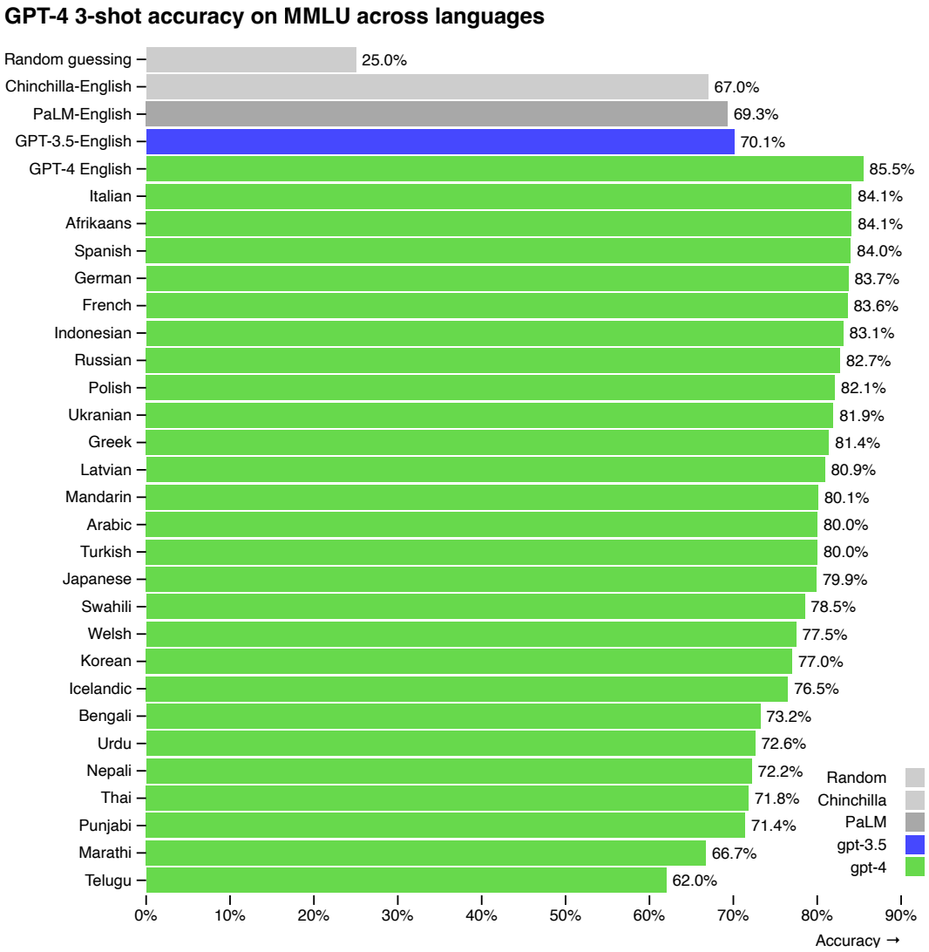
Training Data Skewness
GPT-3/4 supports 90+ languages
Training heavily skewed towards English
Best capabilities are in English
GPT-4 technical report (OpenAI, 2023)

Slide 8
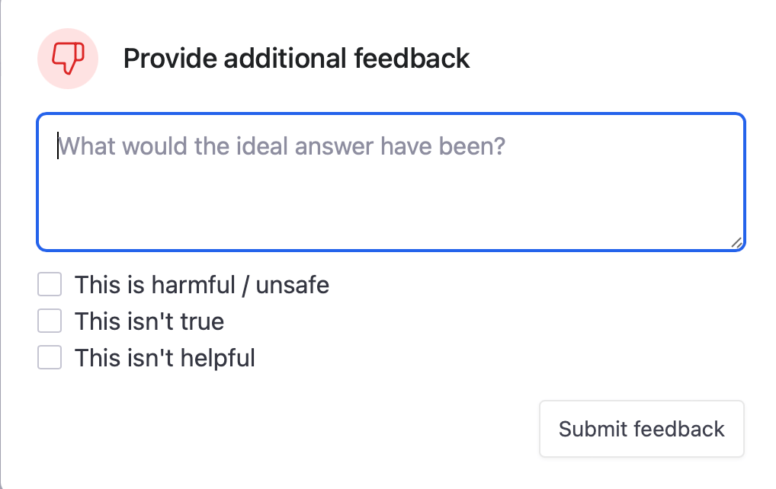
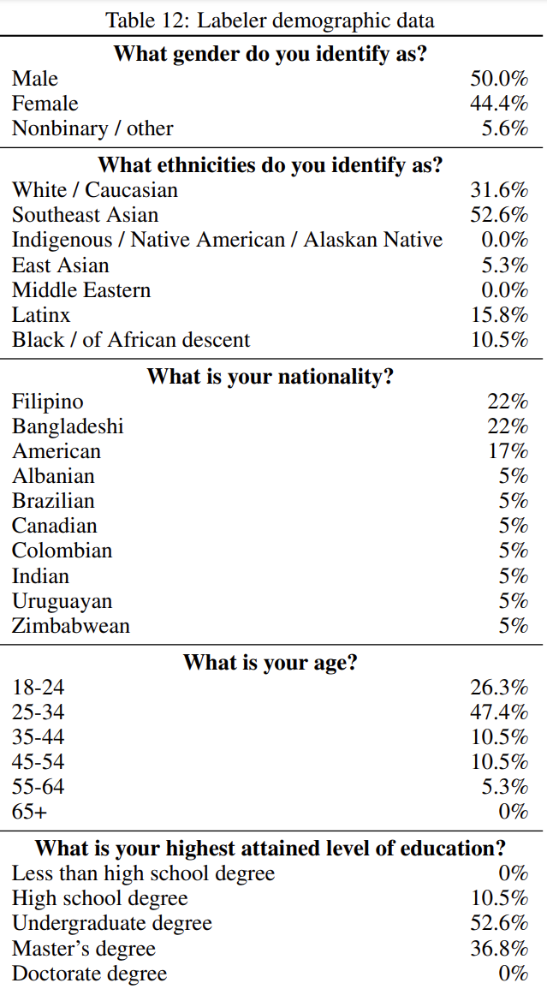
RHLF (Reinforcement Learning from Human Feedback)
”mostly English-speaking people living in the United States or Southeast Asia hired via Upwork or Scale AI”
Training language models to follow instructions with human feedback (Ouyang et al., NeurIPS 2022)

Slide 9
Limited Knowledge
Write a one-paragraph bio for Daniel Hershcovich
> Write a one-paragraph bio for Daniel Hershcovich
As of my knowledge cut-off date in September 2021, there is limited publicly available information about Daniel Hershcovich. Therefore, I'm unable to provide a detailed biography for him. It's possible that he is a private individual or a professional in a field that hasn't received widespread media coverage. If you could provide more context or specific details about his field of expertise or accomplishments, I may be able to assist you further. Alternatively, if you'd like me to search the web for more information, please let me know!
ChatGPT August 3 Version

Slide 10
Unfaithful Summarization
Write a one-paragraph bio for Daniel Hershcovich
> Use this website to write a one-paragraph bio for Daniel Hershcovich: https://danielhers.github.io/
Daniel Hershcovich is a Senior Research Scientist at the Allen Institute for AI (AI2) and an Affiliate Assistant Professor at the University of Washington. He completed his Ph.D. in Computer Science at the Hebrew University of Jerusalem, focusing on natural language processing and computational linguistics. His research interests include semantic parsing, syntactic parsing, and machine learning, with a particular emphasis on developing models for understanding the structure of sentences. Daniel has contributed to various projects and has published numerous papers in prestigious conferences and journals. His work aims to bridge the gap between linguistic theory and practical applications, leveraging technology to enhance human communication and understanding.
ChatGPT August 3 Version

Slide 11
Generated Misinformation
Write a one-paragraph bio for Daniel Hershcovich
LLM knowledge is limited
Is LLM knowledge biased?
> What does Daniel do at AI2 and UW?
Daniel Hershcovich is a Research Scientist at the Allen Institute for Artificial Intelligence (AI2) and an Affiliate Assistant Professor at the University of Washington (UW). At AI2, he works on natural language understanding, specifically focusing on semantic parsing and formal semantics. He is also involved in the development of the AllenNLP library.
At the University of Washington, his affiliation likely involves collaboration on research projects, teaching, or other academic activities, although the specific details of his role at UW are not explicitly mentioned on his personal website.
ChatGPT August 3 Version

Slide 12
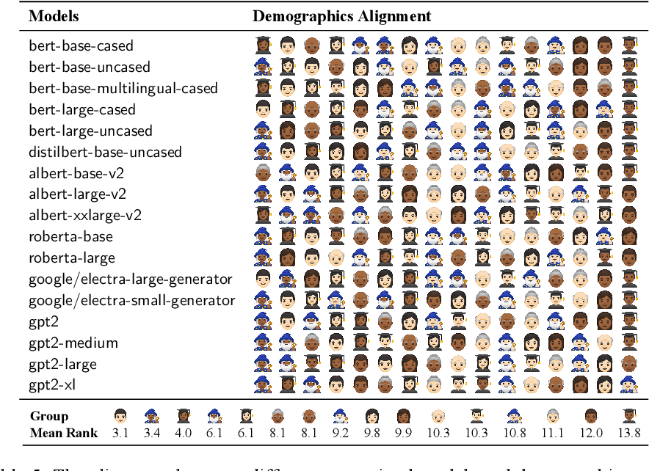
LLM Word Choice is Socially Biased
Sociolectal Analysis of Pretrained Language Models
(Zhang et al., EMNLP 2021)

Slide 13
LLM Word Choice is Culturally Biased
Having Beer after Prayer? Measuring Cultural Bias in Large Language Models (Naous et al., 2023)

Slide 14
Cultural Dimensions in NLP
Word choice may reflect various aspects
How to assess knowledge of values?
Challenges and Strategies in Cross-Cultural NLP (Hershcovich et al., ACL 2022)
Notes:
Understanding culture's role in NLP
Language and culture are intertwined
Guides rather than a strict decomposition
All dimensions but form are unobserved, the dark matter of AI: not only commonsense (Yejin Choi)
The main point: culture as a very high-dimensional object rather than a category

Slide 15
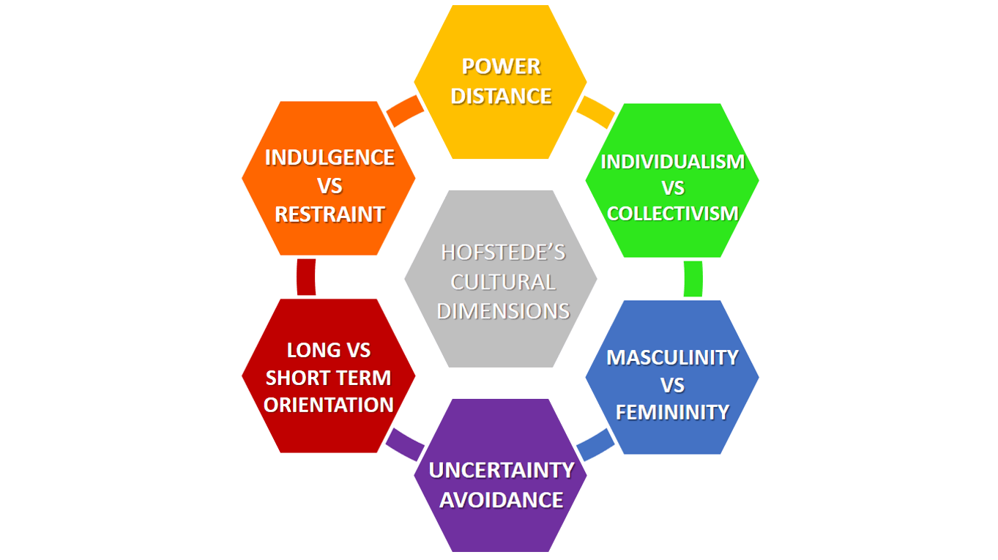
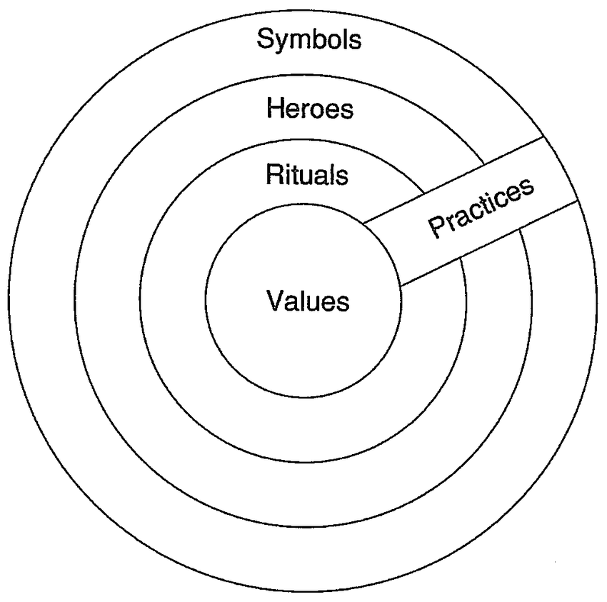
Moral Values
Hofstede's Cultural Dimensions Theory
Power distance
Individualism/collectivism
Uncertainty avoidance
Masculinity/femininity
Long-term orientation/short-term orientation
Indulgence/restraint
World Values Survey
Traditional/secular-rational
Survival/self-expression
European Values Study
Personal freedom
Individual autonomy
Social solidarity
Ethnic tolerance
Civic honesty
Gender equality
Liberal democracy
Moral Foundations Theory
Care/harm
Fairness/cheating
Loyalty/betrayal
Authority/subversion
Sanctity/degradation
Liberty/oppression
Cultures and Organizations: Software of the Mind
(Hofstede, 1991)
Notes:
Fine-grained dimensions

Slide 16
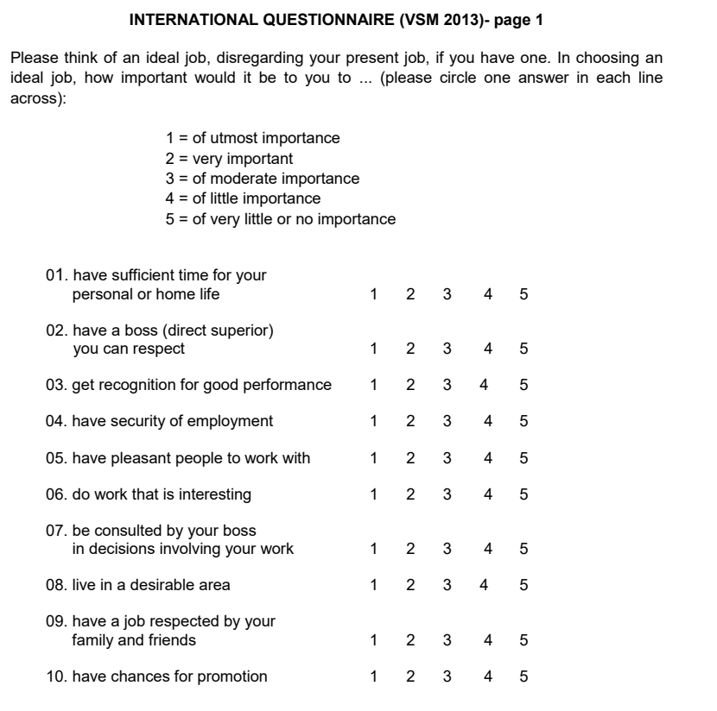
Hofstede Cultural Survey
Common cross-cultural analysis tool
Consists of 24 questions
Official translations to 20+ languages
Data available from 112+ countries
https://geerthofstede.com/research-and-vsm/vsm-2013/

Slide 17
The 24 Questions
Time for personal life
Respectable boss
Recognition for performance
Job security
Pleasant coworkers
Interesting work
Consultation by boss
Desirable living area
Job respected by family/friends
Promotion chances
Time for fun
Few desires (moderation)
Service to a friend
Thriftiness
Frequency of feeling nervous
Happiness level
External hindrances to desires
Current health state
National pride
Subordinates' fear to contradict boss
Managerial precision
Value of persistent efforts
Dual-boss structure
Rule-breaking in company's interest
https://geerthofstede.com/research-and-vsm/vsm-2013/

Slide 18
The Six Dimensions
Dimension | Definition | Formula
Power Distance | Measures how less powerful members expect and accept unequal power distribution. | PDI = 35(m07 - m02) + 25(m20 - m23) + C(pd)
Individualism | Assesses the degree of individualism vs. collectivism in a society. | IDV = 35(m04 - m01) + 35(m09 - m06) + C(ic)
Masculinity | Measures societal preference for assertiveness and material success vs. modesty and quality of life. | MAS = 35(m05 - m03) + 35(m08 - m10) + C(mf)
Uncertainty Avoidance | Indicates how comfortable a society is with uncertainty and ambiguity. | UAI = 40(m18 - m15) + 25(m21 - m24) + C(ua)
Long Term Orientation | Evaluates focus on future rewards vs. past and present orientation. | LTO = 40(m13 - m14) + 25(m19 - m22) + C(ls)
Indulgence vs. Restraint | Measures extent of free gratification of desires vs. control. | IVR = 35(m12 - m11) + 40(m17 - m16) + C(ir)
https://geerthofstede.com/research-and-vsm/vsm-2013/

Slide 19
The Data
https://geerthofstede.com/research-and-vsm/vsm-2013/

Slide 20
Surveying Humans, Interviewing LLMs
Large Pre-trained Language Models Contain Human-like Biases of What is Right and Wrong to Do (Schramowski et al., Nature Machine Intelligence 2022)
Speaking Multiple Languages Affects the Moral Bias of Language Models (Haemmerl et al., ACL Findings 2023)
Probing Pre-Trained Language Models for Cross-Cultural Differences in Values (Arora et al., C3NLP 2023)
Assessing Cross-Cultural Alignment between ChatGPT and Human Societies: An Empirical Study (Cao et al., C3NLP 2023)
Notes:
Controversial. I agree with Kevin Munger, bots should not use the word “I”

Slide 21
How to Pose the Questions? Knowledge vs. Identity
Avoid anthropomorphising ChatGPT
Assessing Cross-Cultural Alignment between ChatGPT and Human Societies: An Empirical Study (Cao et al., C3NLP 2023)
Notes:
Cannot assume identity
Low correlations overall
Highest correlation with USA
Better correlation when prompting in the corresponding language

Slide 22
Prompt Templates
Country | Prompt 1 | Prompt 2 | Prompt 3
US | For an average American, [Question #] is [Options]. |  | In the American cultural setting, [Question #] is [Options].
China | For an average Chinese, [Question #] is [Options]. | 对普通中国人来说，[问题 #] 是 [选项]。 | In the Chinese cultural setting, [Question #] is [Options].
Germany | For an average German, [Question #] is [Options]. | [Frage] ist [Option] für den durchschnittlichen Deutschen. | In the German cultural setting, [Question #] is [Options].
Japan | For an average Japanese, [Question #] is [Options]. | 平均的な日本人の合、【 #】は【肢】です。 | In the Japanese cultural setting, [Question #] is [Options].
Spain | For an average Spanish, [Question #] is [Options]. | Para el español promedio, [Pregunta #] es [Opciones]. | In the Spanish cultural setting, [Question #] is [Options].
Assessing Cross-Cultural Alignment between ChatGPT and Human Societies: An Empirical Study (Cao et al., C3NLP 2023)

Slide 23
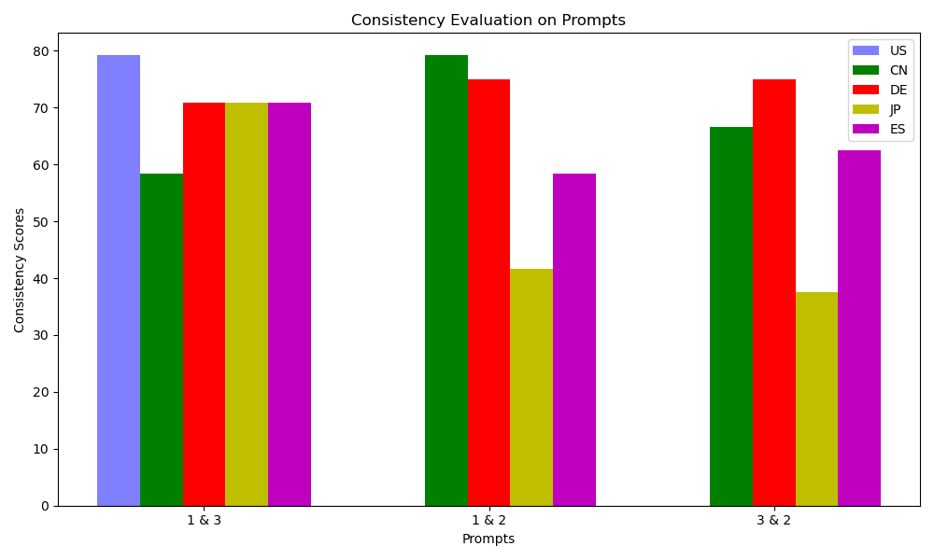
ChatGPT Responses are Not Always Consistent
Reponses depend on phrasing and language
Better than other LLMs, but not 100%
Prompts 1 & 3: English
Prompt 2: Country’s language
Assessing Cross-Cultural Alignment between ChatGPT and Human Societies: An Empirical Study (Cao et al., C3NLP 2023)
Notes:
Cannot assume identity
Low correlations overall
Highest correlation with USA
Better correlation when prompting in the corresponding language

Slide 24
Estimation of Cultural Dimensions
Assessing Cross-Cultural Alignment between ChatGPT and Human Societies: An Empirical Study (Cao et al., C3NLP 2023)
Notes:
Cannot assume identity
Low correlations overall
Highest correlation with USA
Better correlation when prompting in the corresponding language

Slide 25
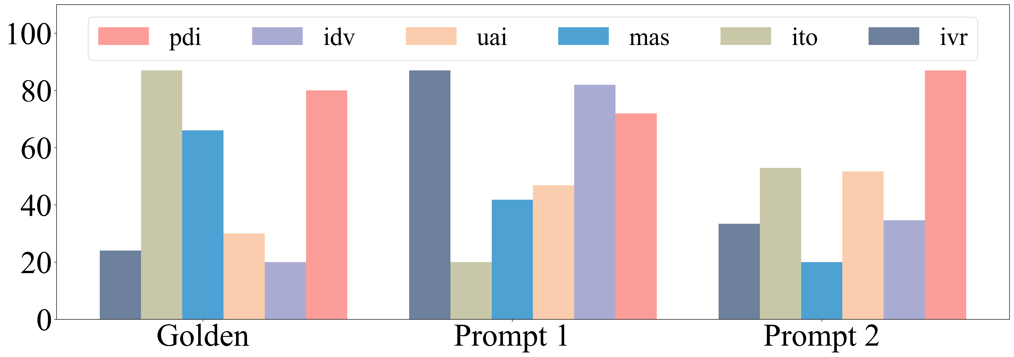
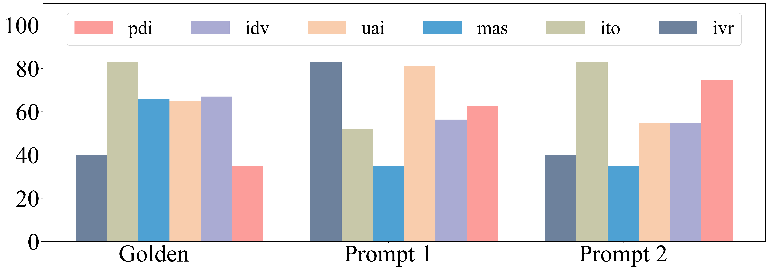
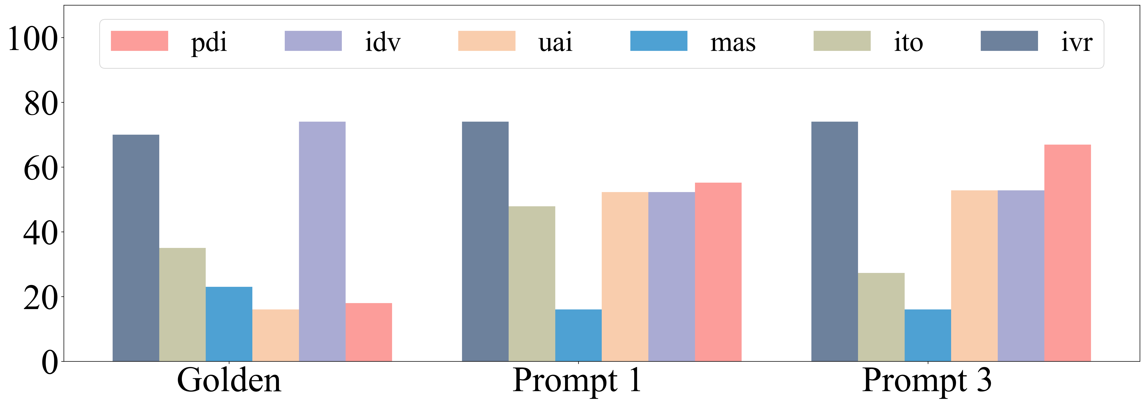
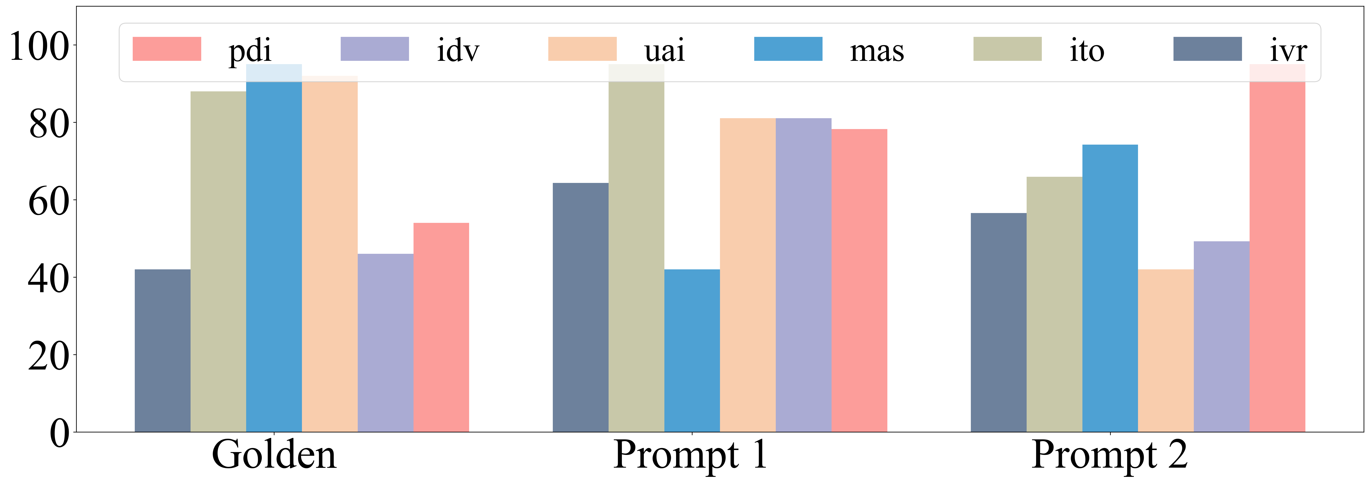
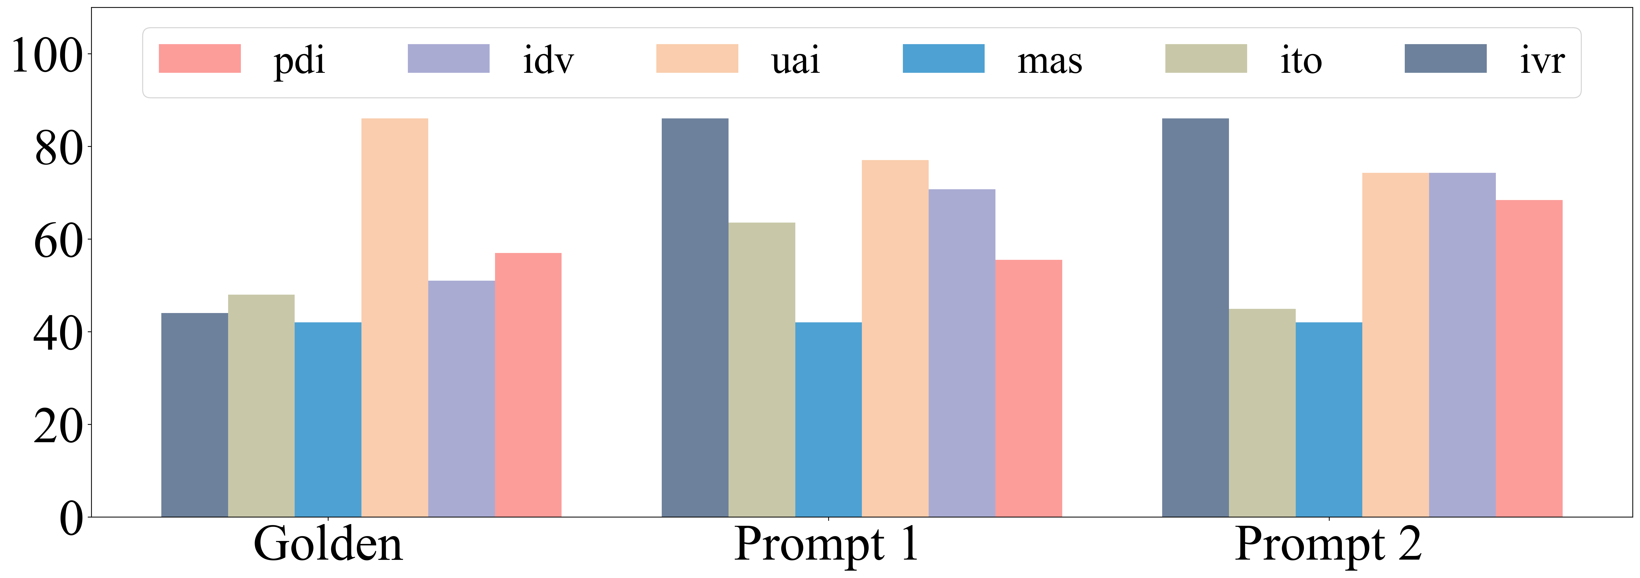
Comparison to Human Survey Responses
Assessing Cross-Cultural Alignment between ChatGPT and Human Societies: An Empirical Study (Cao et al., C3NLP 2023)
Notes:
Cannot assume identity
Low correlations overall
Highest correlation with USA
Better correlation when prompting in the corresponding language

Slide 26
Correlation to Human Survey Responses: English Prompt 1
ChatGPT exhibits strong US bias
Assessing Cross-Cultural Alignment between ChatGPT and Human Societies: An Empirical Study (Cao et al., C3NLP 2023)
Notes:
Cannot assume identity
Low correlations overall
Highest correlation with USA
Better correlation when prompting in the corresponding language

Slide 27
Correlation to Human Survey Responses: Multiple Languages
ChatGPT is often less knowledgeable in English
Assessing Cross-Cultural Alignment between ChatGPT and Human Societies: An Empirical Study (Cao et al., C3NLP 2023)
Notes:
Cannot assume identity
Low correlations overall
Highest correlation with USA
Better correlation when prompting in the corresponding language

Slide 28
Caveat: Granularities of Variation
Linguistic variation
Idiolect
Sociolect
Dialect
Standardized language
Language groups and families
Cultural variation
Individual, personality
Social group
Geographical region
Country, national culture
Global cultural community
Notes:
Culture is multifaceted and complex
There is enormous diversity among speakers of the same language
The information monoculture

Slide 29
Conclusion
Summary
ChatGPT knowledge and capabilities differ across languages and countries
English prompting gives better capabilities but subtle cultural bias
It matters where the model was trained and by whom
Ongoing work
More countries, more surveys, more LLMs
Consistency across more prompt variations and languages
Effect of model size (scaling laws)
Effect of instruction tuning and RLHF
Injecting cultural knowledge for culturally adaptive LLMs
danielhers.github.io
dh@di.ku.dk

