Slide 1
AI 101 – on what ChatGPT is(n’t)
Large Language Models and their Potential and Limitations for Language Learning
Daniel Hershcovich
Forum on AI and ChatGPT
May 15th, 2023

Slide 2
What ChatGPT is(n't)
It is a
LLM (large language model)
GPT (generative pre-trained transformer)
Dialogue model
Service by OpenAI
It is NOT
Full AGI (artificial general intelligence)
The only LLM you should know about
Open/transparent
A search engine
A calculator
Up-to-date (trained in 2021)
Outcome of collective effort

Slide 3
What is an LLM? Large Language Model

Slide 4
Vered Shwartz, Everything you wanted to know about ChatGPT

Slide 5
What is Large?

Slide 6
What is a GPT? Generative Pre-trained Transformer

Slide 7
Generative
Vered Shwartz, Everything you wanted to know about ChatGPT

Slide 8
Generative
Vered Shwartz, Everything you wanted to know about ChatGPT

Slide 9
Pre-trained

Slide 10
Transformer
https://lena-voita.github.io/nlp_course/seq2seq_and_attention.html

Slide 11
Where does it come from?

Slide 12
History
(A long history of)
Vered Shwartz, Everything you wanted to know about ChatGPT

Slide 13
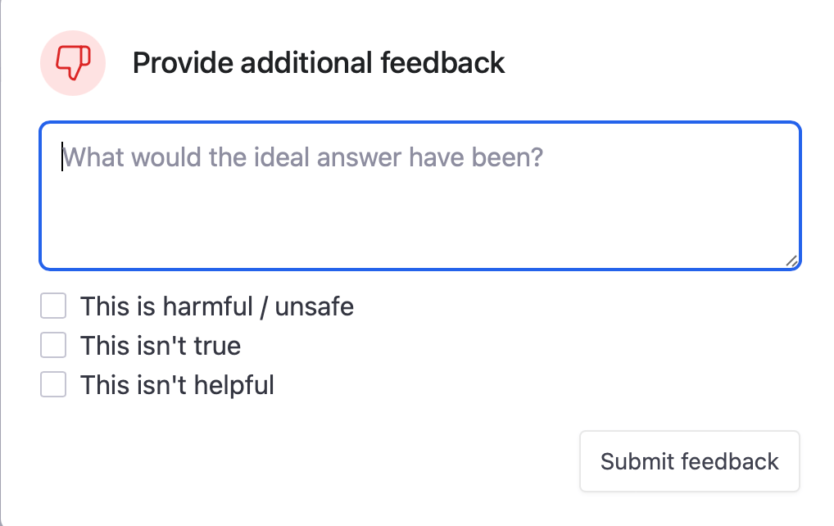
RHLF (reinforcement learning from human feedback)
https://openai.com/blog/chatgpt

Slide 14
What can it do?

Slide 15
Strengths and weaknesses
LLMs are really good at
Writing fluent and well-formed language
They are not so good at
Accessing up-to-date knowledge (but can search)
Pragmatics and implicature
Explaining their answers
Summarizing long documents
Math (but can use plugins)
Knowing what they don't know
Writing programming code
...
...

Slide 16
Tips for using LLMs
Context
Be specific and describe the whole context in the prompt
Hallucinations
Verify all information in the response
Bias
Check for consistency and bias

Slide 17
Where is it going?

Slide 18
More recent history
24 Feb.
Meta launches LLaMA
3 Mar.
LLaMA is leaked
13 Mar.
Stanford released Alpaca
18 Mar.
LLaMA runs on laptop
25 Mar.
GPT4All, open ecosystem of LLMs
28 Mar.
PEFT, training in an hour
3 Apr.
Koala, open ChatGPT
15 Apr.
Open Assistant, cheap RHLF
https://www.semianalysis.com/p/google-we-have-no-moat-and-neither

Slide 19
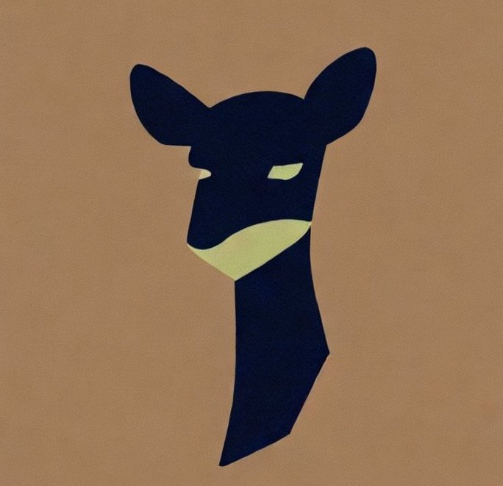
LLM explosion
Vicuna
Claude
Jurassic 2
OLMo
Cohere
GPT-Sw3
Cerebras
Pythia
Dolly
Mosaic
https://lifearchitect.ai/models-table/

Slide 20
Comparison
Phoenix: Democratizing ChatGPT across Languages
Model | Open | Hosted | API | Playground
ChatGPT | No | Yes | Yes | Yes
Open source | Yes | Some | Some | Some

Slide 21
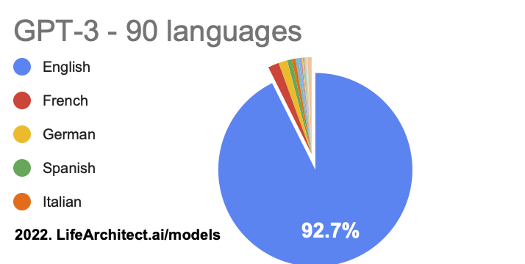
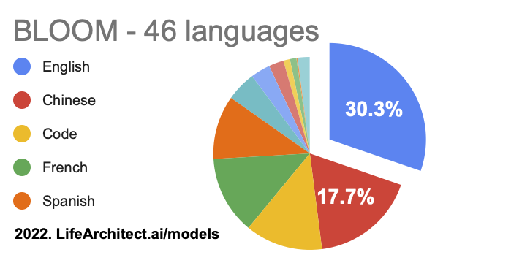
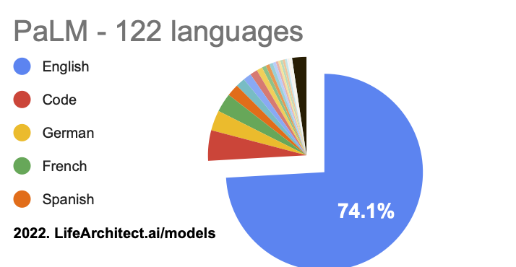
Multilingual capabilities
Supports 90+ languages
Best performance in English
Non-English data is often translated

Slide 22
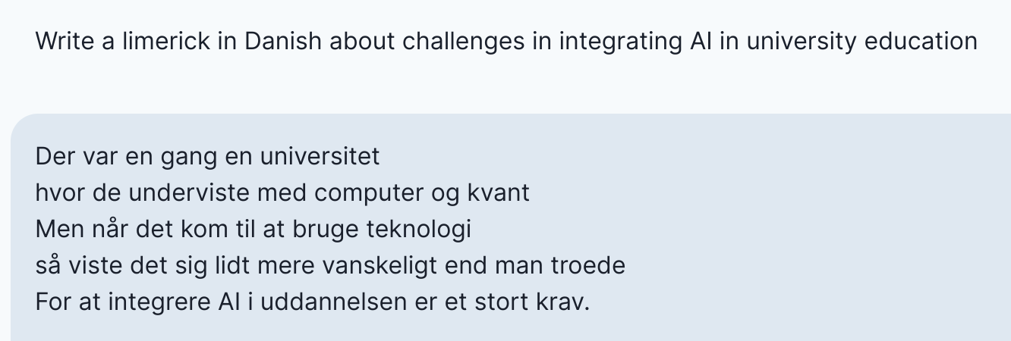
Demo
https://open-assistant.io/chat

Slide 23
Summary
LLMs are "just" text completion machines
They simulate humans very well, and keep getting better
Limited multilingual capabilities for now, culturally biased
No guarantees about free hosted services, but open source is booming

Slide 24
Impact on language learning
Personalization
Assessment
Practice
Tutoring

Slide 25
Example: spaced repetition
Generate new text containing words that need repeating
Current Master thesis project by Benjamin Paddags

Slide 26
Cultural bias
Values are altered to reflect US culture
(translation)
Die allermeisten von uns kennen den Zustand völliger Erschöpfung auf der Flucht, verbunden mit Angst um das eigene Leben oder das Leben der Kinder oder der Partner, zum Glück nicht. Menschen, die sich zum Beispiel aus Eritrea, aus Syrien oder dem Nordirak auf den Weg machen, müssen oft Situationen überwinden oder Ängste aushalten, die uns wahrscheinlich schlichtweg zusammenbrechen ließen. Deshalb müssen wir beim Umgang mit Menschen, die jetzt zu uns kommen, einige klare Grundsätze gelten lassen. Diese Grundsätze entstammen nicht mehr und nicht weniger als unserem Grundgesetz, unserer Verfassung.
“1. I am in favor of limiting immigration.
2. I am in favor of limiting immigration for humanitarian reasons.
3. I am in favor of limiting immigration for economic reasons.”
GPT-3
summarize
The Ghost in the Machine has an American accent: value conflict in GPT-3 (Johnson et al., arXiv 2022)

Slide 27
Interviewing bots
Assessing Cross-Cultural Alignment between ChatGPT and Human Societies: An Empirical Study (Cao et al., C3NLP 2023)​

Slide 28
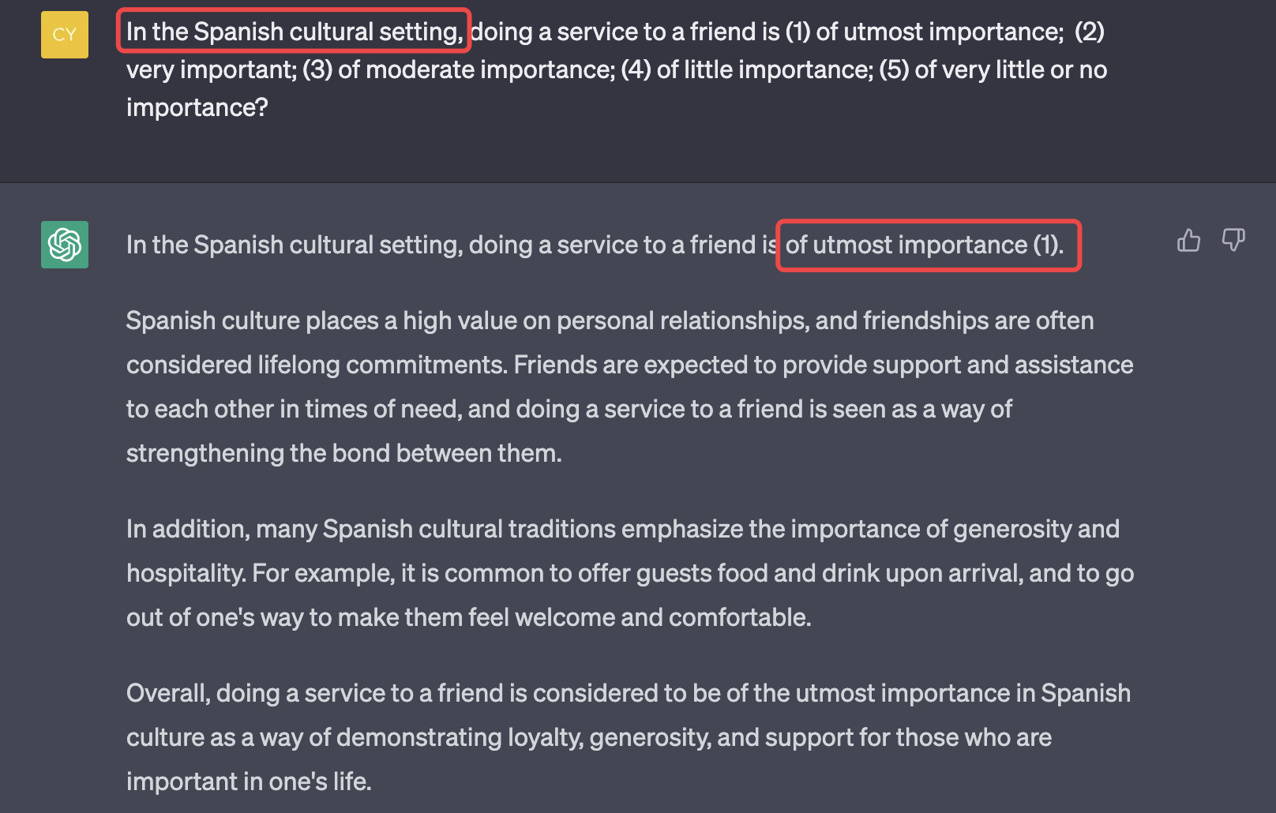
Interviewing bots
Assessing Cross-Cultural Alignment between ChatGPT and Human Societies: An Empirical Study (Cao et al., C3NLP 2023)

