Slide 1
Cultural Adaptation with and of Language Models
EACL 2023 workshop on Cross-Cultural Considerations in NLP
Daniel Hershcovich
May 5th, 2023

Slide 2
Agenda
Building NLP for various cultures
Using NLP to bridge between cultures
Understanding culture's role in NLP
Understanding cultures with NLP
Notes:
Mostly questions

Slide 3
What is culture?
shared beliefs, values, practices, behaviors, and artifacts
a system of symbols
characterizes a social group
learned, not innate
integrated with daily experience
taken-for-granted notions, rules, moralities, and behaviors
dynamic process through which social meanings are constructed
Cultural anthropology: Asking questions about humanity (Welsch and Vivanco, 2015)

Slide 4
Granularities of variation
Linguistic variation
Idiolect
Sociolect
Dialect
Standardized language
Language groups and families
Cultural variation
Individual, personality
Social group
Geographical region
Country, national culture
Global cultural community
Notes:
Culture is multifaceted and complex
There is enormous diversity among speakers of the same language
The information monoculture

Slide 5
Cultural dimensions in NLP
Challenges and Strategies in Cross-Cultural NLP (Hershcovich et al., ACL 2022)
Notes:
Understanding culture's role in NLP
Language and culture are intertwined
Guides rather than a strict decomposition
All dimensions but form are unobserved, the dark matter of AI: not only commonsense (Yejin Choi)
The main point: culture as a very high-dimensional object rather than a category

Slide 6
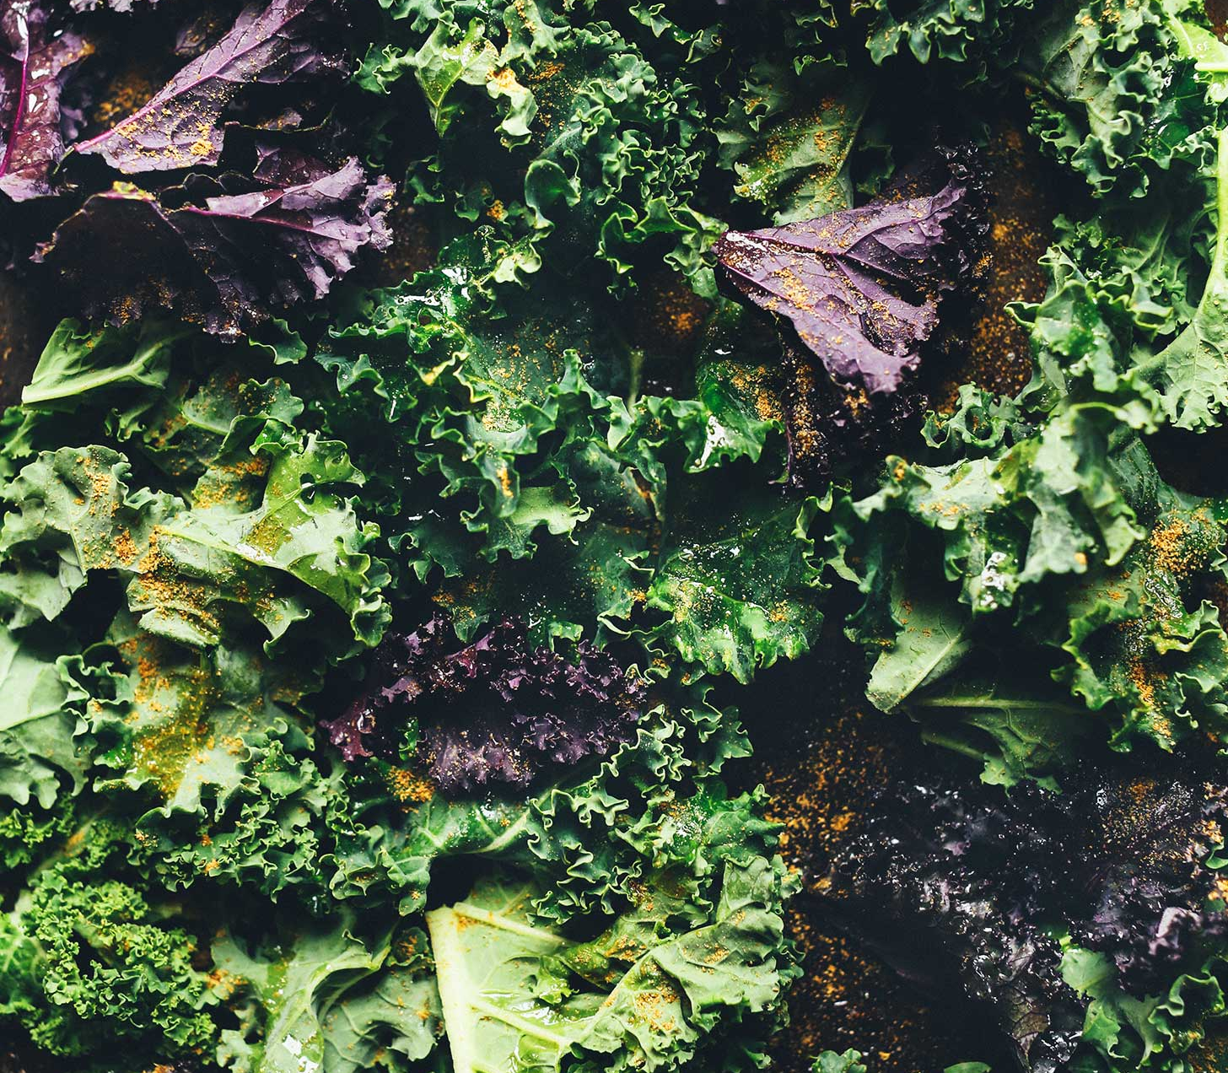
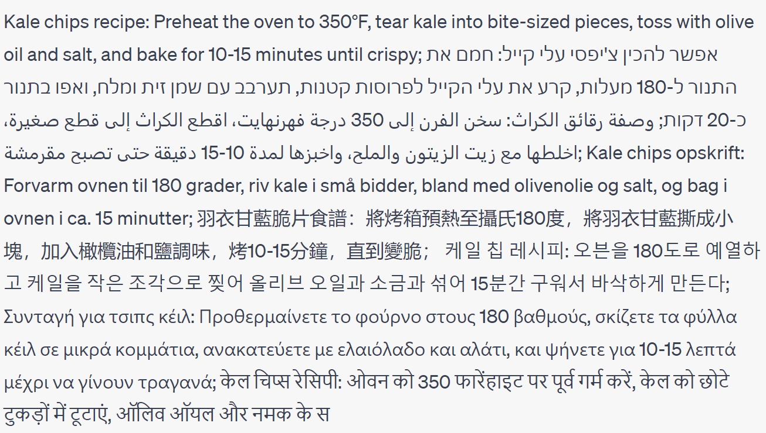
Linguistic form
Give me a one-sentence kale chips recipe in English, Hebrew, Arabic, Danish, Mandarin Chinese, Korean, Greek, Hindi, Bulgarian and Turkish. Do not say which languages they are.
Notes:
A popular web app to assist me in generating examples, not to showcase its AGI
Orthography, morphology, syntax, word choice, style

Slide 7
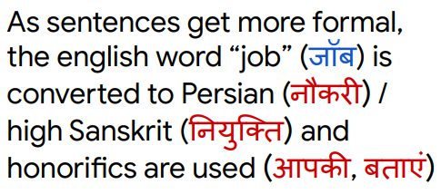
Style
HINDI
BRAZILIAN-PORTUGUESE
FRENCH
ITALIAN
Olá, Bonjour, Salve! XFORMAL: A Benchmark for Multilingual Formality Style Transfer (Briakou et al., NAACL 2021)
Few-shot Controllable Style Transfer for Low-Resource Multilingual Settings (Krishna et al., ACL 2022)
Notes:
Directness
Formality
Politeness
Emotional expression
Information order

Slide 8
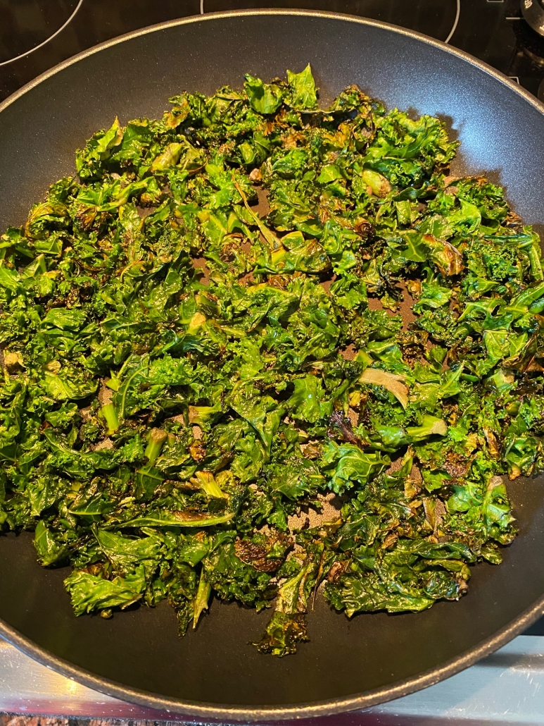
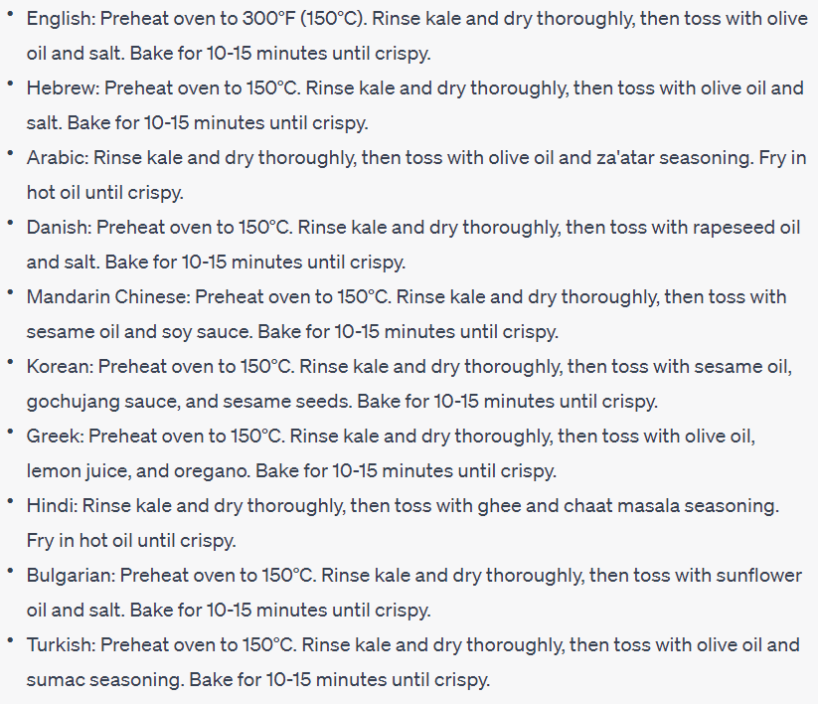
Common ground
Adapt the recipe to the common ingredients, cooking methods and tools in each culture's cuisine.
Notes:
Shared knowledge based on which people reason and communicate
Can also be about explaining methods in more detail if they are not commonly known

Slide 9
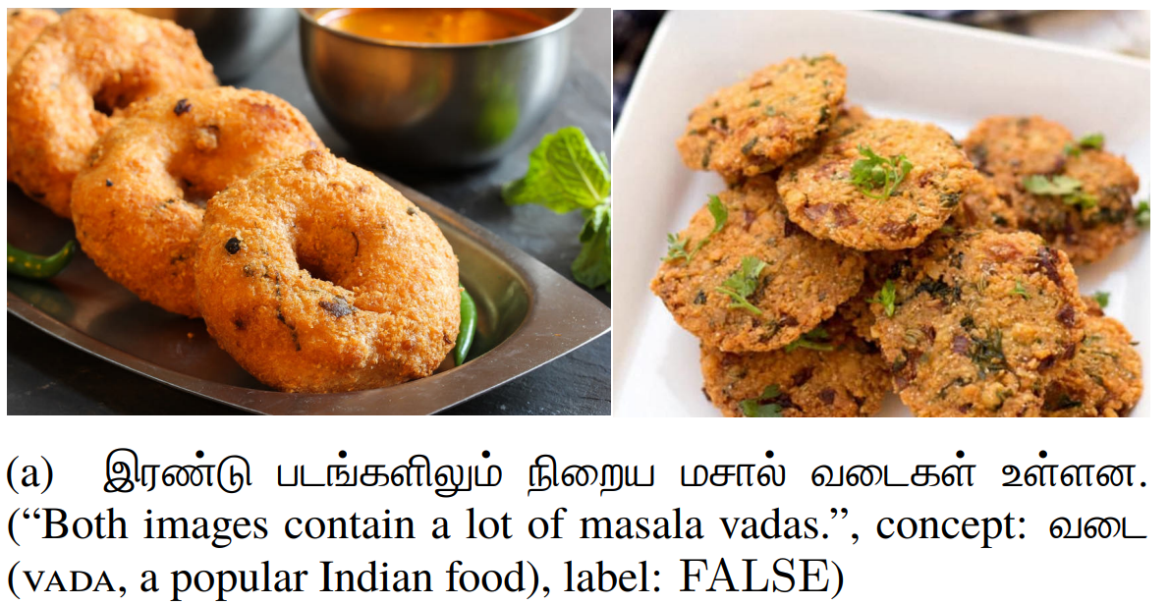
Conceptualization
Visually Grounded Reasoning across Languages and Cultures (Liu et al., EMNLP 2021)
Notes:
Visual concepts include culture-specific activities that cannot be mapped across cultures.
Objects
Colours
Kinship
Space
Time
Events

Slide 10
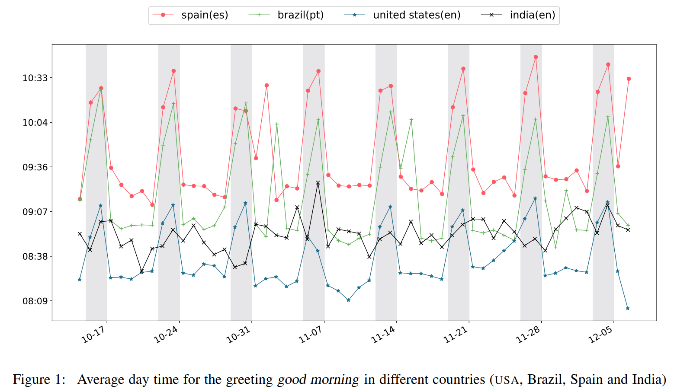
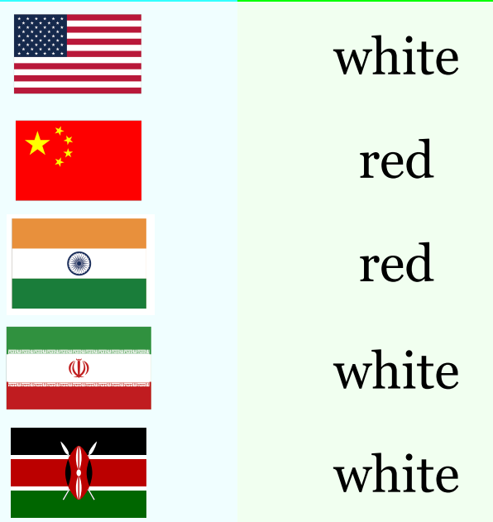
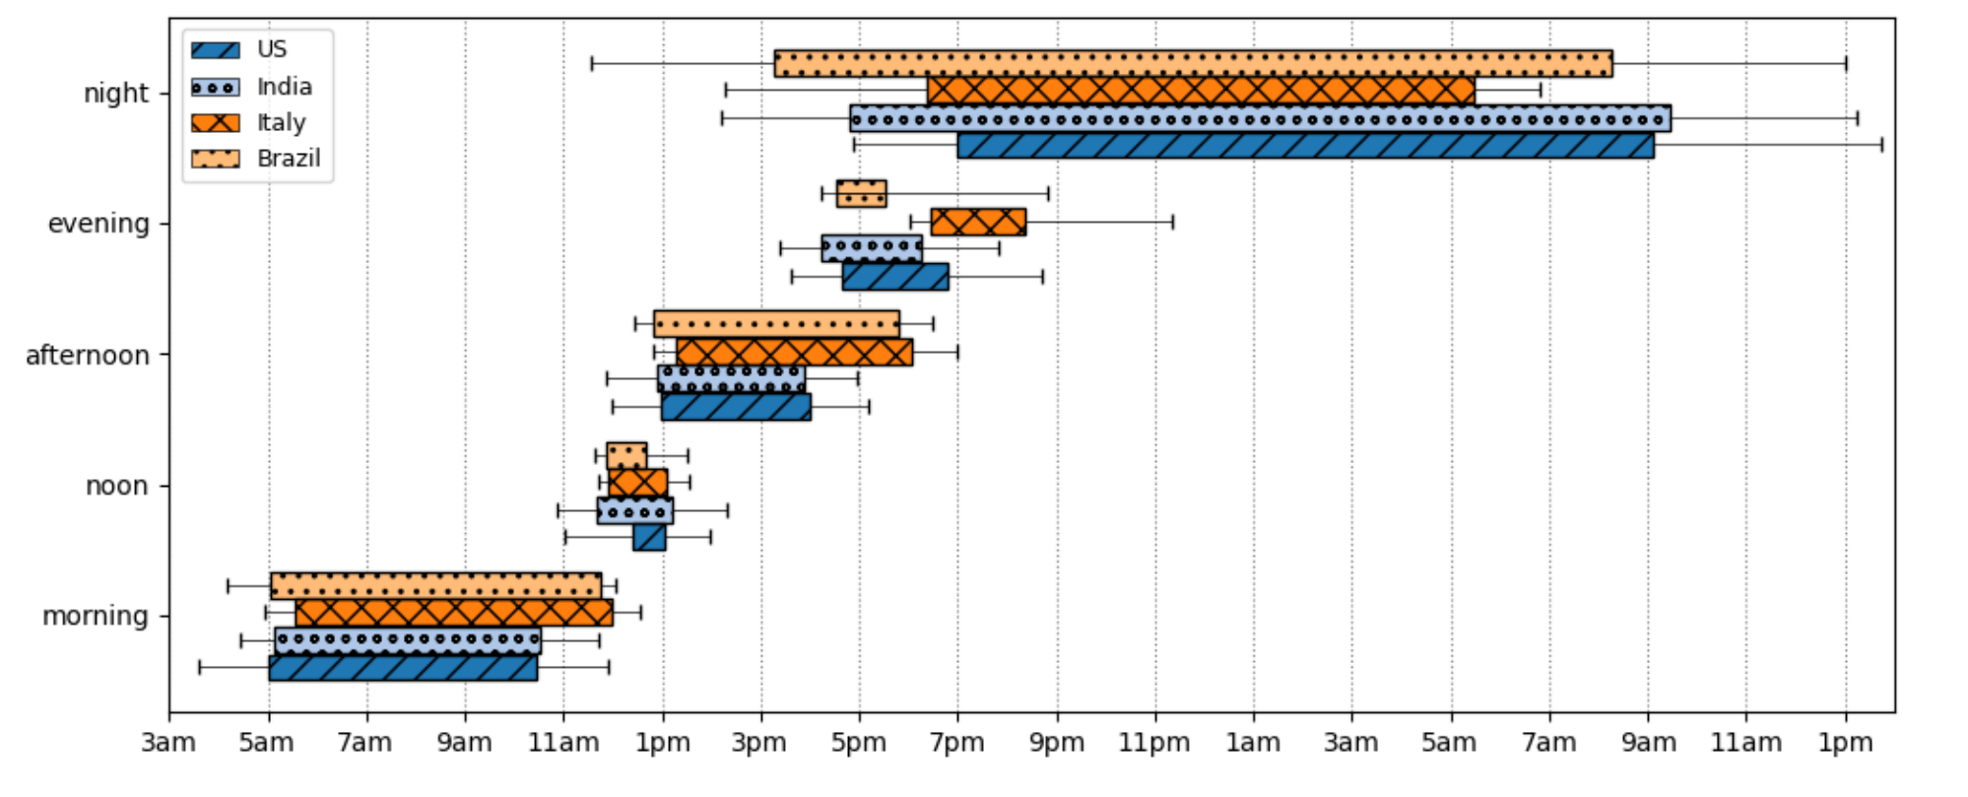
Commonsense
Geo-Diverse Concepts
Color of wedding dress
Shower time
Staple food
Driver seat side
Unit of measurement
…
Grounding the Semantics of Part-of-Day Nouns Worldwide using Twitter (Vilares & Gómez-Rodríguez, PEOPLES 2018)
GeoMLAMA: Geo-Diverse Commonsense Probing on Multilingual Pre-Trained Language Models (Yin et al., EMNLP 2022)
Good Night at 4 pm?! Time Expressions in Different Cultures (Shwartz, Findings 2022)
Notes:
"Commonsense is the basic level of practical knowledge and reasoning concerning everyday situations and events that are commonly shared among most people."
Physical
Social
Taxonomic
Temporal

Slide 11
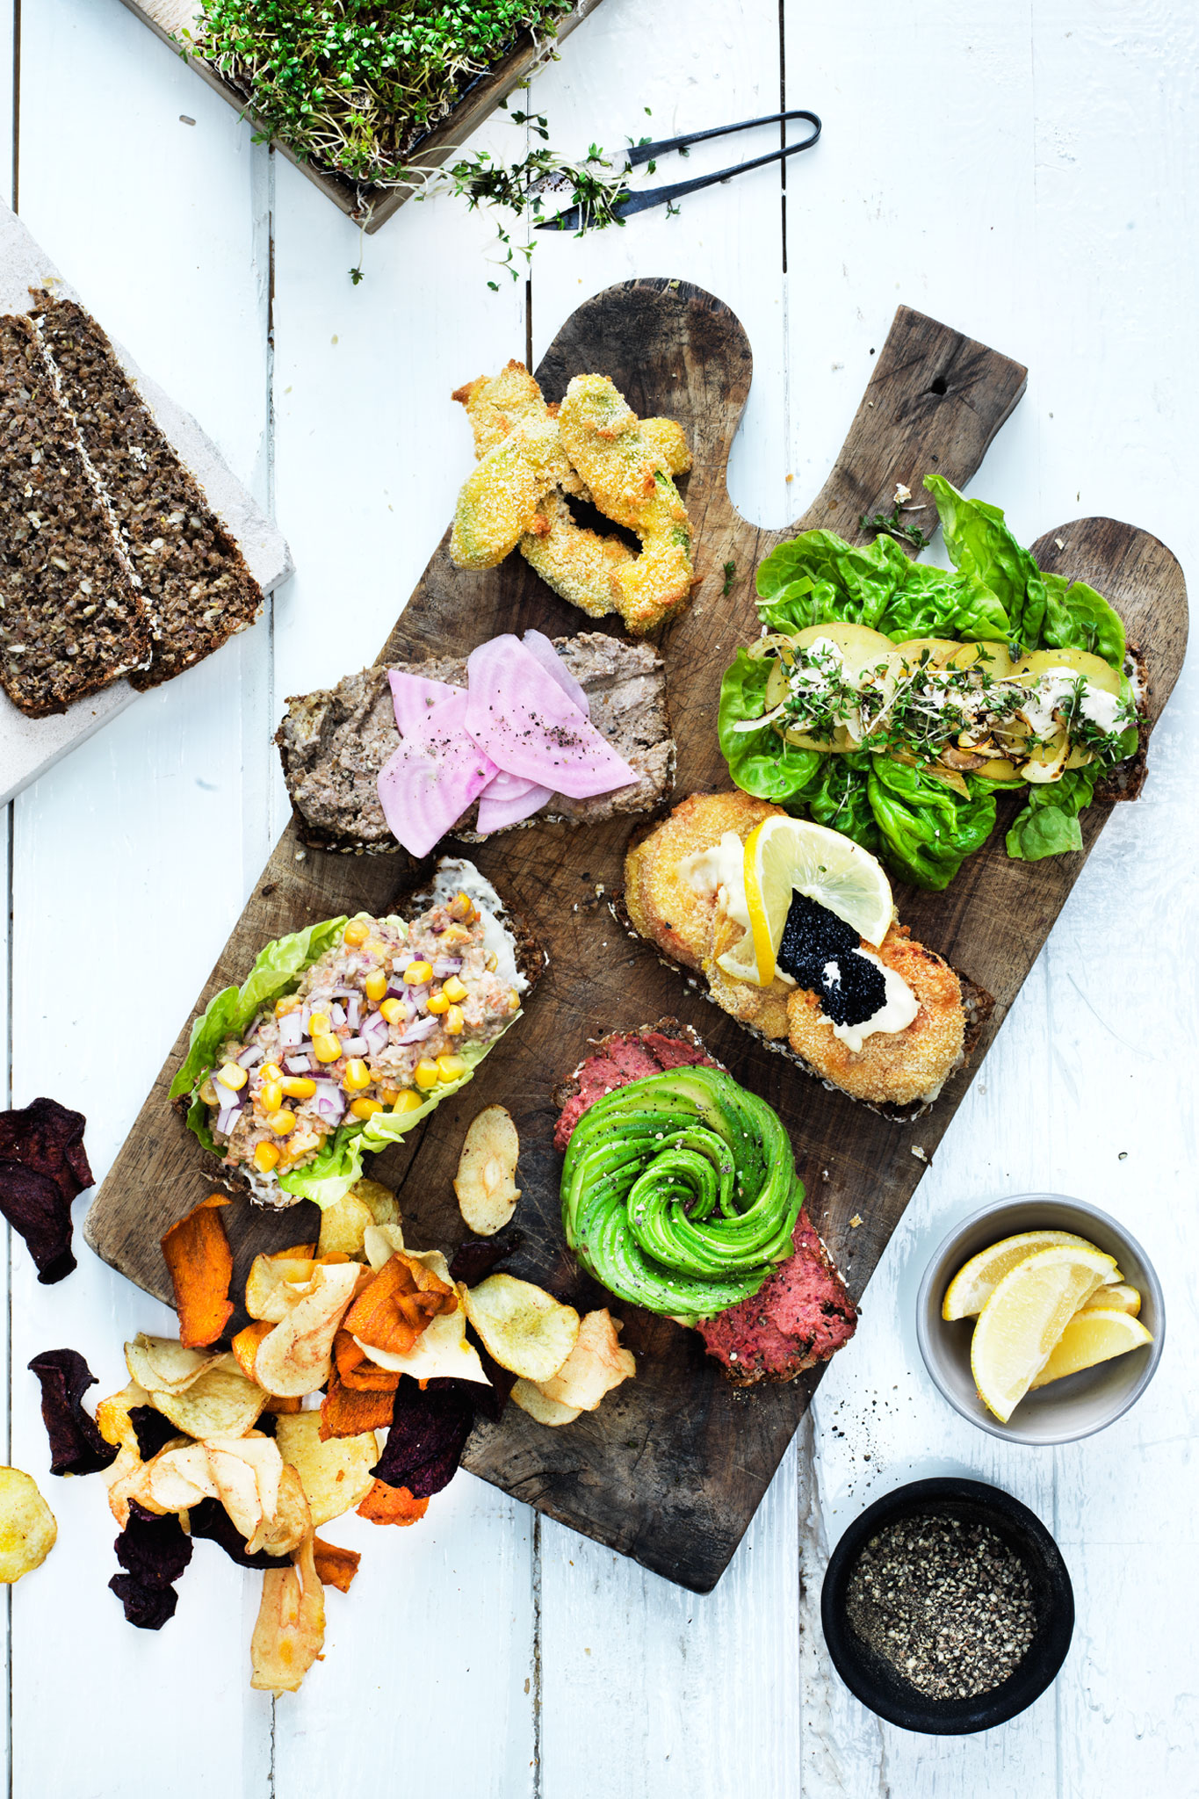
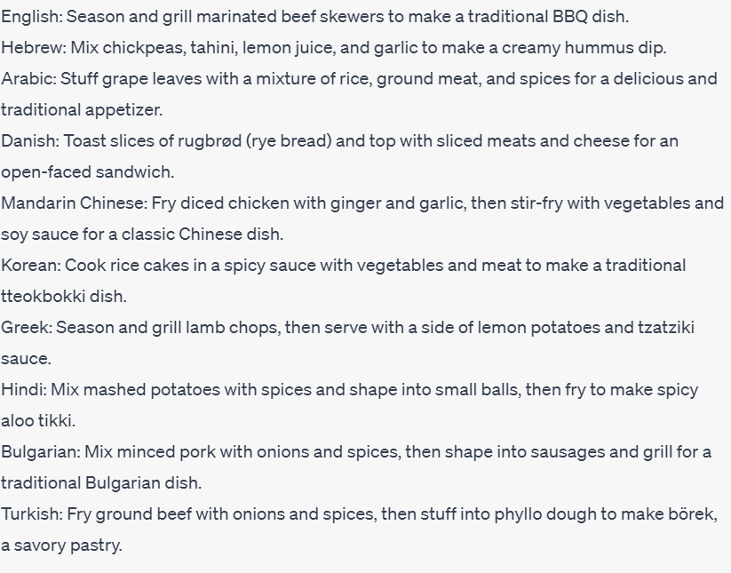
Aboutness
Give me one-sentence recipes for different culture-specific dishes in the following languages (without specifying the dish names): English, Hebrew, Arabic, Danish, Mandarin Chinese, Korean, Greek, Hindi, Bulgarian and Turkish
Notes:
What people care to talk about: topics, aspects, entities

Slide 12
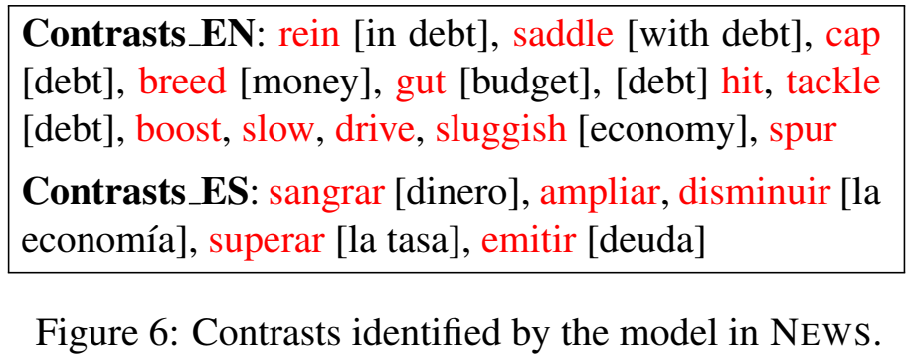
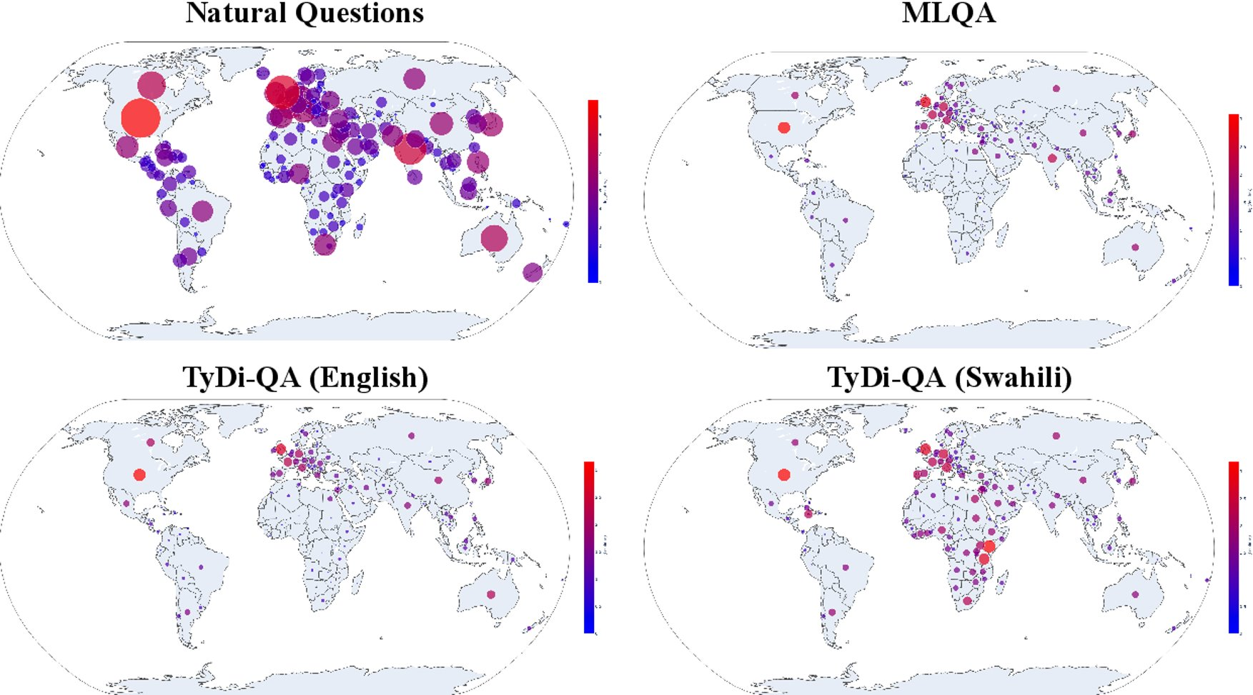
Topics and entities
Detecting Cross-Cultural Differences Using a Multilingual Topic Model (Gutiérrez et al., TACL 2016)
Dataset Geography: Mapping Language Data to Language Users (Faisal et al., ACL 2022)
Mining Cross-Cultural Differences and Similarities in Social Media (Lin et al., ACL 2018)

Slide 13
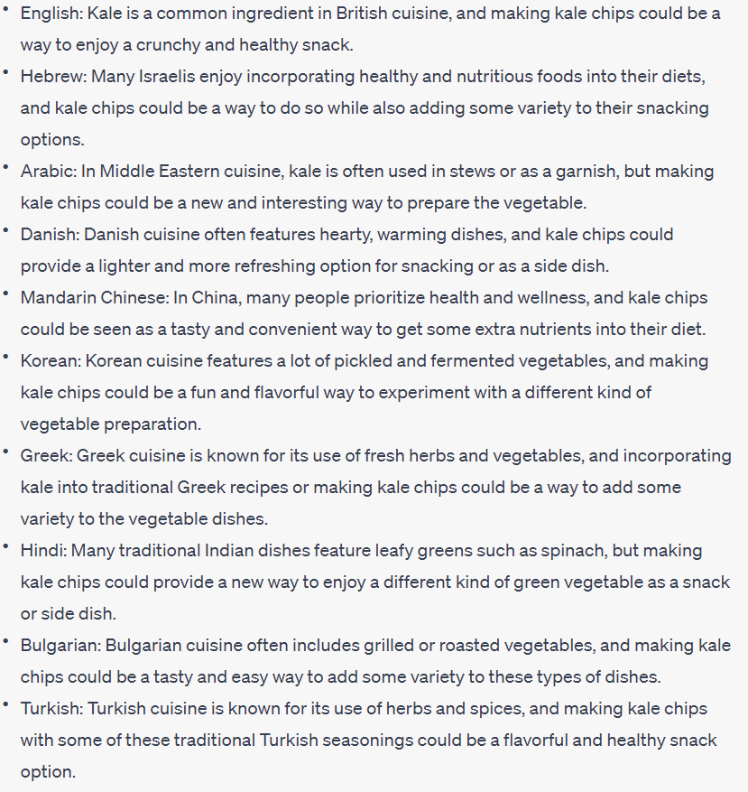
Objectives and values
For each of these cultures, give a specific reason for why they would even want to make kale chips
Reasons
Variety
Sustainability
Enjoyment
Health

Slide 14
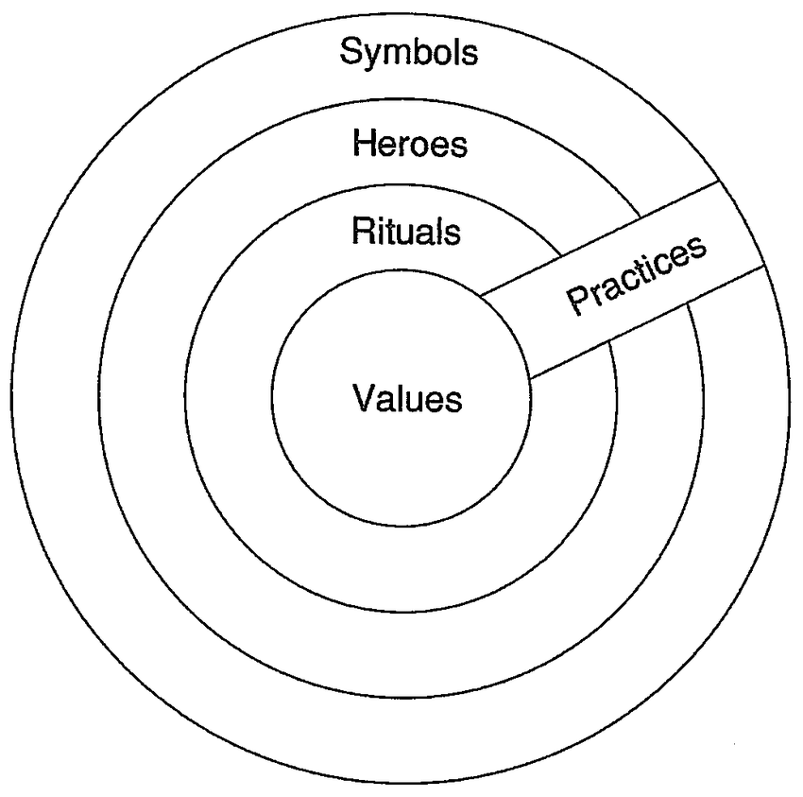
Moral values
Hofstede's Cultural Dimensions Theory
Power distance
Individualism/collectivism
Uncertainty avoidance
Masculinity/femininity
Long-term orientation/short-term orientation
Indulgence/restraint
World Values Survey
Traditional/secular-rational
Survival/self-expression
European Values Study
Personal freedom
Individual autonomy
Social solidarity
Ethnic tolerance
Civic honesty
Gender equality
Liberal democracy
Moral Foundations Theory
Care/harm
Fairness/cheating
Loyalty/betrayal
Authority/subversion
Sanctity/degradation
Liberty/oppression
Cultures and Organizations: Software of the Mind
(Hofstede, 1991)
Notes:
Fine-grained dimensions

Slide 15
Meta-objectives
The Values Encoded in Machine Learning Research (Birhane et al., ACM FAccT 2022)
Notes:
Why are we doing NLP? Kevin Munger: to publish papers and sell chatbot API subscriptions
Steven Bird: to teach other people our culture and build local intelligence – knowledge transmission

Slide 16
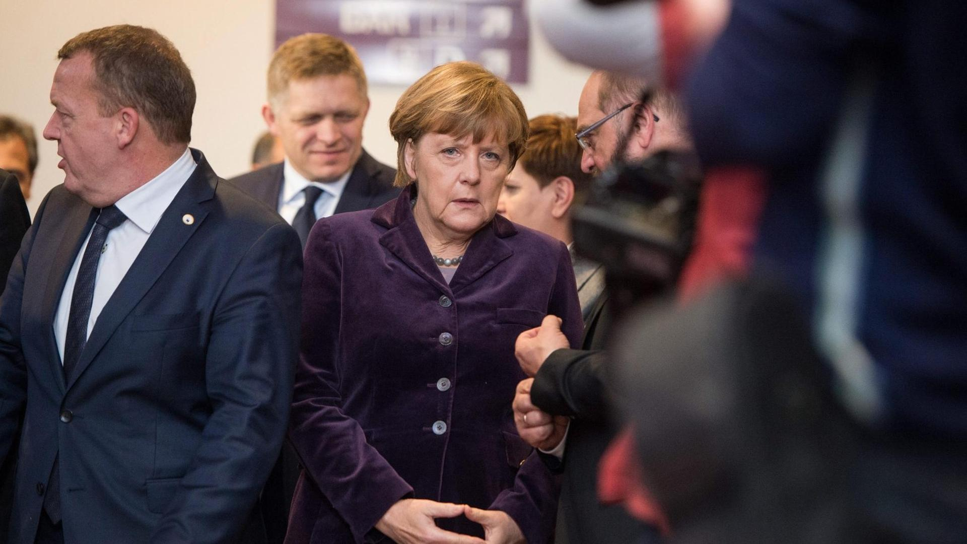
Value bias in language models
Values are altered to reflect US culture
(translation)
Die allermeisten von uns kennen den Zustand völliger Erschöpfung auf der Flucht, verbunden mit Angst um das eigene Leben oder das Leben der Kinder oder der Partner, zum Glück nicht. Menschen, die sich zum Beispiel aus Eritrea, aus Syrien oder dem Nordirak auf den Weg machen, müssen oft Situationen überwinden oder Ängste aushalten, die uns wahrscheinlich schlichtweg zusammenbrechen ließen. Deshalb müssen wir beim Umgang mit Menschen, die jetzt zu uns kommen, einige klare Grundsätze gelten lassen. Diese Grundsätze entstammen nicht mehr und nicht weniger als unserem Grundgesetz, unserer Verfassung.
“1. I am in favor of limiting immigration.
2. I am in favor of limiting immigration for humanitarian reasons.
3. I am in favor of limiting immigration for economic reasons.”
GPT-3
summarize
The Ghost in the Machine has an American accent: value conflict in GPT-3 (Johnson et al., arXiv 2022)
Notes:
Values picked up from the data but also from the developers

Slide 17
Adaptation of models
Culturally grounded objectives
Inference of desired target culture
Cultural prompts
Knowledge representation
Transfer learning
Notes:
Personalized dialogue

Slide 18
Culturally grounded objectives
Training
Transfer
Pre-training
Data
Models
Selection
Annotation
Projection
Tasks
Reflecting on meta-objectives
Co-design and stakeholder agency
Cross-disciplinary collaboration
Notes:
Culture-sensitive curation, Culturally diverse annotation, Native data or cultural translation
Robust optimization, Balanced sampling, Measuring cultural bias

Slide 19
Language (and culture) distribution
mT5: A Massively Multilingual Pre-trained Text-to-Text Transformer (Xue et al., NAACL 2021)
BLOOM: A 176B-Parameter Open-Access Multilingual Language Model (Le Scao et al., 2022)

Slide 20
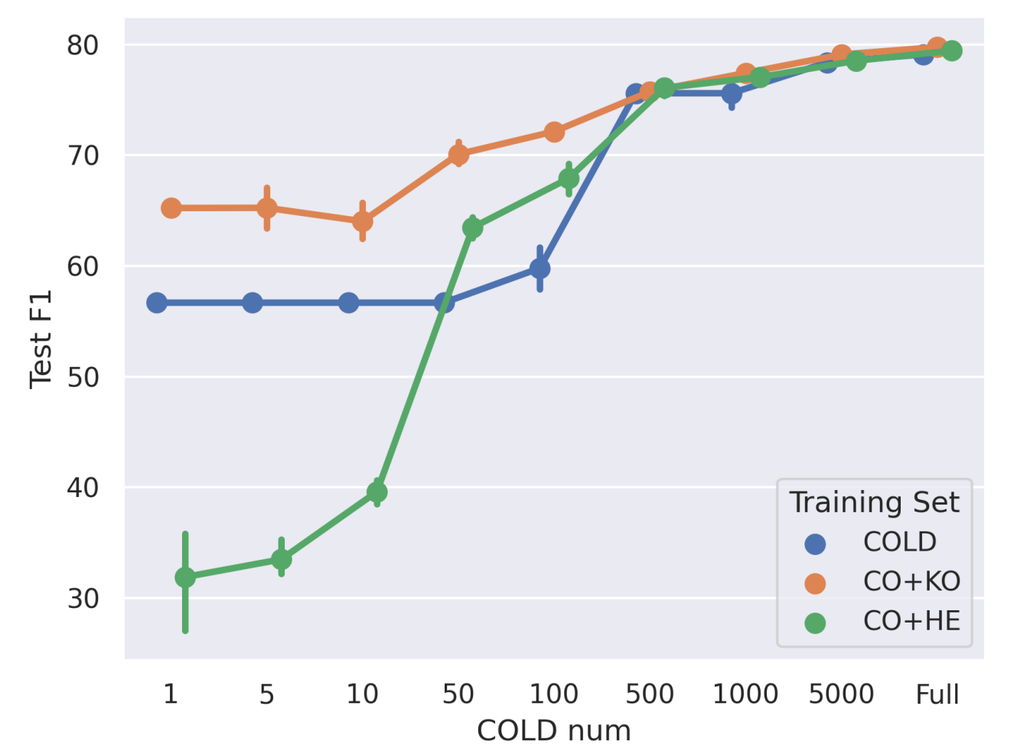
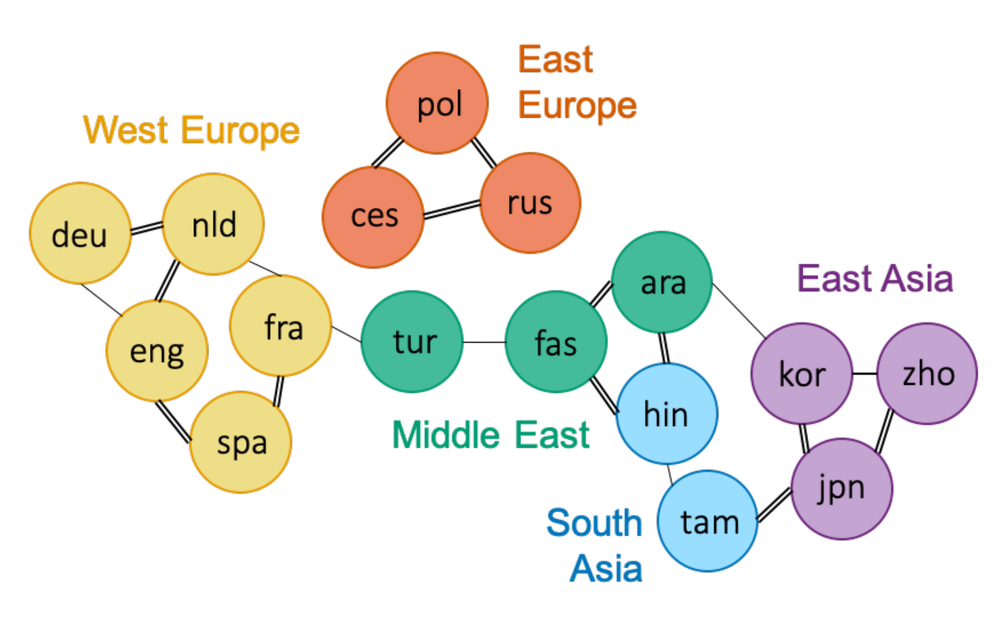
Transfer learning
(Emotion Semantics Distance)
China
Korea
US
Cross-Cultural Similarity Features for Cross-Lingual Transfer Learning of Pragmatically Motivated Tasks (Sun et al., EACL 2021)
Cross-Cultural Transfer Learning for Chinese Offensive Language Detection (Zhou et al., C3NLP 2023)
Notes:
Lexical differences: offensive words. Differences in stereotypes, values: what is considered good or bad.
Culture-specific biases in what is considered offensive negatively impact the transferability

Slide 21
Cultural prompts: interviewing bots
Large Pre-trained Language Models Contain Human-like Biases of What is Right and Wrong to Do (Schramowski et al., Nature Machine Intelligence 2022)
Speaking Multiple Languages Affects the Moral Bias of Language Models (Hämmerl et al., arXiv 2022)
Probing Pre-Trained Language Models for Cross-Cultural Differences in Values (Arora et al., C3NLP 2023)
Assessing Cross-Cultural Alignment between ChatGPT and Human Societies: An Empirical Study (Cao et al., C3NLP 2023)
Notes:
Controversial. I agree with Kevin Munger, bots should not use the word “I”

Slide 22
Knowledge vs. identity
Assessing Cross-Cultural Alignment between ChatGPT and Human Societies: An Empirical Study (Cao et al., C3NLP 2023)
Notes:
Cannot assume identity
Low correlations overall
Highest correlation with USA
Better correlation when prompting in the corresponding language

Slide 23
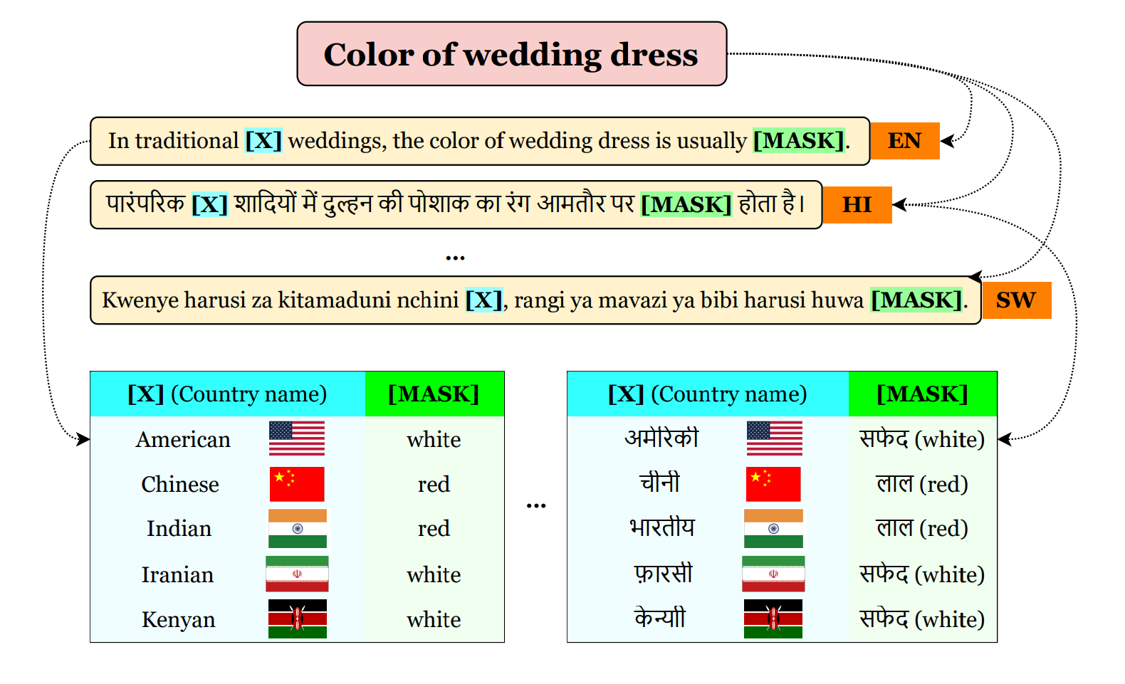
Commonsense probing
GeoMLAMA: Geo-Diverse Commonsense Probing on Multilingual Pre-Trained Language Models (Yin et al., EMNLP 2022)
Notes:
LMs are not intrinsically biased towards US knowledge; the native language of a country may not be the best language to probe its knowledge (reporting bias)

Slide 24
Factual knowledge probing
Consistency
Multilingual LAMA: Investigating Knowledge in Multilingual Pretrained Language Models (Kassner et al., EACL 2021)
Factual Consistency of Multilingual Pretrained Language Models (Fierro & Søgaard, Findings 2022)
Notes:
The language of prompting affects the model's answer to prompts
Varying performance across languages
Pooling predictions across languages improves performance
mBERT and XLM-R exhibit a high degree of inconsistency in English and even more so for all the other 45 languages.

Slide 25
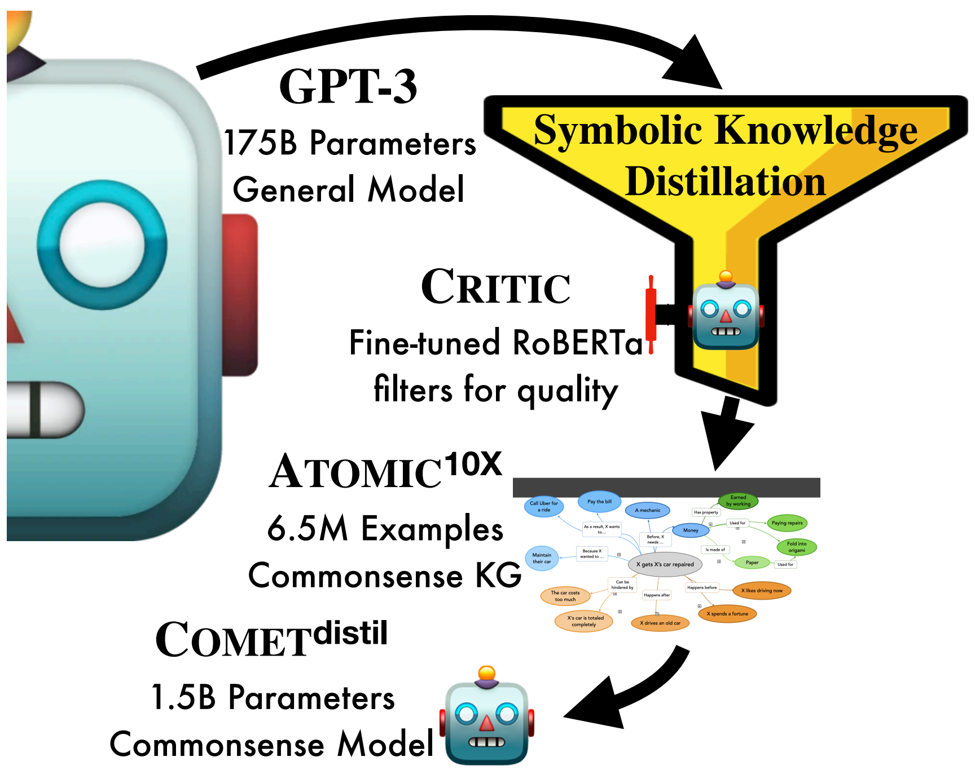
Knowledge representation
BeliefBank: Adding Memory to a Pre-Trained Language Model for a Systematic Notion of Belief (Kassner et al., EMNLP 2021)
Symbolic Knowledge Distillation: from General Language Models to Commonsense Models (West et al., NAACL 2022)
Notes:
All cultures - in particular cultures without large amounts of textual data require humans to define the knowledge and objectives

Slide 26
Who decides what is the desired target culture?
Researchers
Practitioners
End-users
Affected communities
Regulators
"content generated by AI needs to reflect the core values of socialism"
Cyberspace Administration of China, 11 April 2023
Notes:
recently published draft guidelines

Slide 27
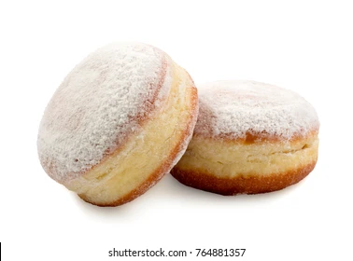
Cultural translation
Entities
Recipes
凉拌秋葵
用料
秋葵 20根左右
生抽 2-3勺
醋 1勺
蚝油 1勺
做法
将秋葵洗净放开水中焯2分钟左右。
开水中放盐一勺，油一勺，这样秋葵颜色翠绿鲜艳）...
香油 1勺
糖 1勺
蒜 3-5瓣
盐 酌量
绿芥末膏不用也行 酌量
„Ich habe Merkel gesehen, als sie im ICE einen Berliner von Dietsch gegessen hat“
Chinese Okra Salad
Ingredients
8 oz (225 g) okra
2 teaspoons light soy sauce (or soy sauce)
1/2 teaspoons green Sichuan pepper oil (or more to taste)
Instructions
Bring a medium pot of water to a boil. Add 1 teaspoon vegetable oil and a pinch of salt...
I saw Biden eating a Boston Cream from Dunkin’ Donuts on the Acela
Adapting Entities across Languages and Cultures
(Peskov et al., Findings of EMNLP 2021)

Slide 28
Domains
Notes:
Countless areas. Challenging to define! Requires expertise. Subjective. But still worth it because it allows breaking barriers

Slide 29
Adaptation with models
Retrieval of comparable cross-cultural examples
Style transfer models trained on unpaired data
Human-authored references and human evaluation
Supervised models trained on paired data
Notes:
Personalized dialogue, fairness

Slide 30
Conclusion
LMs are not culturally universal, but they can be adapted
We can use LMs to bridge between cultures
We must think outside the NLP box to do these things

Slide 31
Thanks! danielhers.github.io dh@di.ku.dk
@daniel_hers
sigmoid.social/@dh

Slide 32
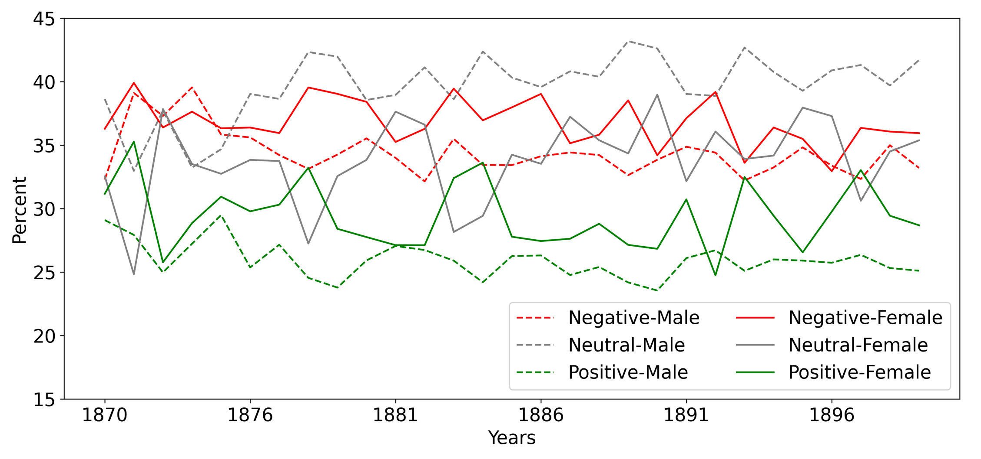
Culture is dynamic
Sentiment Classification of Historical Danish and Norwegian Literary Texts (Al-Laith et al., accepted to NoDaLiDa 2023)

Slide 33
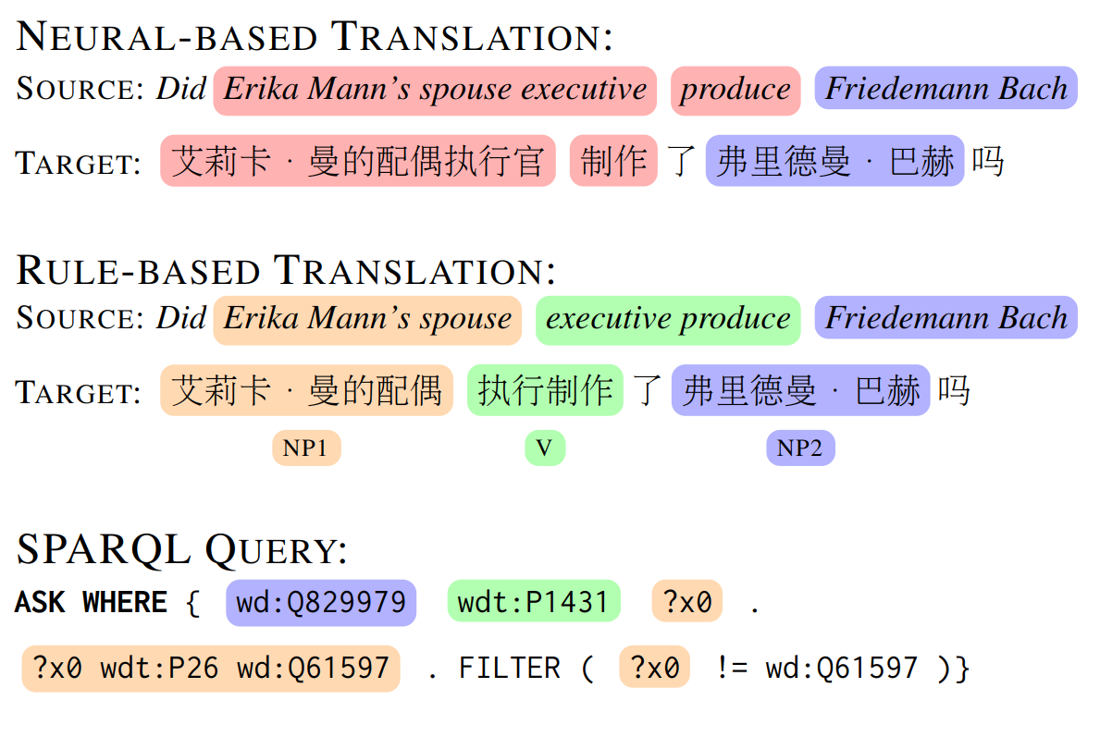
Translated datasets
Compositional Generalization in Multilingual Semantic Parsing over Wikidata (Cui et al., TACL 2022)
On Evaluating Multilingual Compositional Generalization with Translated Datasets (Wang and Hershcovich, accepted to ACL 2023)
Notes:
Automatic translation entails semantic distortions.
Any translation entails simplification, decreased diversity and ignores concepts, knowledge and compositions specific to the target language/culture.

