Slide 1
Cultural Understanding and Adaptation with AI
Linguistics and English Language Seminar
University of Manchester
February 28, 2024
Daniel Hershcovich
Notes:
##-AccessibilityAssistant: Skip layout check-##

Slide 2
Who I am – Daniel Hershcovich
2005–2010
The Open University of Israel
Math & Computer Science
2008–2019
IBM Research
GPro, Debater
2012–2019
The Hebrew University of Jerusalem
ELSC
2019
University of Copenhagen
Natural Language Processing

Slide 3
What this talk is about
Cultural considerations in Natural Language Processing (NLP)
Culturally adaptive Large Language Models (LLMs)
Cross-cultural adaptation of linguistic content

Slide 4
What is culture?
shared beliefs, values, practices, behaviors, and artifacts
a system of symbols
characterizes a social group
learned, not innate
integrated with daily experience
taken-for-granted notions, rules, moralities, and behaviors
dynamic process through which social meanings are constructed
Cultural anthropology: Asking questions about humanity (Welsch and Vivanco, 2015)

Slide 5
Granularities of variation
Linguistic variation
Idiolect
Sociolect
Dialect
Standardized language
Language groups and families
Cultural variation
Individual, personality
Social group
Geographical region
Country, national culture
Global cultural community
Notes:
Culture is multifaceted and complex
There is enormous diversity among speakers of the same language
The information monoculture

Slide 6
Cultural Dimensions in NLP
Challenges and Strategies in Cross-Cultural NLP (Hershcovich et al., ACL 2022)
Notes:
Understanding culture's role in NLP
Language and culture are intertwined
Guides rather than a strict decomposition
All dimensions but form are unobserved, the dark matter of AI: not only commonsense (Yejin Choi)
The main point: culture as a very high-dimensional object rather than a category

Slide 7
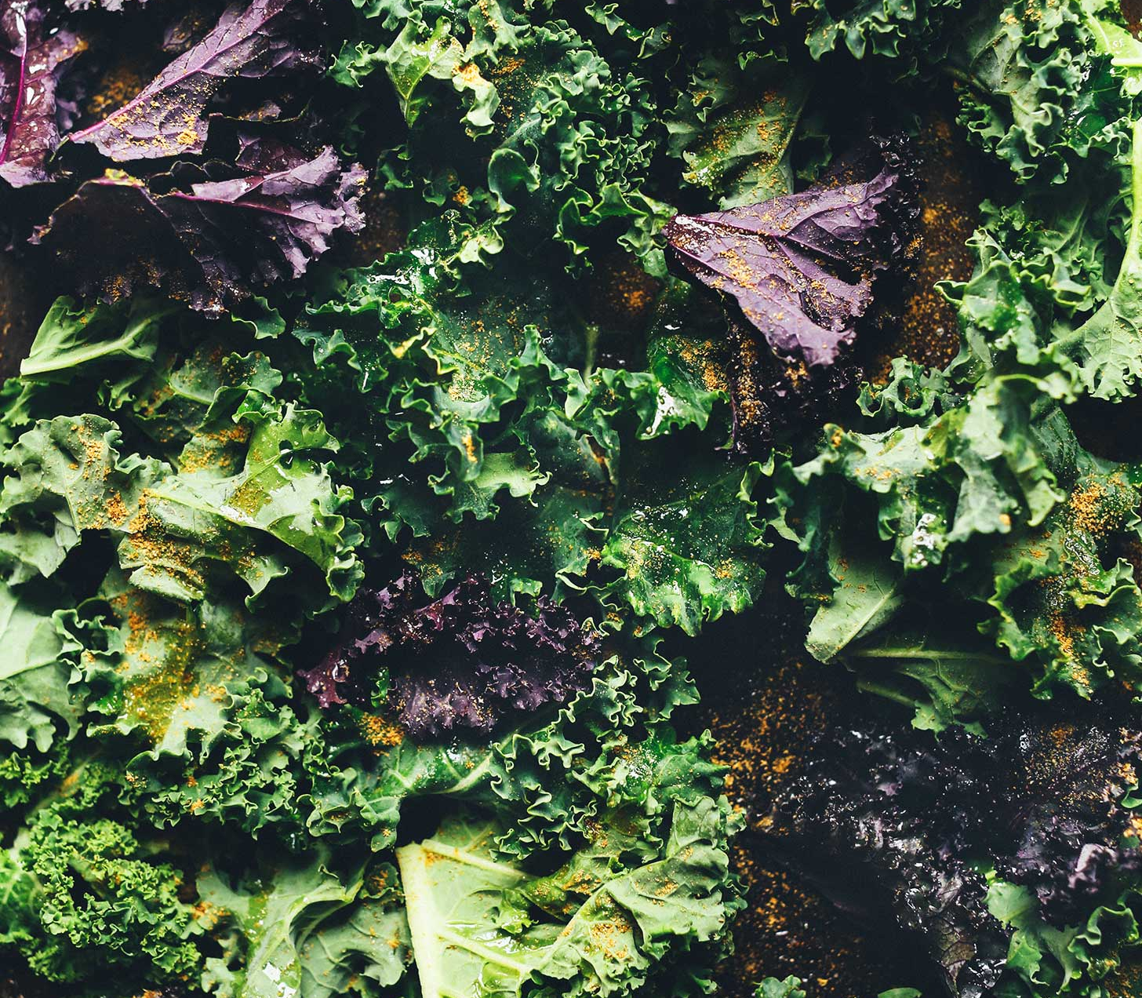
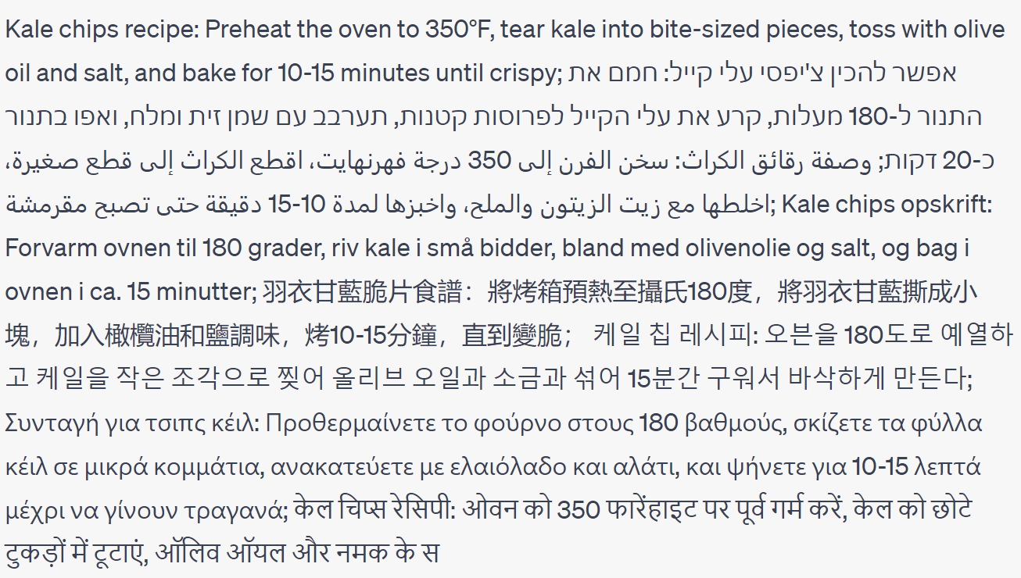
Linguistic form
Give me a one-sentence kale chips recipe in English, Hebrew, Arabic, Danish, Mandarin Chinese, Korean, Greek, Hindi, Bulgarian and Turkish. Do not say which languages they are.
Notes:
A popular web app to assist me in generating examples, not to showcase its AGI
Orthography, morphology, syntax, word choice, style

Slide 8
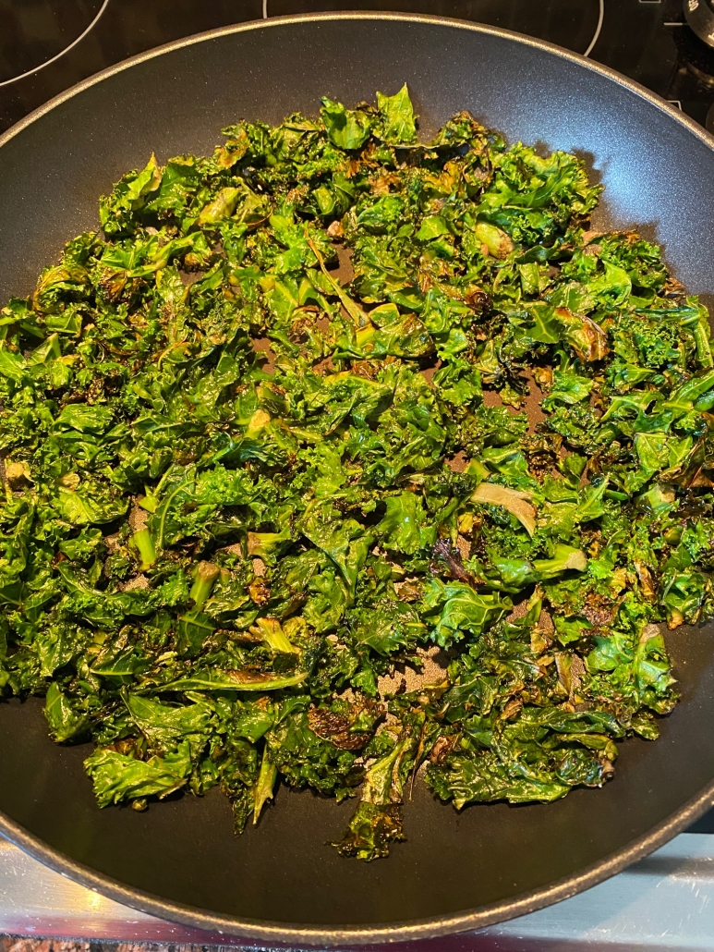
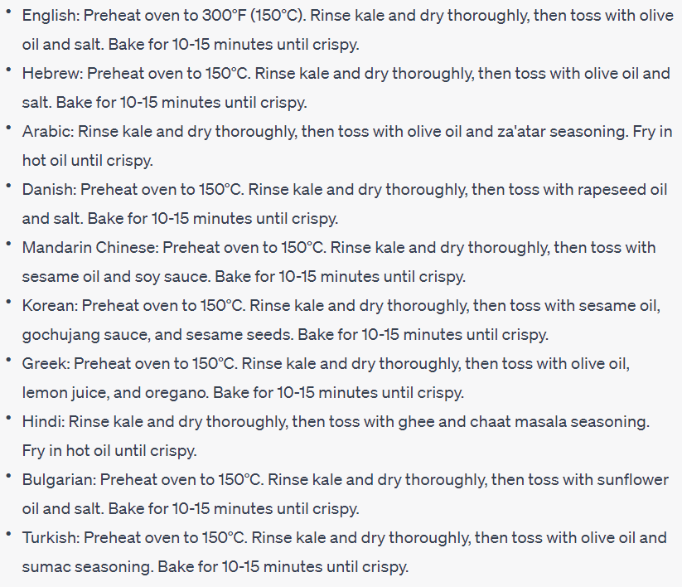
Common ground
Adapt the recipe to the common ingredients, cooking methods and tools in each culture's cuisine.
Notes:
Shared knowledge based on which people reason and communicate
Can also be about explaining methods in more detail if they are not commonly known

Slide 9
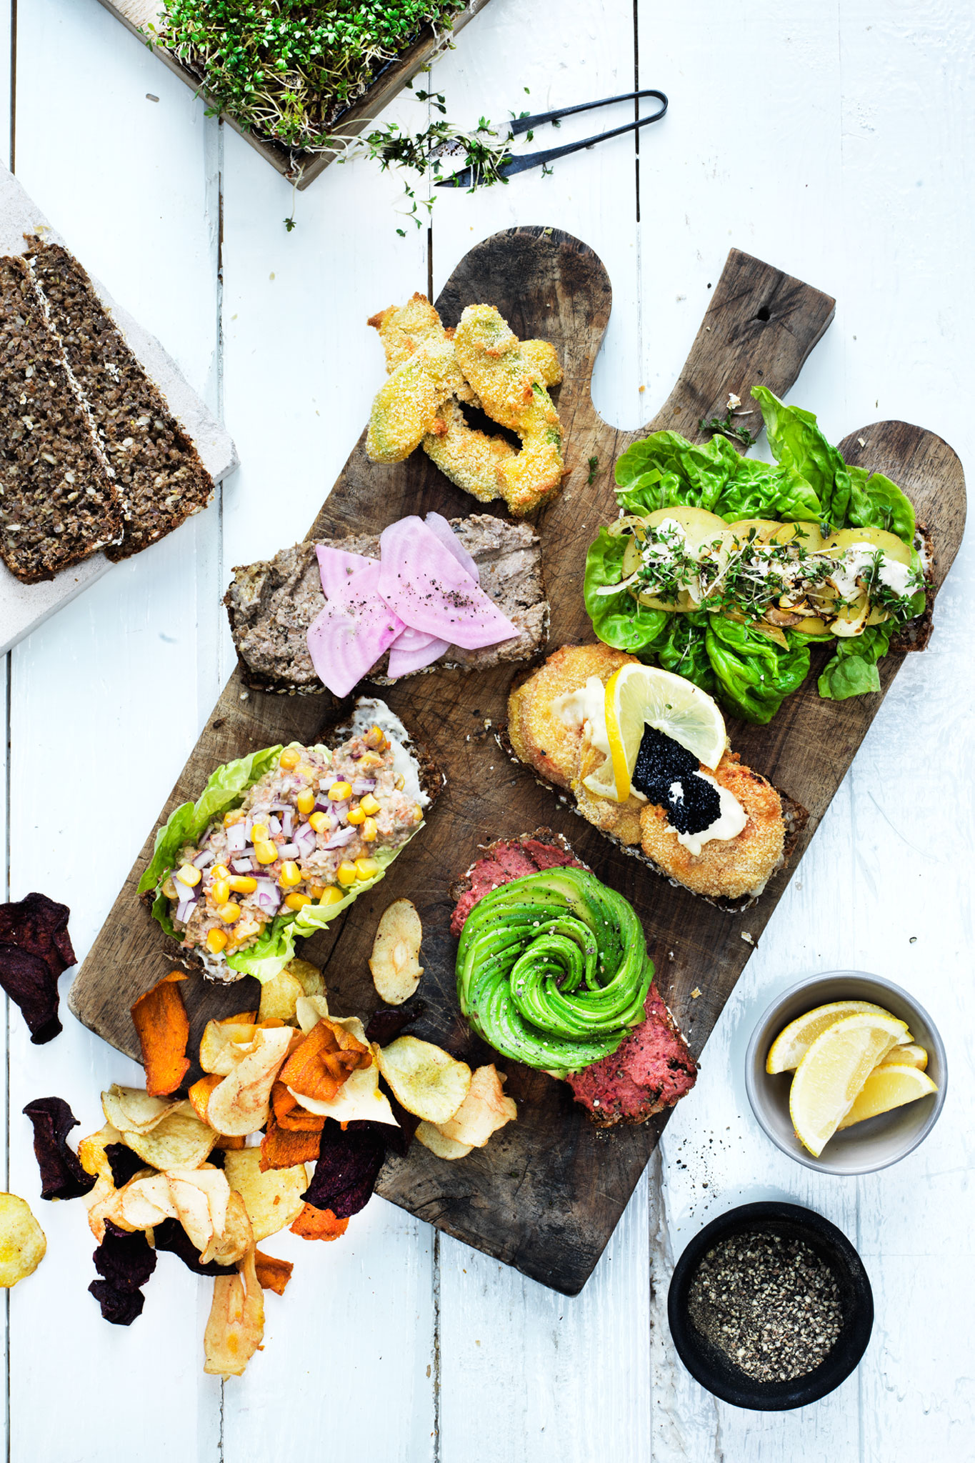
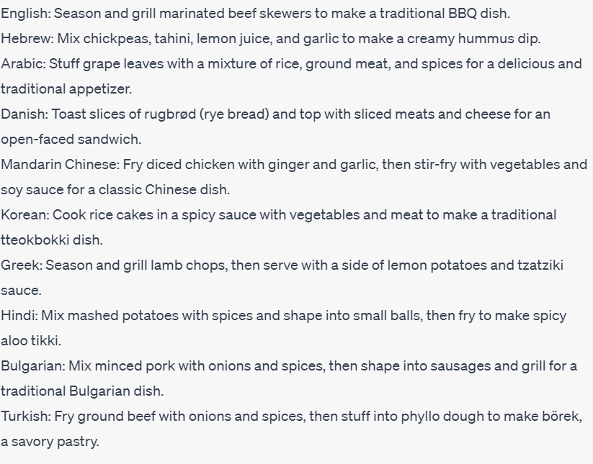
Aboutness
Give me one-sentence recipes for different culture-specific dishes in the following languages (without specifying the dish names): English, Hebrew, Arabic, Danish, Mandarin Chinese, Korean, Greek, Hindi, Bulgarian and Turkish
Notes:
What people care to talk about: topics, aspects, entities

Slide 10
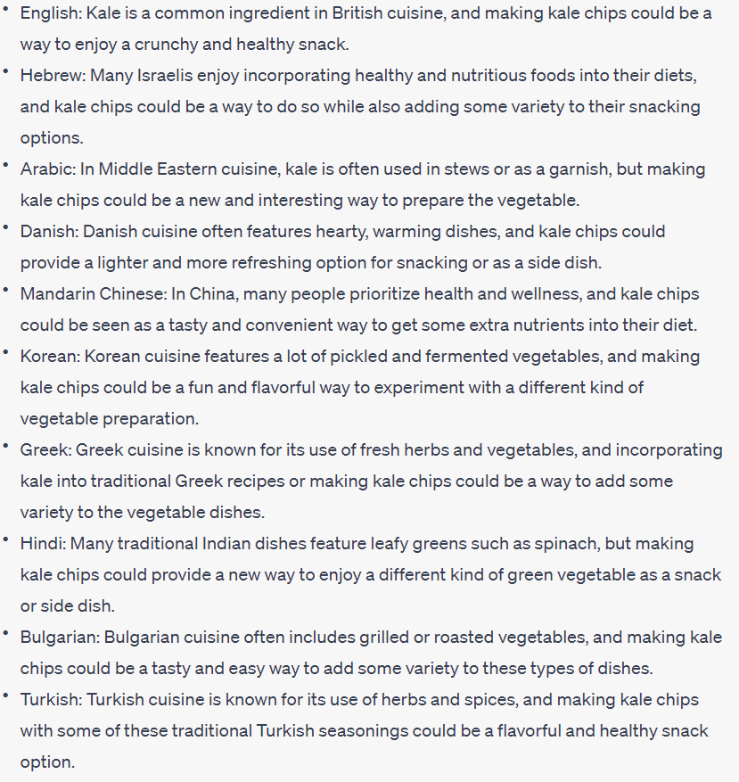
Objectives and values
For each of these cultures, give a specific reason for why they would even want to make kale chips
Reasons
Variety
Sustainability
Enjoyment
Health

Slide 11
Culturally adaptive models
Objective:
Models that work for various cultures (or languages) without duplicating development efforts for each
Dominant approach since 2018:
Cross-lingual model transfer (multilingual pre-training)
But performance varies widely
And language ≠ culture!
How Multilingual is Multilingual BERT? (Pires et al., ACL 2019)

Slide 12
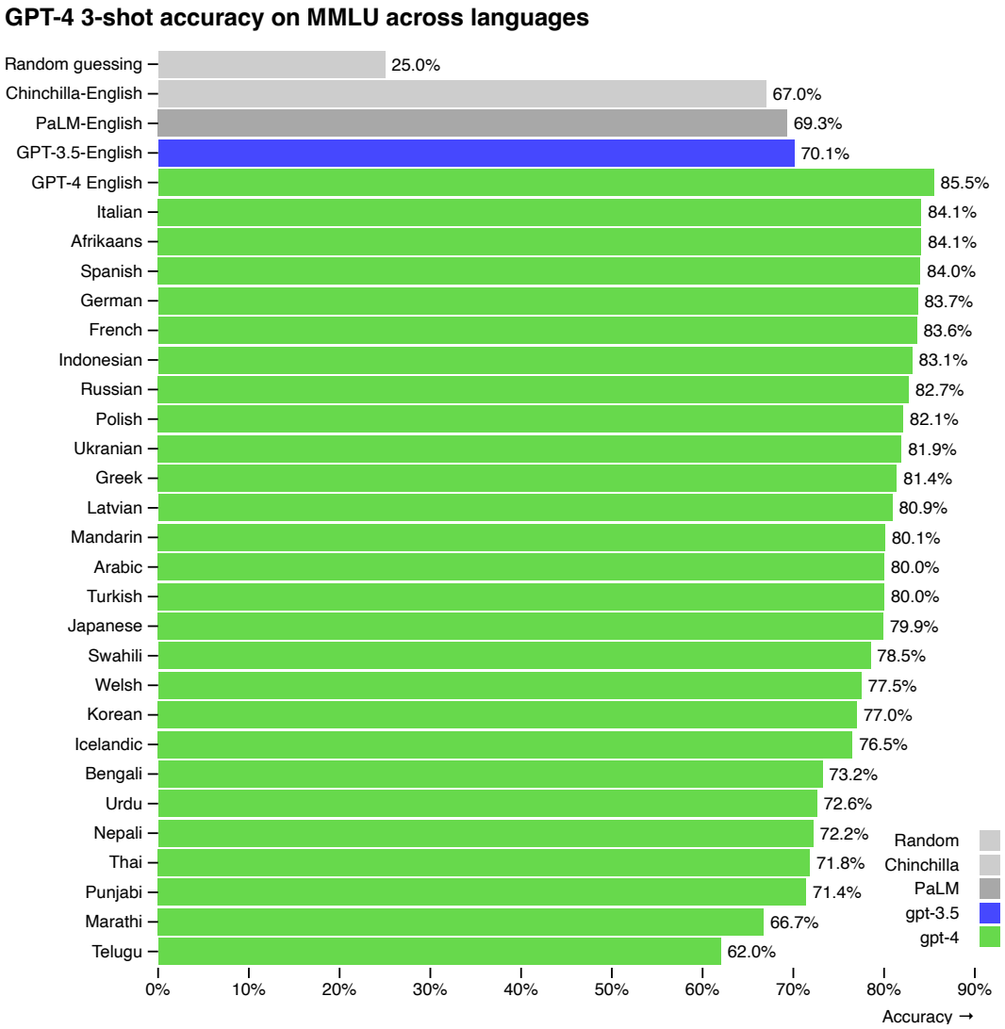
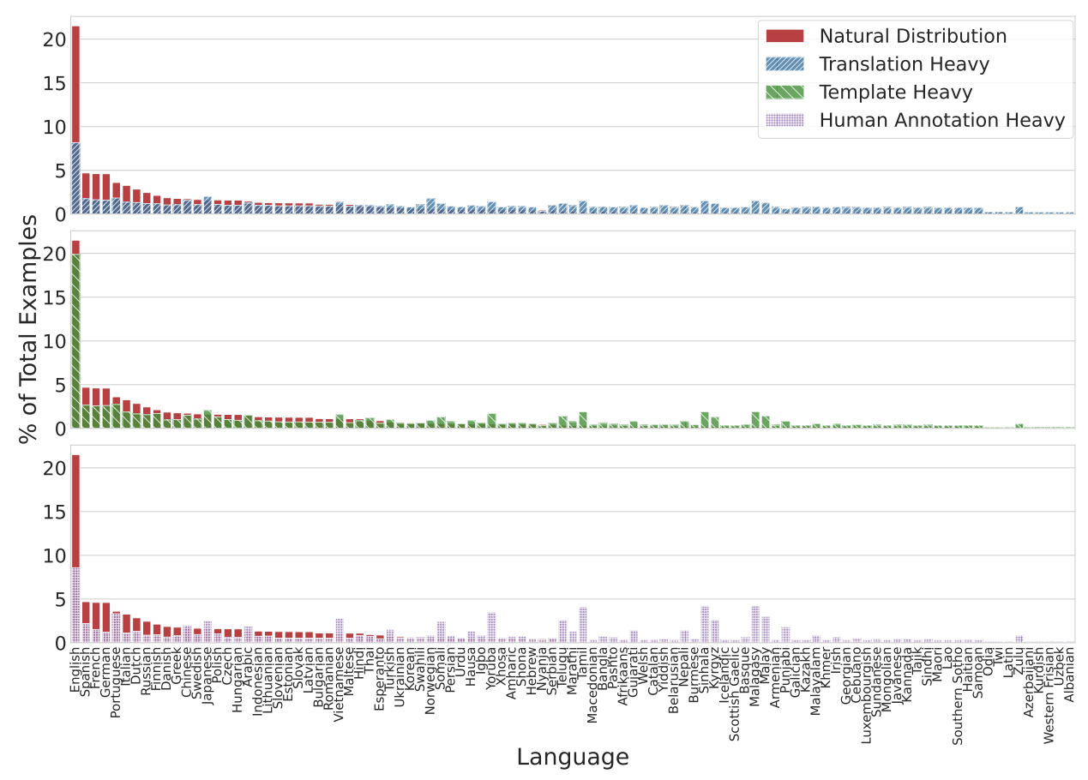
Cross-lingual model transfer
Aya Model: An Instruction Finetuned Open-Access Multilingual Language Model Üstün, Ahmet, et al. (2024)
GPT-4 technical report (OpenAI, 2023)

Slide 13
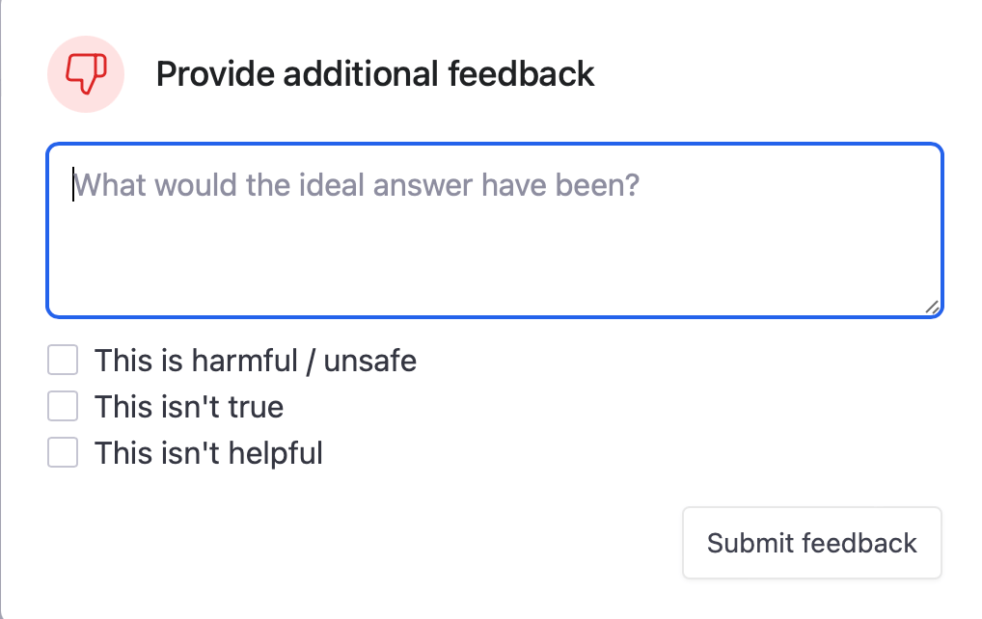
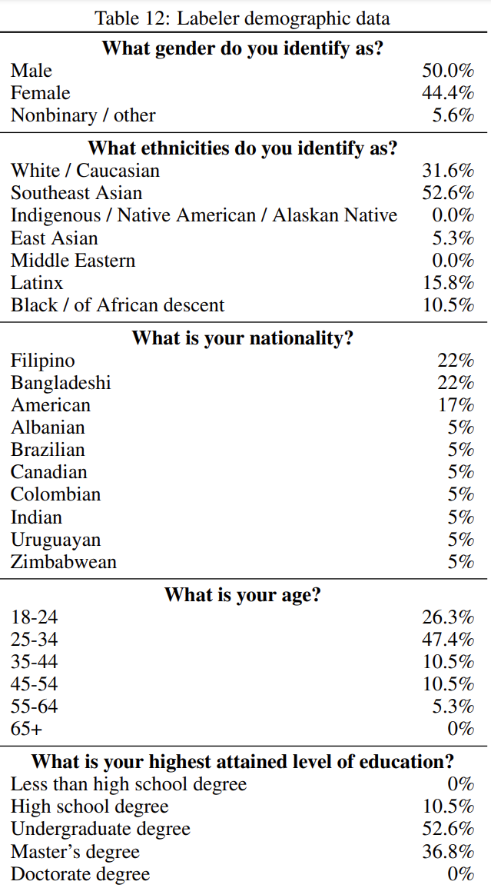
Human feedback
”mostly English-speaking people living in the United States or Southeast Asia hired via Upwork or Scale AI”
Training language models to follow instructions with human feedback (Ouyang et al., NeurIPS 2022)

Slide 14
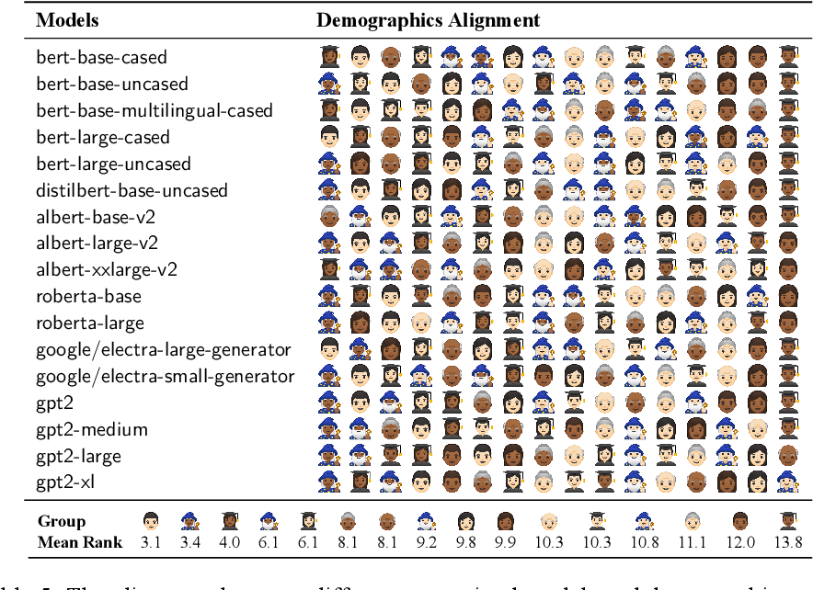
LLM word choice is socially biased
Sociolectal Analysis of Pretrained Language Models
(Zhang et al., EMNLP 2021)

Slide 15
LLM word choice is culturally biased
Having Beer after Prayer? Measuring Cultural Bias in Large Language Models (Naous et al., 2023)

Slide 16
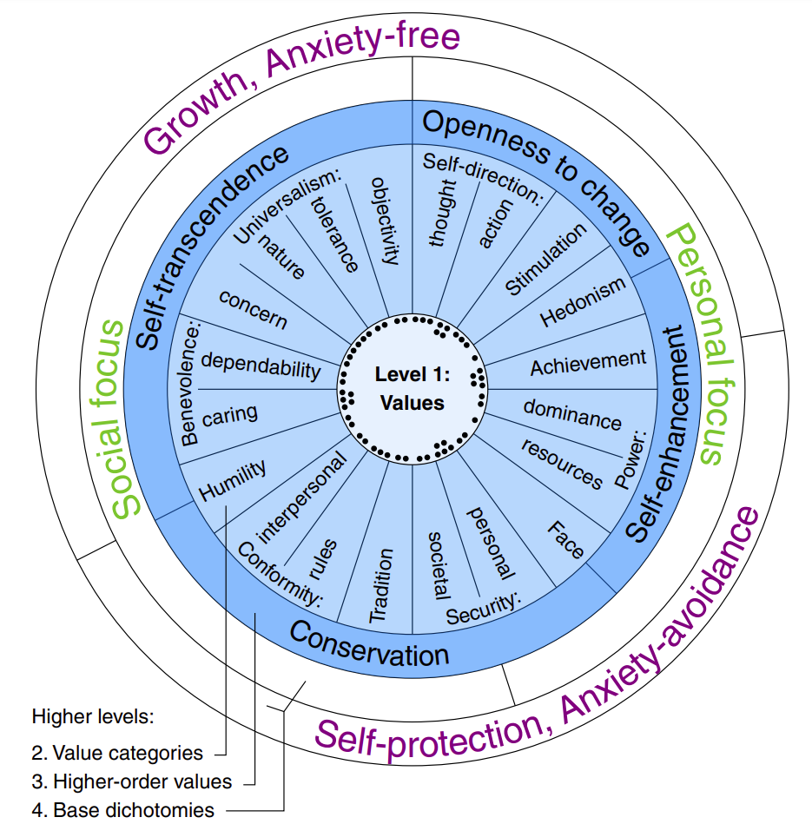
Human values
Hofstede's Cultural Dimensions Theory
Power distance
Individualism/collectivism
Uncertainty avoidance
Masculinity/femininity
Long-term orientation/short-term orientation
Indulgence/restraint
World Values Survey
Traditional/secular-rational
Survival/self-expression
Schwartz's Theory of Basic Values
European Values Study
Personal freedom
Individual autonomy
Social solidarity
Ethnic tolerance
Civic honesty
Gender equality
Liberal democracy
Moral Foundations Theory
Care/harm
Fairness/cheating
Loyalty/betrayal
Authority/subversion
Sanctity/degradation
Liberty/oppression
Identifying the Human Values behind Arguments (Kiesel et al., ACL 2022)
Notes:
Fine-grained dimensions

Slide 17
Assessing knowledge of values in LLMs
Assessing Cross-Cultural Alignment between ChatGPT and Human Societies: An Empirical Study (Cao et al., C3NLP 2023)
Notes:
Controversial. I agree with Kevin Munger, bots should not use the word “I”

Slide 18
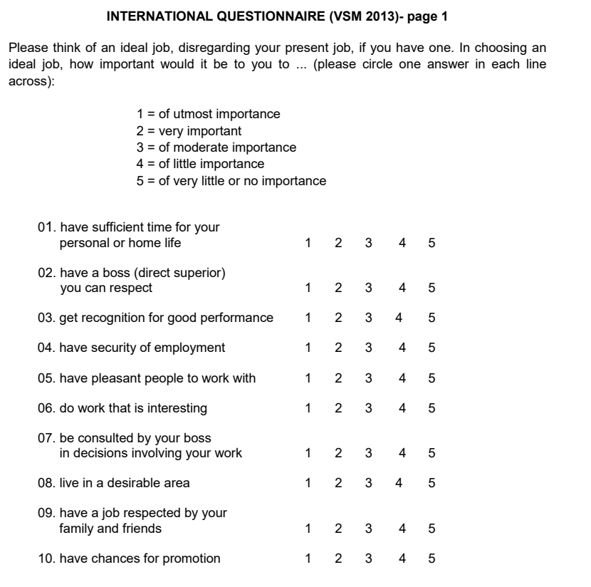
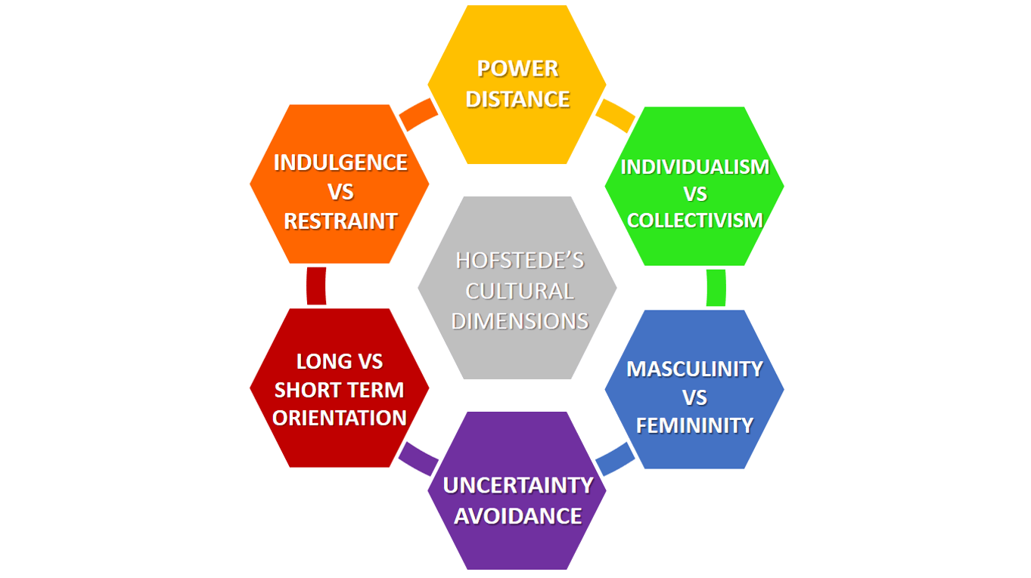
Hofstede Cultural Survey
Common cross-cultural analysis tool
Consists of 24 questions
Official translations to 20+ languages
Data available from 112+ countries
https://geerthofstede.com/research-and-vsm/vsm-2013/

Slide 19
The 24 questions
Time for personal life
Respectable boss
Recognition for performance
Job security
Pleasant coworkers
Interesting work
Consultation by boss
Desirable living area
Job respected by family/friends
Promotion chances
Time for fun
Few desires (moderation)
Service to a friend
Thriftiness
Frequency of feeling nervous
Happiness level
External hindrances to desires
Current health state
National pride
Subordinates' fear to contradict boss
Managerial precision
Value of persistent efforts
Dual-boss structure
Rule-breaking in company's interest
https://geerthofstede.com/research-and-vsm/vsm-2013/

Slide 20
The six dimensions
Dimension | Definition | Formula
Power Distance | Measures how less powerful members expect and accept unequal power distribution. | PDI = 35(m07 - m02) + 25(m20 - m23) + C(pd)
Individualism | Assesses the degree of individualism vs. collectivism in a society. | IDV = 35(m04 - m01) + 35(m09 - m06) + C(ic)
Masculinity | Measures societal preference for assertiveness and material success vs. modesty and quality of life. | MAS = 35(m05 - m03) + 35(m08 - m10) + C(mf)
Uncertainty Avoidance | Indicates how comfortable a society is with uncertainty and ambiguity. | UAI = 40(m18 - m15) + 25(m21 - m24) + C(ua)
Long Term Orientation | Evaluates focus on future rewards vs. past and present orientation. | LTO = 40(m13 - m14) + 25(m19 - m22) + C(ls)
Indulgence vs. Restraint | Measures extent of free gratification of desires vs. control. | IVR = 35(m12 - m11) + 40(m17 - m16) + C(ir)
https://geerthofstede.com/research-and-vsm/vsm-2013/

Slide 21
The data
https://geerthofstede.com/research-and-vsm/vsm-2013/

Slide 22
Contextualizing by country name
Assessing Cross-Cultural Alignment between ChatGPT and Human Societies: An Empirical Study (Cao et al., C3NLP 2023)
Notes:
Cannot assume identity
Low correlations overall
Highest correlation with USA
Better correlation when prompting in the corresponding language

Slide 23
Prompt templates
Country | Prompt 1 | Prompt 2 | Prompt 3
US | For an average American, [Question #] is [Options]. |  | In the American cultural setting, [Question #] is [Options].
China | For an average Chinese, [Question #] is [Options]. | 对普通中国人来说，[问题 #] 是 [选项]。 | In the Chinese cultural setting, [Question #] is [Options].
Germany | For an average German, [Question #] is [Options]. | [Frage] ist [Option] für den durchschnittlichen Deutschen. | In the German cultural setting, [Question #] is [Options].
Japan | For an average Japanese, [Question #] is [Options]. | 平均的な日本人の合、【 #】は【肢】です。 | In the Japanese cultural setting, [Question #] is [Options].
Spain | For an average Spanish, [Question #] is [Options]. | Para el español promedio, [Pregunta #] es [Opciones]. | In the Spanish cultural setting, [Question #] is [Options].
Assessing Cross-Cultural Alignment between ChatGPT and Human Societies: An Empirical Study (Cao et al., C3NLP 2023)

Slide 24
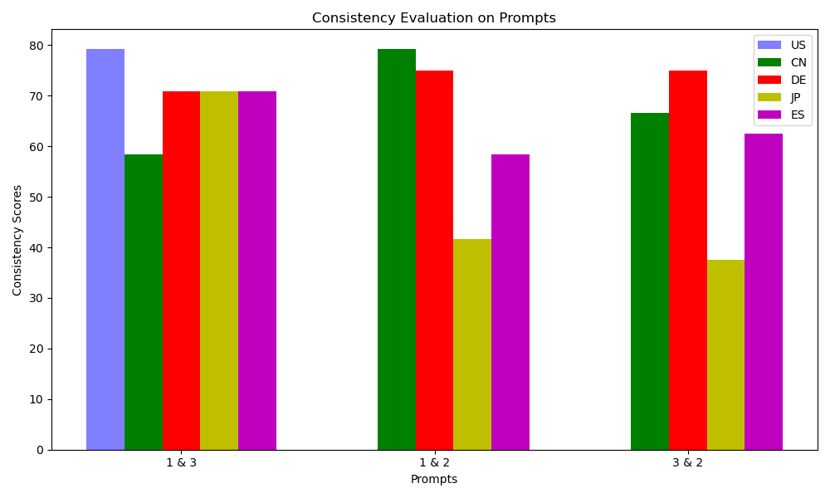
Major limitation: consistency
Reponses depend on phrasing, language, format and context
Prompts 1 & 3: English
Prompt 2: Country’s language
Assessing Cross-Cultural Alignment between ChatGPT and Human Societies: An Empirical Study (Cao et al., C3NLP 2023)
Notes:
Cannot assume identity
Low correlations overall
Highest correlation with USA
Better correlation when prompting in the corresponding language

Slide 25
Estimation of cultural dimensions
Assessing Cross-Cultural Alignment between ChatGPT and Human Societies: An Empirical Study (Cao et al., C3NLP 2023)
Notes:
Cannot assume identity
Low correlations overall
Highest correlation with USA
Better correlation when prompting in the corresponding language

Slide 26
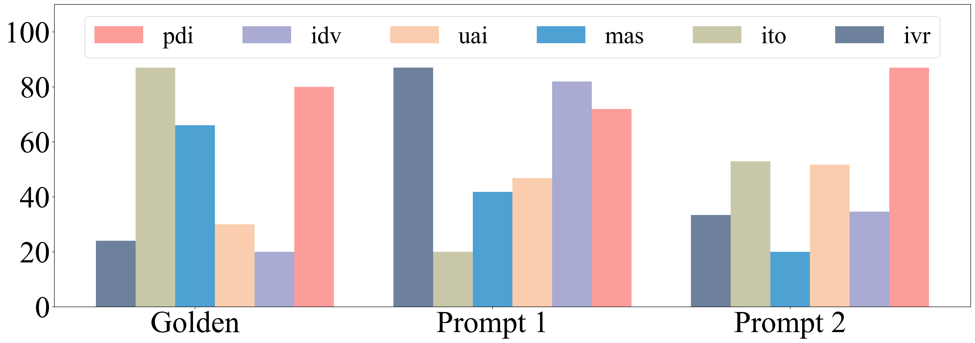
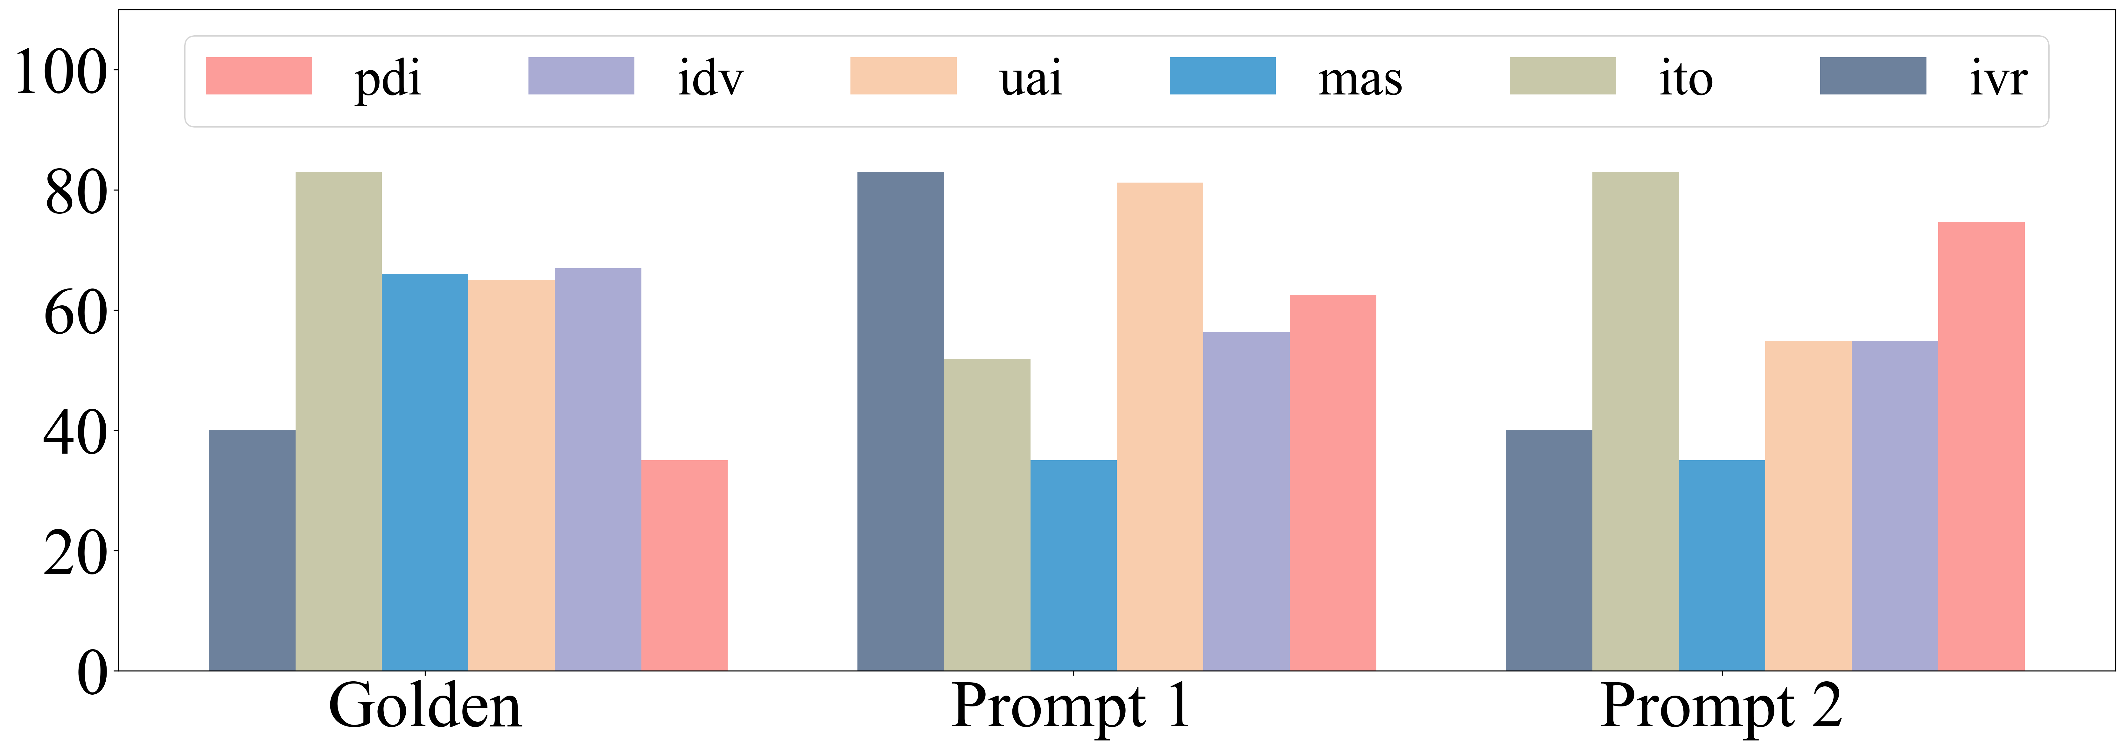
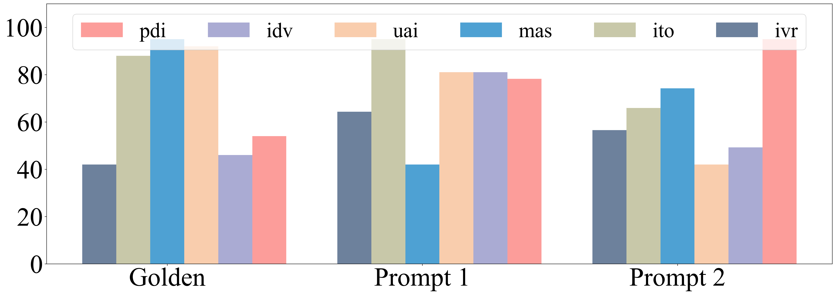
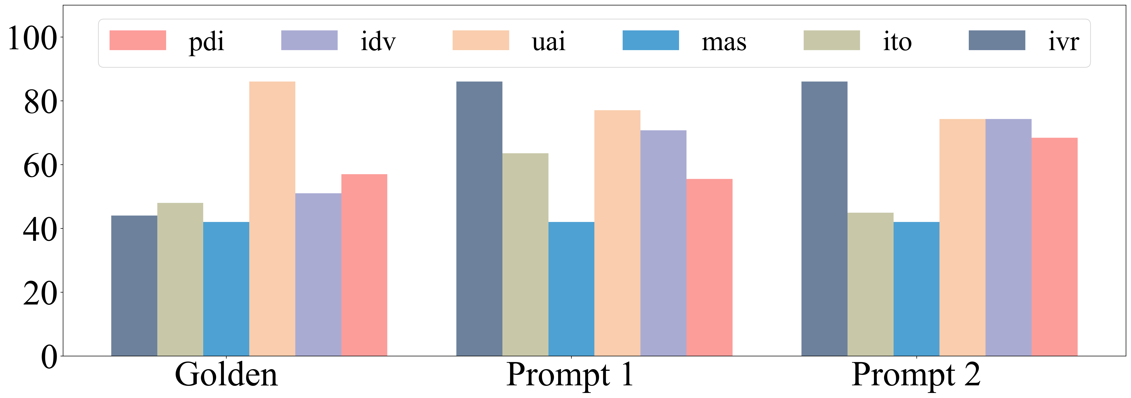
Comparison to human survey responses
Assessing Cross-Cultural Alignment between ChatGPT and Human Societies: An Empirical Study (Cao et al., C3NLP 2023)
Notes:
Cannot assume identity
Low correlations overall
Highest correlation with USA
Better correlation when prompting in the corresponding language

Slide 27
US bias
Assessing Cross-Cultural Alignment between ChatGPT and Human Societies: An Empirical Study (Cao et al., C3NLP 2023)
Notes:
Cannot assume identity
Low correlations overall
Highest correlation with USA
Better correlation when prompting in the corresponding language

Slide 28
Effect of prompting language
Assessing Cross-Cultural Alignment between ChatGPT and Human Societies: An Empirical Study (Cao et al., C3NLP 2023)
Notes:
Cannot assume identity
Low correlations overall
Highest correlation with USA
Better correlation when prompting in the corresponding language

Slide 29
Assessment by surveys: open questions & work in progress
More LLMs & effect of
Pre-training
RLHF
More prompting variations
Multiple choice
Free-form
More cultures
Countries
Sub-groups
More languages
Real-world impact
More surveys
European Value Survey
Moral Foundations Questionnaire
Relationship to behavior in actual applications (alignment)
National languages and dialects
Styles and registers
Assess data contamination

Slide 30
Culturally adaptive models
Transfer learning
Feature injection

Slide 31
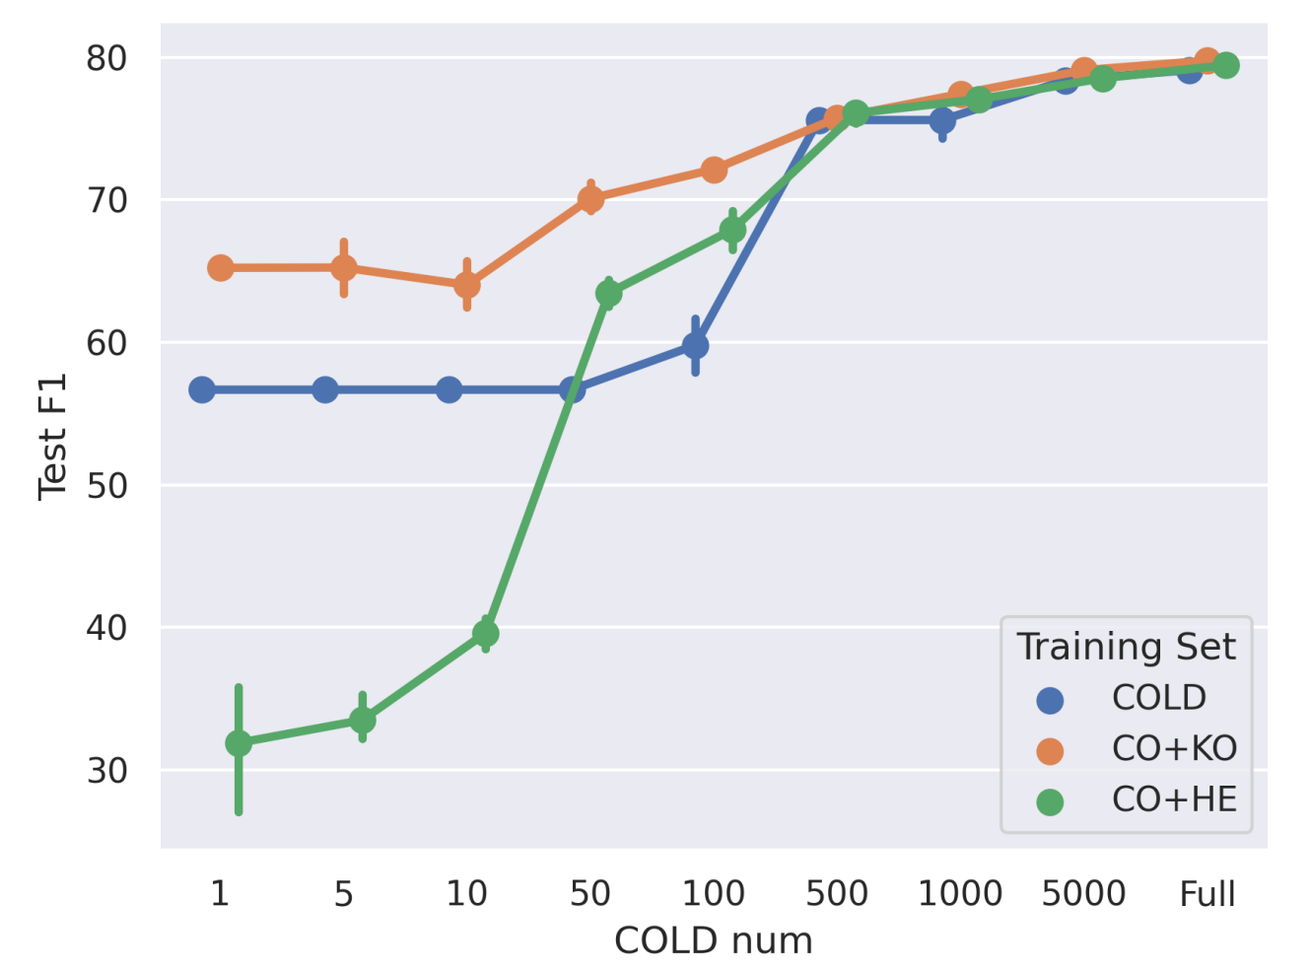
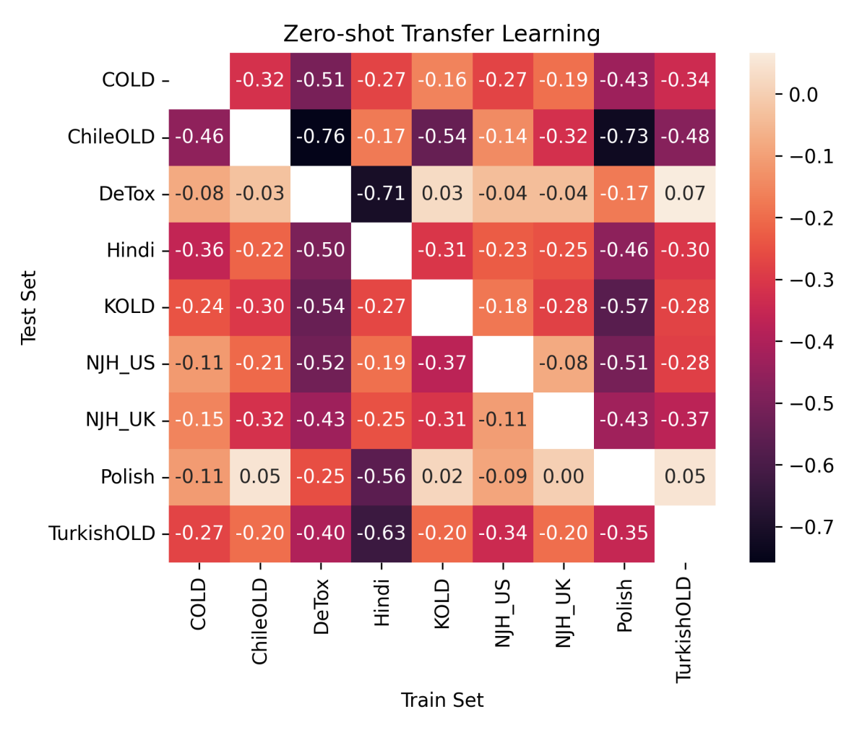
Transfer learning: offensive language detection
Can be predicted by survey data
Better to train on similar culture
Cross-Cultural Transfer Learning for Chinese Offensive Language Detection (Zhou et al., C3NLP 2023)
Cultural Compass: Predicting Transfer Learning Success in Offensive Language Detection with Cultural Features (Zhou et al., Findings 2023)

Slide 32
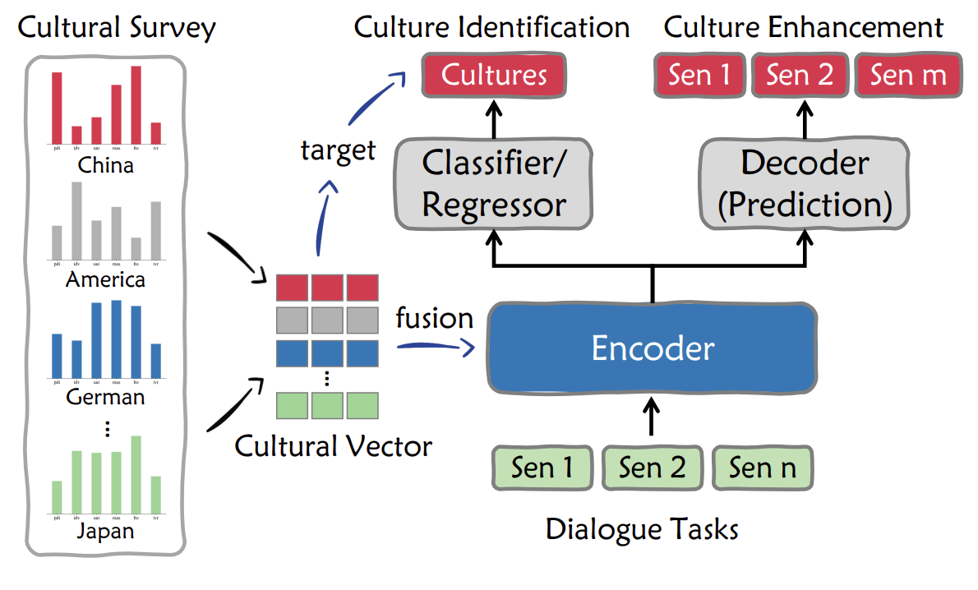
Feature injection: dialogue generation
Bridging Cultural Nuances in Dialogue Agents through Cultural Value Surveys (Cao et al., Findings of EACL 2024)

Slide 33
Adapting linguistic content
“cultural translation”

Slide 34
Food, language and identity
Food is a communicative medium
Food is a carrier of meaning
Food is tightly linked to identity
Notes:
When we talk about food we talk about our embodied existence in the world.
Food addresses historical, cultural, social, bodily, spiritual, and environmental issues.
Sense of community and feelings of national, regional, ethnic, religious etc. belonging.

Slide 35
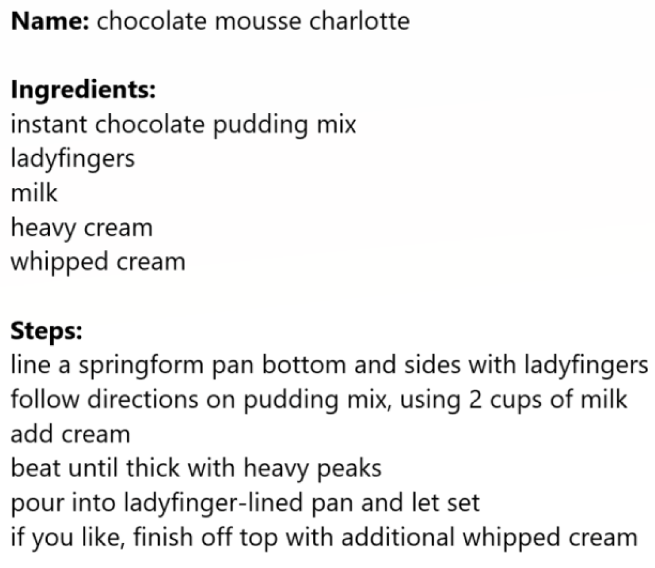
Recipes
A useful way to express food in language
Part of the creative process of food creation
Used by both professional and home cooks

Slide 36
Recipe adaptation
Dietary restrictions, e.g., vegan
Cross-cultural differences
凉拌秋葵
用料
秋葵 20根左右
生抽 2-3勺
醋 1勺
蚝油 1勺
做法
将秋葵洗净放开水中焯2分钟左右。
开水中放盐一勺，油一勺，这样秋葵颜色翠绿鲜艳）...
香油 1勺
糖 1勺
蒜 3-5瓣
盐 酌量
绿芥末膏不用也行 酌量
Chinese Okra Salad
Ingredients
8 oz (225 g) okra
2 teaspoons light soy sauce (or soy sauce)
1/2 teaspoons green Sichuan pepper oil (or more to taste)
Instructions
Bring a medium pot of water to a boil. Add 1 teaspoon vegetable oil and a pinch of salt...
Can we automate this process?

Slide 37
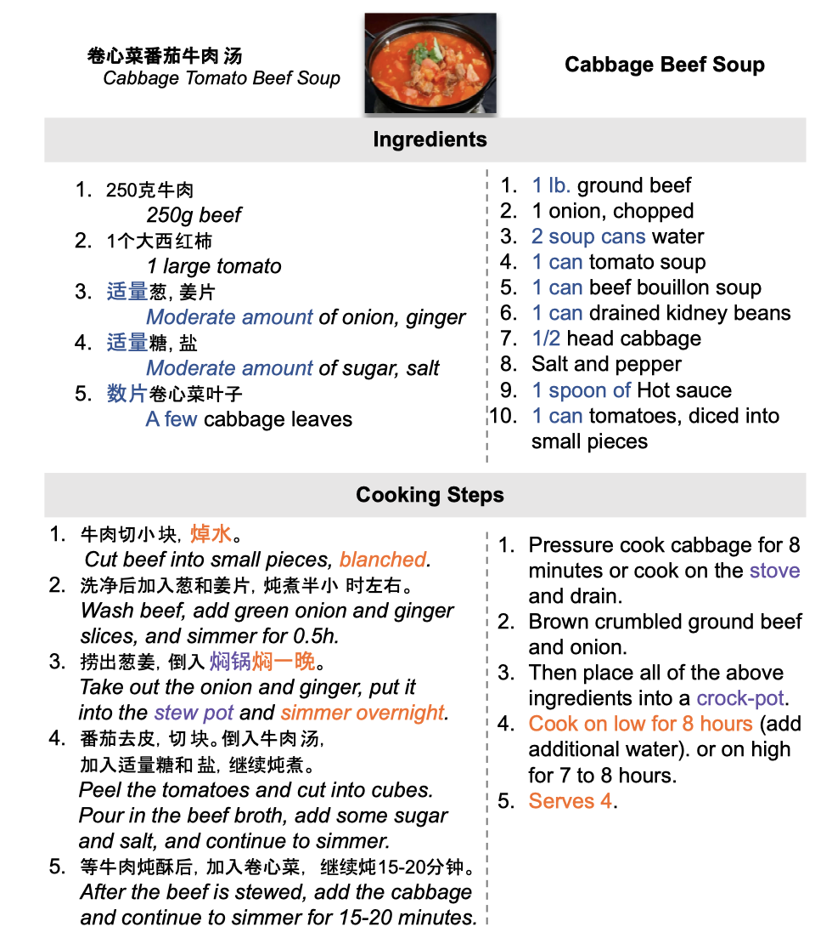
Recipe differences across cultures
Ingredient availability and preference
Measurement units, writing style
Available equipment and tools
Known techniques, typical ordering
Desired flavours
Desired texture

Slide 38
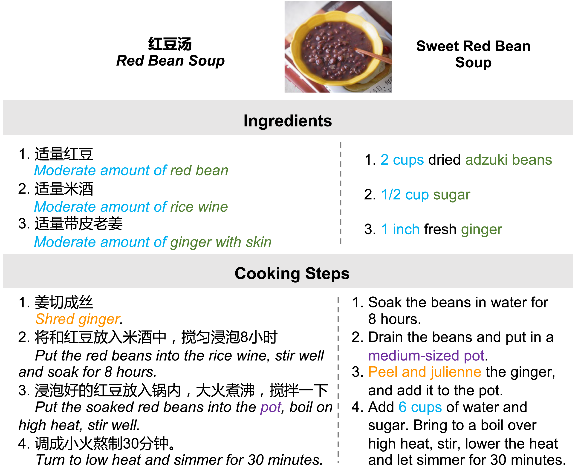
Adapting cooking recipes
Cultural Adaptation of Recipes (Cao et al., TACL 2024)

Slide 39
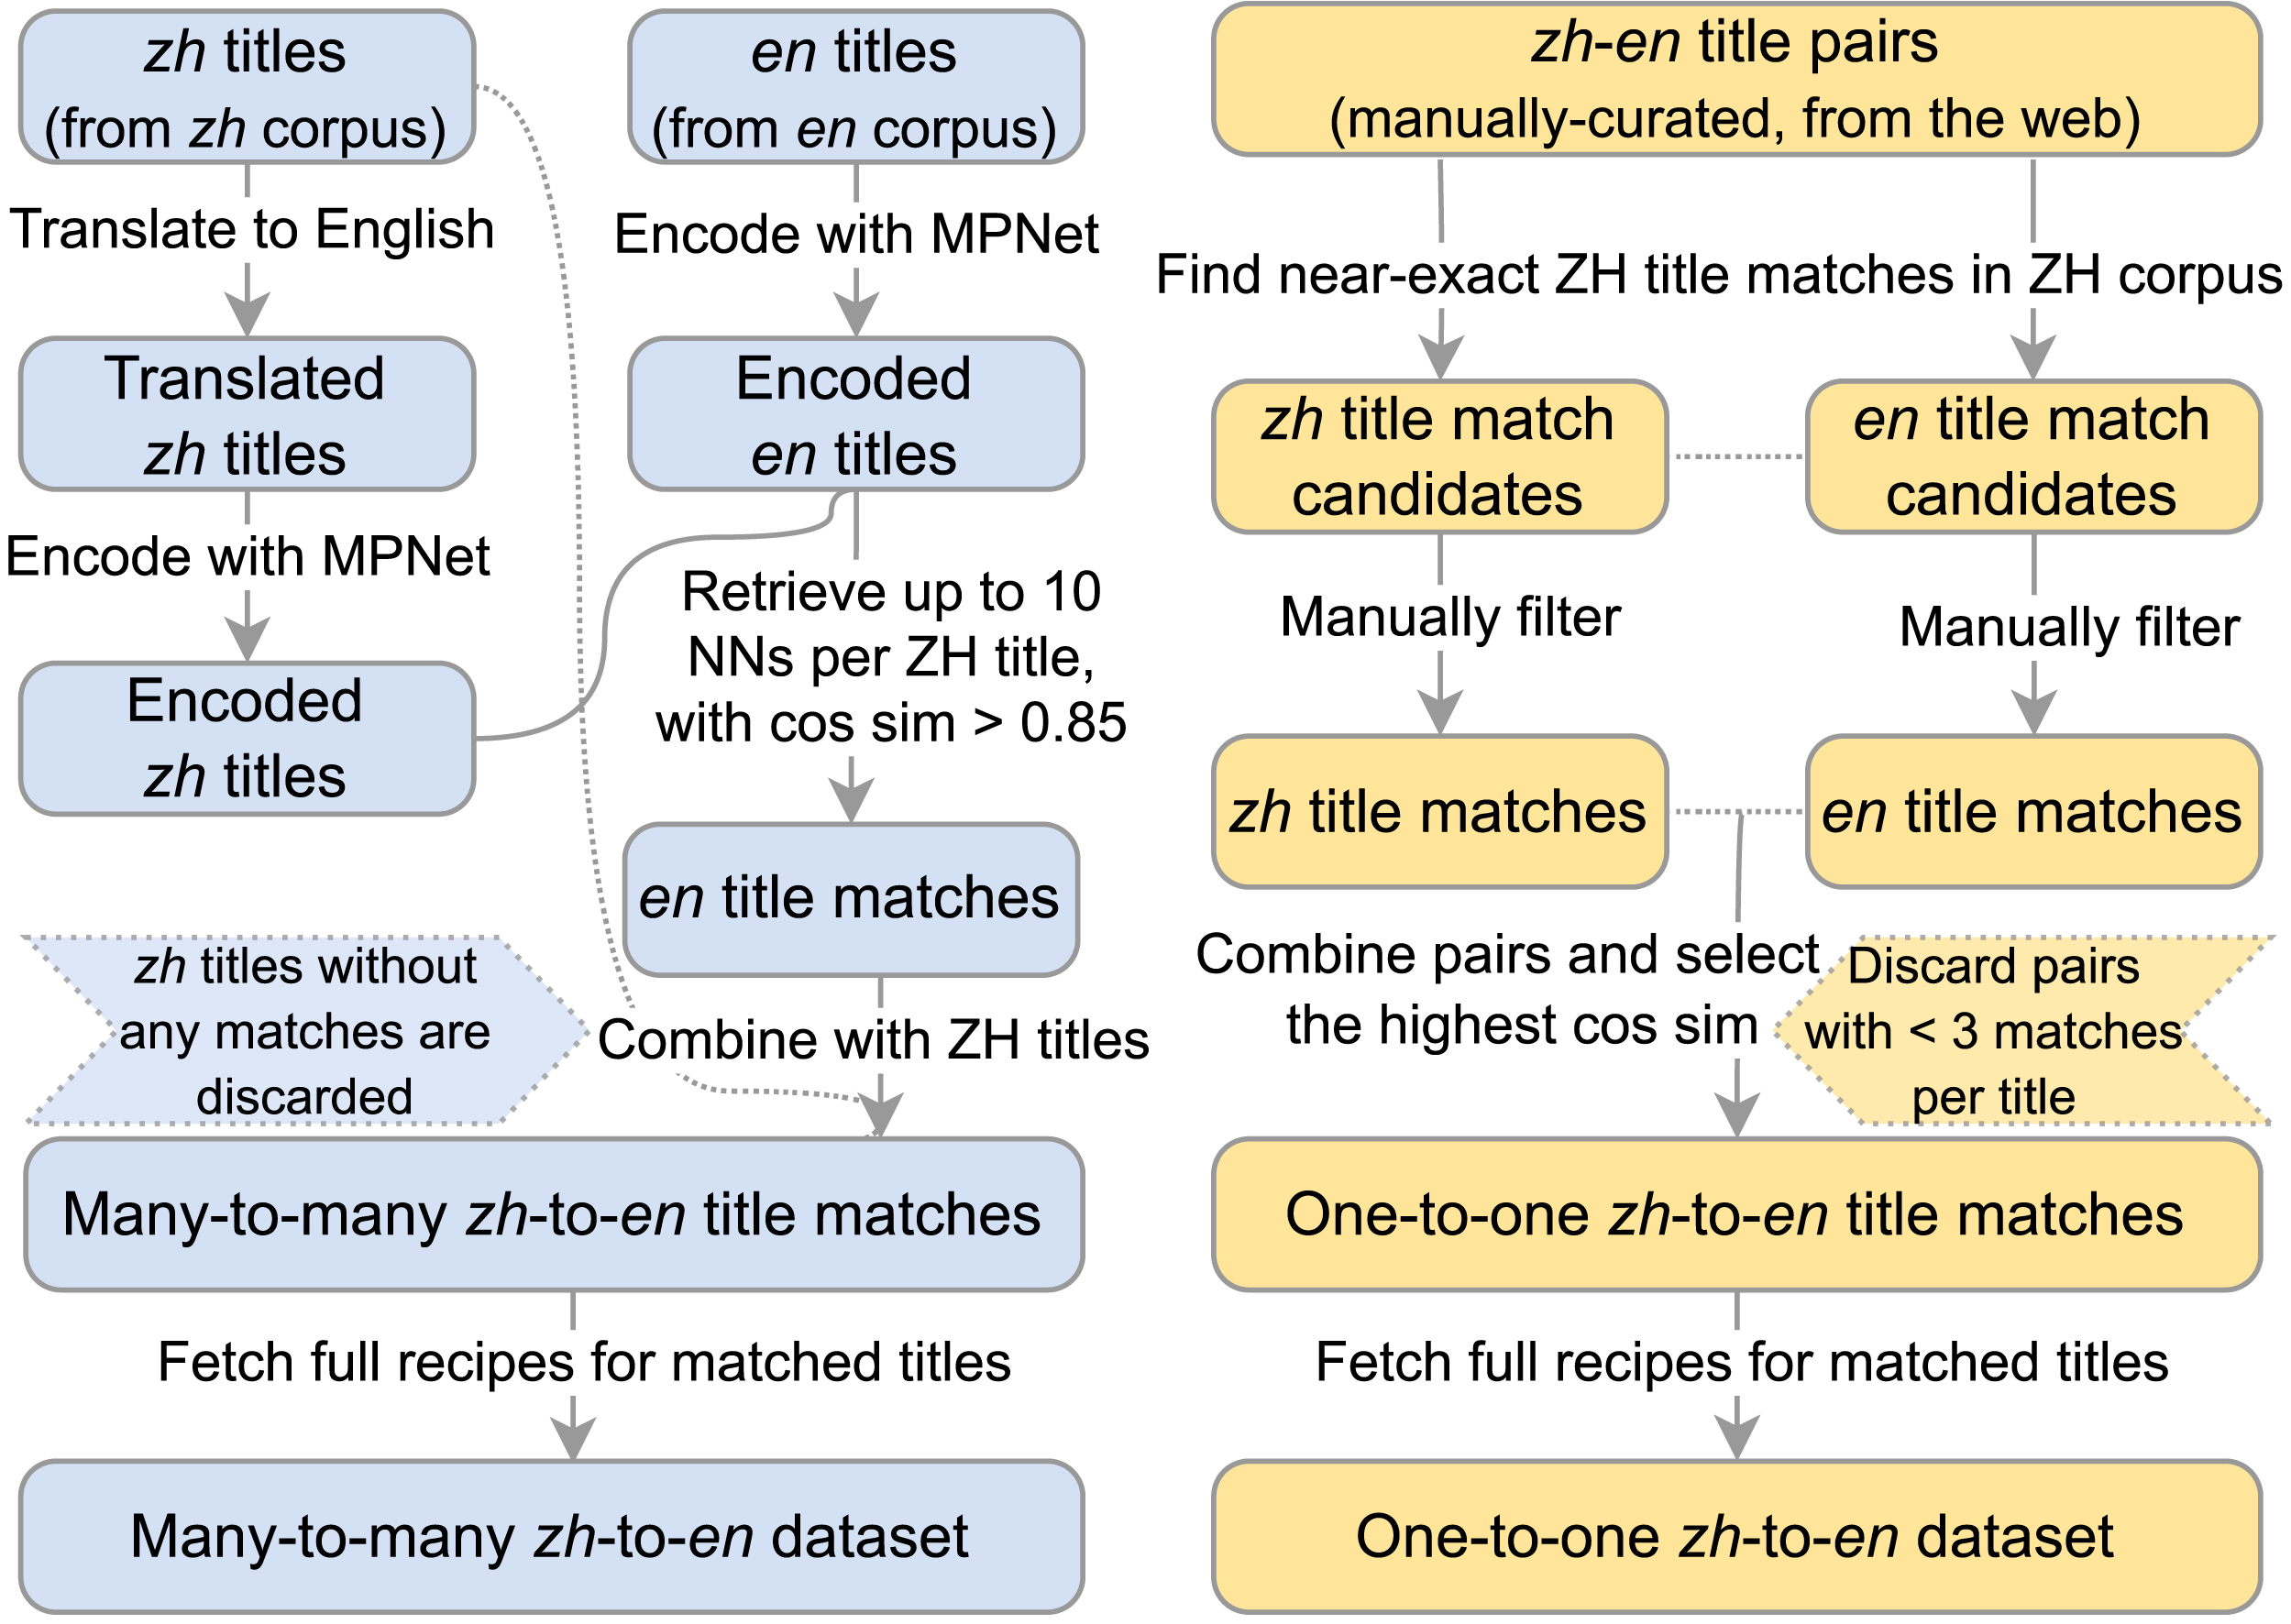
Data collection
2M English recipes from various websites (e.g., food.com)
1.5M Chinese recipes from xiachufang.com
Automatic pairing based on assumption:
If two recipes have a semantically equivalent title (possibly in another language), they describe the same dish.

Slide 40
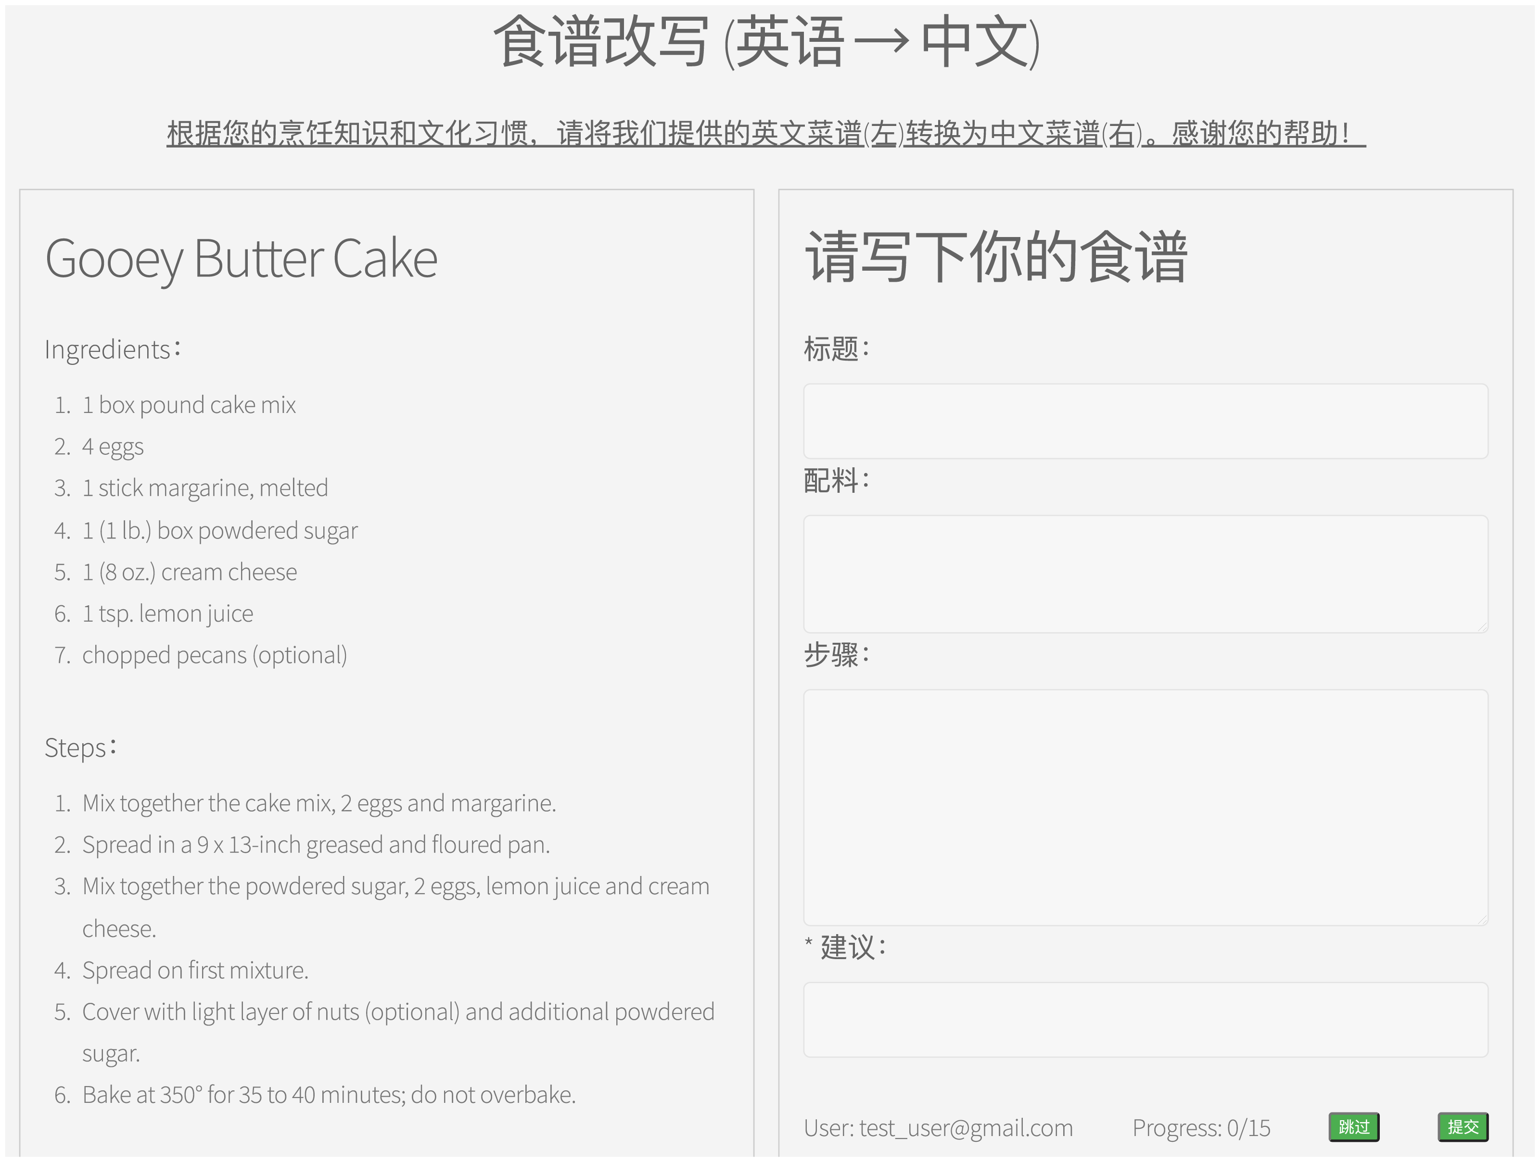
Data collection
Test set:​
Human adaptation of selected recipes
25 English recipes adapted to Chinese
41 Chinese recipes adapted to English
Participants: six bilingual foodies

Slide 41
Models and results
Method | GRAMMAR | CONSISTENCY | PRESERVATION | CULTURAL APPROPRIATENESS
Chinese → English (n = 25)
MT-zs | 2.6 ±1.5 | 2.4 ±1.7 | 2.3 ±1.4 | 2.7 ±1.6
MT-ft | 4.5 ±1.8 | 3.7 ±2.0 | 3.0 ±2.1 | 4.3 ±2.1
mT5 | 4.1 ±2.1 | 3.8 ±2.1 | 3.2 ±2.2 | 3.7 ±2.2
BLOOM | 3.3 ±2.0 | 3.3 ±2.0 | 3.4 ±2.0 | 2.8 ±1.8
ChatGLM2 | 4.1 ±2.4 | 4.3 ±2.2 | 4.6 ±2.1 | 4.0 ±2.3
GPT-4 | 6.0 ±1.2 | 6.1 ±1.3 | 5.9 ±1.0 | 6.0 ±1.2
Human | 4.2 ±2.1 | 4.4 ±1.9 | 4.5 ±1.9 | 4.6 ±1.9
Retrieval | 5.1 ±1.7 | 4.9 ±2.0 | 4.3 ±2.3 | 3.8 ±2.0
English → Chinese (n = 41)
MT-zs | 2.3 ±1.6 | 2.7 ±2.0 | 3.5 ±2.2 | 2.3 ±1.7
MT-ft | 4.8 ±2.2 | 3.1 ±2.2 | 2.5 ±1.9 | 3.2 ±2.0
mT5 | 4.3 ±2.0 | 3.4 ±2.1 | 2.8 ±2.0 | 3.5 ±1.9
BLOOM | 3.8 ±2.1 | 4.2 ±2.1 | 4.6 ±1.9 | 3.0 ±1.6
ChatGLM2 | 5.4 ±1.7 | 5.3 ±1.7 | 5.7 ±1.6 | 4.1 ±2.3
GPT-4 | 5.3 ±2.0 | 5.1 ±2.0 | 5.2 ±1.9 | 4.4 ±2.0
Human | 5.8 ±1.1 | 5.1 ±1.9 | 5.5 ±1.6 | 4.3 ±1.8
Retrieval | 4.5 ±1.9 | 3.9 ±2.0 | 3.3 ±2.0 | 3.5 ±1.7
Language models and machine translation systems trained on our automatically paired reference recipes
Language models trained on other large corpora
Method | BLEU | BERTScore
Chinese → English
MT-zs† | 5.3 | 59.4
MT-ft | 28.0 | 59.9
mT5 | 14.0 | 59.5
mBART50 | 10.2 | 60.5
BLOOM† | 22.3 | 62.5
ChatGLM2 | 18.3 | 61.9
GPT-4† | 28.0 | 66.5
Retrieval† | 16.8 | 61.7
Method | BLEU | BERTScore
English → Chinese
MT-zs† | 10.6 | 69.8
MT-ft | 13.6 | 70.5
mT5 | 16.6 | 70.7
mBART50 | 11.8 | 69.7
BLOOM† | 20.0 | 66.4
ChatGLM2 | 22.4 | 75.2
GPT-4† | 21.1 | 77.8
Retrieval† | 32.8 | 68.4
Human evaluation
Automatic reference-based evaluation

Slide 42
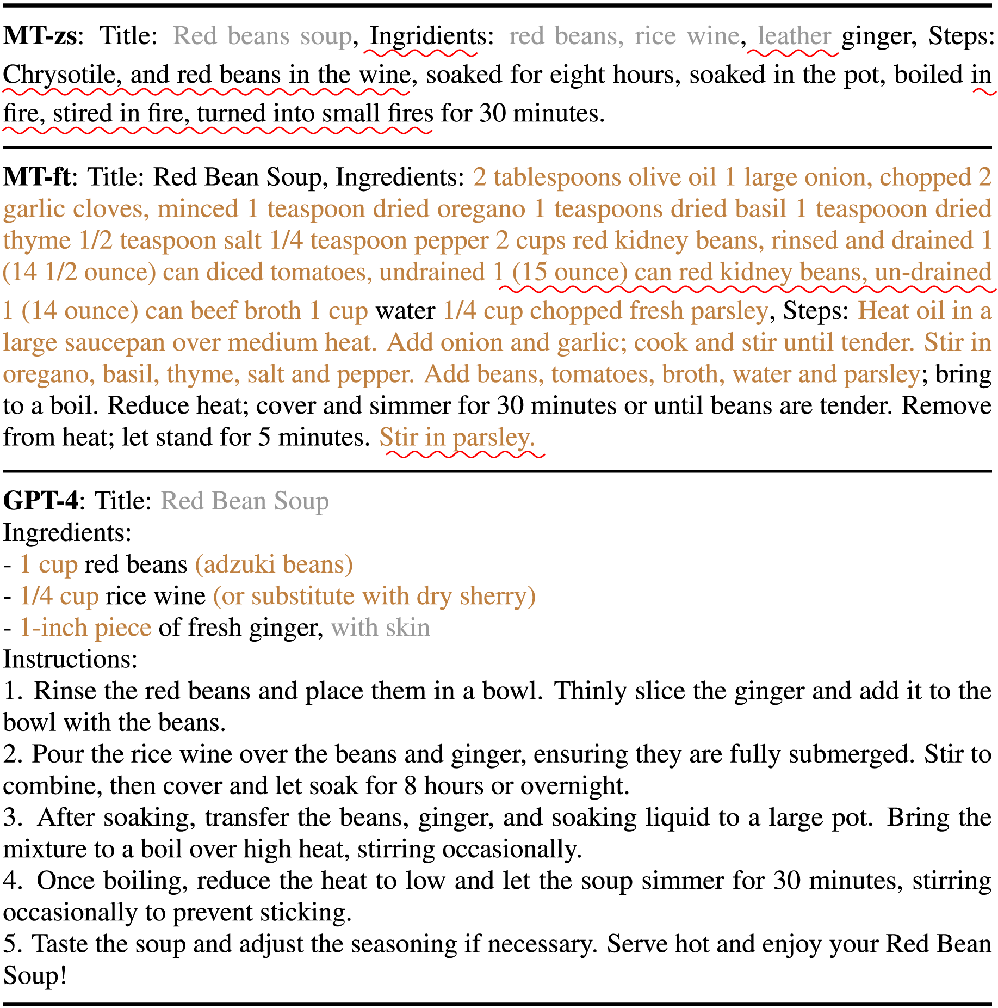
Case study

Slide 43
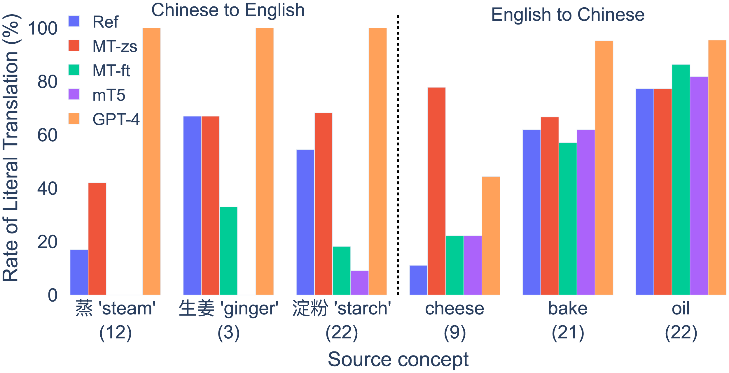
Case study

Slide 44
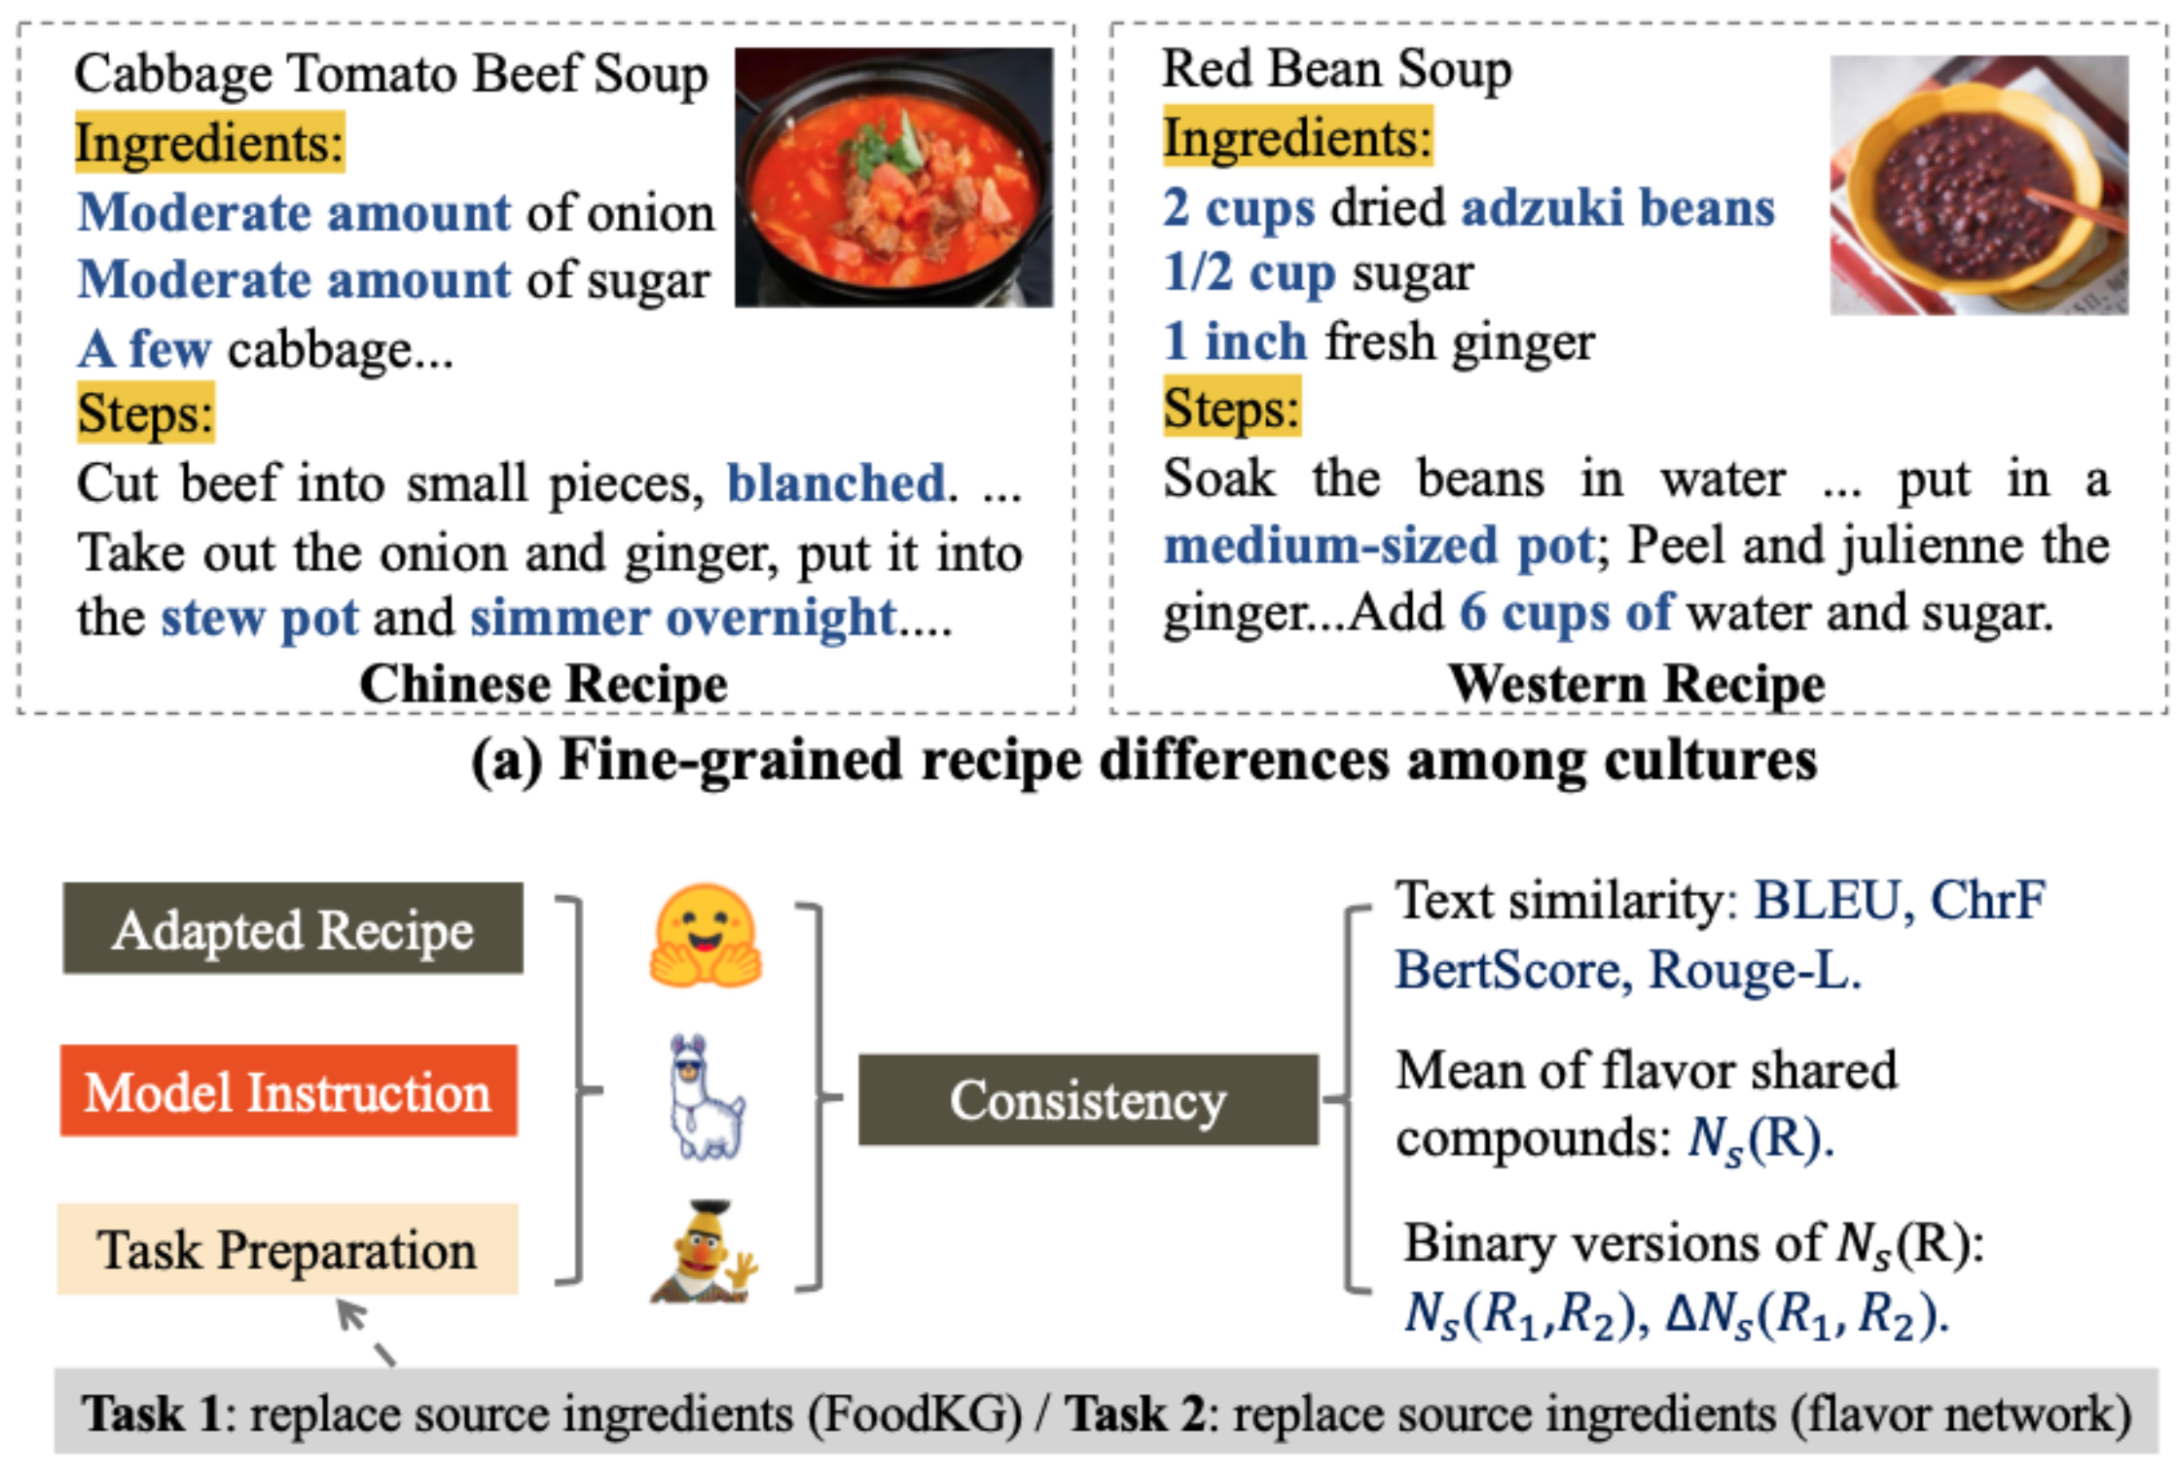
Adapting recipes across cultures with LLMs
Open questions:
Fine-grained evaluation
Assessing cultural knowledge
Adaptive level of adaptation

Slide 45
Conclusion
LLMs can help us understand each other across cultures
For that, they need cultural understanding & knowledge
There is still much we don’t know & much to improve
danielhers.github.io
dh@di.ku.dk

